Slide 1
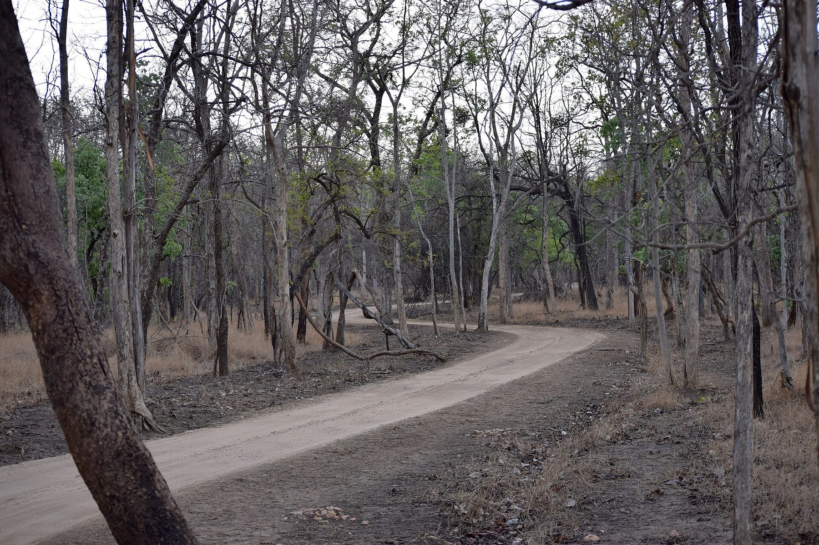
FOREST GUARD AI
Protecting Forests.
Preventing Conflict.
Saving Lives.
An AI-assisted conflict-prevention console: local detection,
explainable GIS risk, guard response and a privacy-safe community portal.
FastAPI
React + Leaflet
YOLO-World v2
CLIP
SQLite
Synthetic demonstration observations · genuine local inference · no live feeds
Single-node build · runs offline after model download
01
Notes:
Open by naming the boundary: the dataset is synthetic and labelled, while every upload is genuinely analysed by a local two-stage model. No camera feeds or government systems are connected.

Slide 2
THE OPERATIONAL GAP
Sightings don't wait.
Neither should the response.
Forest teams already collect camera images, patrol notes, incident logs and village calls.
The hard part is turning them into one timely, defensible decision.
01
Sightings arrive late
02
Maps and records live apart
WHAT A WARDEN NEEDS
A photo on a phone or a note in a register reaches the range officer hours after the animal has moved.
Detections, village boundaries, incidents and patrols sit in different tools, so proximity is judged by memory.
1
Where exactly?
Village-relative distance, not a raw coordinate
2
How serious?
Species, recency, repeat sightings, incidents
03
Warnings don't reach the right people
04
Community reports get lost
3
Who acts?
Advisories are broadcast to everyone or no one, instead of the villages actually inside the risk radius.
Villagers have no simple way to report a sighting or check what happened next — and trust erodes.
An assigned guard and a tracked status
4
What can I say publicly?
Guidance without exposing the animal's location
Forest Guard AI · hackathon build · November 2026
02
Notes:
No invented statistics here on purpose. The problem is operational fragmentation: data exists, but timing, geography and accountability are missing. The right panel sets the four questions the product must answer.

Slide 3
THE PRODUCT
One loop: detect, locate, score, warn, respond.
Six modules share one database and one risk configuration, so a new detection immediately updates the map, the alert queue, the guard board and the public advisory.
SENSE
UNDERSTAND
ACT
AI detection
GIS + risk
Response + public
Image and short-video upload
Village boundaries and cameras
Threshold alerts with reasons
Animal localisation + species
Explainable weighted score
Assign, acknowledge, resolve
Confidence and 'unidentified' fallback
Low / moderate / high
Guard-scoped task board
Annotated evidence stored
Movement only with evidence
Sanitised community advisories
THE INTEGRATION POINT
A single Risk config and Alert lifecycle connect the console and the public portal — with different payloads for each audience.
Forest Guard AI · hackathon build · November 2026
03
Notes:
Frame the demo as one loop rather than eight pages. The key engineering choice is that risk configuration and alert state are shared, while serializers enforce what each audience is allowed to see.

Slide 4
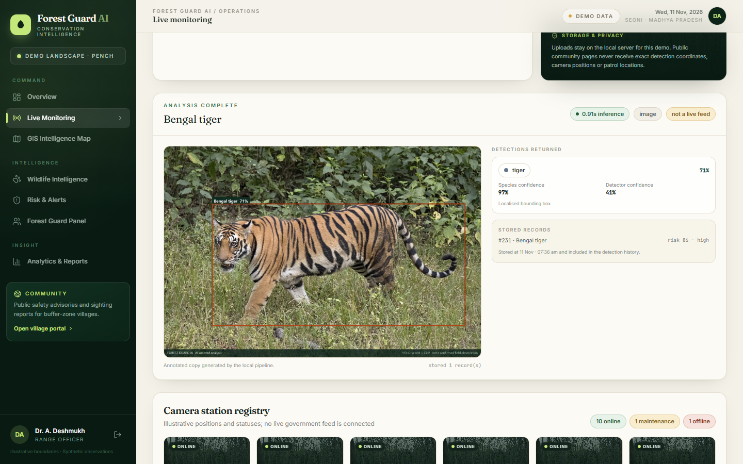
MODULE 1 · AI DETECTION
Real inference,
conservative by design.
Two off-the-shelf models run locally on CPU. No fine-tuning, no cloud calls, and no forced species label when the evidence is weak.
YOLO-World v2 proposes 'animal' boxes
CLIP ViT-B/32 scores six regional species
Low-confidence crops become 'unidentified'
Videos: up to 5 sampled frames, not tracking
6
5.2 s
1.8 s
Live upload in the running app: tiger detected, 71 % species confidence, stored as recognition #231 and scored 86 (high risk).
supported species
CPU model load
6-image smoke check
Smoke check is one photo per species — not an accuracy claim.
Forest Guard AI · hackathon build · November 2026
04
Notes:
Be precise: 6/6 on six licenced reference photos is a plumbing check, not a benchmark. The screenshot is from a genuine upload; point out the confidence and the risk basis, not just the species name.

Slide 5
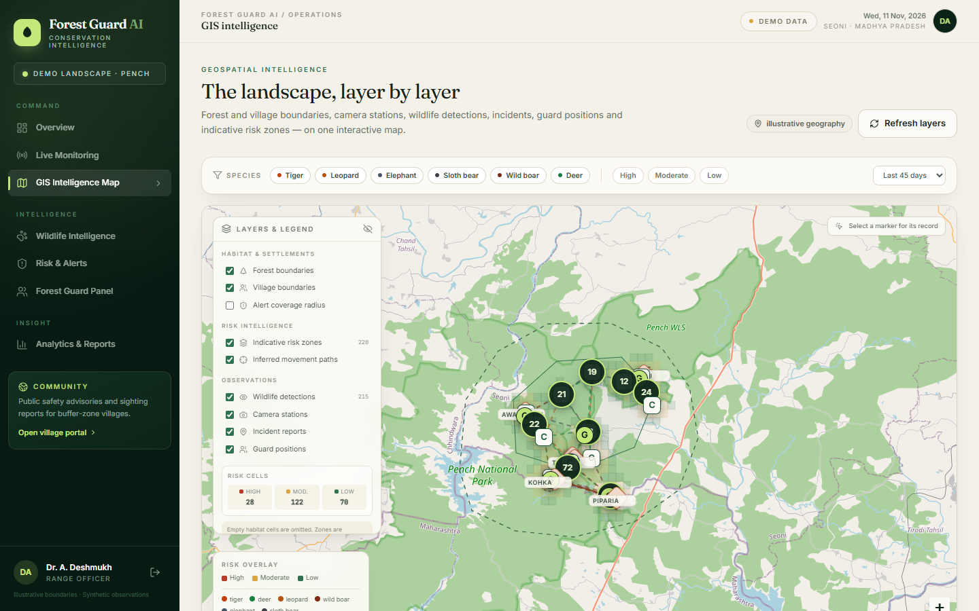
MODULE 2 · GIS INTELLIGENCE
Place changes the decision.
A tiger 4 km deep in the forest and a tiger 200 m from a cattle shed are not the same event. The map makes that difference visible and filterable.
Forest and village polygons
Clustered detections + detail panel
Camera stations and guard posts
Gridded risk cells + alert coverage
Inferred movement paths
score = 100 × species × Σ(w × evidence)
Risk cells are indicative 21-day aggregates, not habitat predictions.
proximity .55 · recency .15 · frequency .12 · incident .10 · movement .08
Forest Guard AI · hackathon build · November 2026
05
Notes:
Show the map live if possible: toggle layers, click a cluster, open a detection, filter by species. Emphasise that proximity and movement are separate evidence, so a nearby sighting is not mislabeled an approach.

Slide 6
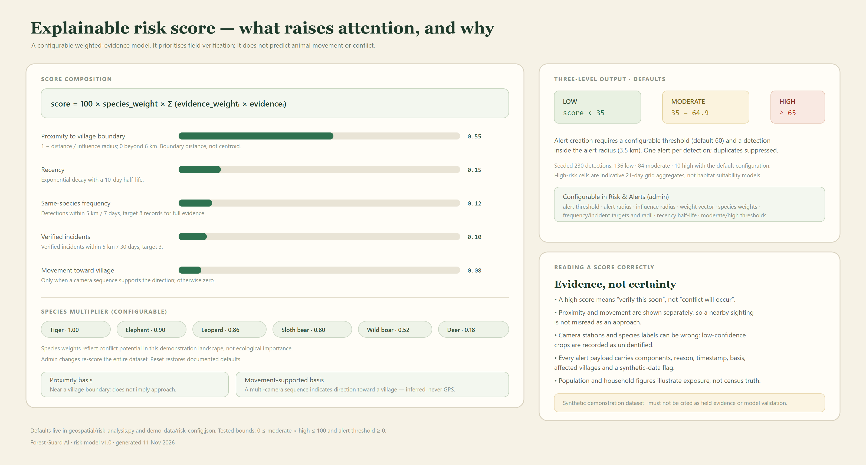
Weights, thresholds and radii are editable at runtime by an admin; reset restores defaults.
06
Notes:
This is the explainability slide. Every alert stores its components and a written basis. If asked for the seeded distribution: 136 low, 84 moderate, 10 high with defaults. The score prioritises verification; it does not predict conflict.

Slide 7
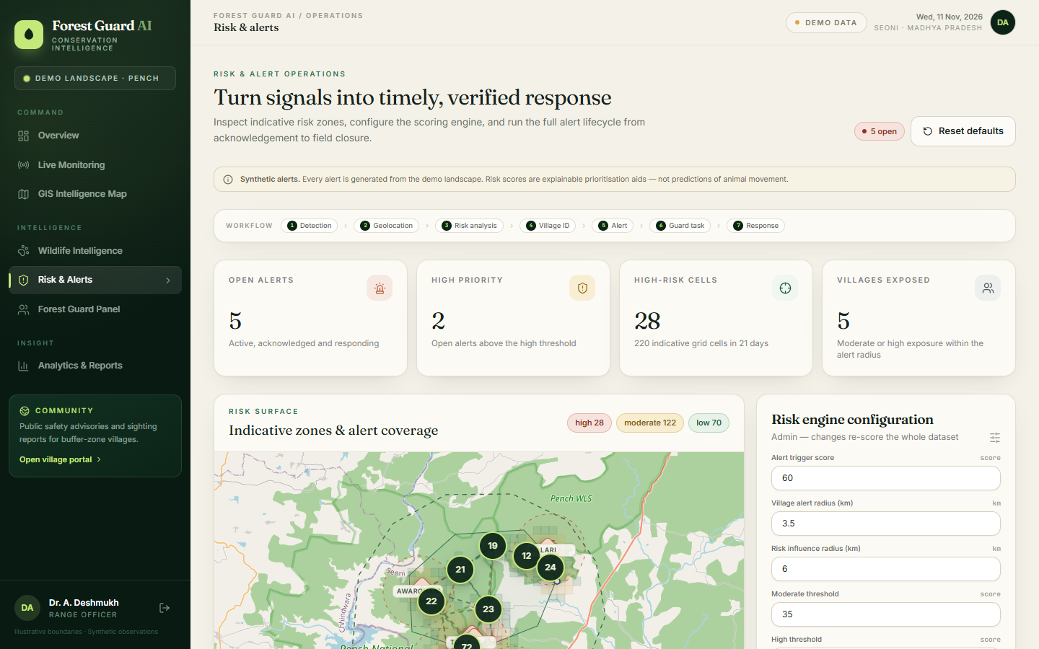
MODULES 4 & 5 · ALERT AND RESPONSE
An alert is a task,
not a notification.
When a detection crosses the configurable threshold inside the alert radius, it becomes one assigned task with a reason, affected villages and a timestamp.
1
Detection
species, camera, score, basis
2
Alert
threshold + radius, deduplicated
3
Assign
nearest available guard
4
Acknowledge
guard confirms ownership
5
Respond
status and note recorded
Guard board
RBAC-scoped queues; acknowledge → responding → resolve with an append-only audit trail.
6
Resolve
audit trail closed
Simulated in-app notification · no SMS sent · every action appends an event
Forest Guard AI · hackathon build · November 2026
07
Notes:
Run one lifecycle live if time allows. Stress that dispatch is simulated: no SMS is sent, and the UI says so. The audit trail is the accountability mechanism.

Slide 8
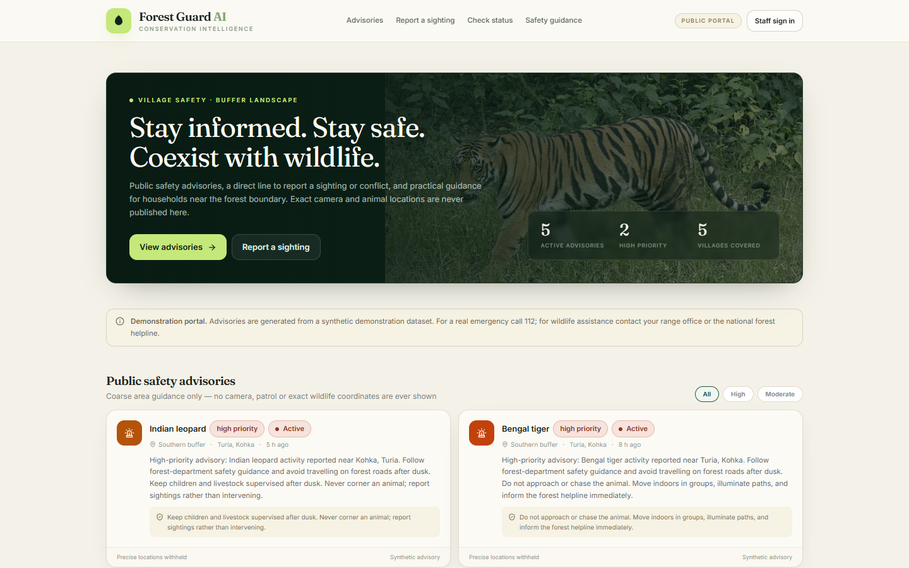
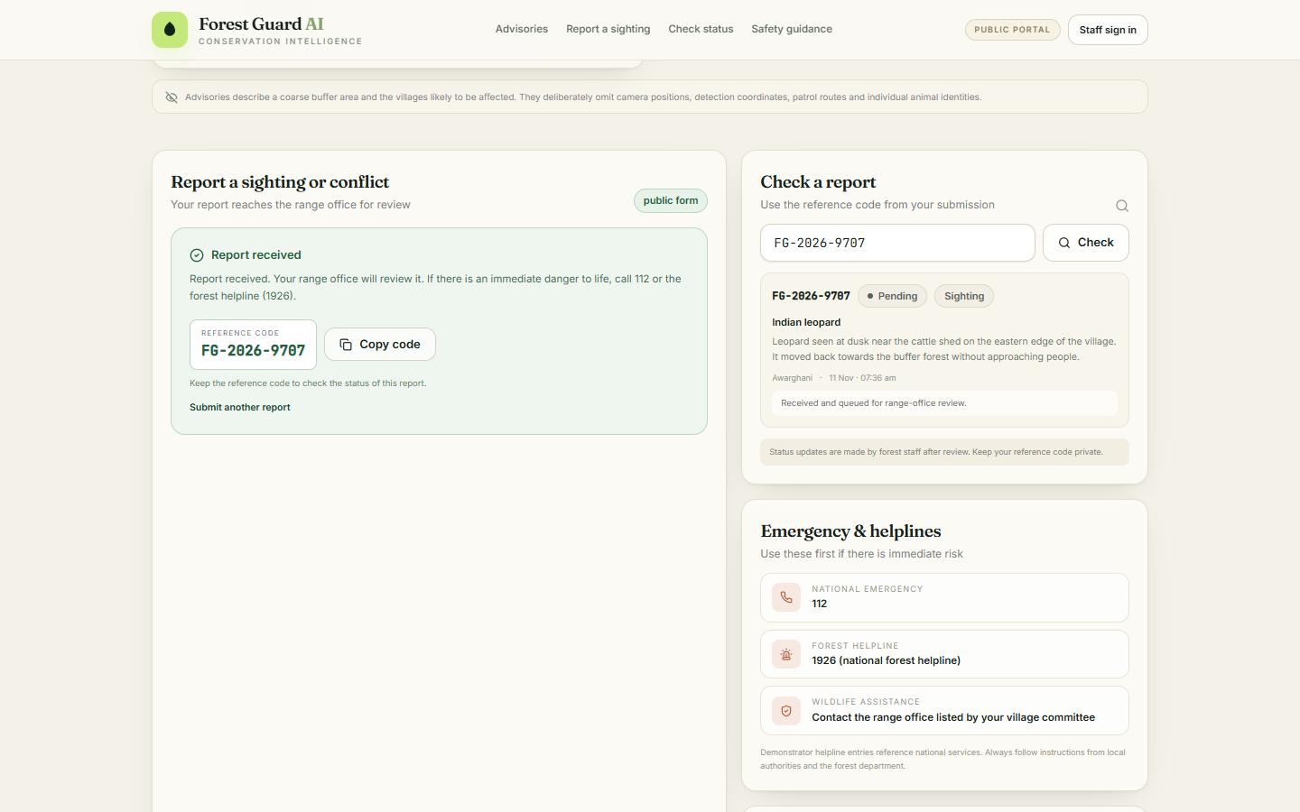
MODULE 6 · COMMUNITY PORTAL (PUBLIC)
Warn the village.
Don't expose the animal.
The public portal republishes the same underlying risk as a coarse advisory. Sanitisation happens on the server, so coordinates never reach the public payload.
PUBLIC SEES
Village names and risk level
Safety guidance
Report sighting / conflict
Reference-code status check
CONSOLE SEES
Exact coordinates and camera codes
Detection media and confidence
Reporter details
Guard assignment and audit
Report FG-2026-9707 accepted and checked live.
Forest Guard AI · hackathon build · November 2026
08
Notes:
Switch to the public tab and submit a report live. The reference code round trip is the proof that the portal is functional, not a static page. The right-hand screenshot is the status lookup.

Slide 9
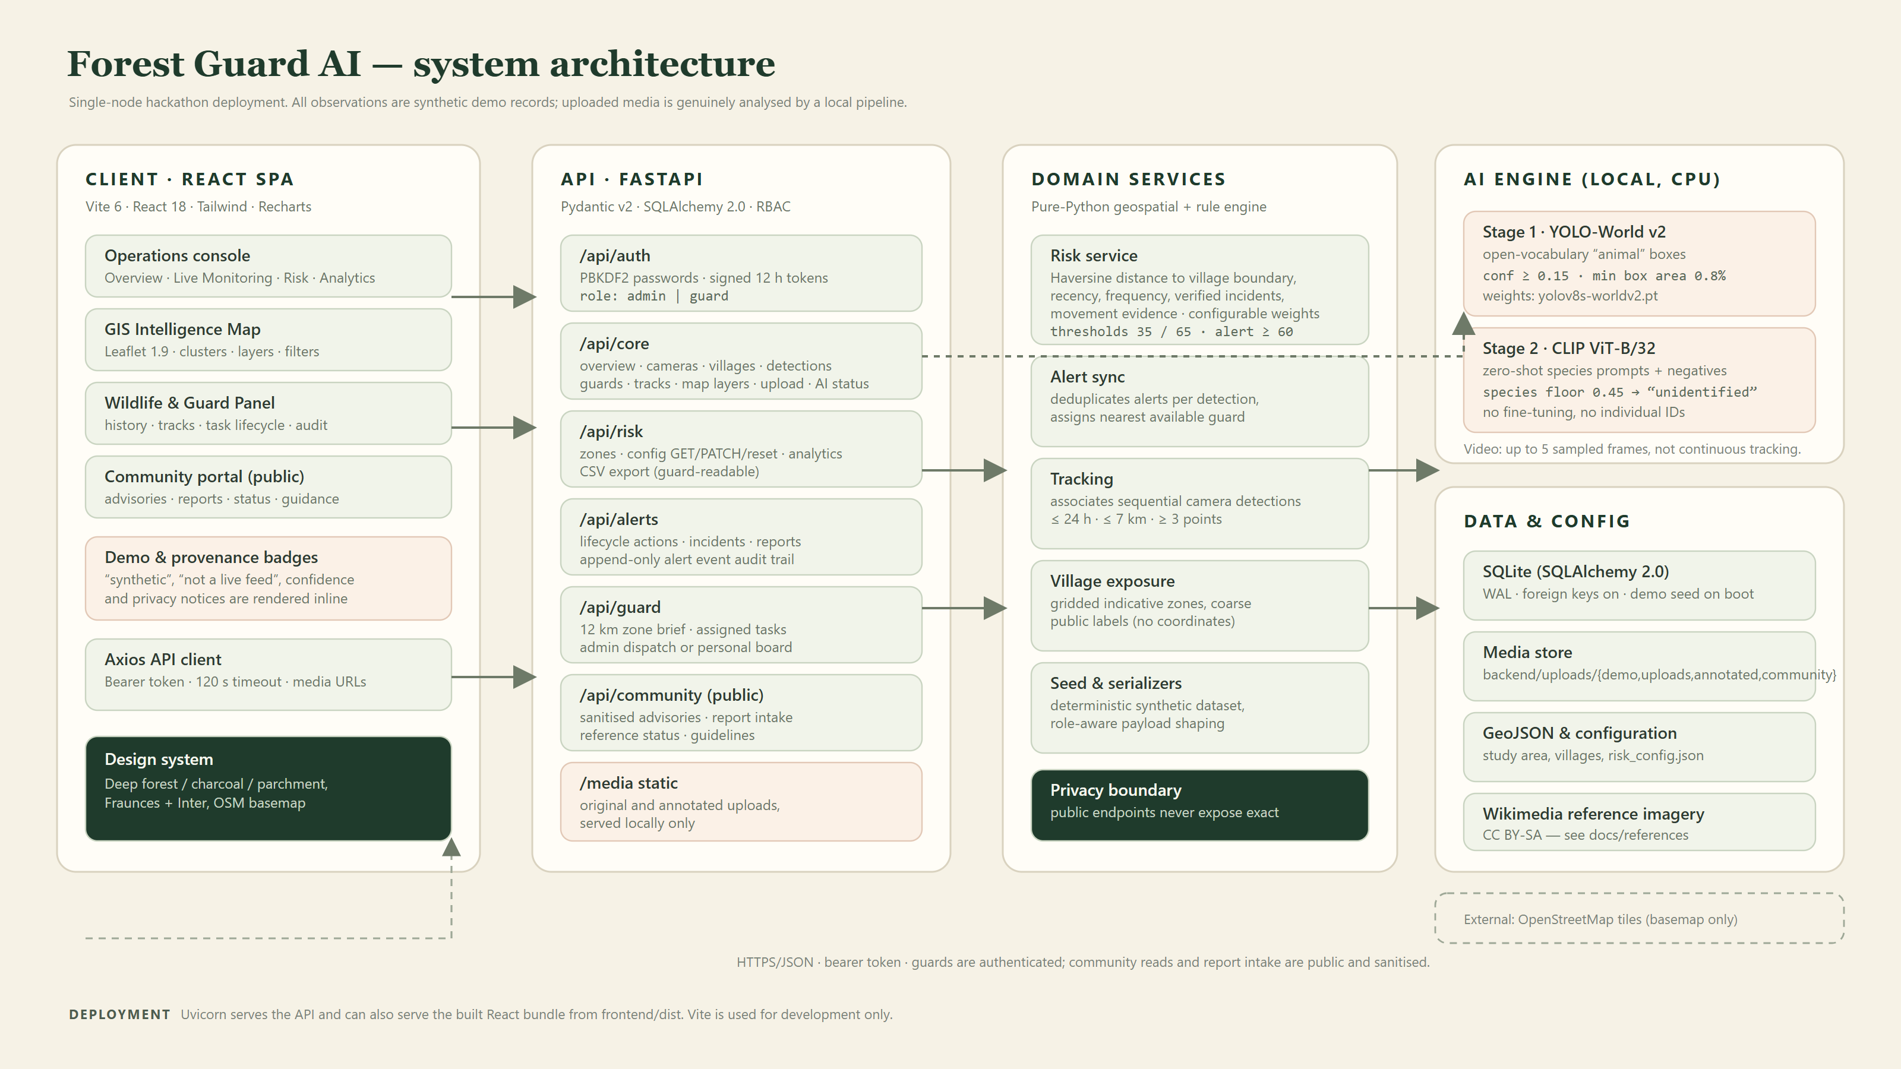
React SPA · FastAPI · SQLite · local AI · OSM basemap · 28 backend tests
09
Notes:
Engineering quality slide: thin routers, services for risk/alerts/tracking, serializer-enforced privacy, 28 tests with an isolated temporary database, and a production build that the API can serve from one process.

Slide 10
STATUS · 11 NOVEMBER 2026
What is real, what is not,
and what comes next.
BUILT AND VERIFIED
NOT BUILT / NOT CLAIMED
8 working dashboard pages, all controls wired
No live camera feeds or CCTV integration
Genuine image/video inference on CPU
No GPS collars or individual identification
GIS map with 8 layers and filters
No SMS/email dispatch (simulated in-app)
Explainable, configurable risk engine
No field accuracy claim — smoke check only
Alert → guard response with audit trail
No government or restricted data access
Public portal with server-side sanitisation
Single-node SQLite, not a scale-out service
28 pytest tests · production build passes
10 live screenshots · 3 architecture diagrams
NEXT
Licenced camera-trap benchmark · PostGIS · real dispatch · offline guard app
Run it
python -m uvicorn backend.main:app --port 8000 · cd frontend && npm run dev
admin@forestguard.ai / forest123 · guard@forestguard.ai / guard123
Notes:
Close with the honesty slide. Judges trust a clear boundary more than a perfect claim. Offer the run commands and demo accounts so they can verify everything themselves.

