Slide 1



OOPS Project Presentation
Institute Entry / Exit Management System
Submitted By:
Ansh Singh (2020 IMT 013)
Arun Singh Kushwaha (2020 IMT 016)
Lucky Kumar (2020 IMT 051)
Ritik Kumar (2020 IMT 080)
Submitted To: Dr. Vinal Patel (Assistant Professor)

Slide 2
Introduction
We have designed an Institute Entry / Exit Management System that stores the information of the people entering and exiting the institute. To do so,
we are using CSV file to store the data of the visitors.
We are maintain 2 databases
For people who are residents of IIITM
For people who are outsiders (not residents of IIITM)
The information stored in the database is reliable, accurate, immutable and it can be easily retrieved, accessed anywhere and anytime unlike the common entry / exit management system

Slide 3

What We'll Need
Understanding the Working of Our Project through Flow Chart

Slide 4

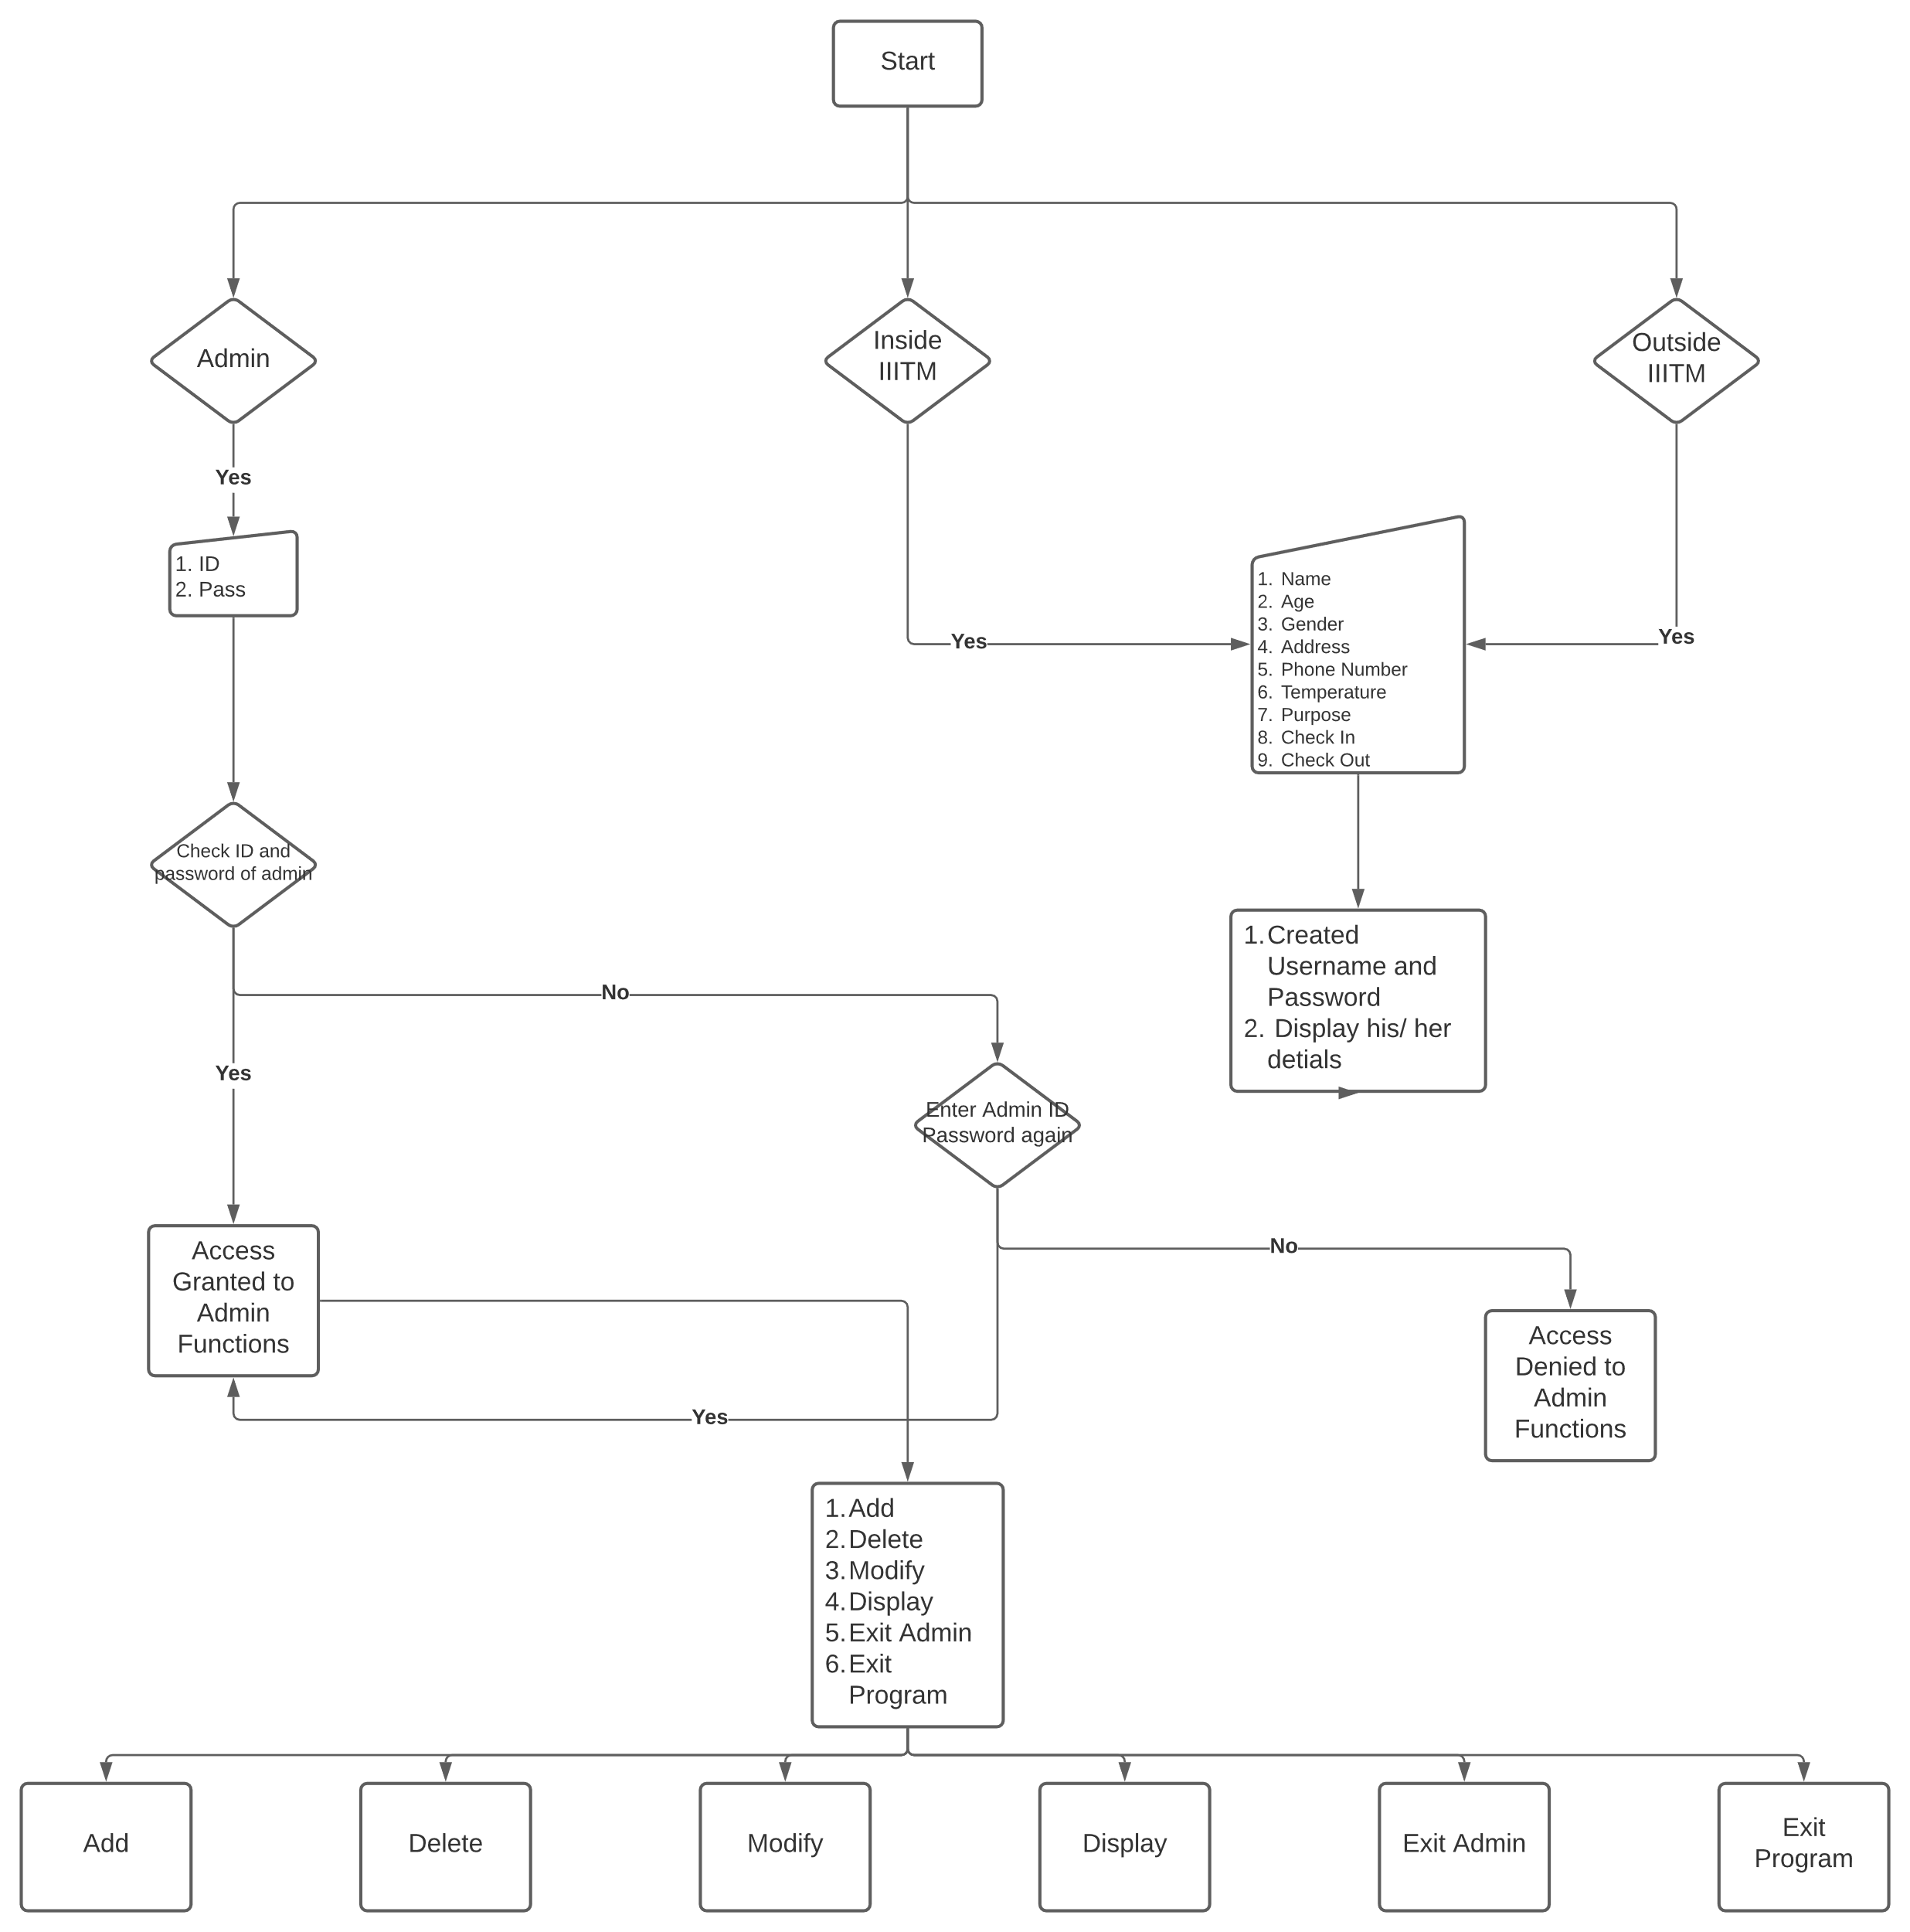

Slide 5

Functions / Classes Used in making of the Project

Slide 6

Class decoration (printing heading)
a. Function decor ()
6. Class Outside (for non residents of IIITM)
a. Function entry ()
b. Function file_entry()
c. Function file_modify()
d. Function file_display()
e. Function file_delete()
2. Class afterchoosing (printing subheadings)
a. Function decor ()
3. Class mainmenu (printing mainmenu)
a. Function menu ()
7. Class Admin (Functions of admin)
a. Function Adminchecker()
b. Function Adminfunctions()
4. Class Displaydetails (for displaying details)
a. Function display ()
8. Class Mainmenuadmin (Mainmenu of Admin)
a. Function menu ()
5. Class Inside (for residents of IIITM)
a. Function entry ()
b. Function file_entry()
c. Function file_modify()
d. Function file_display()
e. Function file_delete()
9. Class Detailchecker (check details is correct or not)
a. Function check()
Finally int main() most important function of the program

Slide 7
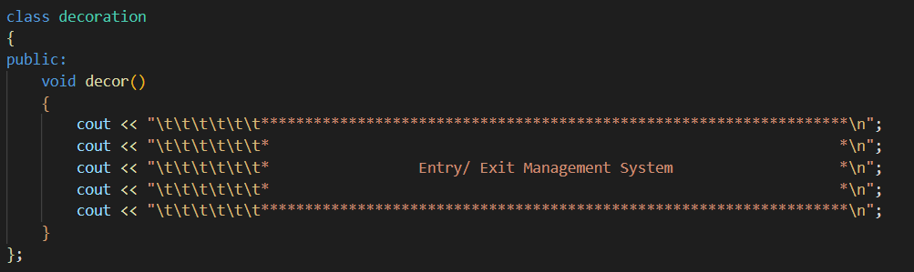
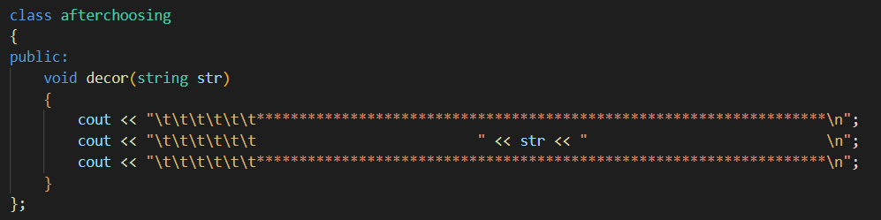
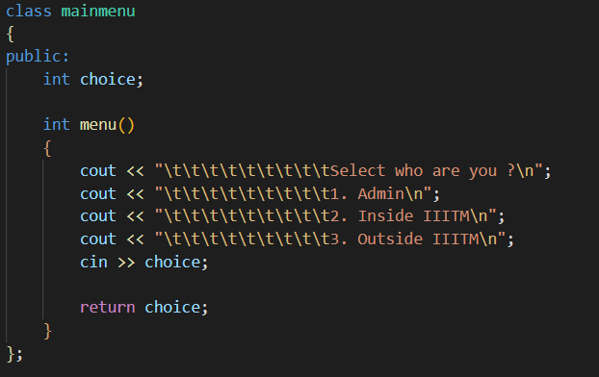
Class Decoration
Class Afterchoosing
Class Mainmenu

Slide 8
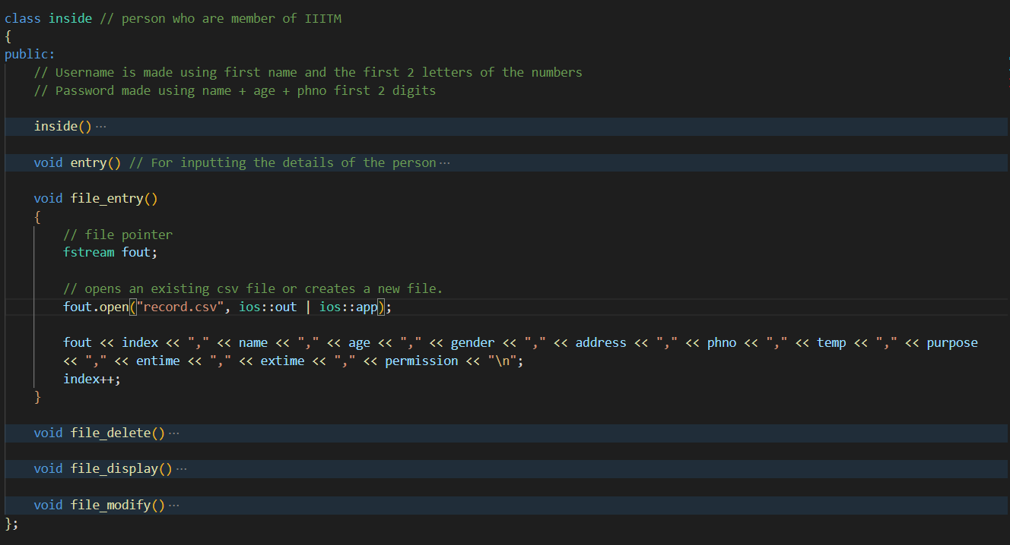
Class Inside

Slide 9
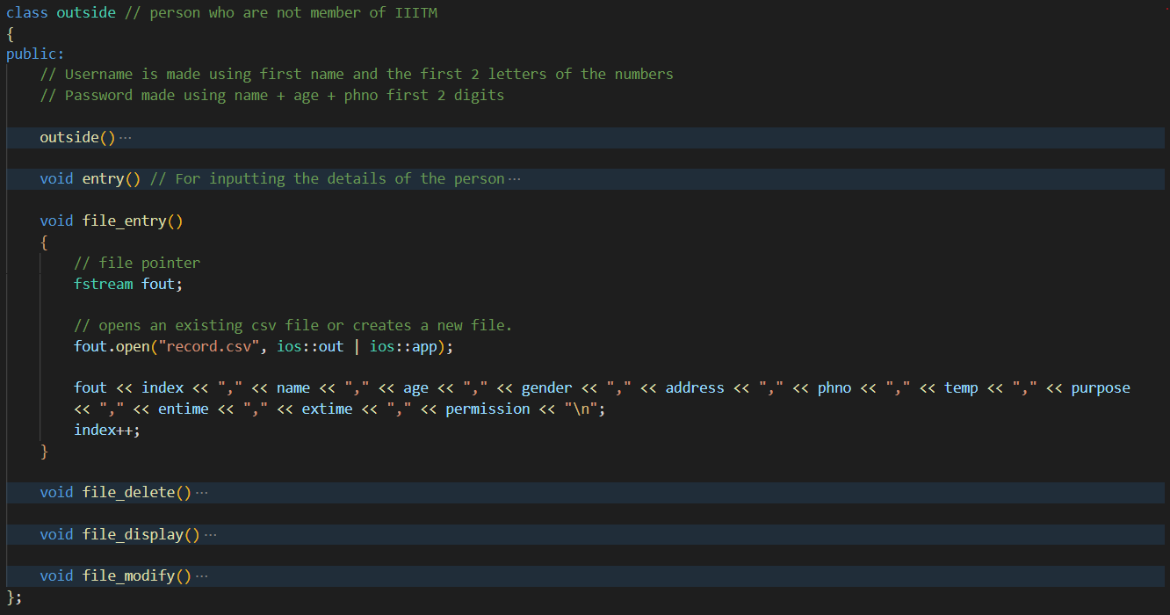
Class Outside

Slide 10
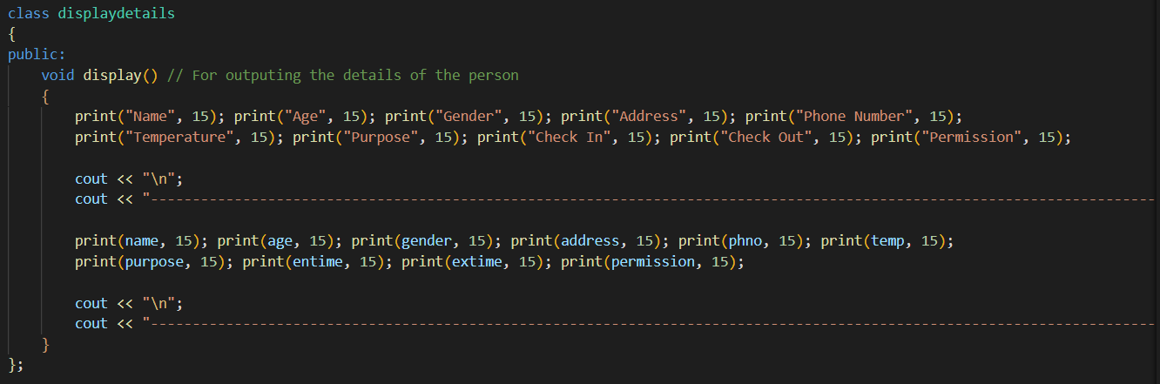
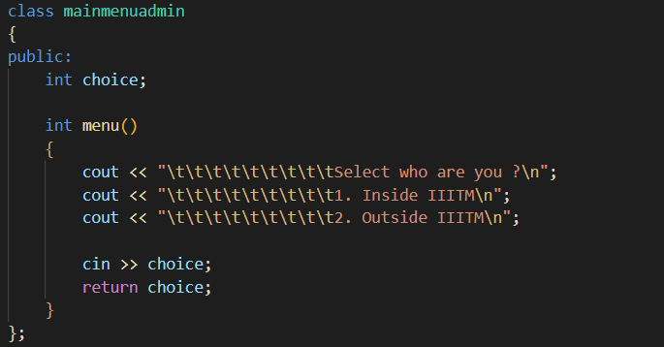
Class DisplayDetails
Class Mainmenuadmin

Slide 11
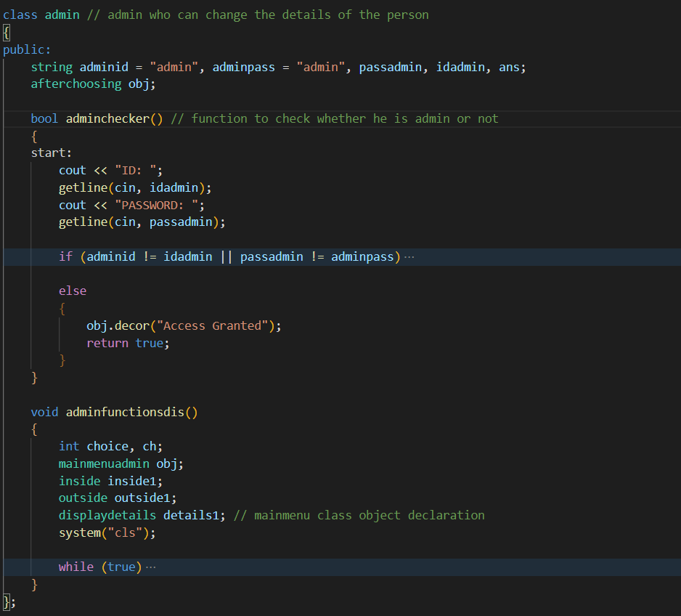
Class Admin

Slide 12
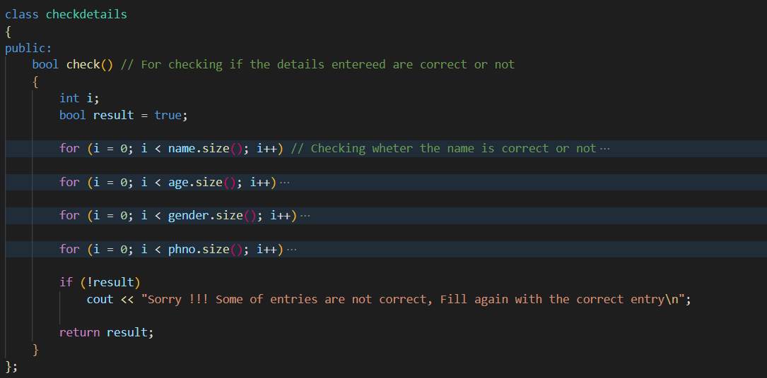
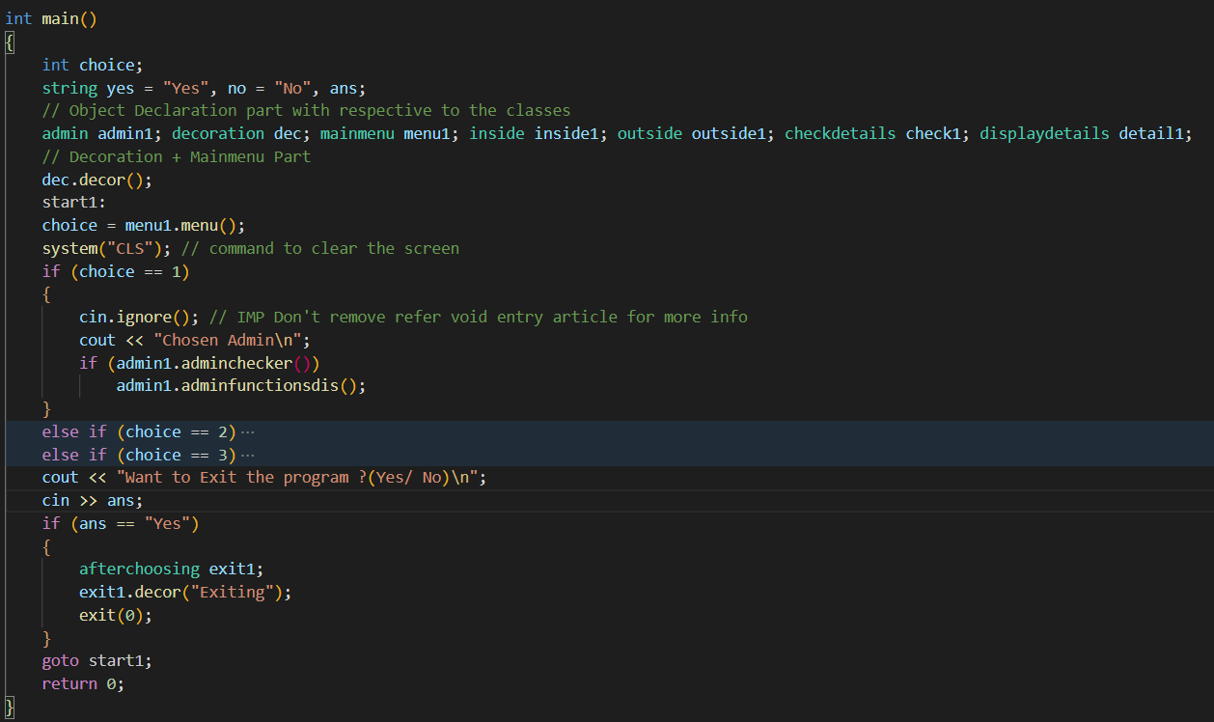
Class Checkdetails
Main Function

Slide 13
Output of the Project

Slide 14
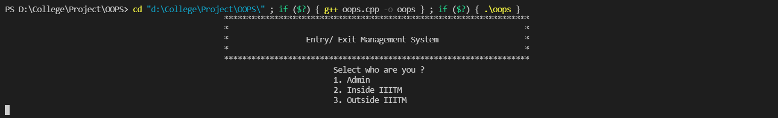
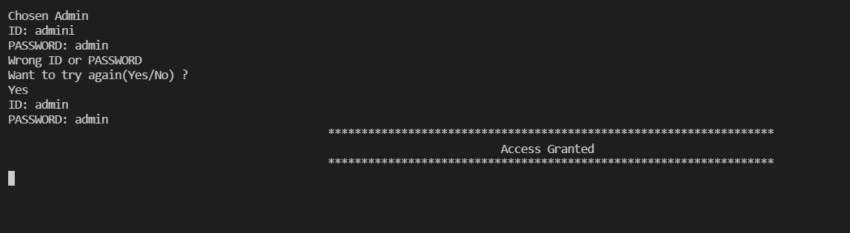
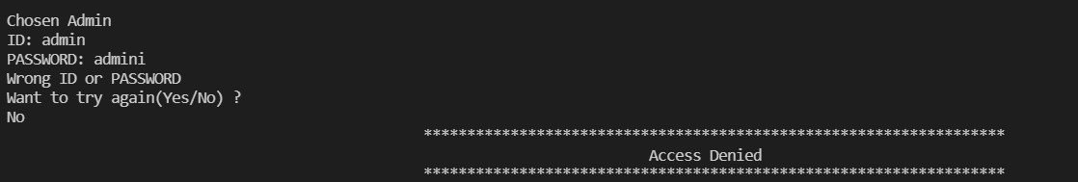
Starting of the Program
When chosen admin (wrong id or password asks user to try again)
When chosen admin (wrong id or password and not trying again)

Slide 15

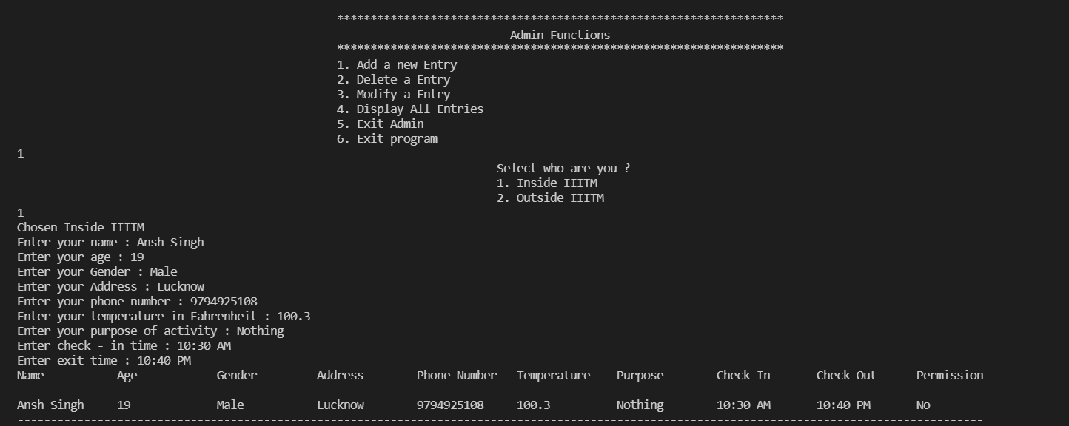
Functions of Admin on successful logging in
Adding a Entry from admin choosing inside

Slide 16
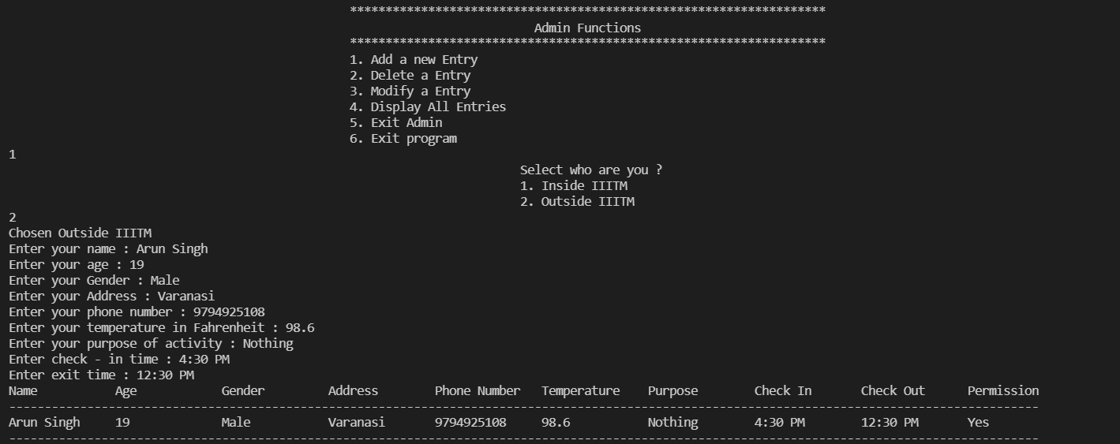
When adding outside person entry

Slide 17
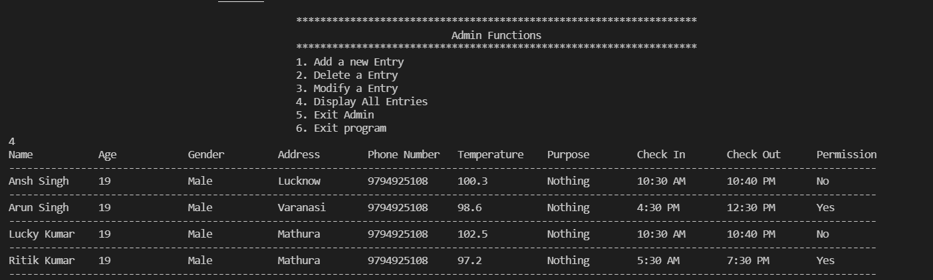
Displaying all the entries from admin functions

Slide 18
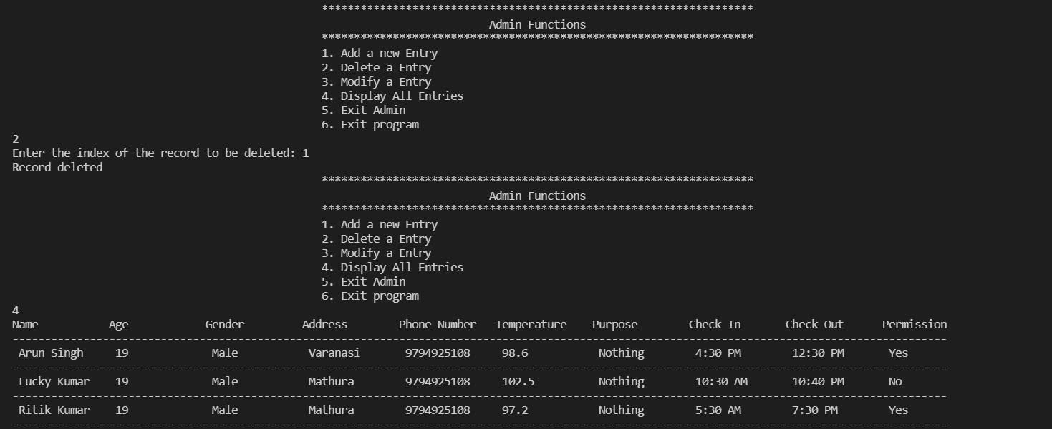
Deleting a record from the admin

Slide 19
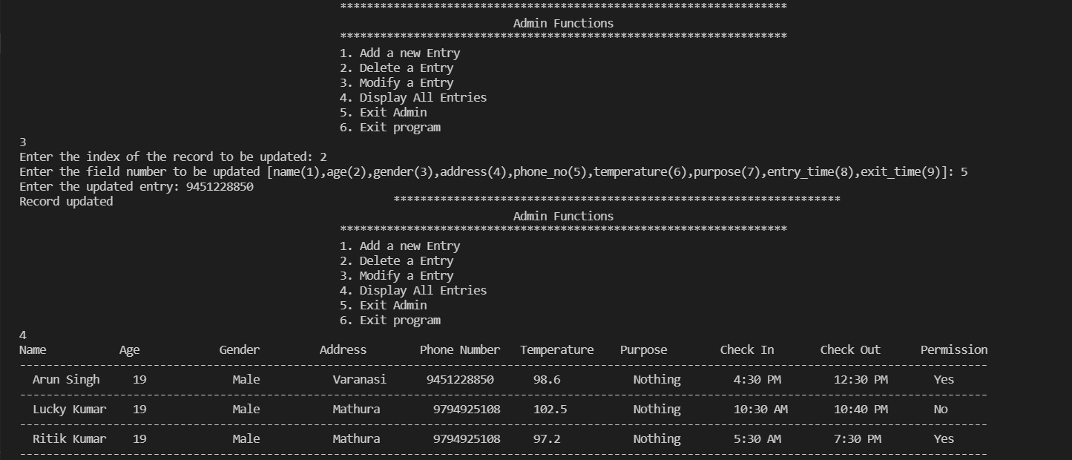
Modifying a Entry from Admin

Slide 20
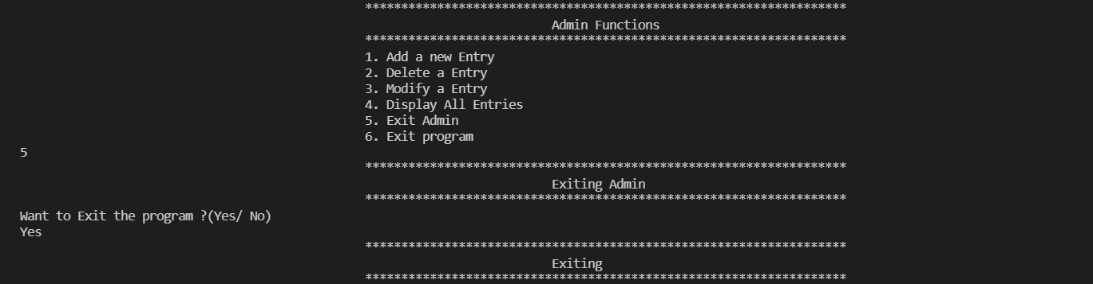
Exiting the Admin and Program

Slide 21
Thank You All for Watching !!!

