Slide 1
KisanLens AI
Camera → Leaf → AI Diagnosis → Voice Advisory
GDG Prayagraj × CMP Hack Squad — Code for Community
Team: The Bug Slayyers
Leader: Anshuman Mishra | Member: Aman Rai

Slide 2
The Problem
🌾 Crop disease is invisible until too late
🏥 Agronomists are scarce & expensive
Farmers often identify disease only after significant crop loss has already occurred.
Expert consultation is out of reach for smallholder farmers in rural India.
🗣️ Language barrier
📡 Limited digital literacy
Agricultural advisories are rarely available in Hindi or local languages.
Complex apps and web portals are not designed for farmers on the field.

Slide 3
Our Solution: KisanLens AI
An AI-powered crop doctor in every farmer's pocket
📷 Camera
🔍 Gemini AI
🩺 Diagnosis
🔊 Voice
Photograph
affected leaf
→
Vision model
analyzes image
→
Crop, disease,
severity & remedy
→
Hindi / English
advisory aloud
✅ Bilingual UI — Hindi & English
✅ Scan history on-device
✅ Voice input/output (TTS + Speech)
✅ Farm insights: weather, soil, NDVI
✅ Offline demo mode
✅ Seasonal crop guide

Slide 4
Tech Stack
Language
UI
Architecture
Kotlin 2.x
Jetpack Compose + Material 3
MVVM · Coroutines · StateFlow · Navigation Compose
AI / Vision
Camera
Audio
Google Generative AI SDK — Gemini Flash
CameraX (core, camera2, lifecycle, view)
Android TTS (hi_IN / en_US) + SpeechRecognizer
Storage
Image / JSON
Location
DataStore Preferences + on-device scan history
Coil + Gson
Platform LocationManager (no Play Services)

Slide 5
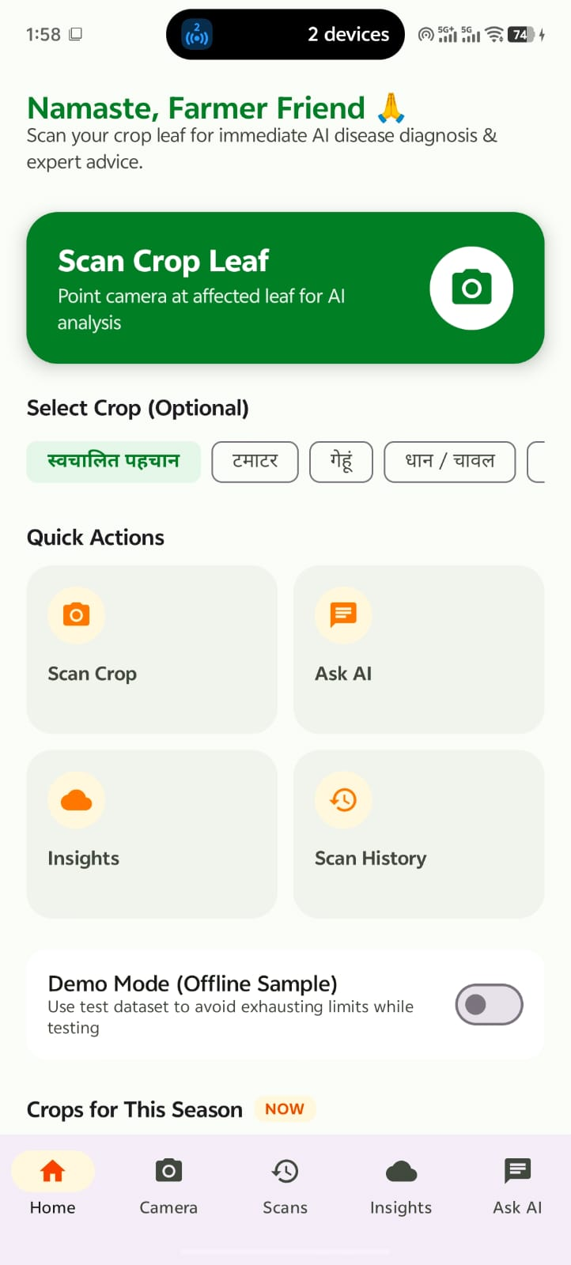
5
Home Screen
Dashboard with Scan Crop Leaf CTA, Quick Actions, seasonal crop guide and Demo Mode toggle
KisanLens AI

Slide 6
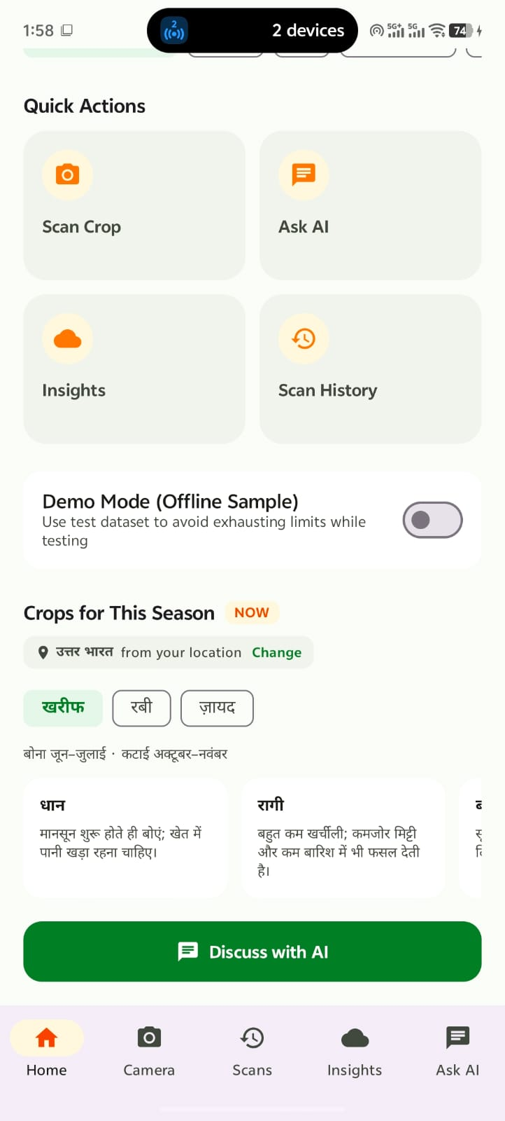
6
Home — Seasonal Guide
Kharif / Rabi / Zayad tabs with planting windows and crop details; Discuss with AI shortcut
KisanLens AI

Slide 7
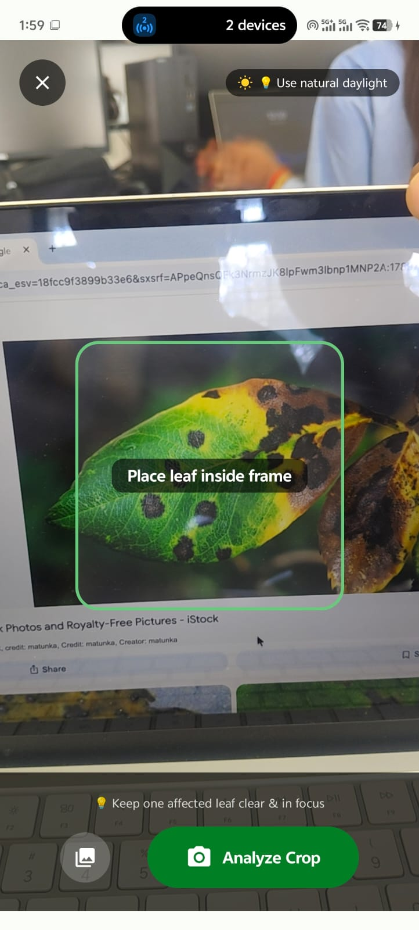
7
Camera Scanner
CameraX live preview with leaf-alignment frame, lighting guidance and Analyze Crop button
KisanLens AI

Slide 8
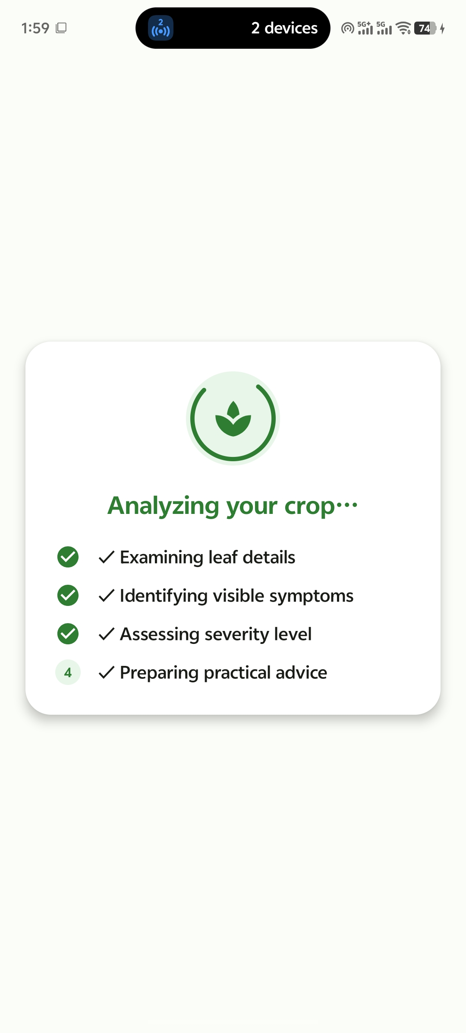
8
Analyzing Your Crop
Gemini AI processing steps: examining leaf → identifying symptoms → assessing severity → preparing advice
KisanLens AI

Slide 9
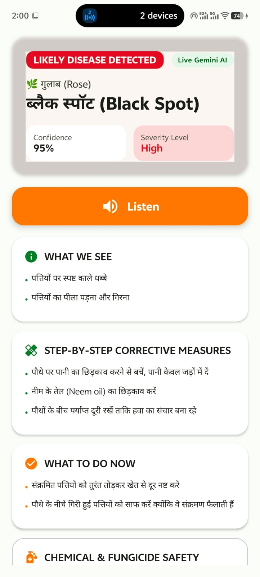
9
Diagnosis Result
Rose: Black Spot — 95% confidence, High severity. Step-by-step corrective measures and immediate actions
KisanLens AI

Slide 10
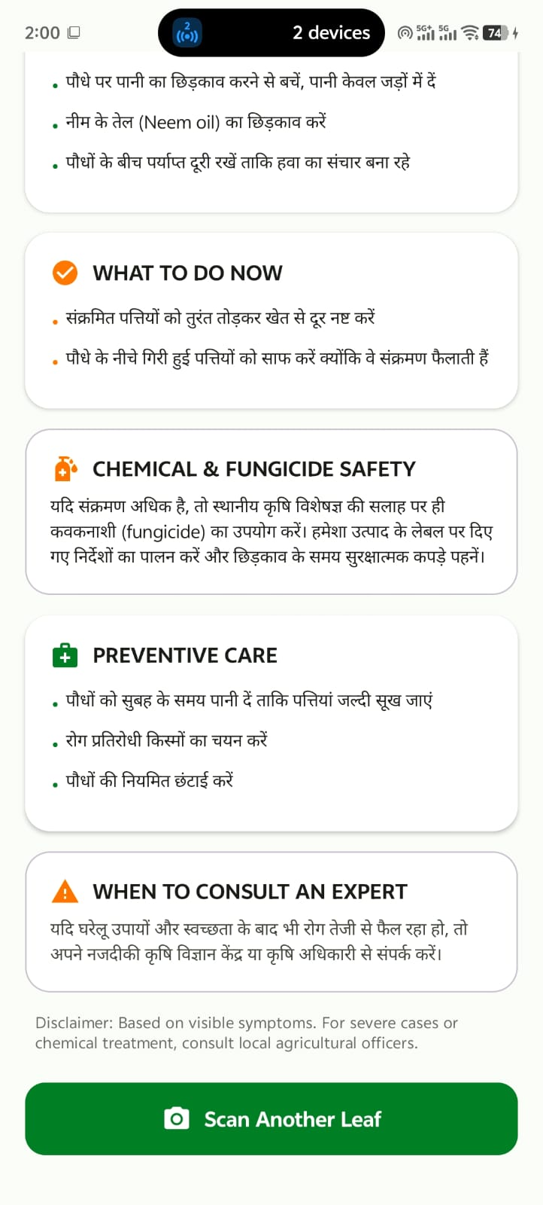
10
Remedies & Safety
Chemical & fungicide safety guidance, preventive care tips, and "When to Consult an Expert"
KisanLens AI

Slide 11
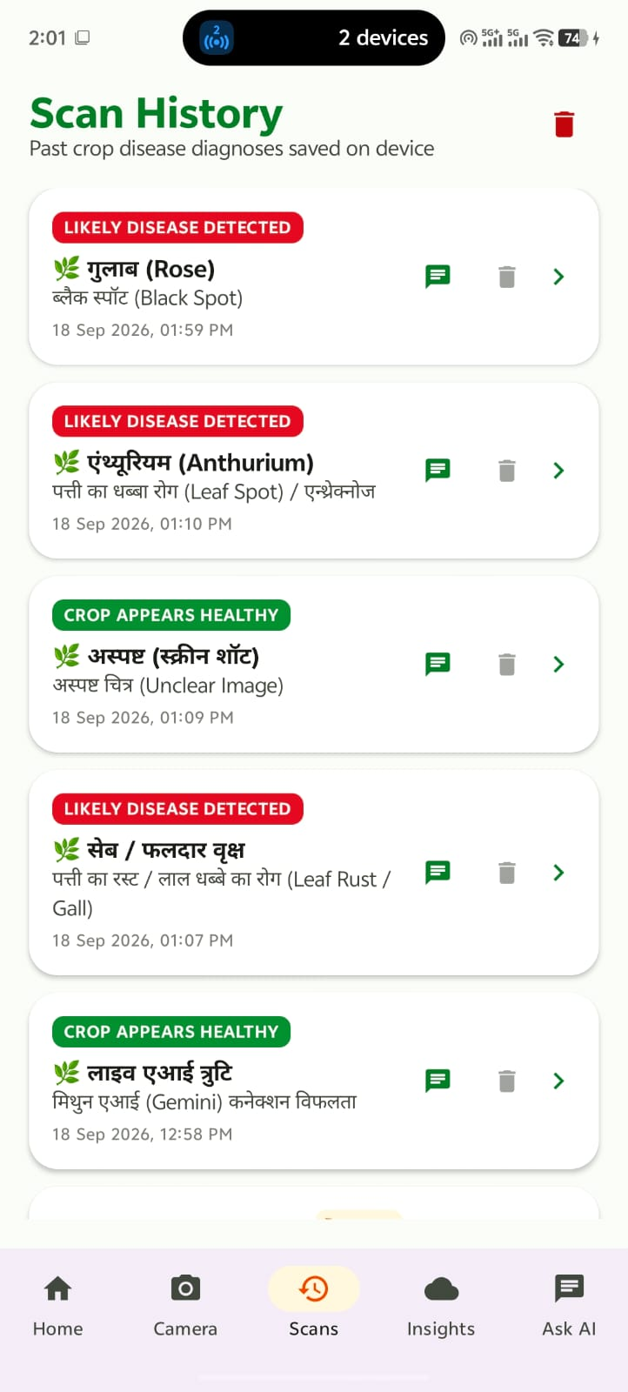
11
Scan History
On-device log of all past diagnoses with crop name, disease, timestamp, status badge and voice replay
KisanLens AI

Slide 12
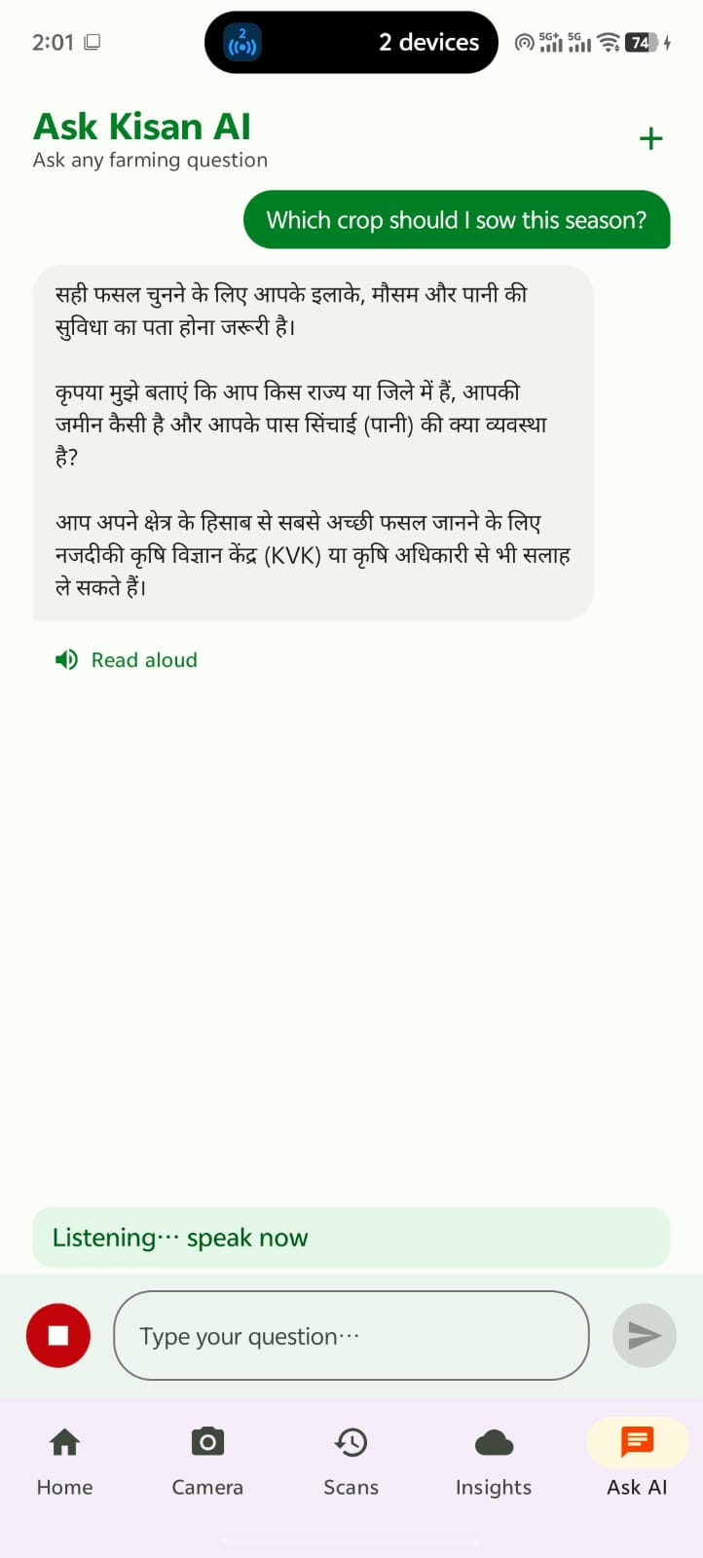
12
Ask Kisan AI
Bilingual voice/text Q&A for farming questions; TTS Read aloud; Listening mode shown active
KisanLens AI

Slide 13
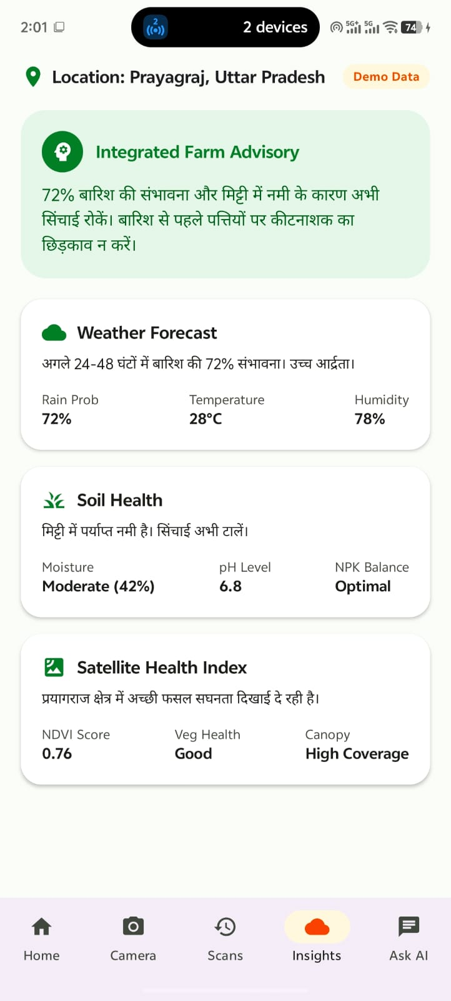
13
Farm Insights
Integrated advisory: weather forecast, soil health (moisture, pH, NPK) and NDVI satellite vegetation index
KisanLens AI

Slide 14
Thank You!
KisanLens AI — Empowering Farmers with AI
Team: The Bug Slayyers
Anshuman Mishra (Leader) · Aman Rai
GDG Prayagraj × CMP Hack Squad — Code for Community
Scan a leaf. Save a harvest.

