Slide 1


Name :- ANSH
Reg. No :- 12213152
Subject:- CSES003
Section:- 9SK02
Roll No :- 18
by Ansh Mishra

Slide 2
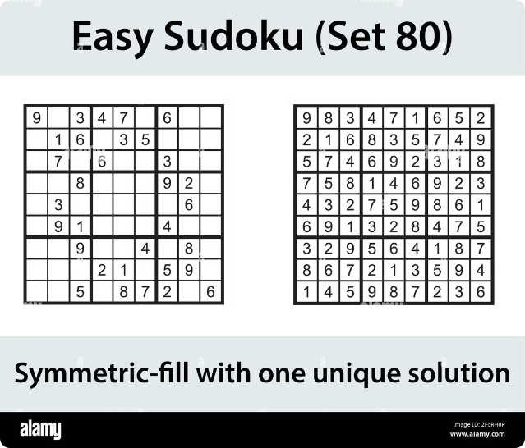
Introduction to Sudoku Solver Visualization
Dive into the captivating world of Sudoku puzzles and explore a visually engaging solution. This presentation will guide you through the fundamentals of Sudoku, the algorithms that solve them, and innovative techniques to visualize the solving process.
by Ansh Mishra

Slide 3

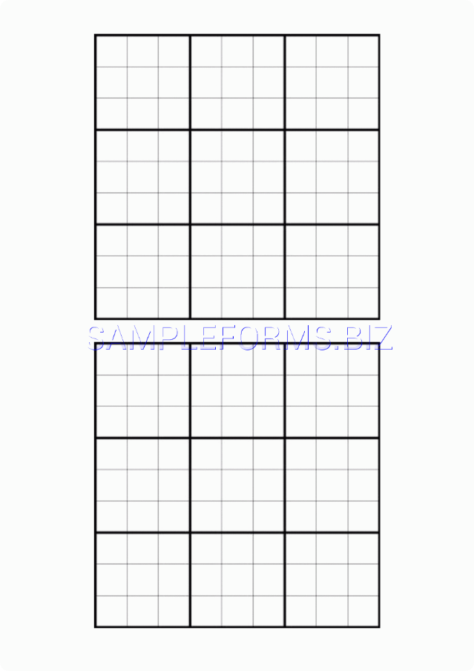
Overview of Sudoku Puzzle
1
Objective
Fill a 9x9 grid with digits so that each column, each row, and each of the nine 3x3 subgrids contains all the digits from 1 to 9.
2
Rules
Each digit can appear only once in each row, column, and 3x3 subgrid.
3
Difficulty Levels
Sudoku puzzles range from easy to fiendishly difficult, challenging players to think logically and strategically.

Slide 4
Sudoku Solving Algorithms
Brute Force
Constraint Propagation
Backtracking
Systematically tries all possible combinations until the solution is found. Effective for easy puzzles but becomes impractical for more complex ones.
Applies logical reasoning to eliminate possible values in each cell, gradually narrowing down the solution.
Explores all possible solutions, backtracking when a dead end is reached. Guarantees finding the solution if it exists.

Slide 5

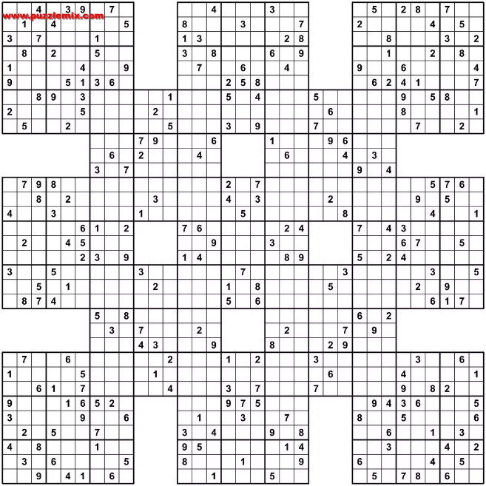
Visualization Techniques
Grid Highlighting
Emphasize the current cell, row, column, or 3x3 subgrid being processed to aid understanding.
Value Trails
Trace the path of each value as the algorithm explores and eliminates possibilities.
Progress Indicators
Visualize the solver's progress, such as the number of filled cells or the solving time.
Algorithmic Animations
Dynamically showcase the step-by-step execution of the solving algorithm.

Slide 6

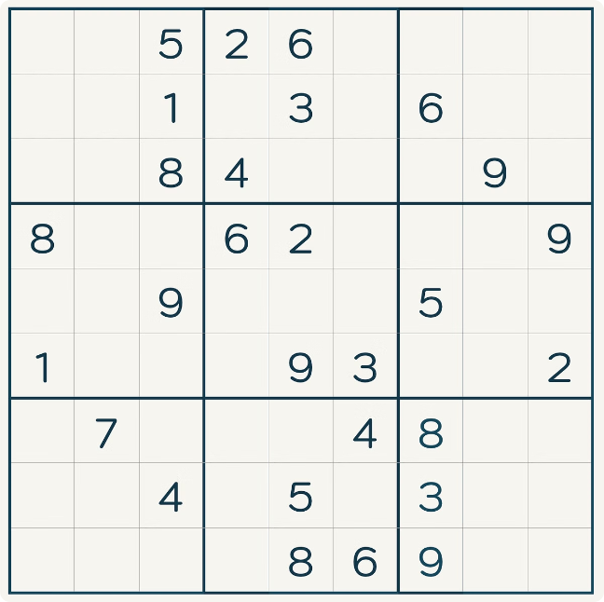
Step-by-Step Walkthrough
1
Initial State
The partially filled Sudoku grid is presented, with the solver ready to begin the process.
2
Logical Reasoning
The solver applies constraint propagation, eliminating possible values and filling in logical deductions.
3
Backtracking
When a dead end is reached, the solver backtracks and explores alternative possibilities.

Slide 7
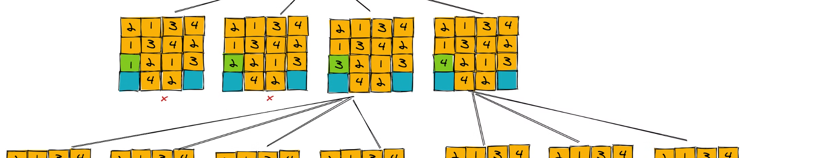



Backtracking Algorithm Demonstration
Explore
Validate
Backtrack
The solver tries a potential value in an empty cell.
The algorithm checks if the value is valid based on the rules.
If the value is not valid, the solver backtracks and tries a different value.

Slide 8





Optimization and Efficiency
Fast Execution
Optimized algorithms and data structures ensure rapid solving times.
Memory Efficiency
Careful memory management to minimize resource consumption.
Scalability
Ability to handle puzzles of increasing complexity and size.

Slide 9

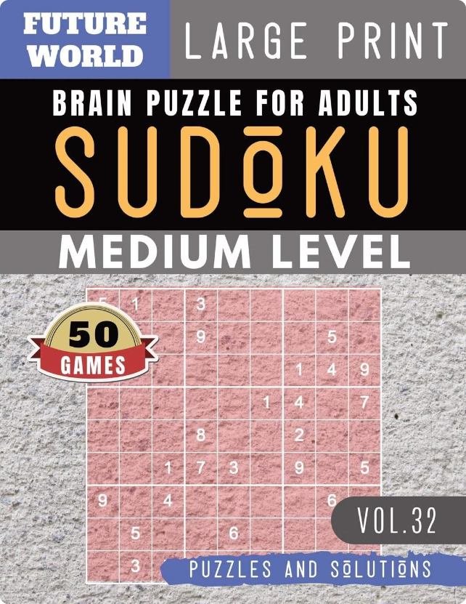
Conclusion and Future Enhancements
1
Recap
Explored the fundamentals of Sudoku puzzles and various solving algorithms.
2
Visualization Insights
Learned how to effectively visualize the solving process for better understanding.
3
Future Potential
Discussed opportunities for further optimization, integration with AI, and broader applications.

