Slide 1

School of Management Studies – MBA in Cyber Security Management
Semester 4
Final Exam
AI-Powered Cloud-Based Vulnerability Scanner with Industrial Experience (MBACS-SIV-1)
Guide:
Dr. Siddharth Dabhade
Student:
Ansh Modi
En.No:
012300400011002007
2024-25

Slide 2
Introduction
In this digital-first age, cybersecurity has emerged as a critical domain that protects sensitive information, systems, and networks from hostile attacks. Be it financial institutions and healthcare services, educational websites and government portals, the ever-growing dependence on the internet has opened up digital systems to unprecedented vulnerabilities and cyber threats. Vulnerability scanners like OWASP ZAP, Burp Suite, and Nessus have been utilized for years by security experts to find and examine prospective vulnerabilities in web applications. Unfortunately, these instruments tend to arrive with a cost: complicated setup, system-demanding requirements, platform dependence (such as Kali Linux), and a daunting learning curve for new users.
Seeing the necessity for an easier and user-friendly approach, this project was initiated to create a cloud-based vulnerability scanner that bridges the technical complexities of conventional scanners and the ease of use of contemporary web applications. Utilizing cloud technologies, artificial intelligence, and simple frontend frameworks, the solution seeks to enable users with diverse levels of knowledge to perform effective vulnerability scans with minimum technical knowledge and expensive hardware.

Slide 3
Objectives
The core objective of this project is to conceptualize, design, and implement a cloud-based, AI-integrated vulnerability scanning platform that streamlines the identification, assessment, and remediation of security flaws in web applications. This solution aspires to simplify the traditionally complex process of vulnerability management by combining automated scanning, domain intelligence, and contextual AI-powered recommendations into a unified, user-friendly platform. Emphasis is placed on cross-platform accessibility, allowing both cybersecurity professionals and novices to conduct assessments efficiently via command-line tools, browser-based interfaces, and intelligent automation layers.

Slide 4
Literature Survey
Existing tools like Nessus and OpenVAS offer vulnerability scanning but lack AI integration.
Research supports using ML and NLP to assist human analysts.
This project fills the gap by offering contextual feedback, rich UI, and live reporting.
Sr. No. | Paper Title and Author(s) | Details of Publication | Findings/Outcome
1 | IoT Security and Privacy: A Survey, Shojafar, M., et al. | 2017 IEEE Communications Surveys & Tutorials | Discusses security and privacy challenges in IoT devices and potential solutions.
2 | Comprehensive Study on Security Issues in IoT: A Survey, Vyas, A., et al. | 2018 SET Conference | Highlights the need for robust security mechanisms in IoT systems.
3 | IoT Security: A Survey, Taxonomy, and Open Issues, Alaba, F. A., et al. | 2017 Future Generation Computer Systems | Categorizes IoT security challenges and explores open research issues.
4 | A Survey of Security and Privacy Issues in IoT Devices, Balakrishnan, V., et al. | 2015 Procedia Computer Science | Focuses on integrating IoT devices and addressing security challenges in IoT.
5 | Comprehensive Study on Security Issues in IoT: A Survey, Vyas, A., et al. | 2017 IEEE Access, Volume 5 | Highlights security breaches and vulnerabilities in IoT ecosystems.
6 | Lightweight Security Frameworks for Constrained IoT Devices, Zhang, K., et al. | 2020 IEEE Internet of Things Journal | Proposes security frameworks for resource-constrained IoT devices.

Slide 5
System Analysis
Identified Gaps:
Lack of user-friendly UI in open-source tools
Manual interpretation of scan results
Proposed Features:
Real-time scanning output
Color-coded vulnerability severity
AI-assisted analysis and advice

Slide 6
System Analysis
Feature | Existing Tools (e.g., Nessus, Burp Suite) | This Project
Open Source | Limited (Burp Suite Free lacks many features) | Yes
AI-Powered Remediation | Rare or non-existent | Yes
Beginner-Friendly UI | Mostly complex or technical | Yes
Cloud-Hosted | Often requires local installation | Yes
WHOIS and Domain Intelligence | Not commonly integrated | Yes
Mobile-Responsive Interface | Minimal | Yes

Slide 7
System Analysis
Type | Description
Technical Feasibility | The technologies used (Python, Flask, React.js, OWASP ZAP, Gemini AI, WHOIS API) are open-source, well-supported, and integrable via REST APIs. Cloud platforms like Vercel and Oracle Cloud simplify deployment.
Operational Feasibility | The project can be used by developers, cybersecurity trainees, and analysts without needing deep security expertise. AI-generated remediation and clean UI reduce learning curves.
Economic Feasibility | Uses mostly free or community-tier APIs and services. Budget remains minimal as deployment on services like Vercel and Oracle Cloud offers generous free tiers.
Legal/Compliance Feasibility | The tool does not store or manipulate sensitive data. WHOIS and vulnerability scan results are publicly accessible. AI integrations comply with usage terms.

Slide 8
Methodology
Phase 1: CLI tool developed in Python for scanning
Phase 2: Flask web app for GUI interaction
Phase 3: ReactJS front-end with Gemini AI integration
Real-time scan result streaming using WebSocket

Slide 9
System Design
Three-layer architecture:
Backend (Python/Flask): Processes scan data
Frontend (ReactJS): Displays results interactively
AI Engine (Gemini AI): Generates contextual advice
Risk Indicators: Red (High), Orange (Medium), Green (Low)

Slide 10
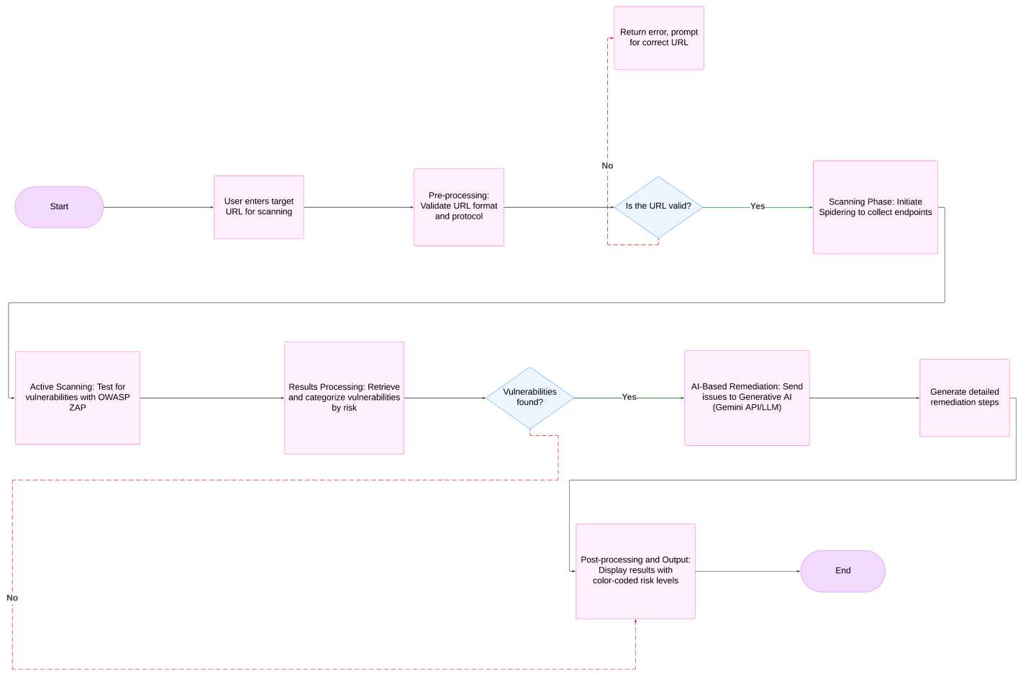
System Design

Slide 11
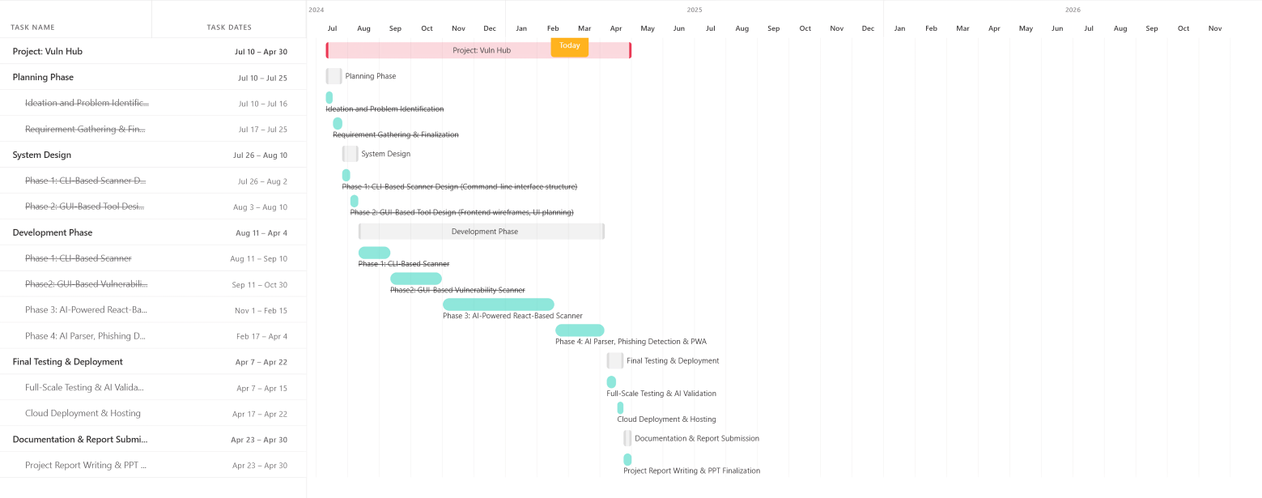
System Design

Slide 12
Implementation
Developed CLI scanner in Python
Flask server for handling user requests and scan output
ReactJS for dynamic dashboard with table and color-coded risks
Area | Technology
Vulnerability Scan | OWASP ZAP (API mode)
CLI | Python
Backend | Flask, Python
Frontend | React.js, Tailwind CSS
AI Integration | Google Gemini API
WHOIS Lookup | WhoisXMLAPI or similar
Deployment | Vercel
Other | Git, GitHub, Postman

Slide 13
Key Features
AI-powered vulnerability explanation (Gemini API)
Real-time scanning via WebSockets
Cross-platform support
Color-coded severity classification
Interactive and modern frontend UI

Slide 14
Results and Output
Vulnerabilities displayed in a live table view
Gemini AI feedback shown alongside each risk
Table includes: CVE ID, Description, Severity, Advice
Performance evaluated using sample attack scenarios
Feature | Outcome | Remarks
CLI-based scanning | Successful for all tested URLs | Fast for small targets; verbose output
Flask web interface | Stable and responsive | Easy access via browser
React.js frontend | Fully responsive on all screen sizes | Improved usability and appearance
WHOIS integration | Returned accurate domain data | Useful for domain reconnaissance
AI remediation output | Contextual, readable, and specific | Significantly helped in understanding fixes
Cloud deployment (Vercel + VM) | High availability, fast load times | Smooth access without setup hassles

Slide 15
Conclusion
Successfully built a modular, intelligent vulnerability scanner
Integrated modern tech stack: Python, Flask, ReactJS, Gemini AI
System performs real-time analysis with minimal latency
Scalable and extendable architecture

Slide 16
Future Scope
Add automated patch recommendation
Extend support for mobile and IoT environments
Use machine learning to predict emerging vulnerabilities
Cloud-native deployment and integration with SIEM tools

Slide 17
Thank You

