Slide 1

School of Management Studies – MBA in Cyber Security Management
Semester 4
Final Presentation
Project (MBACS-SIV-1)
Vuln Hub AI-Powered Cloud-Based Vulnerability Scanner
Guide:
Dr. Siddharth Dhabade
Student:
Ansh Modi
En.No:
012300400011002007
2025

Slide 2
Contents
Abstract | 3
Introduction | 5
Problem Statement | 6
Literature Survey | 8
Tools & Technology | 9
Development Phases | 10
Challenges | 11
Diagram | 13
Result & Achievement | 15
Future Scope | 16
Conclusion | 17
References | 18
Acknowledgement | 19

Slide 3
Abstract
Problem Statement:
Traditional vulnerability scanners require manual expertise, powerful hardware, and specialized software (e.g., ZAP, Nessus).
Many users lack the technical skills or the resources to install and configure these tools.
Standalone tools (WHOIS, vulnerability scanning, DNS lookup) exist separately, requiring multiple configurations.
Our Approach:
Developed a cloud-based, AI-powered vulnerability scanner with an intuitive interface and automated remediation suggestions.
The tool has been built in phases to improve usability and feature set:
Phase 1: Command-Line Interface (CLI) scanner for detecting vulnerabilities.

Slide 4
Abstract
Phase 2: Web-based GUI for easier interaction and integration of WHOIS lookup.
Phase 3: AI-powered React.js-based scanner with automated remediation steps using Google Gemini AI.
Future Scope:
AI-powered vulnerability parsing, scanning, and exploitation automation
AI-based phishing detection for fraud prevention.
Further integration of cloud computing for enhanced scalability.

Slide 5
Introduction
Why Vulnerability Scanning Matters?
With cyber threats evolving rapidly, security assessments need to be automated, accessible, and effective.
Current tools like OWASP ZAP, Nessus, and Metasploit are effective but require technical expertise and high-end hardware.
Small businesses, students, and independent security researchers struggle with accessibility.
Our Goal:
Create an AI-powered, cloud-based security tool that eliminates complexity and provides real-time automated remediation guidance.
Make vulnerability scanning accessible via a simple web interface with features like WHOIS lookup, DNS analysis, and AI-based fixes.

Slide 6
Problem statement
Challenges in Cybersecurity Practices:
Technical Complexity:
Vulnerability scanning tools require substantial technical expertise to configure and use effectively.
CLI-based tools, though powerful, can be intimidating for users unfamiliar with command-line interfaces.
Resource Requirements:
Tools like Nessus, Metasploit, and even OWASP ZAP often demand high computational resources and operating systems like Kali Linux.
Users without such resources find it difficult to perform practical vulnerability assessments.
Standalone Tools:

Slide 7
Problem statement
WHOIS, DNS lookup, and other cyber security utilities are often standalone tools requiring separate installation or subscription.
Consolidating multiple tools into one platform is not common.
Proposed Solution:
Phase-wise development of a cloud-based scanner that integrates vulnerability scanning, WHOIS, and AI-driven remediation.
AI-powered remediation guidance to simplify fixing vulnerabilities.
Accessible GUI-based system that removes the need for manual configurations.

Slide 8
Literature survey
Sr. No. | Paper Title and Author(s) | Details of Publication | Findings/Outcome
1 | IoT Security and Privacy: A Survey, Shojafar, M., et al. | 2017 IEEE Communications Surveys & Tutorials | Discusses security and privacy challenges in IoT devices and potential solutions.
2 | Comprehensive Study on Security Issues in IoT: A Survey, Vyas, A., et al. | 2018 SET Conference | Highlights the need for robust security mechanisms in IoT systems.
3 | IoT Security: A Survey, Taxonomy, and Open Issues, Alaba, F. A., et al. | 2017 Future Generation Computer Systems | Categorizes IoT security challenges and explores open research issues.
4 | A Survey of Security and Privacy Issues in IoT Devices, Balakrishnan, V., et al. | 2015 Procedia Computer Science | Focuses on integrating IoT devices and addressing security challenges in IoT.
5 | Comprehensive Study on Security Issues in IoT: A Survey, Vyas, A., et al. | 2017 IEEE Access, Volume 5 | Highlights security breaches and vulnerabilities in IoT ecosystems.
6 | Lightweight Security Frameworks for Constrained IoT Devices, Zhang, K., et al. | 2020 IEEE Internet of Things Journal | Proposes security frameworks for resource-constrained IoT devices.

Slide 9
Tools & technologies
Frontend: React JS, Tailwind CSS
Backend: Flask, Python, OWASP ZAP API
Database/Storage: NoSQL-based storage for logs (MongoDB/Firebase) (if necessary).
AI Integrated: Google Gemini AI API

Slide 10
Development Phases
Phase 1: CLI based Scanner
Implemented basic OWASP ZAP API integration to detect vulnerabilities.
Conducted initial scans through command-line execution.
Phase 2: GUI based web application
Developed a frontend using Flask and JavaScript for user-friendly interactions.
Integrated WHOIS lookup to provide domain intelligence.
Phase 3: AI-Powered React.js Scanner
Migrated the frontend to React.js for better performance and scalability.
Integrated AI (Google Gemini) to suggest fixes for vulnerabilities.
Implemented real-time vulnerability scanning with dynamic updates.

Slide 11
Challenges
Phase 1: CLI based Scanner
Limited User Accessibility
Manual Analysis Required
Resource Constraints
Phase 2: GUI based web application
Complex GUI Development
Handling Real-Time Scan Results
WHOIS & API Integration
Phase 3: AI-Powered React.js Scanner
Migration From Flask & HTML frontend to Single Page Application using React.JS

Slide 12
Challenges
Integrating Flask with React JS
Finding Companion AI for remediation steps
Integrating AI for Remediation
Ensuring Data Consistency in Output
Dynamic UI Issues in React JS
Handling Large-Scale Scan Output in Terminal Box
Future Challenges:
AI Parser for Better reading of Remediation
AI Based Vulnerability Scanning
AI power Exploitation and Phishing Detection
Deployment to Cloud

Slide 13
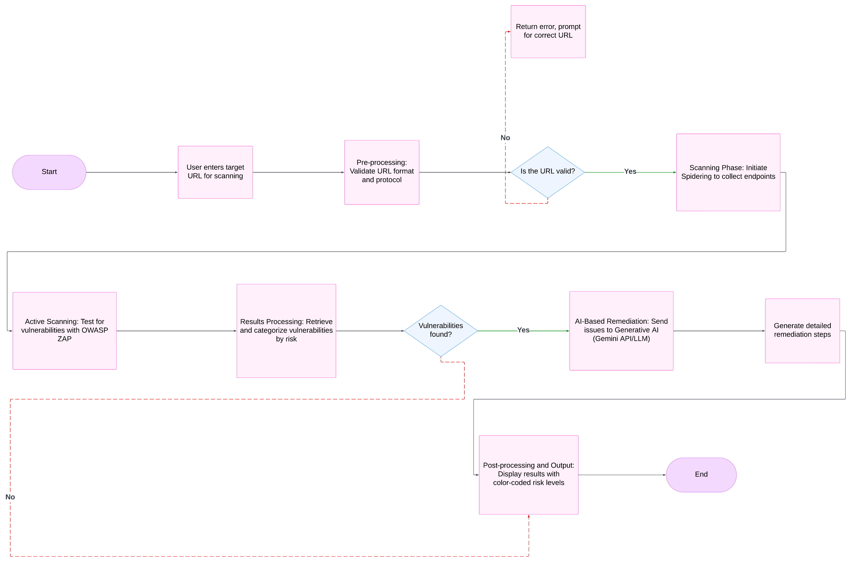
Flow Chart

Slide 14
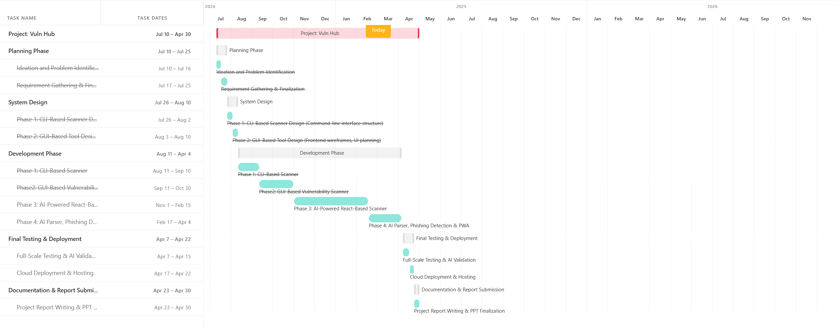
Gantt chart

Slide 15
Result & Achievements
Transitioned from CLI → GUI → AI-powered React-based scanner.
Integrated WHOIS lookup for domain analysis.
AI generates automatic remediation steps for vulnerabilities.
Cloud-based deployment for easy accessibility.
Supports scanning for multiple web vulnerabilities.

Slide 16
Future scope
Phase 4: AI-powered vulnerability parsing for better remediation interpretation.
Phase 5: AI-driven scanning beyond OWASP ZAP, using ML-based detection models.
Phase 6: AI-assisted exploitation simulation for penetration testing.
Phase 7: AI-based phishing detection for fraud prevention.
Cloud deployment: improvements for scalability & accessibility.
Mobile Application: Develop a mobile app for easier access to the scanning functionalities.

Slide 17
Conclusion
Traditional vulnerability scanners require technical expertise and high-end systems.
Our project simplifies vulnerability assessment using AI & React.js.
AI-powered remediation improves security insights and accessibility.
Future work will expand AI-based security intelligence.

Slide 18
References
Books, Papers, and Articles:
OWASP ZAP: A Beginner’s Guide to Automated Security Testing Published on Medium and OWASP Blog.
“Understanding WHOIS and Its Role in Domain Name System” Published by ICANN.
Websites and Tools:
Nmap Official Website - https://nmap.org/
Flask Documentation - https://flask.palletsprojects.com/
Tailwind CSS - https://tailwindcss.com/
OWASP ZAP - https://www.zaproxy.org/
React JS - https://react.dev/
Gemini AI for Developer - https://ai.google.dev/

Slide 19
Acknowledgment
I would like to express my gratitude to:
My supervisor/mentor for their guidance and support.
My peers for their feedback and suggestions.
Everyone who contributed directly or indirectly to the completion of this project.

Slide 20
thank you

