Slide 1
The dynamic equations of IndoTERM By Mark Horridge (CoPS)
1
Copied from ORANIG-RD single-region model
Capital accumulation rule
Investment rule
Wage adjustment rule
See ORANIGRD.DOC

Slide 2
Capital accumulation
2
ΔK = change in capital this year
ΔK = Y₀ - DK0 determined last year
or ΔKΠ₀ = Y₀Π₀ - DK₀Π₀
Here: Y investment
K amount of capital
D depreciation rate
Π price of a unit of new capital
Subscript '0' denotes the initial (start-of-period) value.

Slide 3
Capital accumulation
3
Coefficient ! 2 below are measured in last year price units! (parameter) (all,i,IND)(all,d,DST) CAPADD(i,d) # Addition to CAPSTOK from last year investment #; (all,i,IND)(all,d,DST) CAPSTOK_OLDP(i,d) # Current capstok measured in last years prices #; Formula (initial)(all,i,IND)(all,d,DST) CAPADD(i,d) = INVEST_C(i,d)-DPRC(i,d)*CAPSTOK(i,d);!not updated! (initial)(all,i,IND)(all,d,DST) CAPSTOK_OLDP(i,d)=CAPSTOK(i,d); Update (all,i,IND)(all,d,DST) CAPSTOK_OLDP(i,d)=xcap(i,d); Variable (all,i,IND)(all,d,DST) faccum(i,d) # Shifter to switch on accumulation equation #; (change) delUnity # Dummy variable, always exogenously set to one #; Equation E_faccum # Capital accumulation equation # (all,i,IND)(all,d,DST)
0.01*CAPSTOK_OLDP(i,d)*xcap(i,d)=CAPADD(i,d)*delUnity +faccum(i,d);
ordinary change in K 1 0

Slide 4
Capital accumulation
4
Equation E_faccum # Capital accumulation equation # (all,i,IND)(all,d,DST) 0.01*CAPSTOK_OLDP(i,d)*xcap(i,d) = CAPADD(i,d)*delUnity +faccum(i,d);
When above equation is active, faccum is exogenous and zero; delUnity is shocked to 1.0.Then RHS (like LHS) is the change in capital stock from last year investment.
Both LHS and RHS are measured at start-of-period prices.
To switch off, make faccum endogenous; delUnity is exogenous but unshocked.

Slide 5
What drives investment ?
5
Basic Idea: investment a positive function of profits
Dropping industry and regional subscripts, and given
P_{k} unit rental price of capital
Π unit asset price of capital
Y investment
K amount of capital
We define
R = P_{k}/Π actual gross rate of return
G = Y/K gross rate of capital growth next period
E expected gross rate of return for next period
Rates of growth of capital stock depend on expected rates of return:
G = F(E) where F_{E} > 0
Each industry has a trend growth rate and a normal rate of return
G/G_{trend} = F(E/R_{normal}) = F(M) where F_{E} > 0
M = E/R_{normal}

Slide 6
Logistic curve for investor caution
6
G/G_{trend}
G/G_{trend} = Q.M^{α}/(Q-1+M^{α})
Normal growth and returns
M = E/R_{normal}

Slide 7
Expected rate of return
7
An average of recent and current rates:
E₁ = (1-a)E₀ + aR₁ 0 < a < 1
so E₀ + ΔE = (1-a)E₀ + a(R₀+ΔR)
so ΔE = a(R₀-E₀+ΔR)

Slide 8
Investment in the TAB file
8
Variable (change) (all,i,IND)(all,d,DST) delgret(i,d) # Ordinary change in gross rate of return #; Equation E_delgret # Gross rate of return # (all,i,IND)(all,d,DST) delgret(i,d)=0.01*GROSSRET(i,d)*[pcap(i,d)-pinvitot(i,d)]; Variable (all,i,IND)(all,d,DST) gro(i,d) # Planned investment/capital ratio #; (all,i,IND)(all,d,DST) finv4(i,d) # Shifter to toggle long run investment rule #; Equation E_finv4 # Planned investment/capital ratio # (all,i,IND)(all,d,DST) gro(i,d)=xinvitot(i,d)-xcap(i,d)+finv4(i,d);
Variable (all,i,IND)(all,d,DST) gretxp(i,d)#Percent change in expected rate of return#; (all,i,IND)(all,d,DST) mratio(i,d)#Ratio, (expected/normal) rate of return #;
Equation E_delgretexp # Partial adjustment of expected rate of return # (all,i,IND)(all,d,DST) delgretexp(i,d) = 0.33*[{GROSSRET0(i,d)-GRETEXP0(i,d)}*delUnity +delgret(i,d)]; Equation E_gretxp # Percent change in expected rate of return # (all,i,IND)(all,d,DST) delgretexp(i,d)=0.01*GRETEXP(i,d)*gretxp(i,d); Equation E_mratio # Ratio,(expected/normal) rate of return # (all,i,IND)(all,d,DST) mratio(i,d)=gretxp(i,d)-rnorm(i,d); Equation E_gro # Planned investment/capital ratio # (all,i,IND)(all,d,DST) gro(i,d)=gtrend(i,d) + invslack + ALPHA(i,d)*[1.0-(GROSSGRO(i,d)/GROMAX(i,d))]*mratio(i,d);

Slide 9
Wage adjustment equation
9
Basic Idea: wages rise if employment is above trend
If end-of-period employment exceeds some trend level by x% then real wages will rise, during the period, by γ.x%.
Since employment is negatively related to real wages, this mechanism causes employment to adjust towards the trend level (level corresponding to NAIRU).
With L actual employment
T trend employment
W real wage
We have:
ΔW/W₀ = γ[(L₀/T₀)-1] + γΔ(L/T)
(all,o,OCC) delempratio(o) = 0.01*EMPRAT(o)*[xlab_id(o)-emptrend(o)]; (all,o,OCC) delwagerate(o) = delfwage(o) + delfwage_o + ELASTWAGE(o)*{[EMPRAT0(o)-1.0]*delUnity+delempratio(o)};
Implemented as a NATIONAL mechanism by skill type.

Slide 10
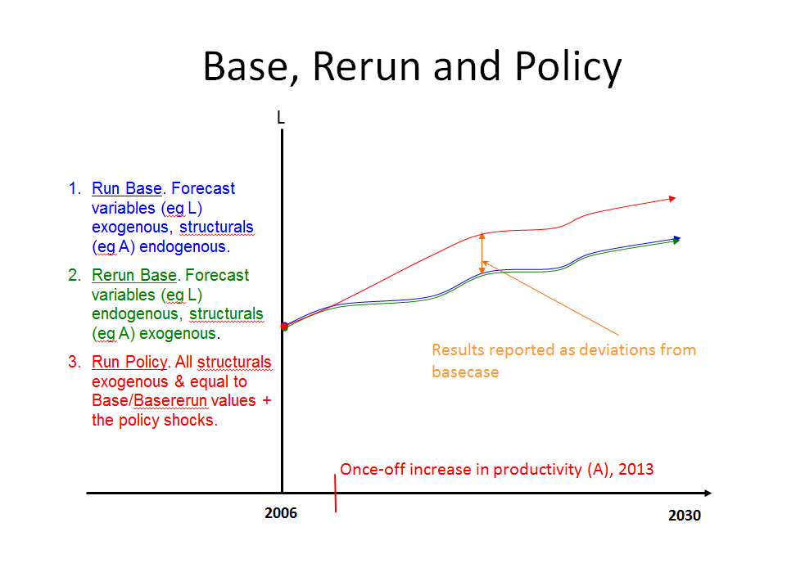
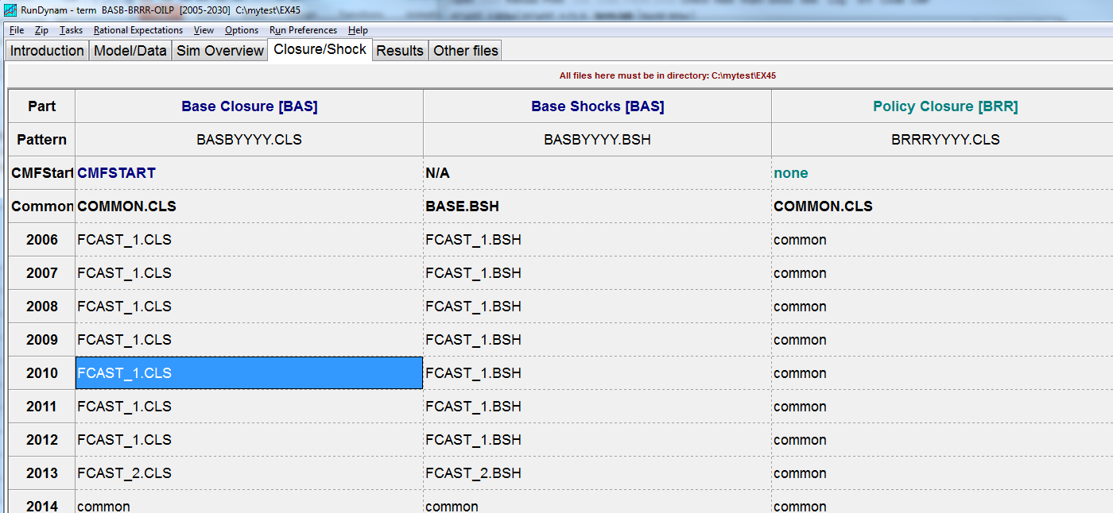
Forecasting and policy analysis By Louise Roose (CoPS)
ForePol.ppt
10

Slide 11
Before the lecture….
11
Run the base for Exercise 3 before the lecture starts!
The instructors will help you to restore the simulation ingredients
Why? Dynamic simulations can take some time to run. While the lecture is presented, you will run the base to save some time
How? Ask the instructor!

Slide 12
Dynamic modelling with IndoTERM
Base simulation
Models the growth of the economy in the absence of a policy under consideration
Typically introduce exogenous data on some naturally endogenous variables
Need a forecast closure to accommodate exogenous data
Base rerun
Reproduces the baseline with the policy closure where naturally endogenous variables are endogenous and naturally exogenous variables are returned to the exogenous list
Policy simulation
Generates a forecast that incorporates all the exogenous features of the baseline, and now includes policy-related shocks reflecting the details of the policy under consideration
12

Slide 13
Base, Rerun and Policy
L
1. Run Base. Forecast variables (eg L) exogenous, structurals (eg A) endogenous.
2. Rerun Base. Forecast variables (eg L) endogenous, structurals (eg A) exogenous.
3. Run Policy. All structurals exogenous & equal to Base/Basererun values + the policy shocks.
Results reported as deviations from basecase
Once-off increase in productivity (A), 2013
2006
2030
Notes:
In a typical baseline closure the choice of exogenous variables is largely determined by the availability of independent forecasts data from reliable sources such as IMF, Treasury and other macroeconomic specialists.
Forecast data are usually available for naturally endogenous variables in the model.
To accommodate forecast data, these naturally endogenous variables are swapped with naturally exogenous variables. This allows the newly exogenous variables to be shocked with the data and allows structural variables to be determined endogenously.
13

Slide 14
Why forecast?
Forecasts may be useful in themselves.
For example, if we impose national macro, regional and detailed sectoral structural shocks, we can trace the outcomes for regional output and employment.
Model can tell you something about the structural changes in the economy and the main drivers of the economy
The counterfactual against which the policy is evaluated
Impose as much or as little forecast detail on the model as we like – there is no single correct closure
Historical data may be available for naturally endogenous variables in the model (total private consumption)
For every variable for which we have independent data (eg total private consumption) we endogenise the structural variable most directly responsible for it (eg the APC).
We always have a valid closure.
Notes:
Baseline simulation is not about perfect foresight or about creating a steady state
Expect agriculture share in GDP to decline overtime
14

Slide 15
Baseline simulation design for IndoTERM
2006-2012: historical closure where we introduce observed data for most macroeconomic variables
2013-2030: forecast closure where we introduce our view on selected productivity variables
1. Run Base. Forecast variables (eg L) exogenous, structurals (eg A) endogenous.
2006
2012
2030
Notes:
2006-2012: historical closure where we introduce observed data for most macroeconomic variables
2013-2030: forecast closure where we introduce independent forecast data from reliable sources such as Treasury and other macroeconomic specialists.
Gain from specialisation
15

Slide 16
Baseline simulation design
We impose the following shocks for the period 2006 – 2030
Land related shocks
Land productivity improves for
Agricultural industries by 3% per annum
OilPalm industry by 3% per annum
Other Natural resource using industries improves by 2% per annum
No improvement in OilGas industry
Land volume increases for the OilPalm industry by 3% per annum
Labour productivity shocks
Non-service industries improves by 6% per annum
Service industries improves by 3% per annum
Number of households increase by 1.5%
Labour force increases by 2.5%
Foreign demand for Indonesian products increases by 6%
Notes:
With the focus on policy analysis, IndoTERM can be used with just one closure in both the base and policy simulations
Agricultural industries = Paddy, Crops, EstateCrops, Animals
Other Natural resource using industries = Forestry, Fishing, Coal, Other Mining
Motivation for the size of the shocks????
For all years we impose our views on:
Land and labour productivity
Labour force and population growth
Foreign demand for Indonesian commodities
For 2006-2012 we create a historical closure and imposed observed data for:
Total household consumption
Total investment
Total government spending
Exports
GDP
Employment
16

Slide 17
Baseline simulation design
Historical closure (2006-2012)
Impose year-on-year observed data for:
Aggregate private consumption
Aggregate investment
Aggregate public consumption
Aggregate exports
National employment
Real GDP
These variable are naturally endogenous in the model
Need swap statements to move them to the exogenous list – allows these variables to be shocked
17

Slide 18
Baseline simulation design
new endogenous new exogenous
swap shrBoTnom2 = NatMacro("RealHou") ; swap invslack = NatMacro("RealInv") ; swap fgovgen = NatMacro("RealGov") ; swap natfpexp = NatMacro("ExpVol") ; swap delfwage_o = NatMacro("AggEmploy") ; swap bprimnat = NatMacro("RealGDP") ;
18
Notes:
In a typical baseline closure the choice of exogenous variables is largely determined by the availability of independent forecasts data from reliable sources such as IMF, Treasury and other macroeconomic specialists.
Forecast data are usually available for naturally endogenous variables in the model.
To accommodate forecast data, these naturally endogenous variables are swapped with naturally exogenous variables. This allows the newly exogenous variables to be shocked with the data and allows structural variables to be determined endogenously.
18

Slide 19
Baseline simulation design
Forecast closure (2014-2030)
Do not have independent forecast data
Impose our view on:
land productivity
land use in oil palm sector
labour productivity
population growth
labour force growth
foreign demand for Indonesian products
These variable are naturally exogenous in the model
No swap statements required – these variables can be shocked directly
19

Slide 20
Baseline simulation: 25 years of 6% real GDP growth
20

Slide 21
Baseline simulation: Sector growth
21

Slide 22
Baseline simulation:
Regional GDP growth
Poorer peripheral, resource-based regions do less well

Slide 23
Base Rerun
For the base rerun, we return to a standard, policy closure:
Exogenous: BOT/GDP ratio, invslac, fgovgen, natfpexp, bprimnat
Endogenous: C, I, G, X, L and GDP.
We do another simulation (In RunDynam “BaseRerun”). Structural variables are given their forecast (“base run”) values
1. Run Base. Forecast variables (eg L) exogenous, structurals (eg A) endogenous.
2. Rerun Base. Forecast variables (eg L) endogenous, structurals (eg A) exogenous.
2006
2012
2030

Slide 24
Base, Base-rerun and Policy
The Base Rerun simulation reproduces all Base Run values.
More importantly, structural features of the economy are again exogenous.
Policy simulation: All Base Rerun shocks, plus policy shocks

Slide 25
Base, Rerun and Policy
L
1. Run Base. Forecast variables (eg L) exogenous, structurals (eg A) endogenous.
2. Rerun Base. Forecast variables (eg L) endogenous, structurals (eg A) exogenous.
3. Run Policy. All structurals exogenous & equal to Base/Basererun values + the policy shocks.
Results reported as deviations from basecase
Once-off increase in productivity (A), 2013
2006
2030
Most policy simulations involve shocks to structural features of the economy
Notes:
In a typical baseline closure the choice of exogenous variables is largely determined by the availability of independent forecasts data from reliable sources such as IMF, Treasury and other macroeconomic specialists.
Forecast data are usually available for naturally endogenous variables in the model.
To accommodate forecast data, these naturally endogenous variables are swapped with naturally exogenous variables. This allows the newly exogenous variables to be shocked with the data and allows structural variables to be determined endogenously.
25

Slide 26
Deviation from basecase
L (% deviation from basecase)
Results reported as deviations from basecase
2006
Once-off increase in productivity (A), 2013

Slide 27
Wages & employment in Policy Sim
We do not believe that employment will be permanently higher as a result of a shock.
Comparative statics: short-run rigid real wages, employment adjusts. Long run fixed NAIRU, wages adjust.
TERM adopts a wage adjustment mechanism where wages sticky in short-run, but fully flexible in the long-run.

Slide 28
Employment returns to NAIRU
L
Policy path for employment
Base rerun employment path
2006

Slide 29
% deviation from basecase
L and W (% deviations from basecase)
W rises so long as L is above NAIRU
L returns to NAIRU (basecase) value
2006
Once-off increase in productivity (A), 2013

