Slide 1



l^{S}
k₁
k₂
k₂*
k^{S}
k₁*
l₁
l₂
l₁*
l₂*
w/r
x₂
RESOURCE CONSTRAINT
x₂
x₂*
GENERAL EQUILIBIRUM
PRODUCTION TECHNOLOGY
CONSUMER’S PREFERENCE
p₁ /p₂
x₁
x₁
x₁*

Slide 2
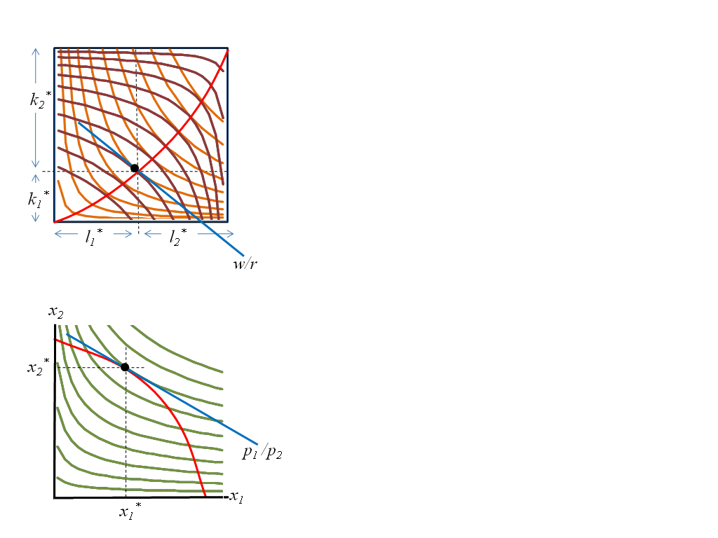
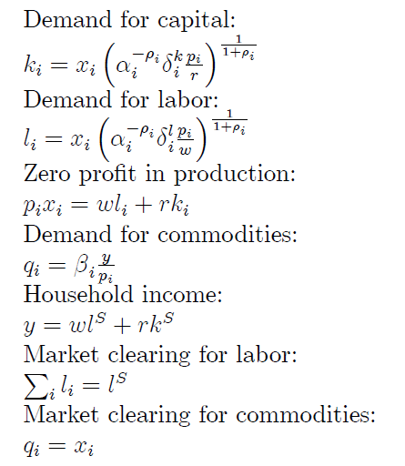
Mathematical representation
12 equations, 12 endogenous variables, 3 exogenous variables

Slide 3
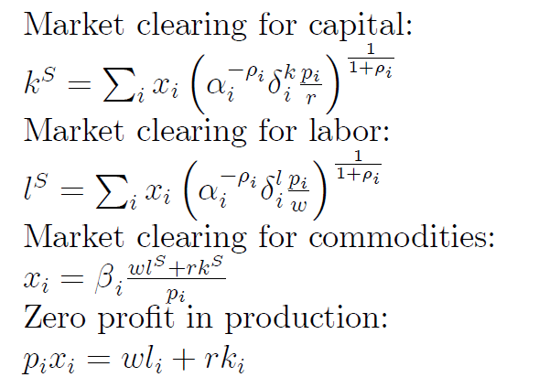
Mathematical representation
All equations can be collapsed into market clearing conditions and zero-profit: “equlibrium in all competitive markets”
Demand equals supply in all market
Market is competitive

Slide 4
Mathematical representation
All equations can be collapsed into market clearing conditions and zero-profit: “equlibrium in all competitive markets”
Walras’ Law: with n-market only n-1 price can be determined!
Let one price as numeraire eg w exogenous

Slide 5
Mathematical representation
Technical change in one of the sector: PPF will change
12 equations, 12 endogenous variables, 3 exogenous variables

Slide 6
Mathematical representation
Preference change toward one of the product: indifference curve change
12 equations, 12 endogenous variables, 3 exogenous variables

Slide 7
Mathematical representation
Increase in labor supply, e.g. migration: Edgworth box expands horizontally
12 equations, 12 endogenous variables, 3 exogenous variables

Slide 8
Mathematical representation
Increase in capital supply, e.g. investment : Edgworth box expands vertically
12 equations, 12 endogenous variables, 3 exogenous variables

