Slide 1

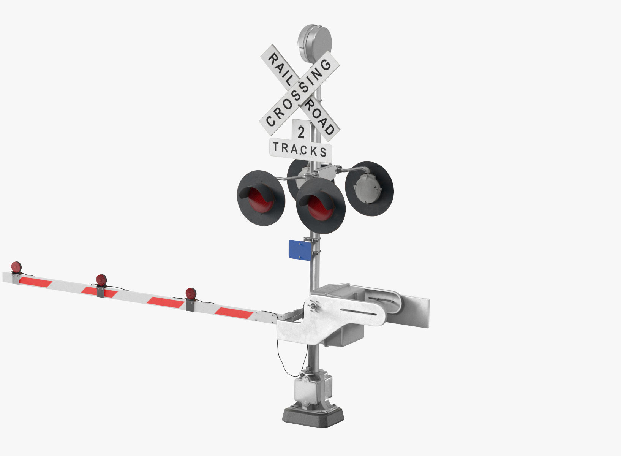
TERM Closure and Shocks guideline
Arief Anshory Yusuf

Slide 2
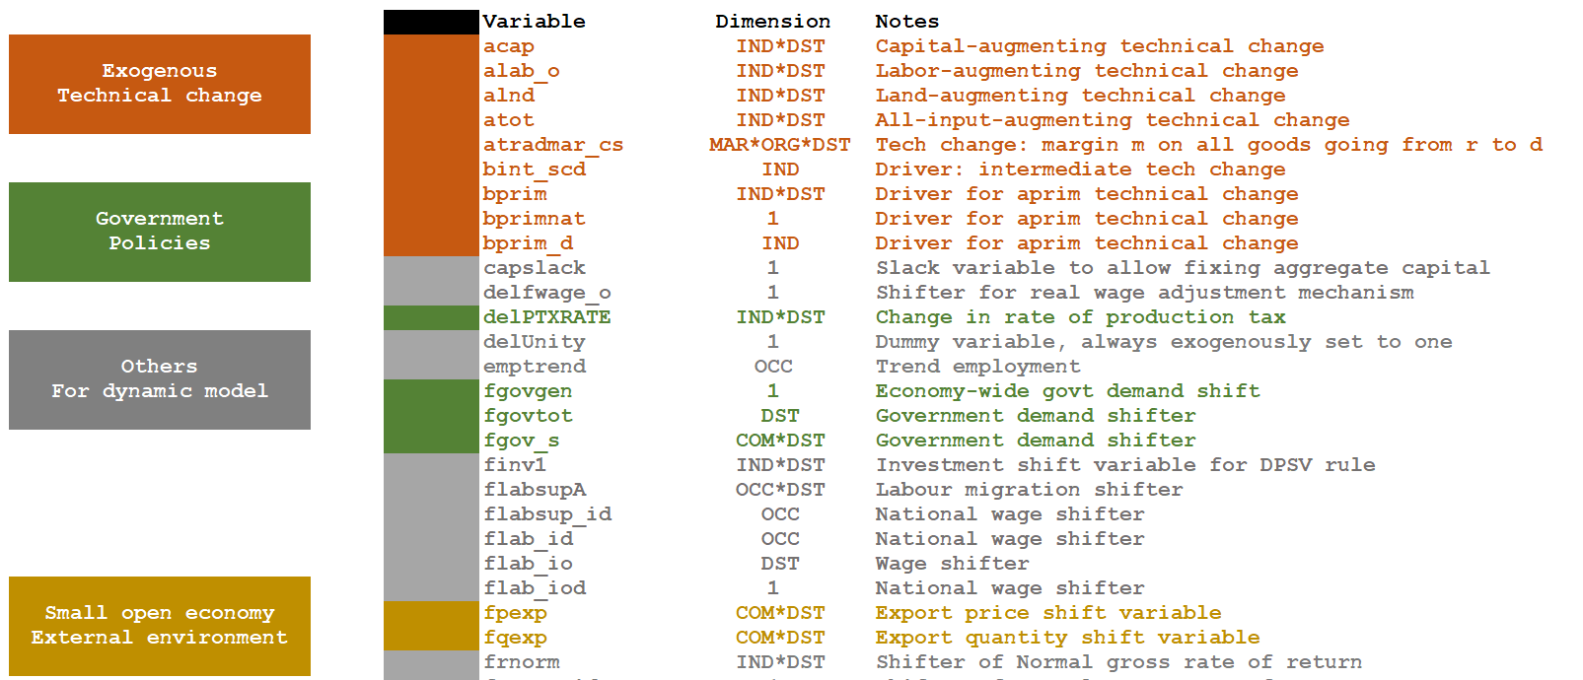
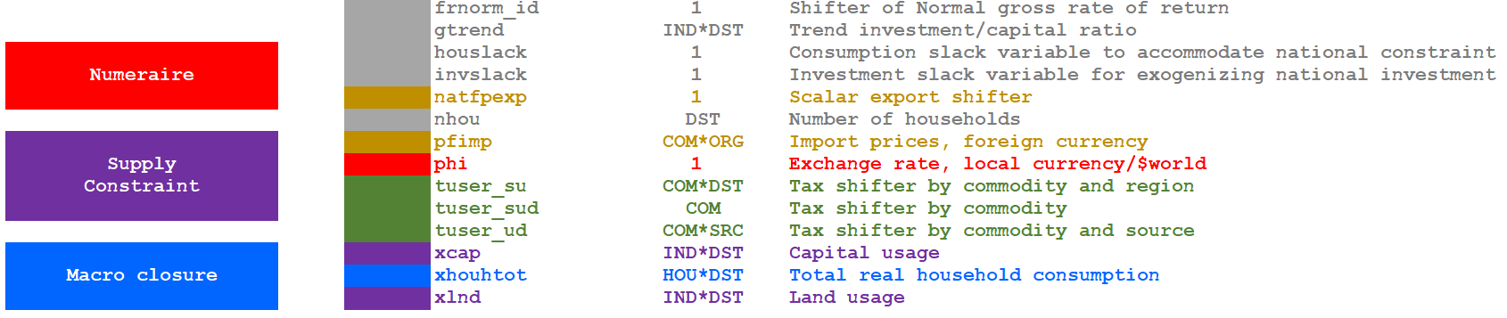
TERM Automatic Closure

Slide 3


Modifying automatic closures: short-run
National Investment is exogenous swap invslack = NatMacro("RealInv");
Regional consumption follow wage income swap xhouhtot = fhou;
Switch off regional wage differentials swap flab_i = flabsupA;
Switch off national labour supply mechanism swap labslack = flabsup_id;

Slide 4
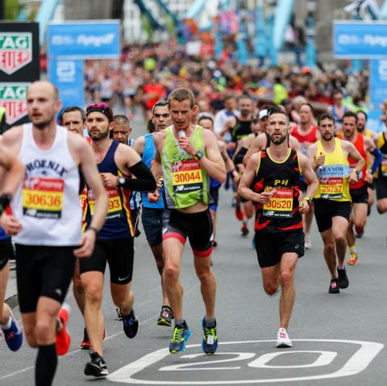
Modifying automatic closures: long-run
Capital stocks determined endogenously swap xcap = fgret;
Sectoral Investment follows xcap swap finv1 = ggro;
Make regional consumption follow wage income swap xhouhtot = fhou;
Fix nominal BOT/GDP nationally swap houslack = shrBoTnom;
Option: Link real gov demand to real consumption, by region swap fgovtot = fgovtot2;
Fix national employment swap flabsup_id = xlab_id;

Slide 5
Shock guideline

Slide 6
atradmar*
atrad

