Slide 1



SMART INDIA HACKATHON 2026
Problem Statement ID - SIH1822
Problem Statement Title- Indian Document Authenticity & Multi-Layer Verification Platform
Theme- Blockchain & Cybersecurity
PS Category- Software
Team ID-
Team Name - Syntax Squad
Idea Title- PramaanSetu INDIA - Multi-Layer Document Authenticity Platform
Notes:
1

Slide 2
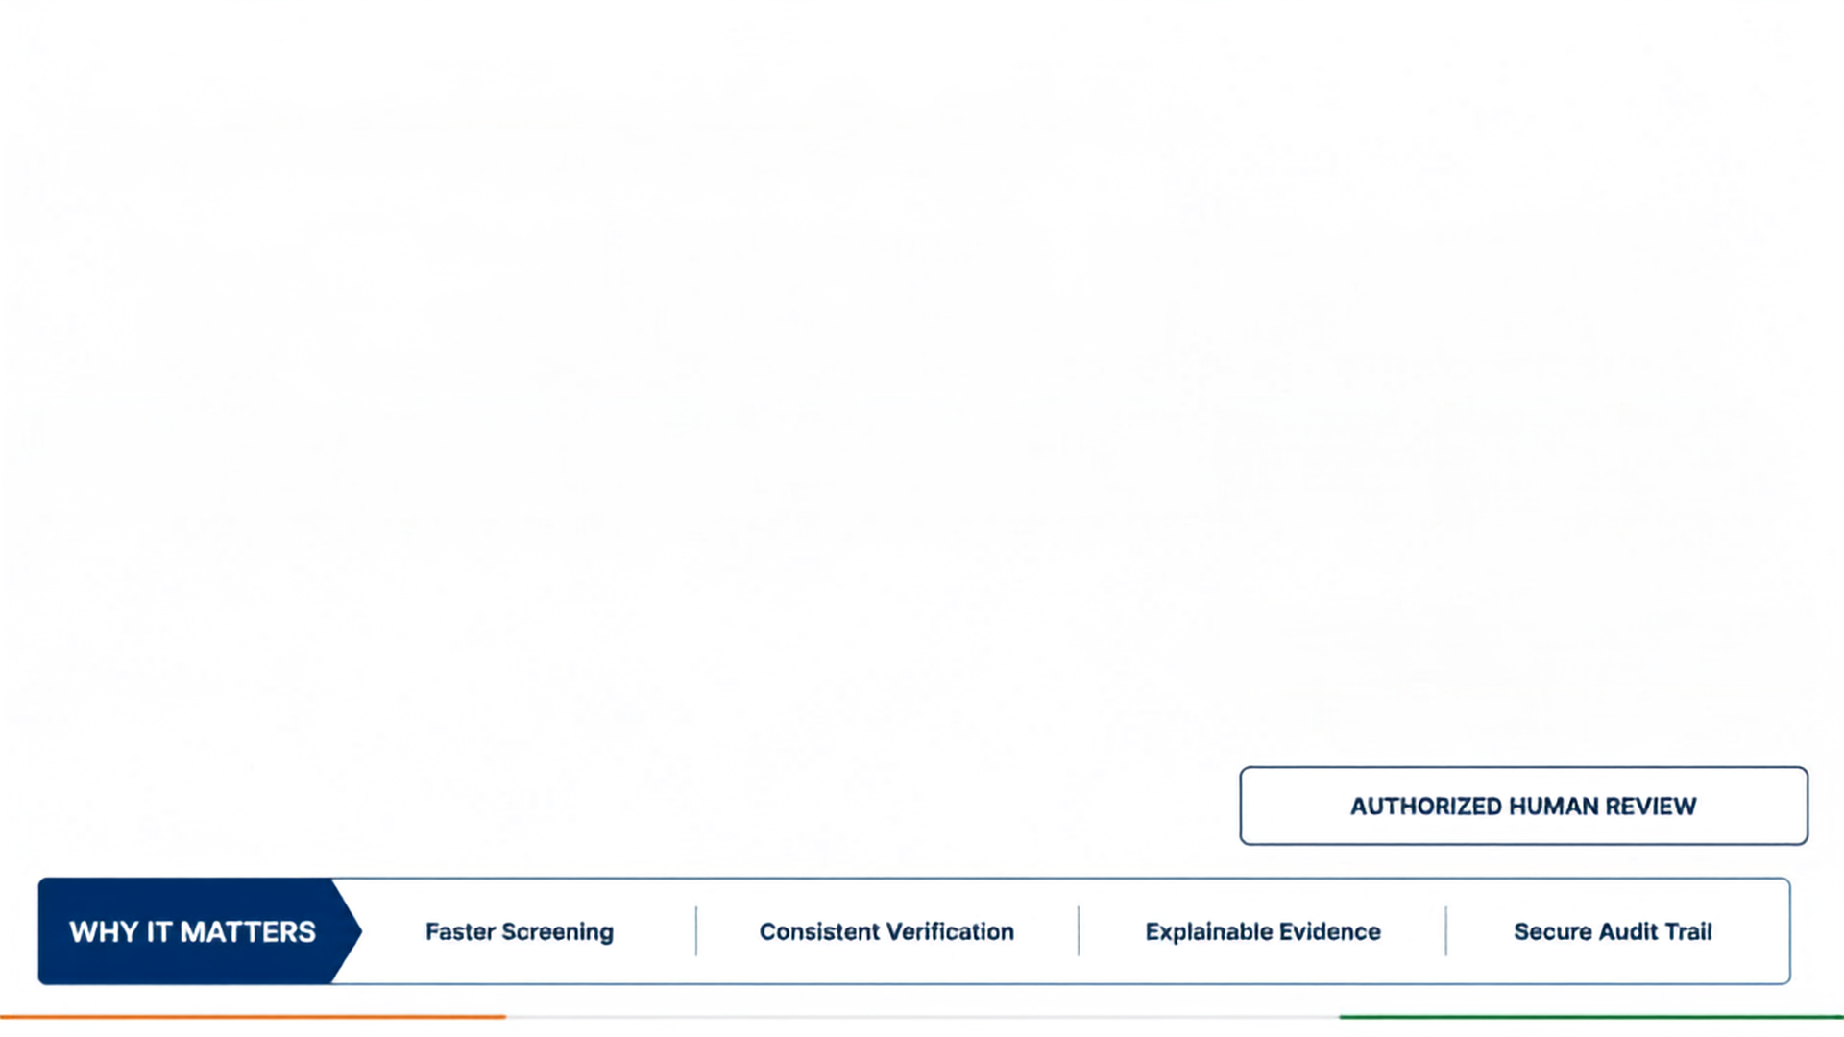
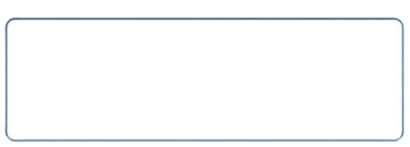
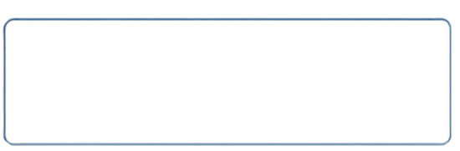
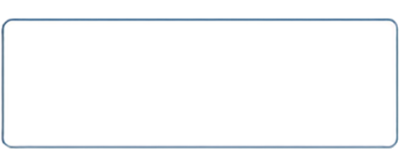






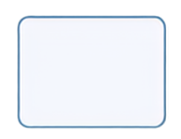
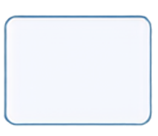
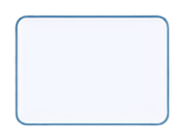















Syntax Squad
AI VERIFICATION PIPELINE
End-to-end multi-layer document authenticity and risk assessment
MULTI-SIGNAL VERIFICATION
TAMPERING-AWARE ANALYSIS
EXPLAINABLE RISK SCORE
OCR + MRZ + Document + Face
Detect suspicious document manipulation
Low / Medium / High with evidence
DOCUMENT VALIDATION
DOCUMENT
CAPTURE
IMAGE QUALITY
OCR + FIELD EXTRACTION
TAMPERING ANALYSIS
MRZ / FIELD CONSISTENCY
FACE VERIFICATION
AI RISK ENGINE
LOW RISK
MEDIUM RISK
HIGH RISK
@SIH Idea submission
2
Notes:
2

Slide 3
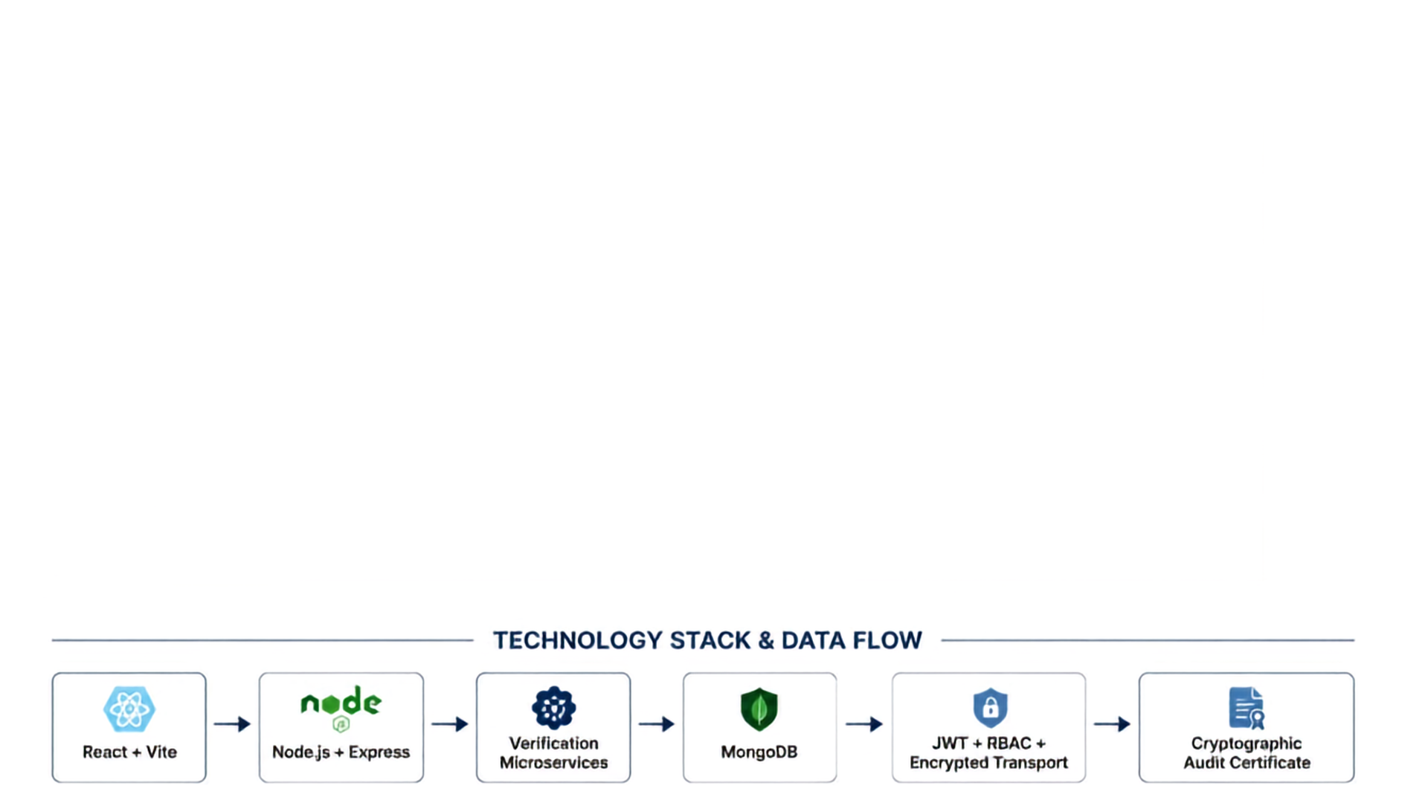















Syntax Squad
TECHNICAL ARCHITECTURE LAYERS
01
DOCUMENT CAPTURE
Camera / Upload
02
PREPROCESSING
Image Quality Check, Laplacian Clarity, Image Normalization
03
EXTRACTION
Tesseract.js OCR, MRZ Parser, Field Extraction, jsQR
04
VERIFICATION
Document Validation, Verhoeff Checklist, MRZ Consistency, Face Verification, ELA Tampering Analysis
05
AI RISK ENGINE
Weighted Multi-Signal Scoring, 0–100 Risk Score
06
06
DECISION + AUDIT
LOW → PASS
MEDIUM → REVIEW
@SIH Idea submission
3
Notes:
3

Slide 4




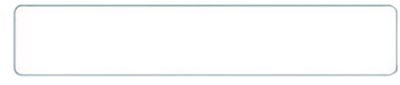
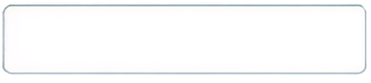



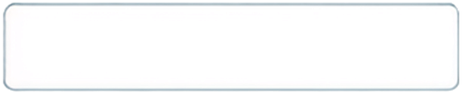

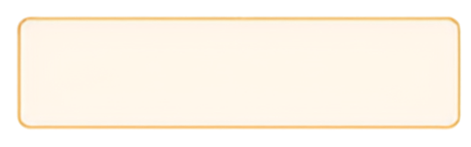

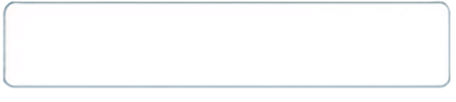





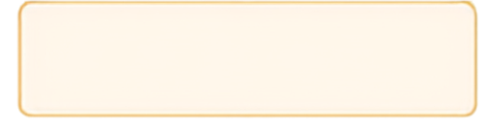

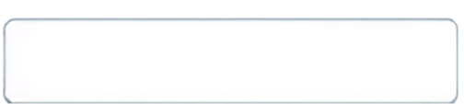


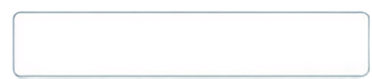

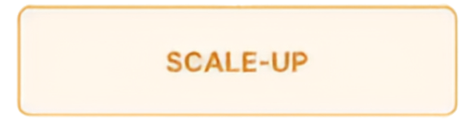

Syntax Squad
FEASIBILITY AND VIABILITY
KEY CHALLENGES
OUR MITIGATION ENGINE
DEPLOYMENT ROADMAP
Low-quality images
Image preprocessing + quality assessment
PROTOTYPE
Different document formats
Document-specific validation
Multi-signal forensic analysis
CONTROLLED PILOT
Sophisticated tampering
False positives / negatives
Threshold calibration + human review
FIELD VALIDATION
Sensitive identity information
Encryption + RBAC
Integration complexity
Controlled deployment + API architecture
SCALE-UP
@SIH Idea submission
4
Notes:
4

Slide 5


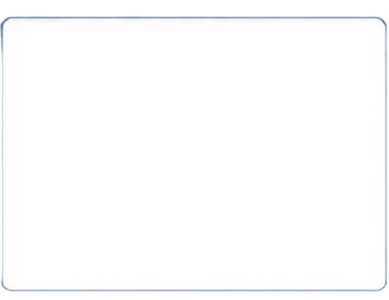

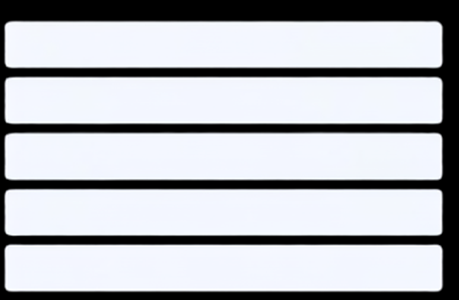

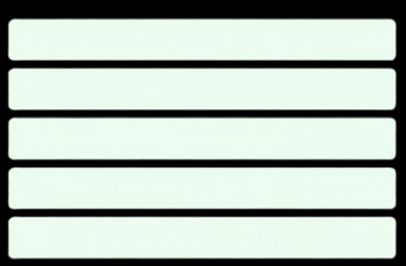


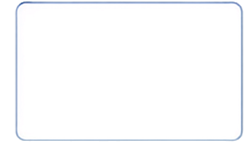
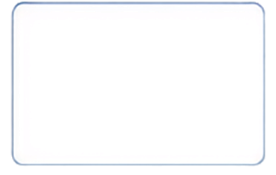

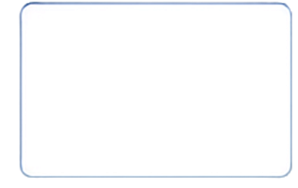
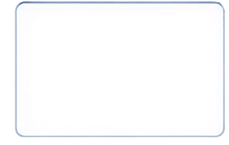





Syntax Squad
IMPACT AND BENEFITS
BEFORE PRAMAANSETU INDIA
AFTER PRAMAANSETU INDIA
Manual checks
Faster first-level screening
PRAMAANSETU INDIA
Slow screening
Structured verification
Reviewer variation
Multi-Layer AI Platform for Document Authenticity and Risk Assessment
Risk-based prioritization
Repetitive verification
Human-in-the-loop review
Limited traceability
Secure audit trail
AI SYSTEM
RISK + EVIDENCE
LOW RISK
AUTHORIZED PERSONNEL
FINAL DECISION
Analyzes document across multiple layers
Generates risk score and explainable evidence
MEDIUM RISK
Approve, escalate, or reject with rationale logged
Reviews insights and evidence
HIGH RISK
DEPLOYMENT ECOSYSTEM
AIRPORTS
LAND BORDERS
SEAPORTS
IMMIGRATION
INVESTIGATION SUPPORT
@SIH Idea submission
5
Notes:
5

Slide 6
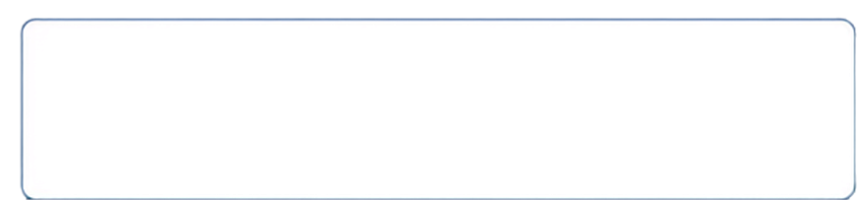
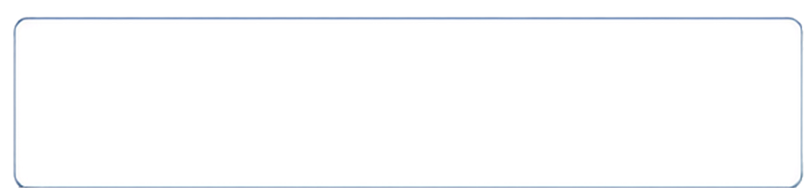


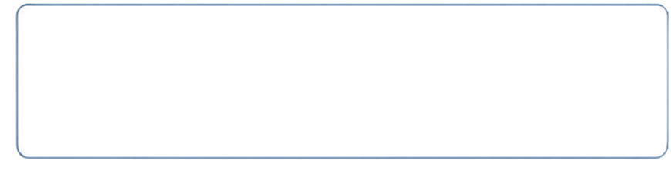
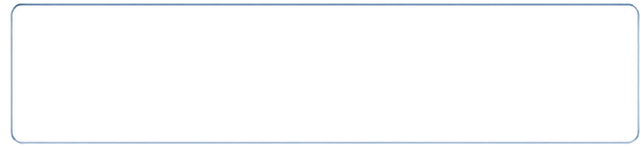


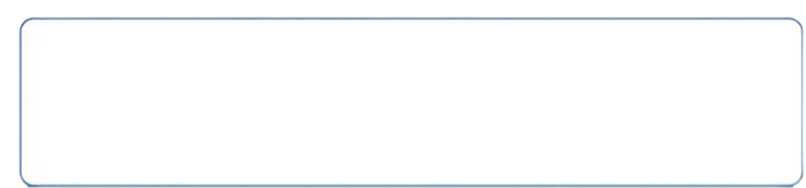
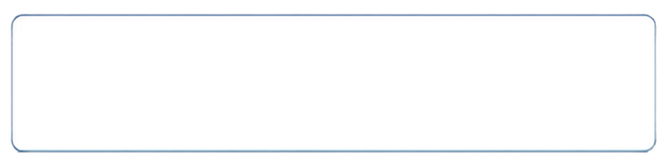


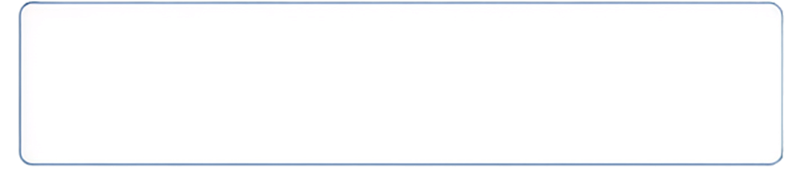

Syntax Squad
RESEARCH AND REFERENCES
1
Smart India Hackathon 2026
5
Research literature on document image tampering and forgery detection
Problem Statement 26188, official portal
2
Ministry of Home Affairs, Government of India
6
Research literature on
face verification and face presentation-attack detection
official identity/document verification resources
3
ICAO Doc 9303
7
OWASP
Machine Readable Travel Documents, International Civil Aviation Organization
Authentication, Authorization, and Security Practices
4
OpenCV Documentation
open-source computer vision library
@SIH Idea submission
6
Notes:
6

