Slide 1
IBM BoB AI INNOVATION HACKATHON 2026
PharmaGuard
AI
Drug Safety Signal Detection
& Regulatory Submission Readiness
SAFETY
+
Team PharmaNex
REGULATORY
Ansh Patel • Saiyam Purabiya
Prince Patel • Devansh Patel
AI-assisted pharmaceutical intelligence for faster, more structured expert review.

Slide 2
PharmaGuard AI
01 — PROBLEM
Pharmacovigilance is a data-scale problem
Safety teams must detect meaningful signals while regulatory teams must validate enormous submission packages.
20M+
100K+
6–12 mo
$50–100M
FAERS adverse-event reports
Pages possible in a CTD dossier
Potential delay from submission gaps
Potential cost exposure from delays
WHO
Pharmacovigilance scientists, drug-safety reviewers, regulatory-affairs teams
WHY IT HURTS
Manual review does not scale: emerging drug–event relationships can be buried in reports, while missing CTD components can surface late in the submission cycle.
Team PharmaNex
2

Slide 3
PharmaGuard AI
02 — PROBLEM
Two workflows. One bottleneck: manual review
The challenge is not just data volume — it is turning complex evidence into prioritized, reviewable decisions.
SAFETY SIGNAL WORKFLOW
REGULATORY READINESS WORKFLOW
01
Adverse-event reports
Millions of observations
01
CTD dossier
Large multi-module package
02
Drug × event pairs
Many combinations to compare
02
Requirement mapping
ICH M4 structure
03
Disproportionality analysis
PRR / ROR calculations
03
Gap detection
Missing / incomplete sections
04
Human investigation
Clinical context still required
04
Readiness review
Prioritize remediation
Opportunity: make the first-pass review faster, structured, and explainable — without removing the expert from the loop.
Team PharmaNex
3

Slide 4
PharmaGuard AI
03 — SOLUTION
PharmaGuard AI: one intelligence layer for two critical reviews
A focused platform that turns adverse-event data and CTD documents into structured signals, gaps, and reviewer-ready insights.
01
Safety Data
03
CTD Documents
PHARMAGUARD AI
Adverse-event records
PDF / DOCX intake
Decision-support layer
02
Signal Engine
04
Gap Detection
PRR + ROR analysis
Evidence → analysis → prioritization → expert review
ICH M4 mapping
Team PharmaNex
4

Slide 5
PharmaGuard AI
04 — HOW IT WORKS
End-to-end workflow
The same interface connects ingestion, analysis, regulatory mapping, and reporting.
01
02
03
04
05
INGEST
→
NORMALIZE
→
ANALYZE
→
PRIORITIZE
→
REVIEW
Adverse events
or CTD files
Structured data
& document intake
PRR / ROR
& CTD checks
Signals, gaps,
readiness findings
AI-assisted
reviewer summary
Human-in-the-loop by design
Outputs are review aids: every potential signal or gap remains subject to qualified expert assessment.
Team PharmaNex
5

Slide 6
PharmaGuard AI
05 — TECHNICAL
Drug safety signal detector
Disproportionality statistics help prioritize drug–event combinations for further investigation.
2 × 2 CONTINGENCY TABLE
ROR + THRESHOLDING
Drug + Event
a
ROR = (a/b) / (c/d)
Drug + Other
b
• Configured thresholding can surface candidates for review.
• Current prototype UI exposes ROR ≥ 2.0, N ≥ 3, p < 0.05.
• A flagged result is a potential safety signal — not proof of causality.
Other Drug + Event
c
Other Drug + Other
d
PRR = [a/(a+b)] / [c/(c+d)]
Team PharmaNex
6

Slide 7
PharmaGuard AI
06 — TECHNICAL
Regulatory submission readiness
The CTD workflow maps uploaded document structure to configured ICH M4 expectations and highlights gaps.
01
02
03
04
05
Document
→
Extraction
→
Requirement Mapping
→
Gap Detection
→
Score
PDF / DOCX
Sections / metadata
ICH M4
Missing / incomplete
Module readiness
Output
Module-level completeness • detected gaps • remediation focus • reviewer-oriented summary
Team PharmaNex
7

Slide 8
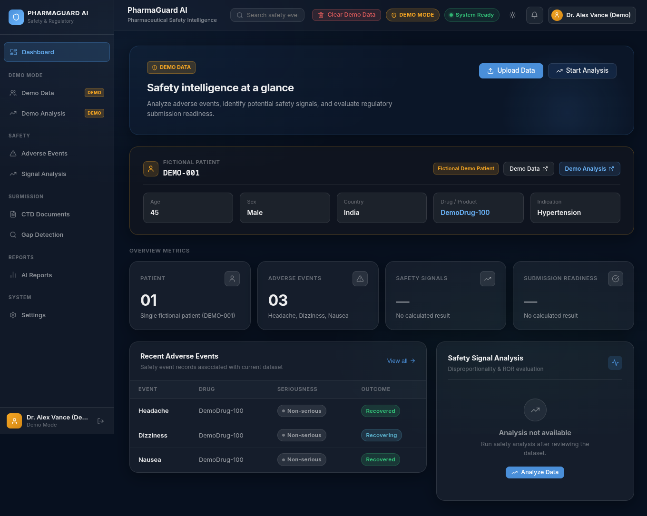
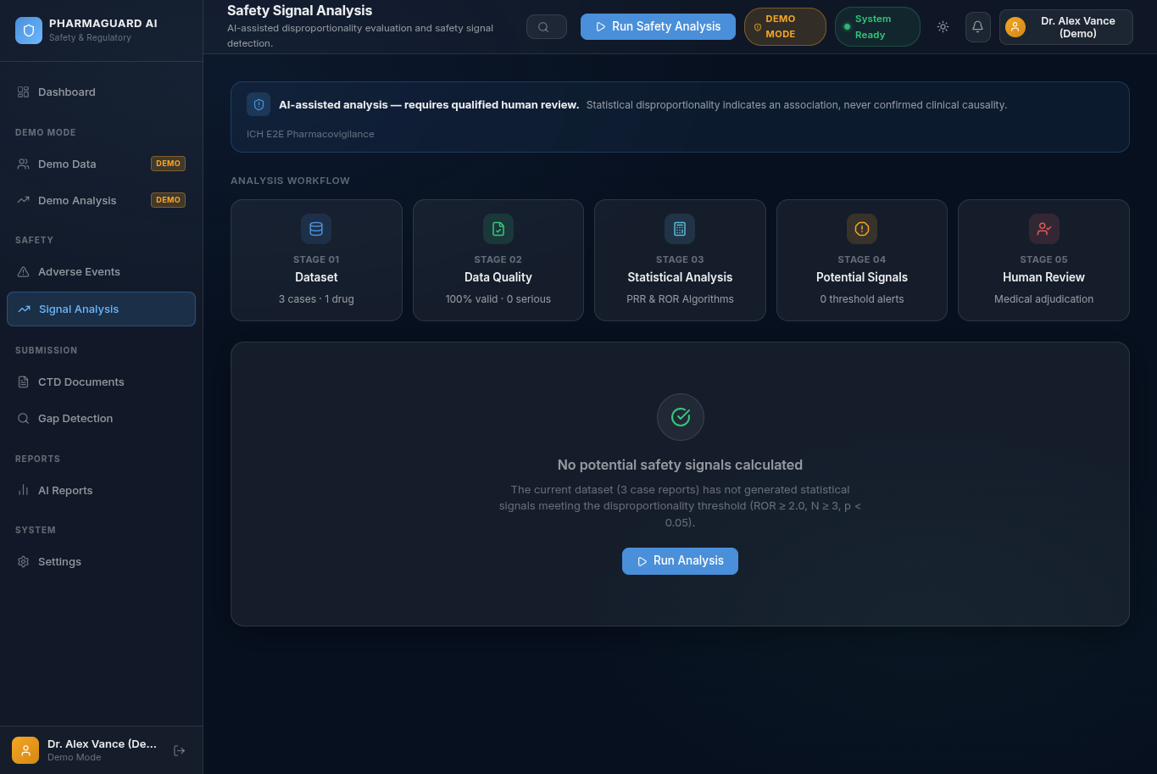
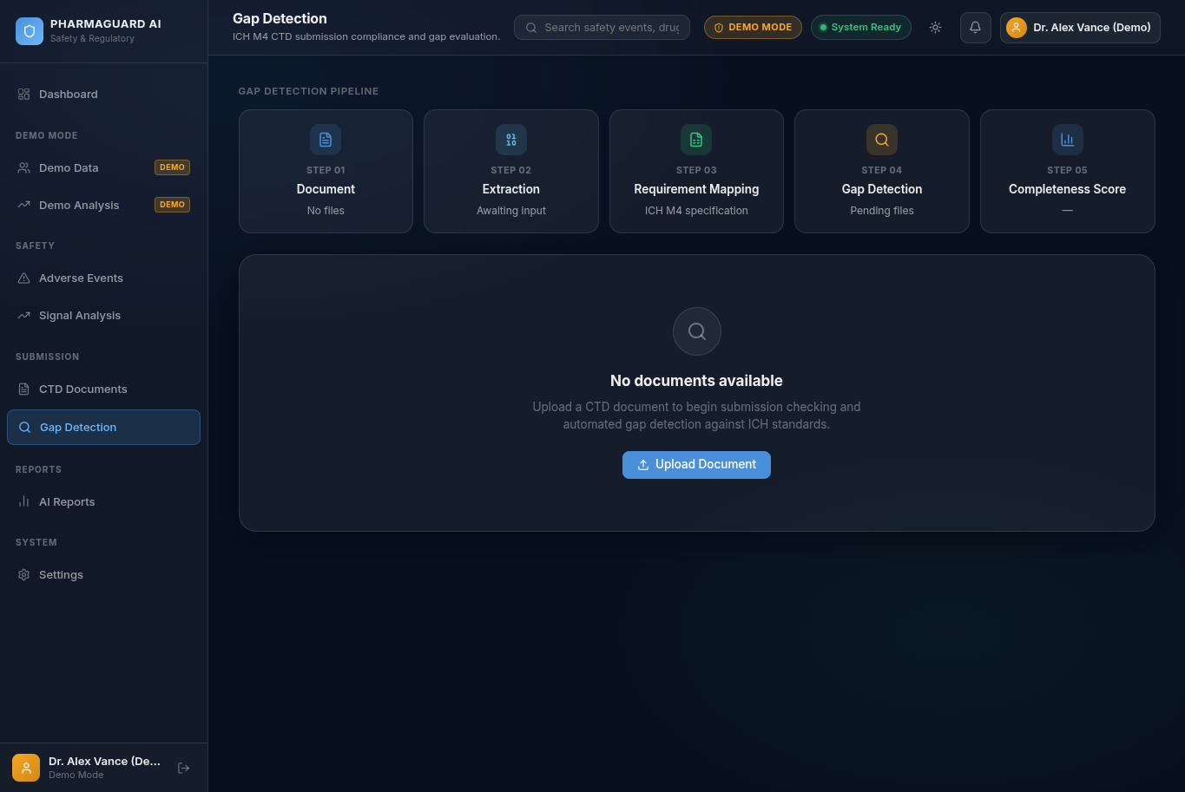
PharmaGuard AI
07 — DEMO
Product walkthrough: from data to insight
Real interface screens from the deployed prototype.
Dashboard
Signal Analysis
Gap Detection
Dashboard
Signal Analysis
Gap Detection
Demo screens show the actual application workflow and UI; demo data is intentionally limited and fictional.
Team PharmaNex
8

Slide 9
PharmaGuard AI
08 — Architecture
Technical architecture
A web application with a React frontend, FastAPI backend, persistence, document handling, and deployment tooling.
USER
→
FRONTEND
→
BACKEND
→
DATA
Reviewer / analyst
React + Vite + TypeScript
FastAPI + routes
Database + storage
Auth & ownership
Protected routes and user access
Signal services
Adverse-event analysis and metrics
Document services
Upload and CTD workflow
Reports
Structured reviewer outputs
Containerization + deployment configuration support reproducible local and hosted environments.
Team PharmaNex
9

Slide 10
PharmaGuard AI
09 — IBM Technology Integration
IBM Bob is a core part of the build workflow
The hackathon requirement is addressed by using IBM Bob IDE as a core development component.
IBM BOB IDE
WHERE BOB FITS
Core development environment
1
Plan
Translate challenge requirements into implementation tasks
• Used to develop and iterate on the application.
2
Build
Generate and refine frontend/backend components
• Supports AI-assisted implementation across the project workflow.
3
Validate
Iterate on workflows, tests, and integration
• Relevant Bob task/session reports can be included in the submission repository.
4
Document
Prepare reproducible setup and submission artifacts
No unsupported watsonx claim is made here; the deck highlights the IBM Bob integration used for this project.
Team PharmaNex
10

Slide 11
PharmaGuard AI
10 — DEMO NARRATIVE
A judge should understand the value in 90 seconds
Suggested live-demo sequence for the final presentation.
01
Open dashboard
Show the unified safety + regulatory workspace.
02
Load adverse events
Show structured records and the analysis entry point.
03
Run signal analysis
Explain PRR/ROR and the potential-signal framing.
04
Upload CTD material
Show the document intake workflow.
05
Run gap detection
Show requirement mapping and readiness findings.
06
Close with impact
Explain how the same workflow scales with richer datasets.
Team PharmaNex
11

Slide 12
PharmaGuard AI
11 — IMPACT
Beyond the hackathon: a scalable safety & regulatory co-pilot
The prototype establishes a foundation for a broader evidence-to-action workflow.
NEAR TERM
MID TERM
LONG TERM
• Larger, permissioned pharmacovigilance datasets
• More robust signal triage and review queues
• Richer CTD requirement libraries
• Evidence traceability and audit-friendly outputs
• Role-based regulatory workflows
• Integration with enterprise document systems
• Continuous safety surveillance
• Submission lifecycle intelligence
• Human-guided AI for regulated decisions
Vision: move from “searching through information” to “knowing what deserves expert attention next.”
Team PharmaNex
12

