Slide 1

Airplane Crash Analysis using Power BI
By- Ayush Kumar

Slide 2
Table of Contents
01
02
03
04
Project Overview
Data Transformation
Data Cleaning & Feature Engineering
Dashboard & Insights
Data Visualization
Conclusion

Slide 3
01
Project Overview

Slide 4

What is this Project?
This project is centered around a thorough examination of aircraft accidents and associated fatalities from 1908 to 2023. The dataset encompasses vital details like the dates and locations of crashes, flight operators, flight specifics, types of aircraft, and statistics on fatalities. The objective is to utilize Power BI to create interactive visualizations and gain profound insights into the patterns, underlying factors, and trends in aviation accidents. The analysis is intended to equip stakeholders with significant information that can aid in improving aviation safety and reducing risks.

Slide 5



Understanding the Steps
Loading Dataset
Transforming Dataset
Dashboard
The dataset has to be uploaded into the Power BI desktop application.
Transform the data in the Power Query. Involves Data Cleaning, Feature Engineering etc.
Creating a fully interactive dashboard for effective insight generation and Data Visualization.

Slide 6
Dataset Description
02
Date: The date when the airplane crash occurred.
Time: The specific time when the airplane crash happened.
Location: The geographical location where the airplane crash took place.
Operator: The operator or airline that was involved in the incident.
Flight #: The flight number that is associated with the incident.
Route: The planned route that the flight was supposed to take.
AC Type: The type of aircraft that was involved in the crash.
Registration: The registration details of the aircraft.
cn/ln: The construction or serial number of the aircraft.
Aboard: The total number of individuals that were aboard the aircraft.
Aboard Passengers: The number of passengers that were aboard the aircraft.
Aboard Crew: The number of crew members that were aboard the aircraft.
Fatalities: The total number of fatalities in the incident.
Fatalities Passengers: The number of passenger fatalities.
Fatalities Crew: The number of crew member fatalities.
Ground: The number of casualties on the ground, if any.
Summary: A brief summary or description of the incident.
Data Transformation
4998 × 17

Slide 7
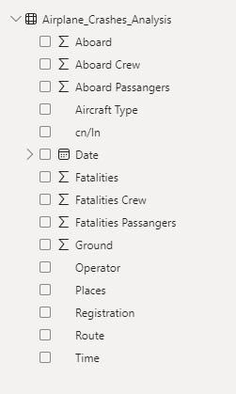
02
Data Transformation

Slide 8
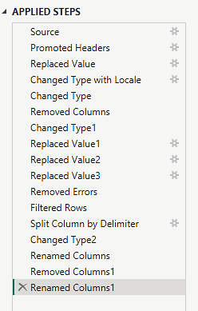
Final Dataset after Transformation
Each step has its own separate command through which Power Query transforms the data.

Slide 9
Steps applied in the Power Query to transform the dataset
03
Each step has its own separate command through which Power Query transforms the data.
Dashboard & Insights

Slide 10
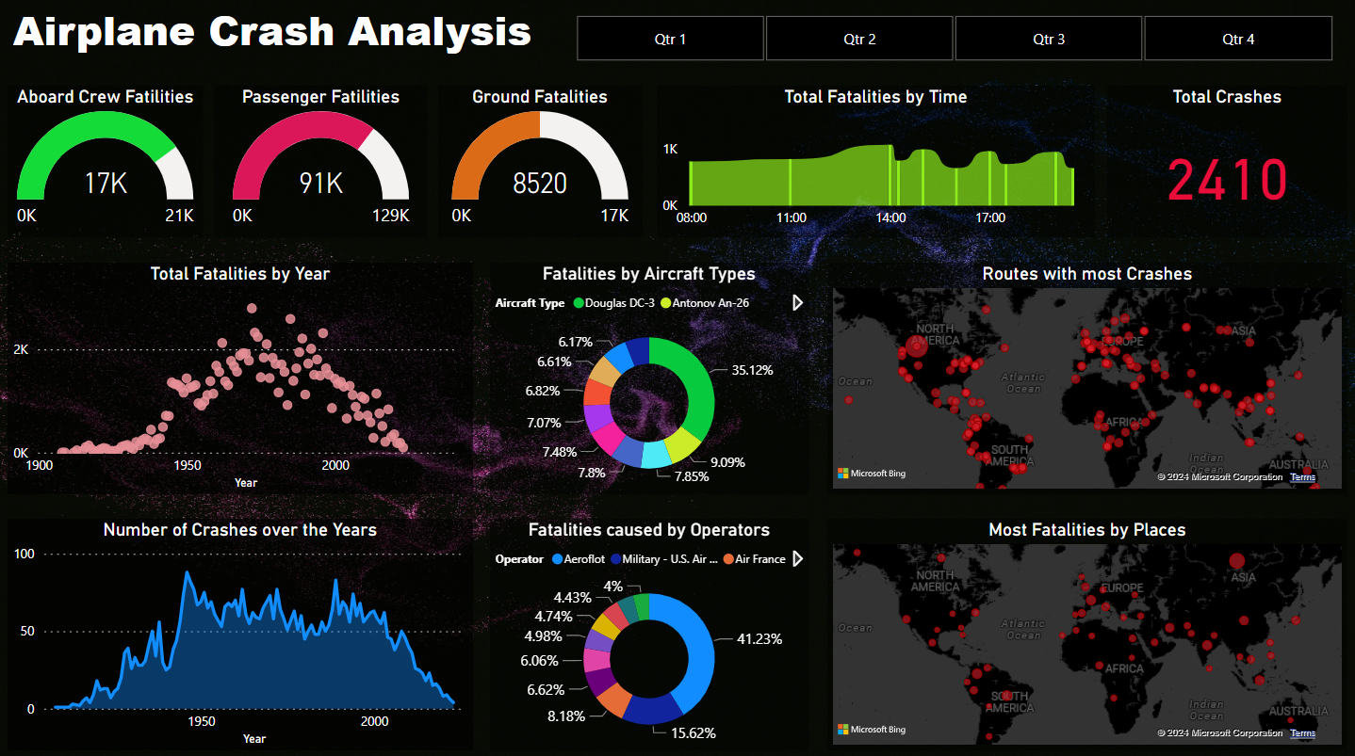
03
Dashboard & Insights

Slide 12
Slicer for filtering the data according to every Quarter for all the years

Slide 13
17000 fatalities out of total aboard crew members, i.e. 21000.
≈ 81%

Slide 14
91000 fatalities out of total aboard passengers, i.e. 129000.
≈ 70%

Slide 15
Shows the Casualties on the ground, if any.

Slide 16
Number of fatalities across various times. Shown by this Ribbon Chart.

Slide 17
Total number of airplane crashes occurred.

Slide 18
Variation in Fatalities over the years. Shown by this Scatter Plot.

Slide 19
Total number of crashes over these years. Shown by this Area Chart.

Slide 20
Percentage of Fatalities caused by different operators.

Slide 21
Percentage of Fatalities caused by different Aircrafts.

Slide 22
Dangerous routes for aircrafts.

Slide 23
04
Project Conclusion
Places with the most fatalities

Slide 24
04
Project Conclusion

Slide 25
Conclusion
Based on the comprehensive analysis conducted through Microsoft Power BI, the following conclusions have been drawn:
Temporal Analysis: There are discernible trends in airplane crashes over the years, with certain periods showing a higher frequency and severity of incidents. This could be attributed to various factors such as advancements in technology, changes in aviation regulations, and global events.
Geospatial Analysis: Certain geographical regions emerged as hotspots for airplane crashes. The distribution of incidents varied across different regions, possibly due to factors like air traffic density, terrain, and weather conditions.
Operator Performance: The safety records of operators and airlines varied significantly. Some operators had higher incident rates, indicating a need for improved safety measures and protocols.
Aircraft Analysis: Specific types of aircraft were more frequently involved in incidents, suggesting potential areas for further investigation.
Fatality Trends: Trends in passenger and crew fatalities were explored. Certain factors were identified that contributed to fatalities, providing valuable insights for enhancing safety measures.
Route Analysis: Certain flight routes exhibited a higher likelihood of incidents. This could be due to factors such as route complexity, weather conditions, and air traffic.
In conclusion, this analysis provides valuable insights into various aspects of aviation safety. It highlights areas for improvement and can guide efforts towards enhancing safety measures and mitigating risks in the aviation industry.

Slide 26
4998
112000
1908-2023
Total Crashes
Total Fatalities
Navigating Air History

Slide 27
Thanks!

