Slide 1
UE18CS348 Human Computer Interaction AirBoard
Team Members :
Ansh Sarkar - PES1201800275
Vishesh P - PES1201800314
Aditeya Baral - PES1201800366

Slide 2
INDEX
What is AirBoard
Problem Statement
Low Fidelity Diagram
High Fidelity Diagram
Heuristic Evaluation
Empathy Map

Slide 3
What is AirBoard?
AirBoard turns your air handwritten words/sentences in the air to text
The application tracks any suitable target (for example, a pen) and uses the target to draw in the air.
The motion of the target is captured by a webcam.
The video from the webcam is processed by the computer to get an AR like image overlay on top of the live footage.

Slide 4
Problem Statement
Why do we need AirBoard?

Slide 5
Arrival of Pandemic
The arrival of the COVID-19 pandemic in late 2019 as well as the strict lockdowns imposed all over the world have had a devastating effect on various industries.
With businesses and ventures moving online, even professions such as education have been pushed into a virtual mode of conduction
Teachers and professors used to the old-school methods of conducting classes have been forced to adjust to a new way of life, with online classes as well as tests.
But adjusting is not easy, given that most practitioners have spent years, if not decades adhering to old methodologies.

Slide 6
Old School Methodologies and Practices
Teachers have been facing difficulties with teaching through an online portal. The lack of proper equipment at homes, leads to greater difficulty in teaching to a wider audience
Most teachers do not use digital writing pads, and hence have to resort to using the good old mouse to draw and explain concepts, leading to more squiggles than readable text
Digital pads with displays are often expensive, and they also take some amount of time to get used to

Slide 7
The Solution?
With AirBoard, teachers will be able to use the air as their canvas, and will also be able to overlay over their screens. This will result in a slightly more natural method of teaching of concepts as well as reduce the costs by a vast margin, hence allowing practitioners some more comfort in teaching their students.

Slide 8
Low Fidelity Diagrams

Slide 9
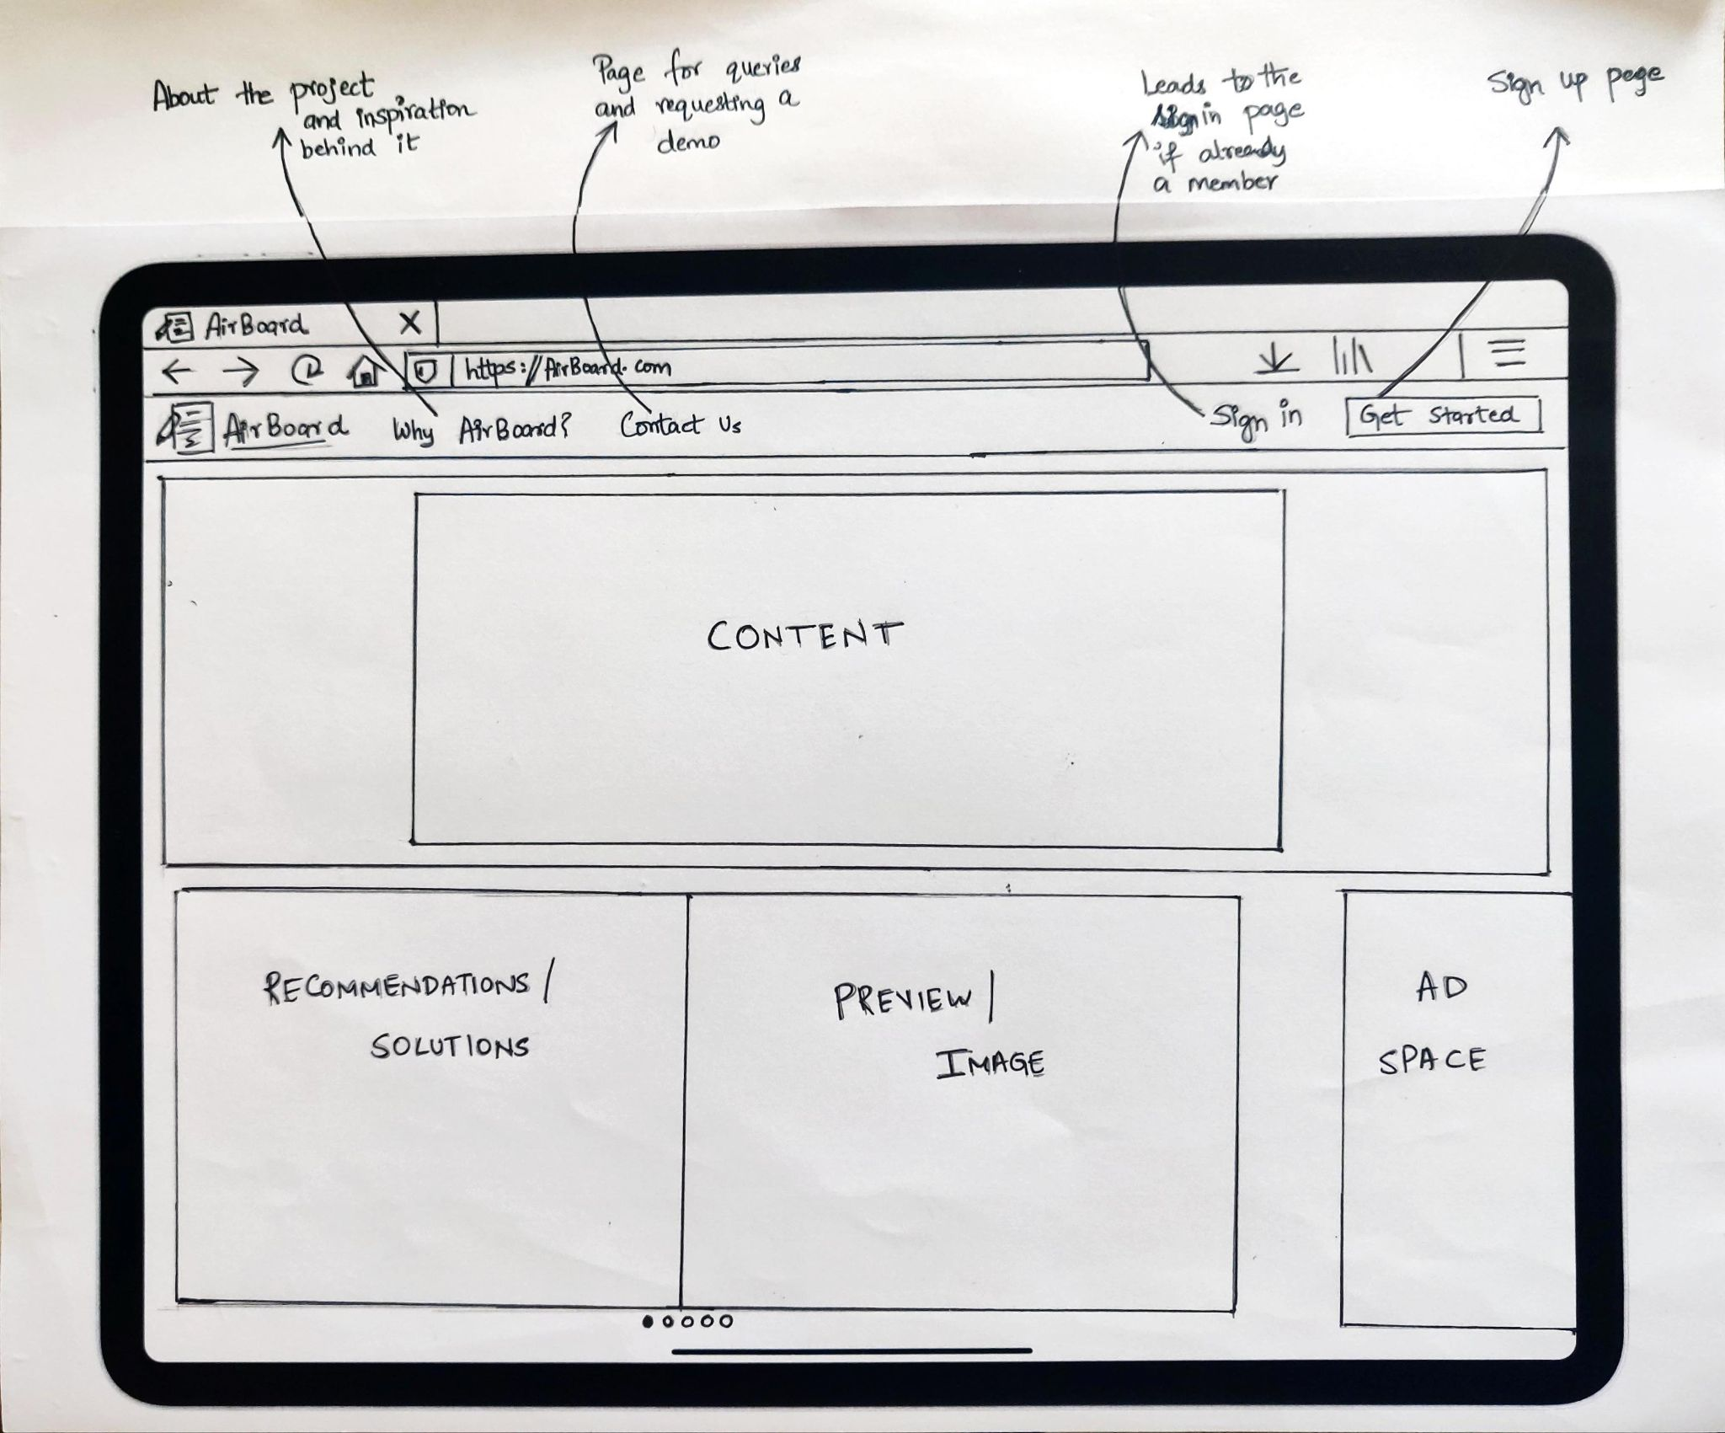
Home Page
The home page of the application is menu-driven as well as intuitive to use allowing for seamless access to features
The top navigation bar will contain all the selectable options
The sign up and user login sections will redirect to a new page, allowing users to enter credentials and start using the application
The Why AirBoard? tab will list the various applications of AirBoard as well as feature prominent reviews from individuals as well as organisations that use AirBoard
The Contact Us tab redirects to a page which will allow the user to contact support

Slide 10
Home Page
The Content section will feature a splash screen with AirBoard as the title and a welcome message for users
The Recommendation and Preview section will contain a slideshow of images displaying how AirBoard has been used in different ways by various institutions and organisations
The Ad Space will be used to feature advertisements from partnering organisations supporting our application

Slide 11
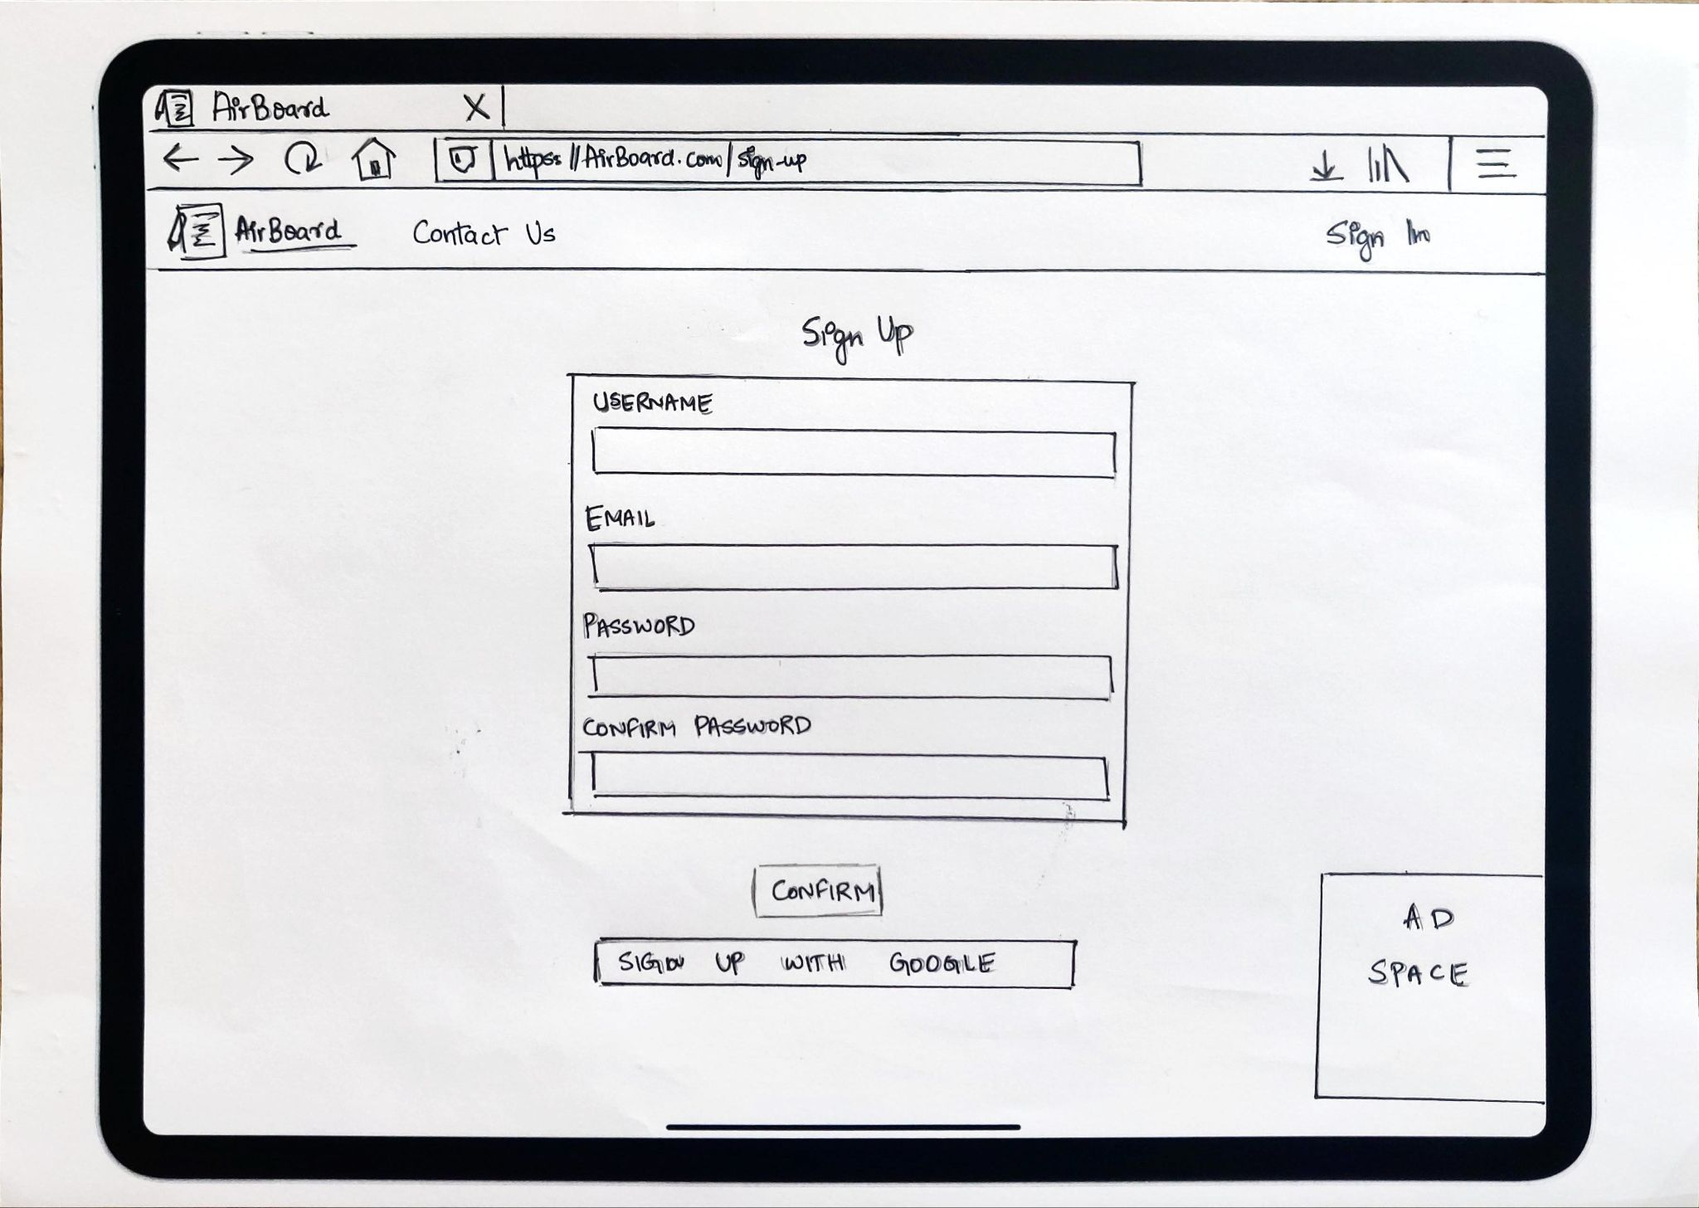
Sign In
The sign in page of our application will allow the user to either sign up using Google or take in user credentials
The sign in page is quick as well as easy to use and helps the user access AirBoard quickly
The Ad Space will be used to feature advertisements from partnering organisations supporting our application

Slide 12
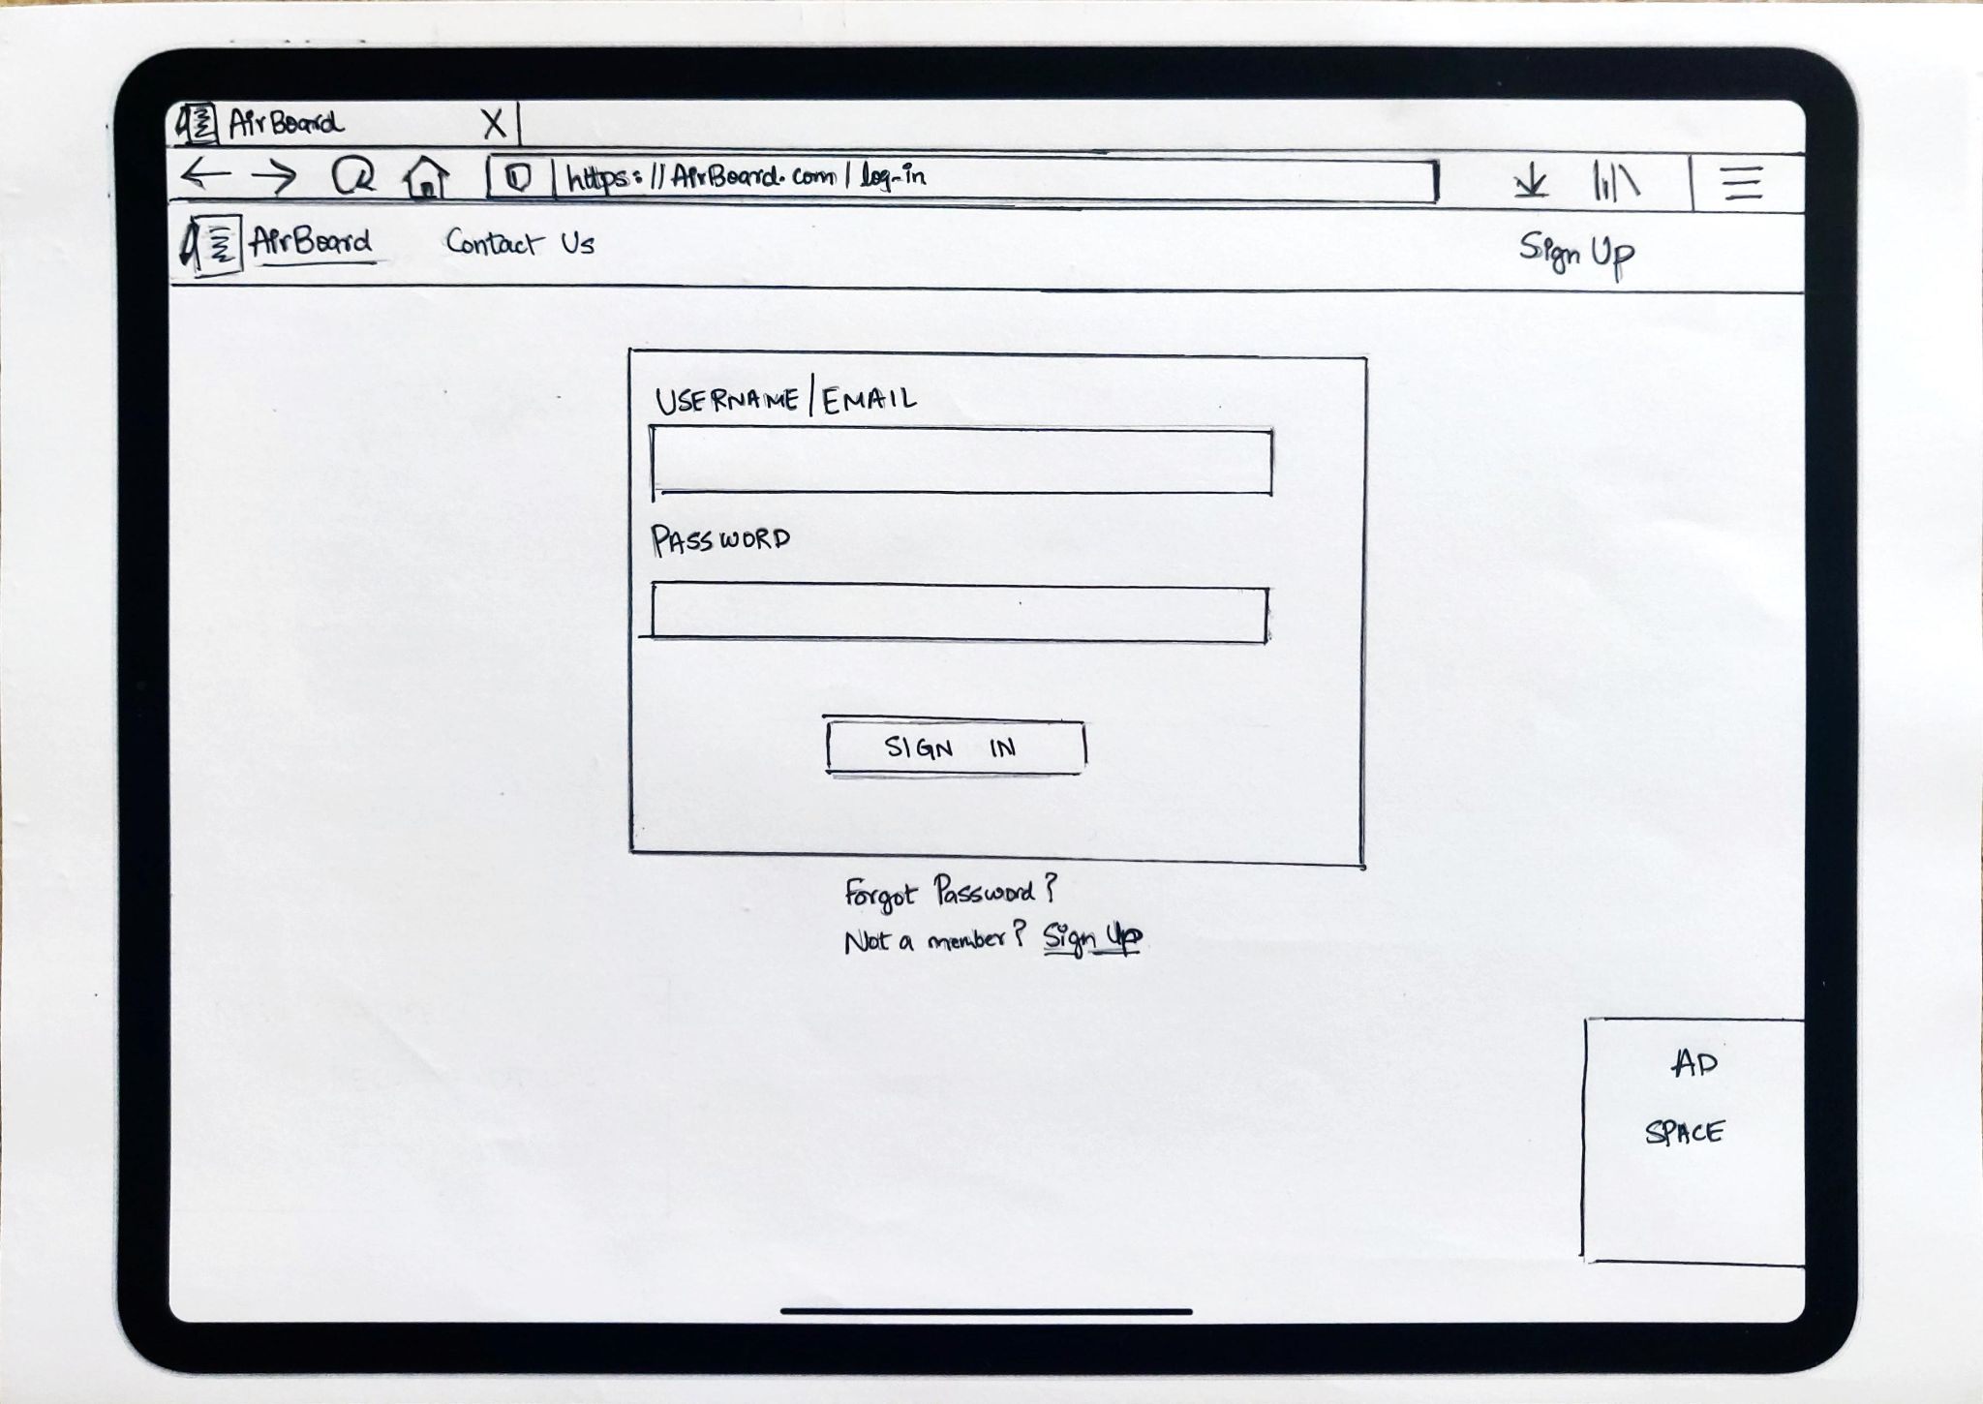
Log In
The login page takes in the user’s credentials and signs them in
It also allows the user to log in with their Google account
It also conveniently features a Forgot Password button, which redirects users to a page allowing them to reset their password and reclaim their account

Slide 13
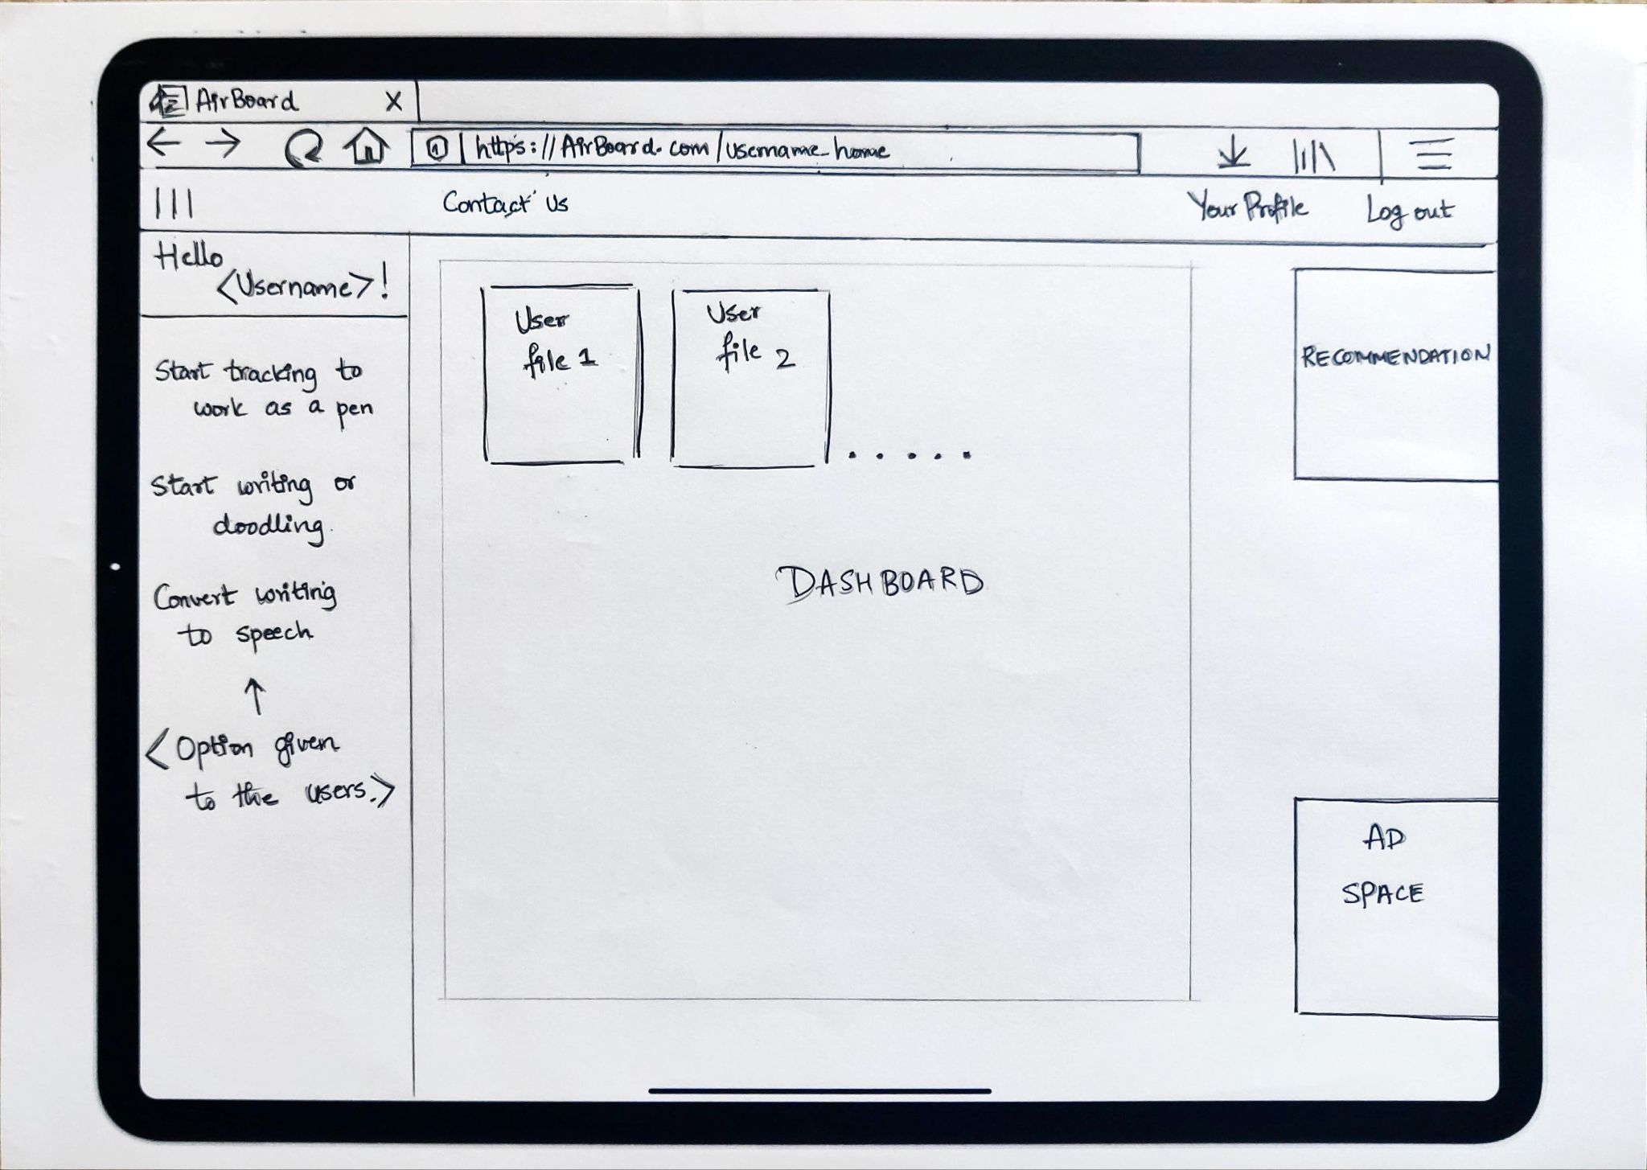
User Dashboard
The user dashboard is the main page of the application
The navigation bar features
Contact Us - redirects to a page which will allow the user to contact support
Your Profile - redirects to a page displaying the user’s details and allows them to modify them
Log Out - allows the user to log out
The left panel allows the user to pick options as per their requirements
The centre panel displays the various whiteboards and files the user has previously created
The Ad Space will be used to feature advertisements from partnering organisations supporting our application

Slide 14
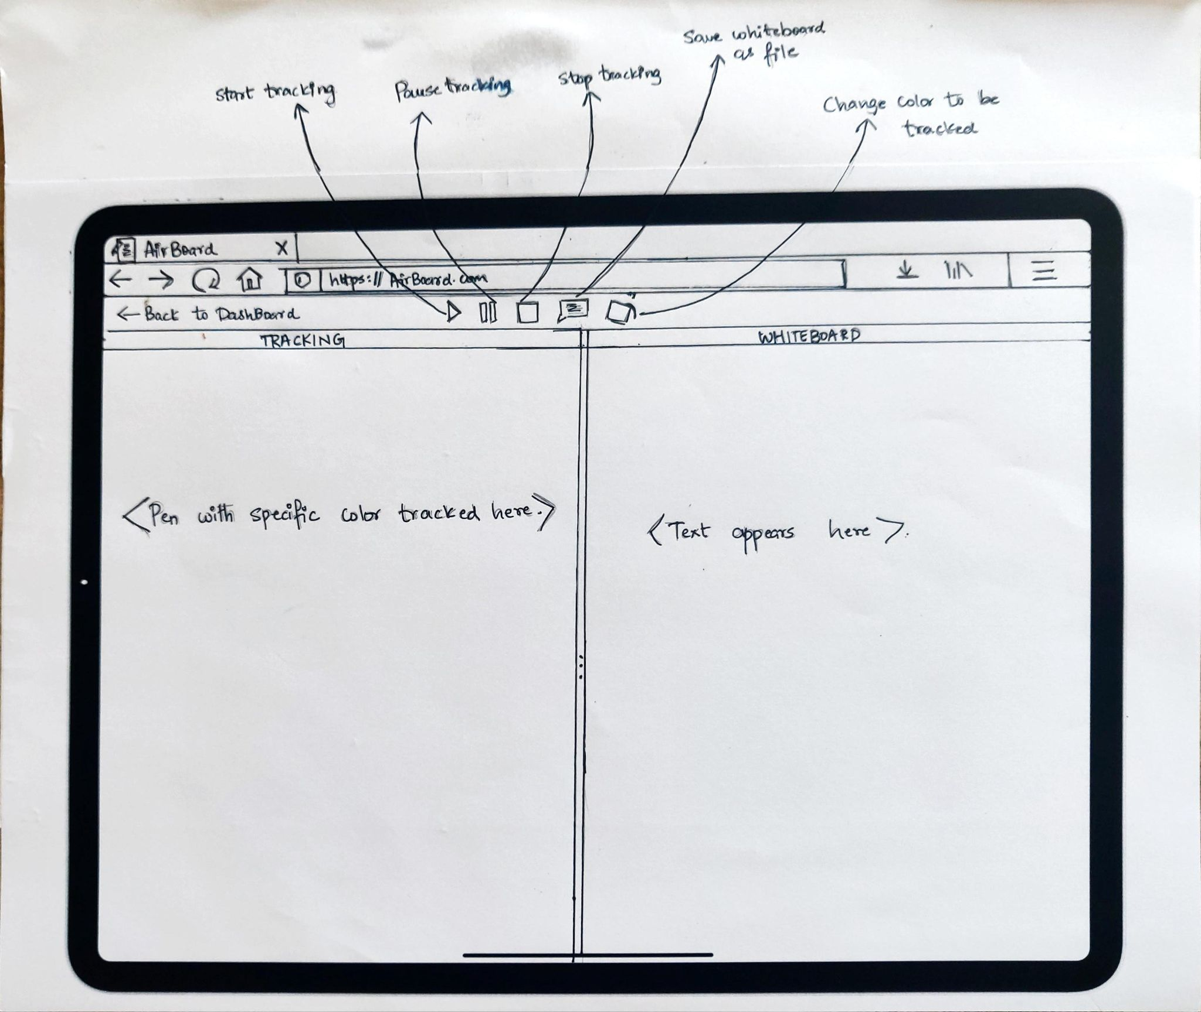
Main Page
The main page is intuitive and easy-to-learn allowing users to master AirBoard quickly
The top navigation bar features
Buttons to start, pause and stop tracking the target object
Save - allows the user to save the whiteboard for later use
Colour - change colour of lines being drawn

Slide 15
Heuristic Evaluation

Slide 16
Strive for Consistency
Consistent sequences of actions should be required in similar situations; identical terminology should be used in prompts, menus, and help screens; and consistent commands should be employed throughout.
The navigation bar will be situated at the top of every webpage of the website which will contain the logo of the application on the left hand side(which when clicked on takes the user to the homepage), The about section to the right of the logo, an additional options dropdown to the right of the about button and if the user hasn’t logged in, then the login/signup buttons will be situated at the right hand side and if he/she has logged in then the user will be redirected to the user’s dashboard.

Slide 17
Enable frequent users to use shortcuts.
As the frequency of use increases, so do the user's desires to reduce the number of interactions and to increase the pace of interaction. Abbreviations, function keys, hidden commands, and macro facilities are very helpful to an expert user.
If at any point the user wishes to go to the home screen, he/she need only click the logo situated on the navigation bar to get there instantly.
Conventional keyboard shortcuts(only applicable on desktops and laptops)(along with UI options) to undo, redo, save etc. can be used to increase the pace of interaction between the user and the application.

Slide 18
Offer informative feedback
For every operator action, there should be some system feedback. For frequent and minor actions, the response can be modest, while for infrequent and major actions, the response should be more substantial.
Always show/highlight where the AirBoard’s pointer is on the board when the user is using their finger. Any finger movement by the user has to be clearly displayed on the file in front of the user.
Show a pop-up indicating to the user to save the file if the user tries to quit the application/open a new file without saving. The user may also choose to quit without saving.
Show a status window while saving the file and display a success message on another window upon successfully saving the file. If the file couldn’t be saved, then display a simple error message explaining why it failed.

Slide 19
Design dialog to yield closure
Sequences of actions should be organized into groups with a beginning, middle, and end. The informative feedback at the completion of a group of actions gives the operators the satisfaction of accomplishment, a sense of relief, the signal to drop contingency plans and options from their minds, and an indication that the way is clear to prepare for the next group of actions.
Whenever the user logs in, there should be a message indicating it was successful.
Show a status window while saving the file and display a success message on another window upon successfully saving the file. If the file couldn’t be saved, then display a simple error message explaining why it failed. Similar messages on small windows can be displayed when trying to load a file.

Slide 20
Offer simple error handling
As much as possible, design the system so the user cannot make a serious error. If an error is made, the system should be able to detect the error and offer simple, comprehensible mechanisms for handling the error.
Simple error handling procedures will make AirBoard very user-friendly. Procedures to handle invalid entries made while a user registers or tries to login can provide the necessary cues to correct their details that have been erroneously entered. Pop Ups on the screen will help guide the user to fixes and provide more details on the matter. To make the application error-prone, features or options not accessible or applicable at a certain stage will not be shown to prevent the user from encountering unwanted errors. The application will not crash unless a fatal error has occurred.
At all given stages, instructions will be provided to users, along with a reason for the error to occur as well as clear-cut steps to mitigate them. This will allow greater control to users when it comes to handling the error and also provide them quick and easy fixes to the error at hand.

Slide 21
Permit easy reversal of actions
This feature relieves anxiety, since the user knows that errors can be undone; it thus encourages exploration of unfamiliar options. The units of reversibility may be a single action, a data entry, or a complete group of actions.
AirBoard will not only feature a host of canvas and marker choices but also an eraser tool, which will allow users to quickly erase any erroneous strokes made. Additionally, users will also be able to adjust the size of this tool to help them erase larger regions faster or smaller regions with great precision. Users will also be able to choose a stroke on screen with their mouse and delete it.
AirBoard will also have the ever-useful undo as well as redo options, allowing users to quickly remove a stroke made and get back to drawing.

Slide 22
Support internal locus of control
Experienced operators strongly desire the sense that they are in charge of the system and that the system responds to their actions. Design the system to make users the initiators of actions rather than the responders.
Common operations such as undo as well as delete will be keyboard mapped to convenient (but also customizable) shortcuts such as Ctrl+Z and Del. Users will also be given the choice to set keyboard shortcuts for quickly shuffling between choices of canvas, or picking a colour. Thus, a user will be able to customize AirBoard such that at most two devices (a target and either a keyboard or a mouse) can be used to operate the application.
AirBoard also keeps track of a user’s drawings made, and a user can easily get back to a drawing and update or delete it if necessary.

Slide 23
Reduce short-term memory load
The limitation of human information processing in short-term memory requires that displays be kept simple, multiple page displays be consolidated, window-motion frequency be reduced, and sufficient training time be allotted for codes, mnemonics, and sequences of actions.
The layout of AirBoard will be simple as well as efficient. All options and access to features will be provided from a single screen. This will greatly reduce latency since there will not be any requirement of switching screens to access other features. Options to choose colours as well as canvas will be overlayed on the screen itself with visually suitable cues, therefore eliminating the need for a user to look for necessary features.
Panels will be made for features and they will be presented in an easy to access as well as in constant view of the user so they can quickly monitor other panels while drawing. The panels containing the features will be intuitive and all information will be relayed in an easily understandable manner.

Slide 24
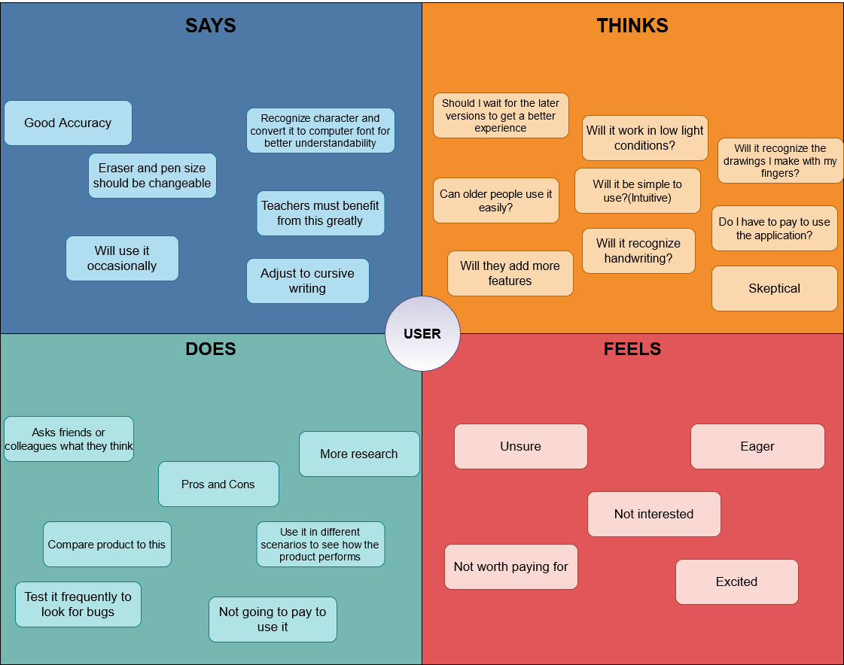
Empathy Map
A questionnaire was created and shared with fellow peers as well as prospective target audiences who might be interested in AirBoard
An Empathy Map was constructed from the responses received displaying a typical user’s perspectives after combining the four aspects obtained by analysing each user’s response.

Slide 25
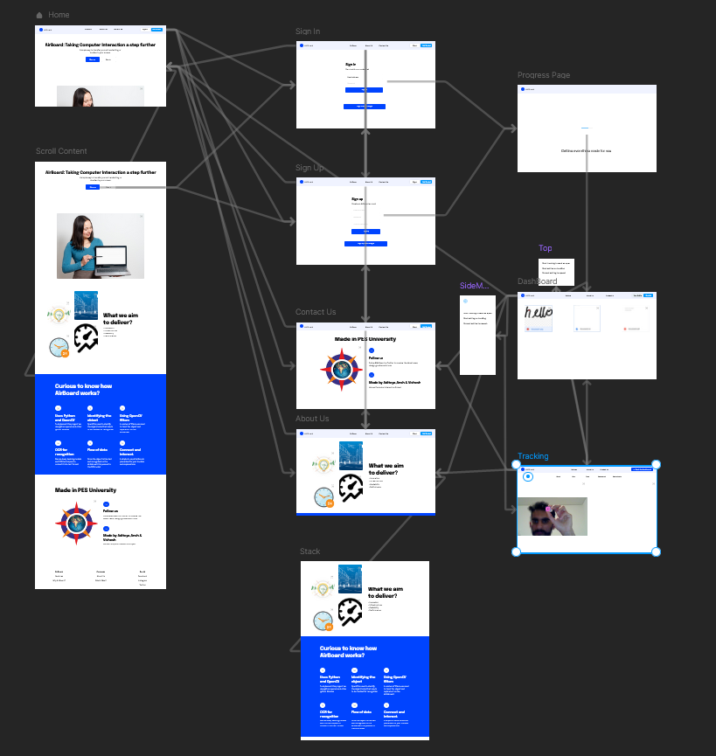
High Fidelity Prototype

Slide 26

Thank You

