Slide 1
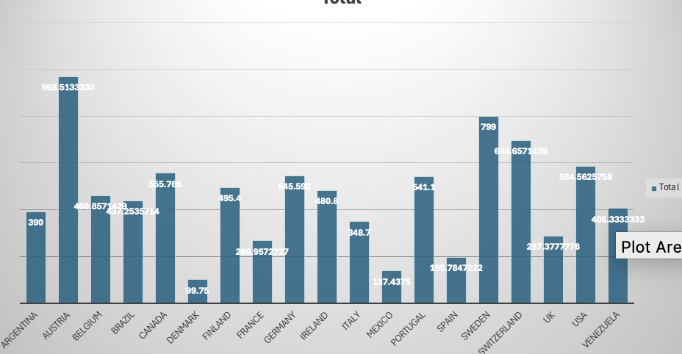
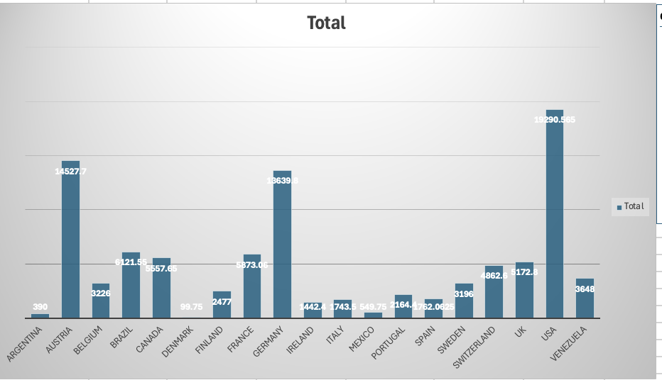
How do customer preferences vary based on their location or demographics? Can we explore this through interactive visualizations?
Customers in Austria has most average sales and USA has max total sales

Slide 2
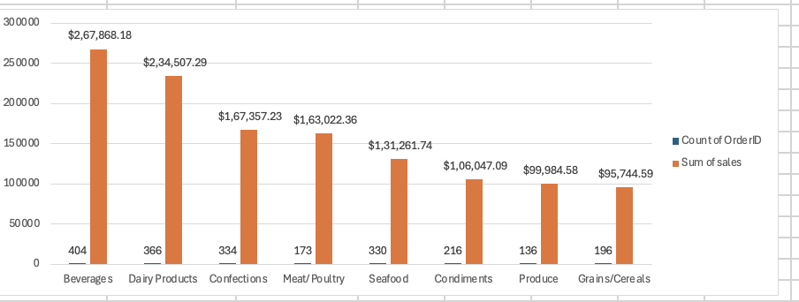
Are there any interesting patterns or clusters in customer behavior that can be visualized to identify potential market segments?
Beverages has potential market for northwind traders

Slide 3
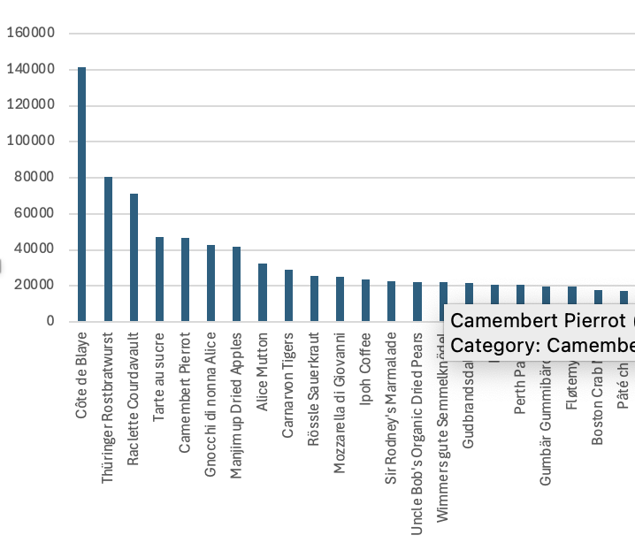
Are there any specific product categories or SKUs that contribute significantly to order revenue? Can we identify them through visualizations?
'Côte de Blaye’ has maximum sales

Slide 4
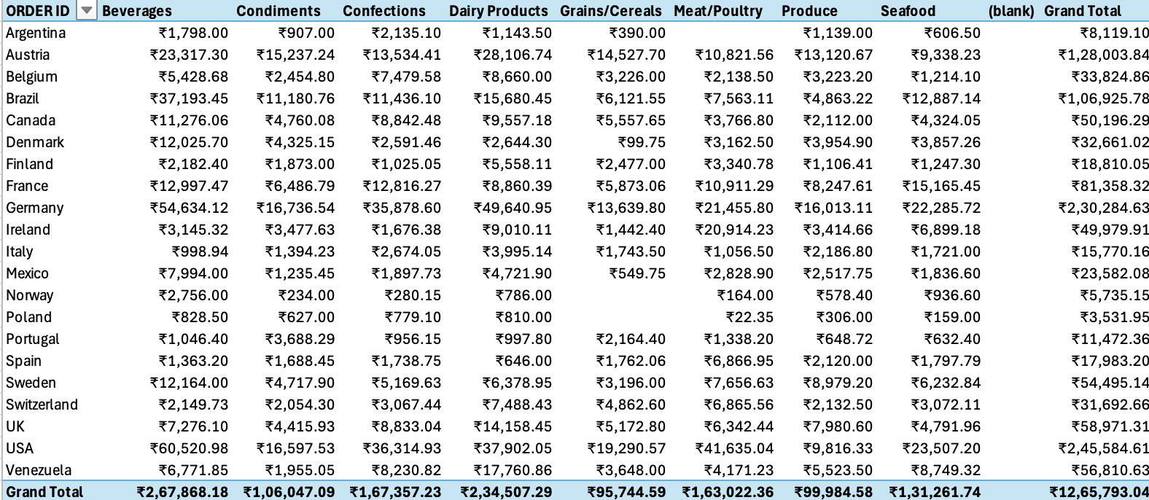
Are there any correlations between order size and customer demographics or product categories? Can we explore this visually using scatter plots or heatmaps?

Slide 5
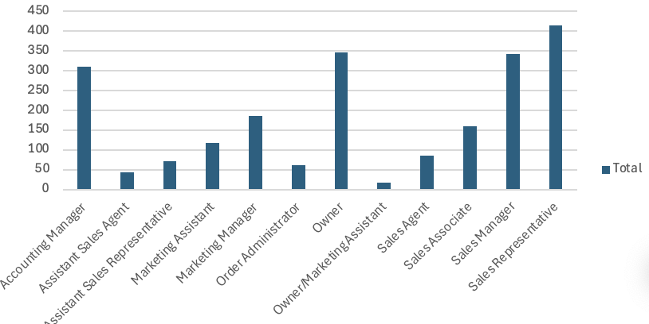
How does order frequency vary across different customer segments? Can we visualize this using bar charts or tree maps?
Sales representative has maximum order frequency

Slide 6
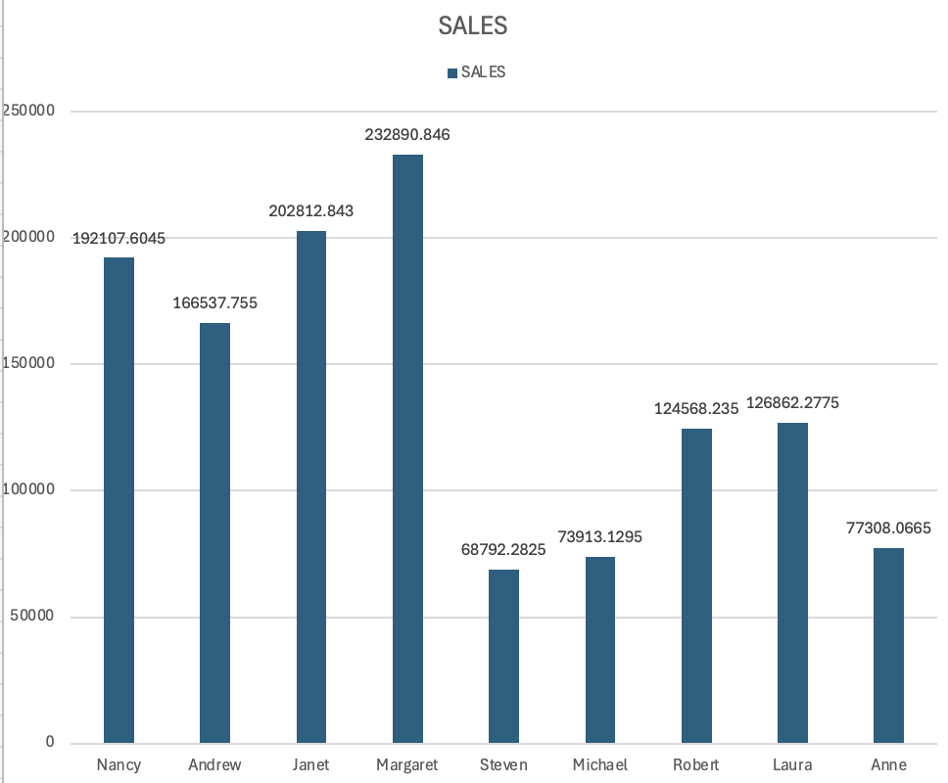
How does employee turnover vary across different departments or job roles? Can we visualize this using bar charts or heatmap
Margaret has done max turnover

Slide 7
How does product demand fluctuate over different seasons or months? Can we visualize this through line charts or area charts?
These are max product sold each month
month | product | count orderID
'1' | 'Gorgonzola Telino' | '313'
'2' | 'Camembert Pierrot' | '216'
'3' | 'Sir Rodney\'s Scones' | '230'
'4' | 'Guaraná Fantástica' | '333'
'5' | 'Raclette Courdavault' | '386'
'6' | 'Gorgonzola Telino' | '155'
'7' | 'Gorgonzola Telino' | '171'
'8' | 'Raclette Courdavault' | '185'
'9' | 'Boston Crab Meat' | '160'
'10' | 'Boston Crab Meat' | '194'
'11' | 'Fløtemysost' | '188'
'12' | 'Camembert Pierrot' | '208'

Slide 8
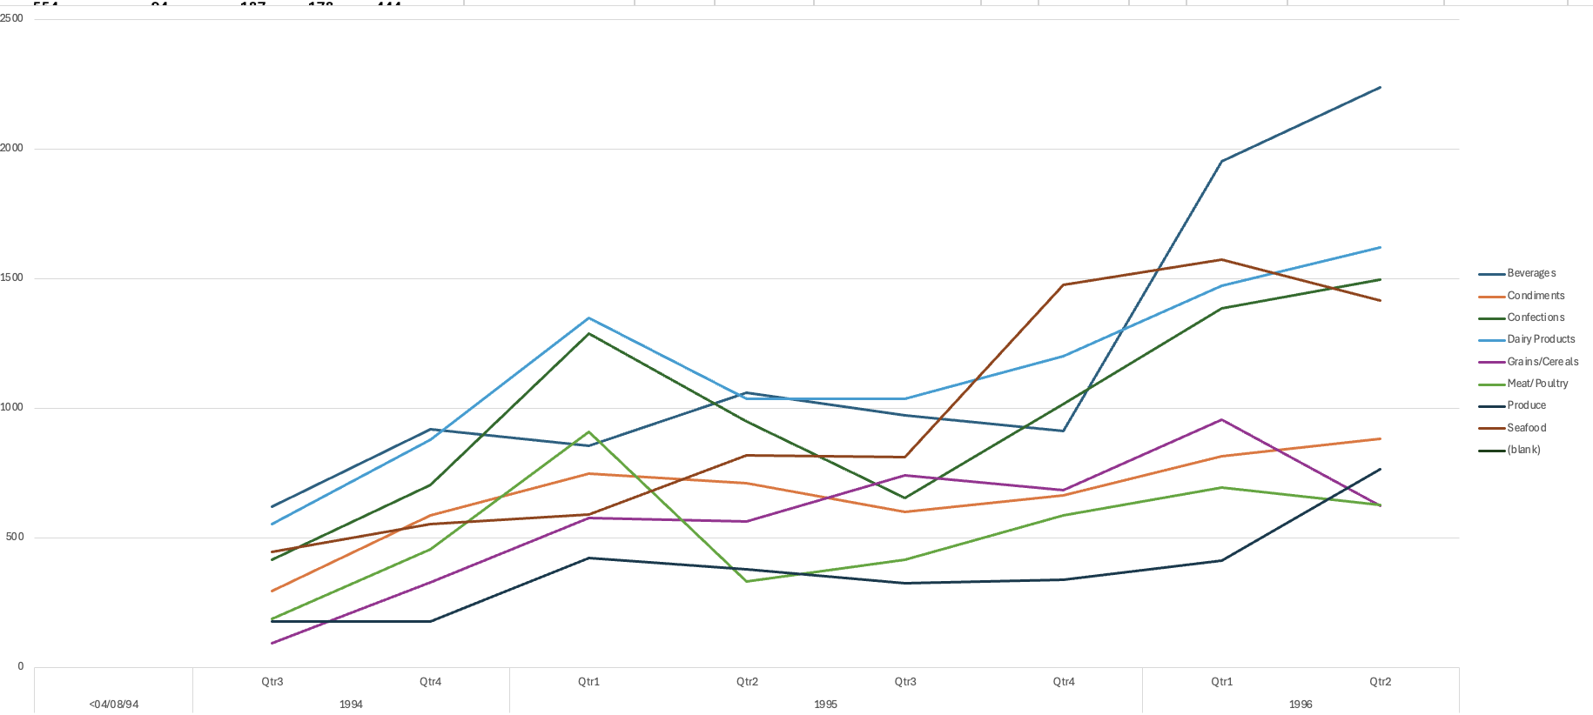
Can we identify any outliers or anomalies in product performance or sales using visualizations? How can this information be used for product optimization?

Slide 9
How does supplier performance vary across different product categories or departments? Can we visualize this using stacked bar charts or grouped column charts?
Biggest supplier of category
supplier | category
'Guylène Nodier' | 'Beverages'
'Shelley Burke' | 'Condiments'
'Chantal Goulet' | 'Confections'
'Eliane Noz' | 'Dairy Products'
'Giovanni Giudici' | 'Grains/Cereals'
'Martin Bein' | 'Meat/Poultry'
'Wendy Mackenzie' | 'Produce'
'Ian Devling' | 'Seafood'
supplier max sale in each category
'Anne Heikkonen' | 'Beverages'
'Antonio del Valle Saavedra ' | 'Dairy Products'
'Beate Vileid' | 'Dairy Products'
'Carlos Diaz' | 'Beverages'
'Chandra Leka' | 'Beverages'
'Chantal Goulet' | 'Confections'
'Charlotte Cooper' | 'Beverages'
'Cheryl Saylor' | 'Beverages'
'Dirk Luchte' | 'Confections'
'Eliane Noz' | 'Dairy Products'
'Elio Rossi' | 'Dairy Products'
'Giovanni Giudici' | 'Grains/Cereals'
'Guylène Nodier' | 'Beverages'
'Ian Devling' | 'Meat/Poultry'
'Jean-Guy Lauzon' | 'Meat/Poultry'
'Lars Peterson' | 'Grains/Cereals'
'Marie Delamare' | 'Seafood'
'Martin Bein' | 'Meat/Poultry'
'Mayumi Ohno' | 'Produce'
'Michael Björn' | 'Seafood'
'Niels Petersen' | 'Seafood'
'Peter Wilson' | 'Confections'
'Petra Winkler' | 'Confections'
'Regina Murphy' | 'Produce'
'Robb Merchant' | 'Seafood'
'Shelley Burke' | 'Condiments'
'Sven Petersen' | 'Seafood'
'Wendy Mackenzie' | 'Produce'
'Yoshi Nagase' | 'Seafood'

Slide 10
Can we identify any trends or patterns in supplier costs or pricing structures through visualizations? How can this information be used for procurement optimization?
Each product has only one supplier so we cant comment on pricing structure and supplier cost

Slide 11
Are there any correlations between supplier attributes (e.g., location, size, industry) and performance metrics (e.g., on-time delivery, product quality)? Can we explore this visually through scatter plots or heatmaps?
We don’t have any data related to product quality and ontime delivery

Slide 12
Are there any correlations between product attributes (e.g., size, color, features) and sales performance? Can we explore this visually using scatter plots or heatmaps?
We don’t have data regarding size color feature

Slide 13

PowerBI questions

Slide 14
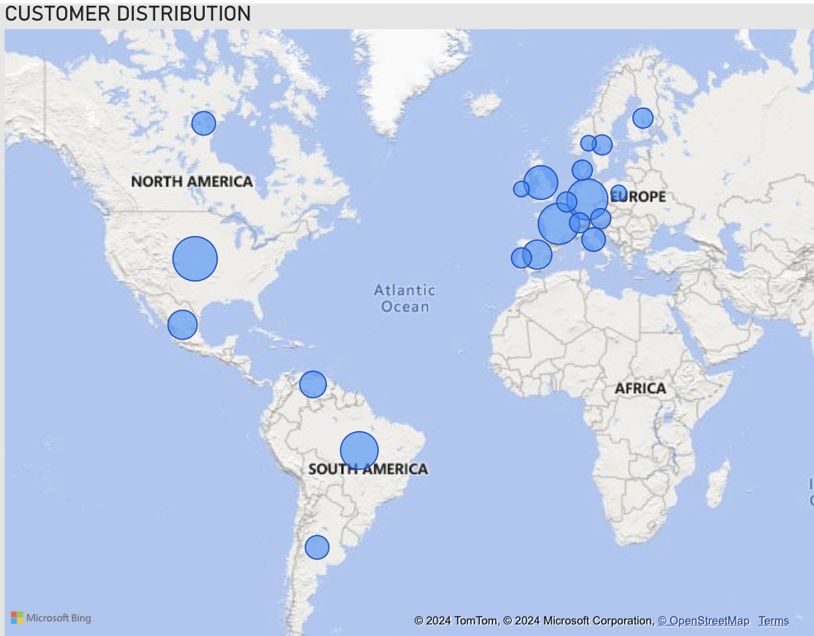
How does customer distribution vary across different regions or customer segments? Can we visualize it on a map or bar chart?

Slide 15
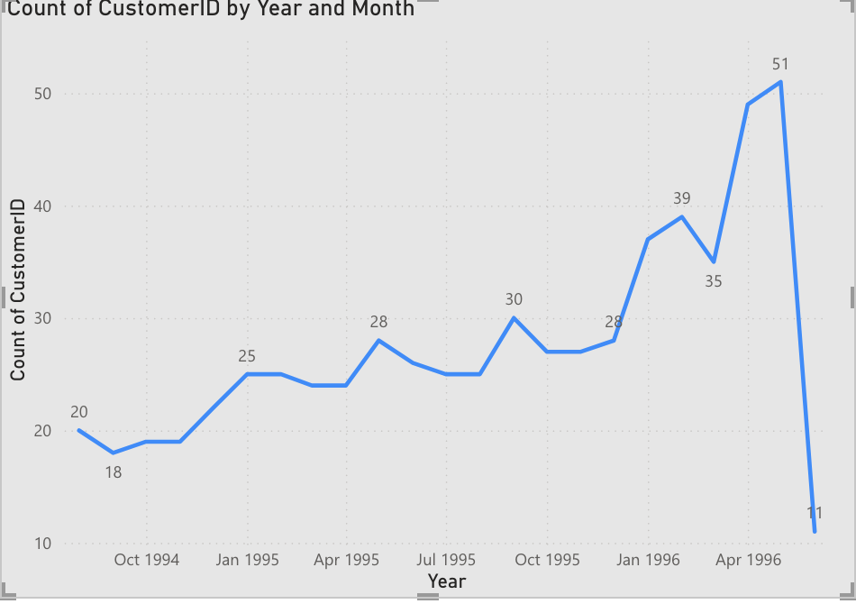
What is the trend in customer acquisition over time? Can we create a line chart or area chart to display it?
Customers count is growing

Slide 16
Can we visualize the distribution of customer demographics such as age, gender, or income using histograms or pie charts?
We dont have data related to customer age gender and income

Slide 17
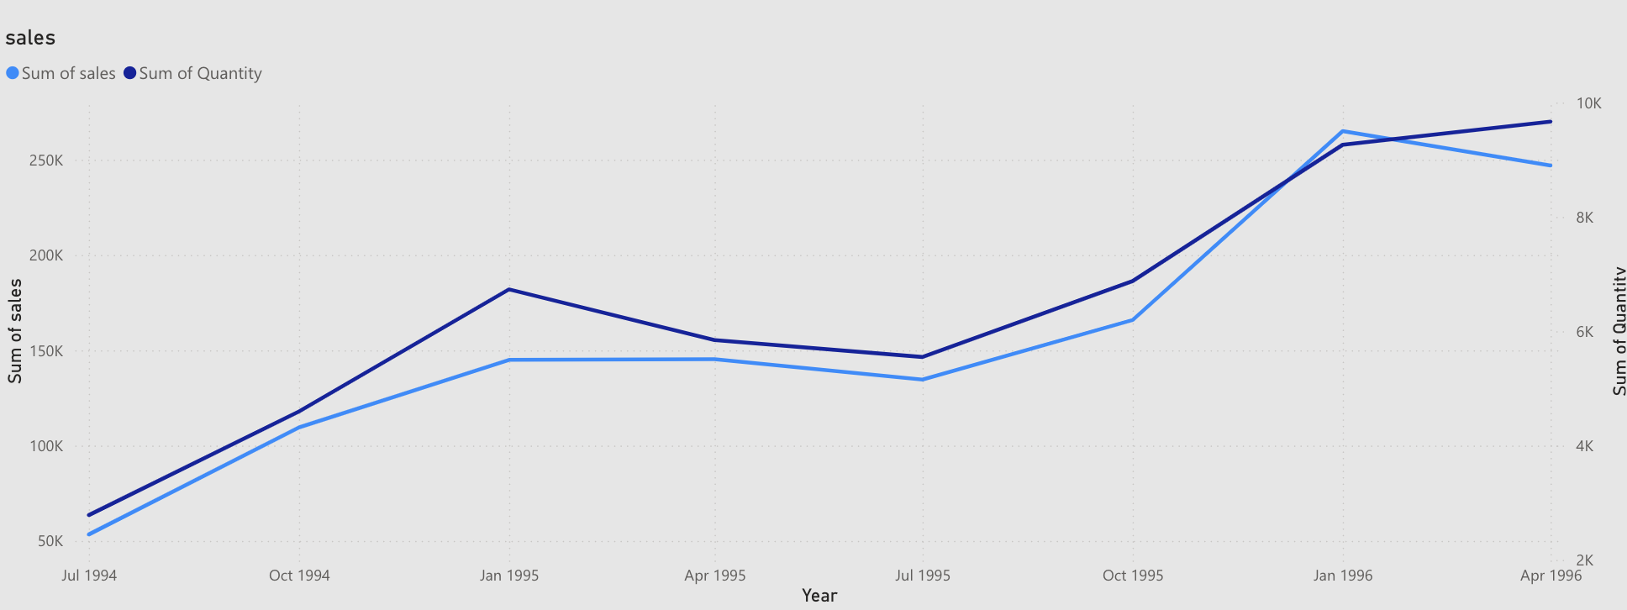
How does order volume change over time? Can we create a time series chart or stacked bar chart to visualize it?

Slide 18
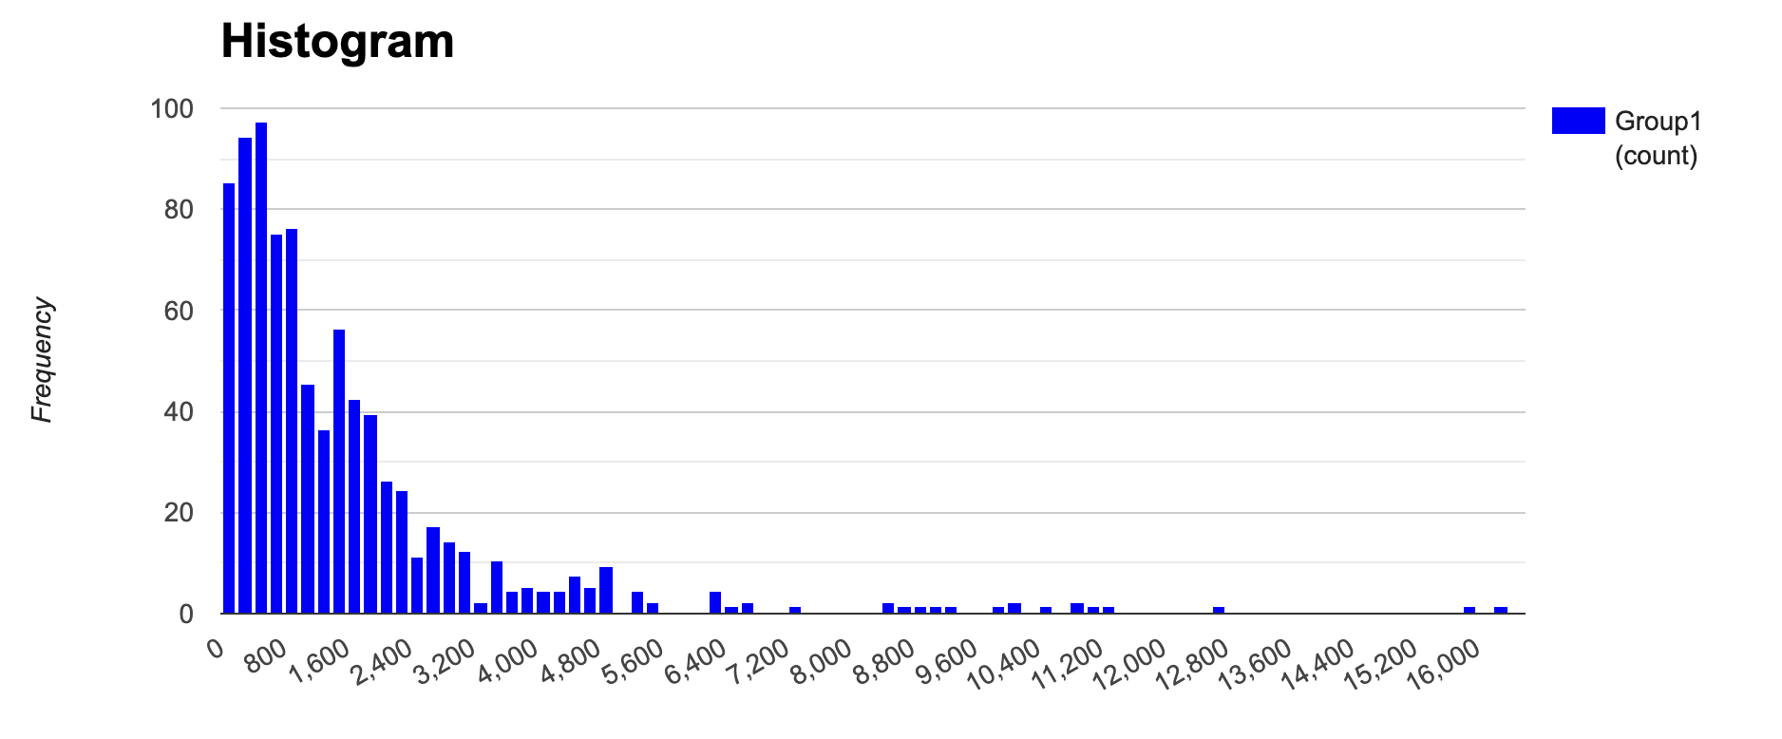
What is the distribution of order values? Can we create a histogram or box plot to display it?

Slide 19
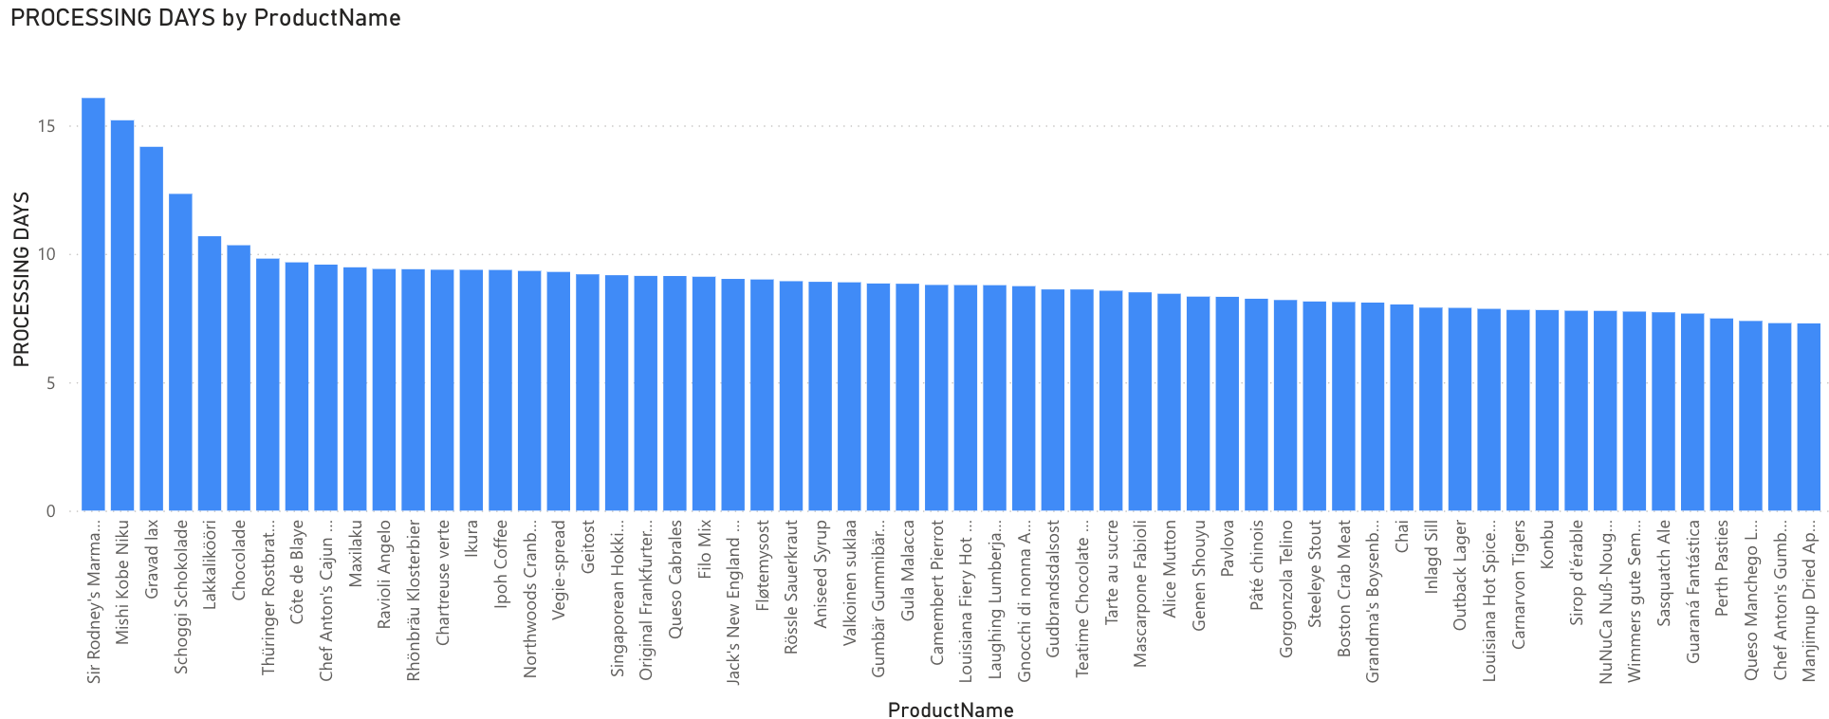
Can we visualize the average order processing time or shipping duration using a bar chart or box plot
From here we can average processing time for each product

Slide 20
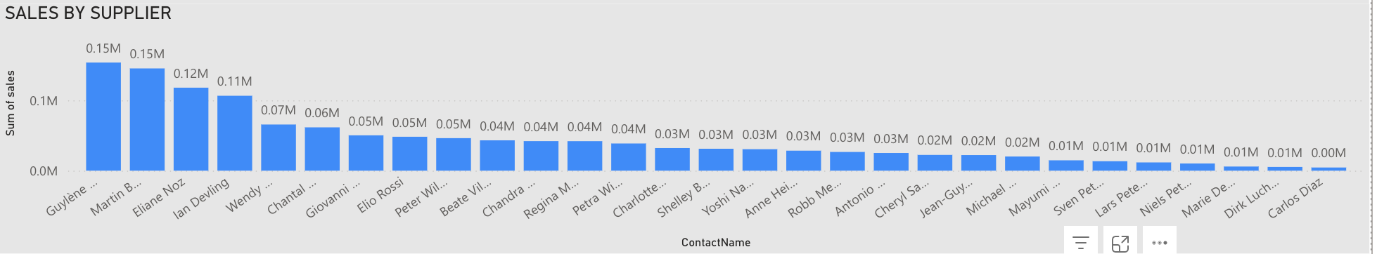
What is the distribution of supplier ratings or performance metrics? Can we create a bar chart or radar chart to visualize it?

Slide 21
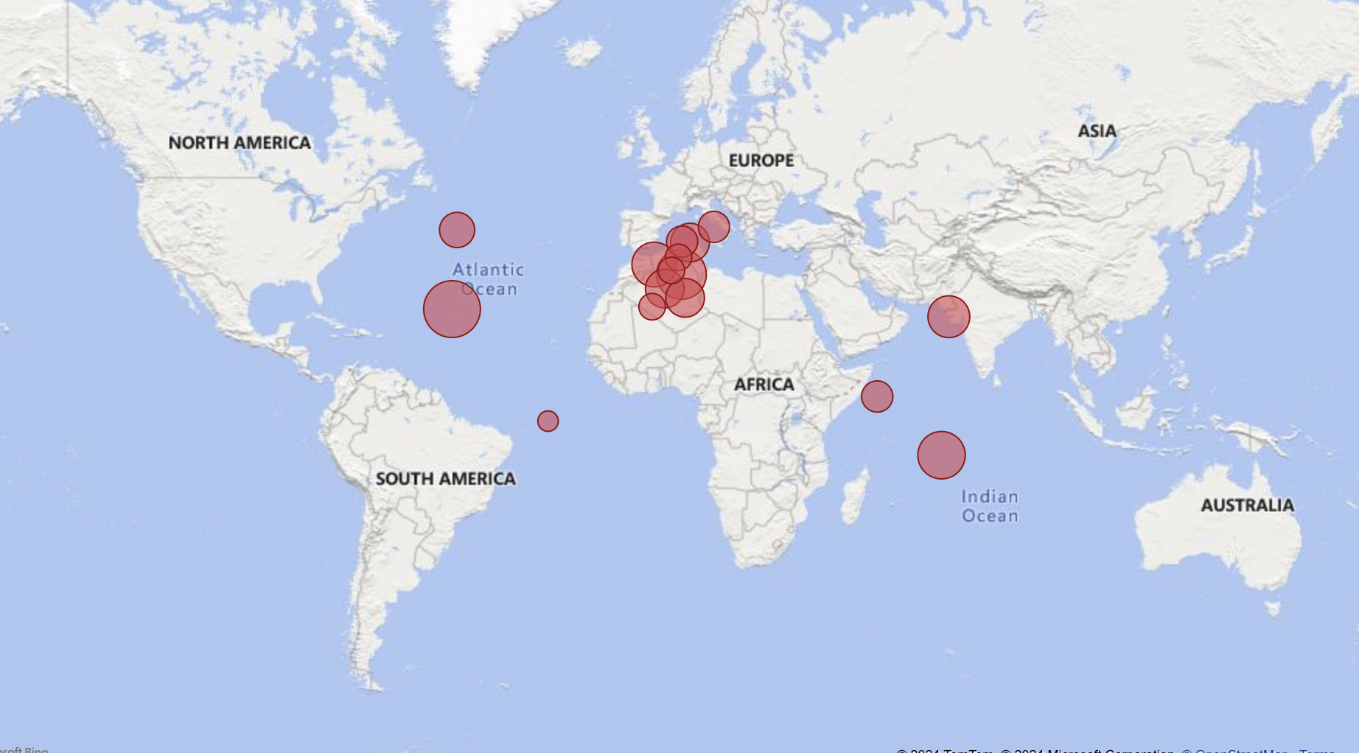
Can we visualize the geographical distribution of suppliers using a map or bubble chart?

Slide 22
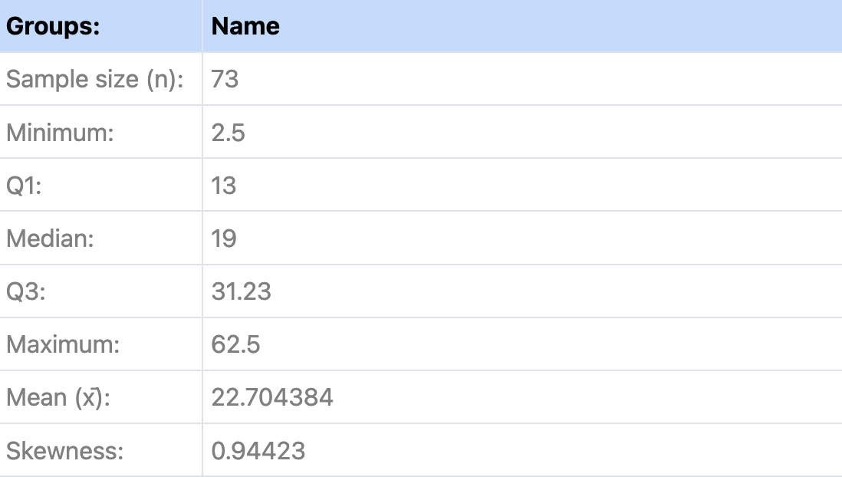
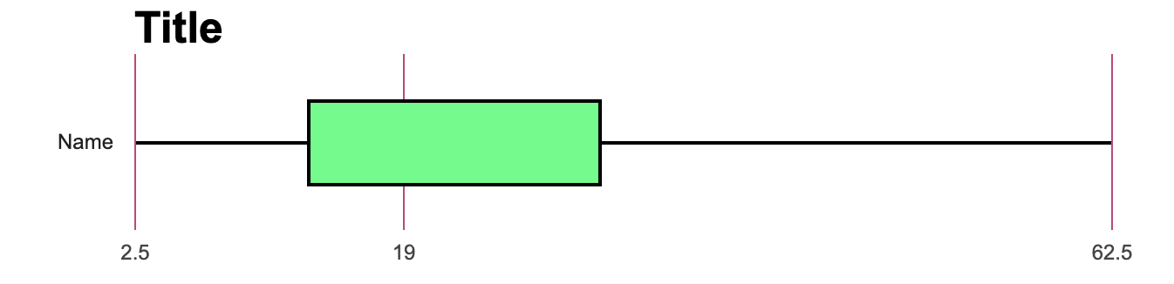
Can we visualize the pricing distribution of products using a box plot or violin plot?

Slide 23
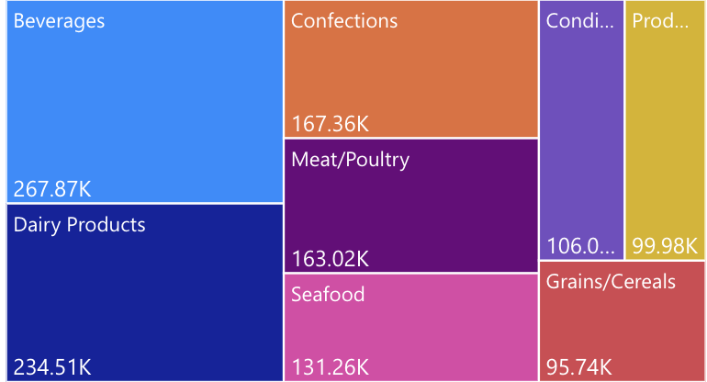
How does the sales volume vary across different product categories? Can we create a bar chart or treemap to display it?

Slide 24
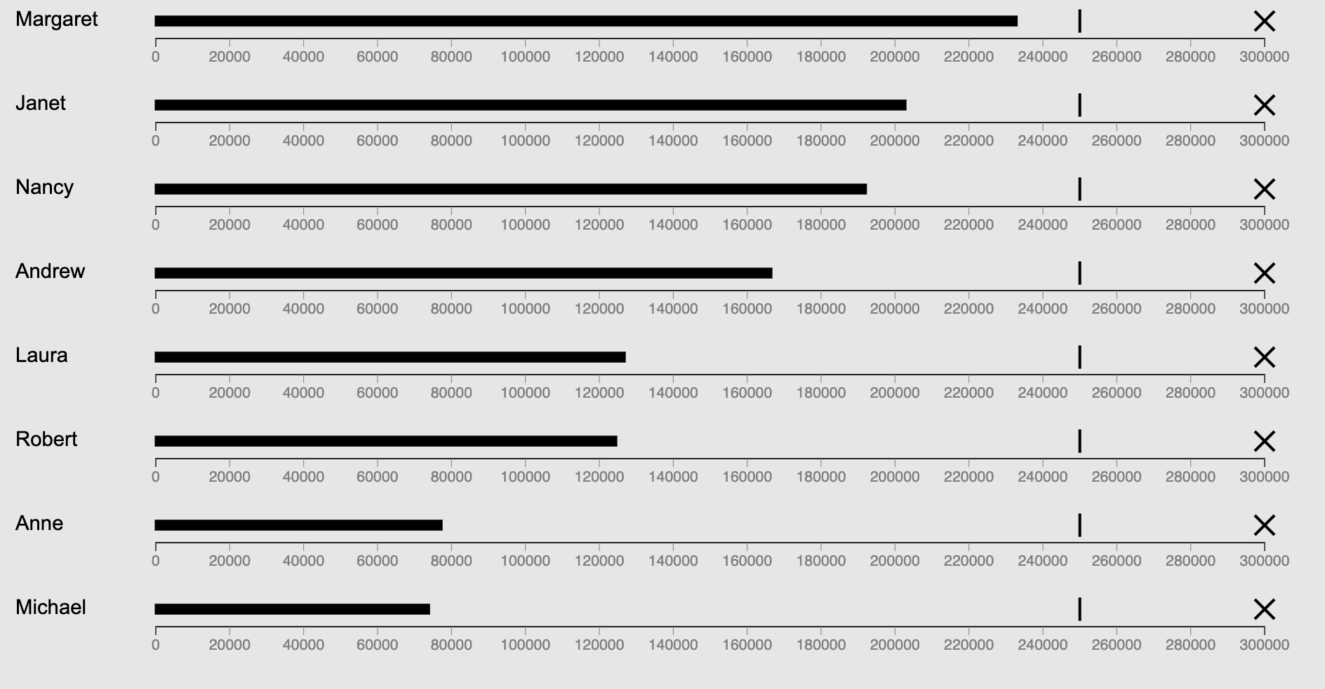
Can we visualize employee performance ratings or KPIs using a radar chart or bullet graph?

