Slide 1


Driver Assisted Adaptive Cruise Control using QNX
Team Member :
Abde Ali(RA2311005010054)
Ansh Srivastava(RA2311005010056)
Lathief Hussain (RA2311005010058)

Slide 2
Introduction
The evolution of intelligent transportation systems has redefined the expectations of modern vehicle control — demanding solutions that are not only automated, but also adaptive, responsive, and situationally aware.
Traditional cruise control systems operate at a fixed speed and do not consider real-time environmental conditions, making them unsuitable for dynamic scenarios.
Adaptive speed control systems overcome this limitation by continuously monitoring the surroundings (using sensors) and adjusting vehicle speed accordingly.
The integration of embedded systems with real-time operating systems (RTOS) enables fast, deterministic, and reliable decision-making, which is essential for such applications.

Slide 3
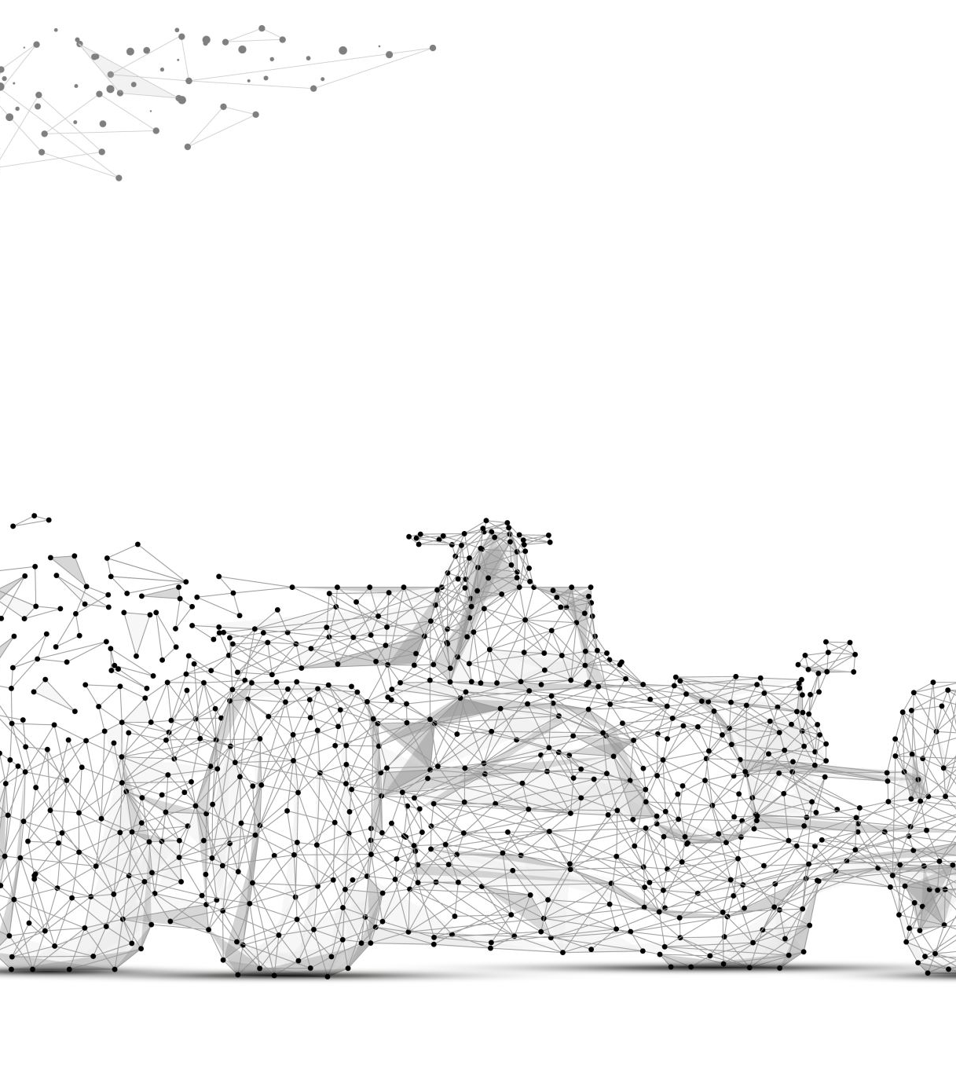
Objectives
Primary Goal: To design, develop, and validate a Driver assisted Adaptive Cruise Control (DACC) system for a robotic vehicle platform, leveraging real-time embedded architecture for intelligent, sensor-driven speed regulation.
Real-Time Speed Control Implement precise and responsive vehicle speed control using QNX RTOS, ensuring deterministic and time-critical performance.
Obstacle Detection Integrate an ultrasonic sensor to continuously measure the distance between the vehicle and surrounding obstacles, enabling proactive hazard awareness.
Dynamic Speed Adjustment Develop a control algorithm that dynamically modulates vehicle speed in response to real-time environmental conditions and proximity data.
System Integration Establish seamless communication and coordinated control across Arduino, Python, and QNX platforms for efficient, multi-layer system operation.
Safety & Reliability Enhance overall system safety, operational reliability, and responsiveness ensuring robust performance across varied and unpredictable driving scenarios.

Slide 4
Problem Statement
Traditional cruise control systems maintain a constant, pre-set speed without any awareness of the surrounding environment, making them fundamentally inadequate for real-world dynamic road conditions where obstacles can appear unexpectedly at any moment. The absence of real-time sensing and adaptive capability creates a critical over-reliance on human reaction, which is delay-prone and significantly increases the risk of collisions. This limitation is especially problematic in automated and robotic vehicle systems, where fast, precise, and reliable speed regulation is essential — highlighting the urgent need for an intelligent, sensor-driven adaptive speed control solution.

Slide 5
System Overview
Hybrid Architecture
The system integrates three specialized platforms, each performing a distinct role within the control pipeline — ensuring modularity, scalability, and real-time performance.
Arduino — Hardware Layer
Acquires real-time data from the ultrasonic sensor
Controls the motor driver and vehicle movement
Operates as a slave device, executing commands from QNX
Python — Communication Layer
Acts as an intelligent bridge between Arduino and QNX RTOS
Uses serial communication with Arduino and socket communication with QNX
Ensures continuous, non-blocking and reliable data transfer
QNX RTOS — Control Layer (Master)
Serves as the primary decision-making and processing unit
Processes incoming sensor data in real time
Generates precise speed regulation and emergency braking commands
Delivers deterministic, fault-tolerant, and reliable system control

Slide 6
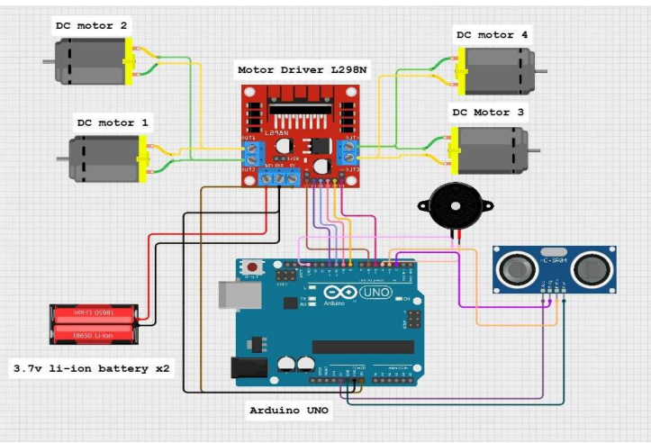
System Circuit Diagram

Slide 7
Hardware Component
Arduino Uno
Primary microcontroller responsible for hardware interfacing
Reads sensor data and controls motor driver and buzzer
Acts as the execution unit for system commands
L298N Motor Driver
H-bridge module used for bidirectional motor control
Enables speed control using PWM signals from Arduino
Drives DC motors efficiently
Ultrasonic Sensor (HC-SR04)
Measures distance using ultrasonic wave reflection
Essential for obstacle detection and braking logic
DC Motors & Buzzer
DC motors provide vehicle movement and speed control
Buzzer gives audio alert when obstacle is too close (<20 cm)
Enhances overall system safety

Slide 8
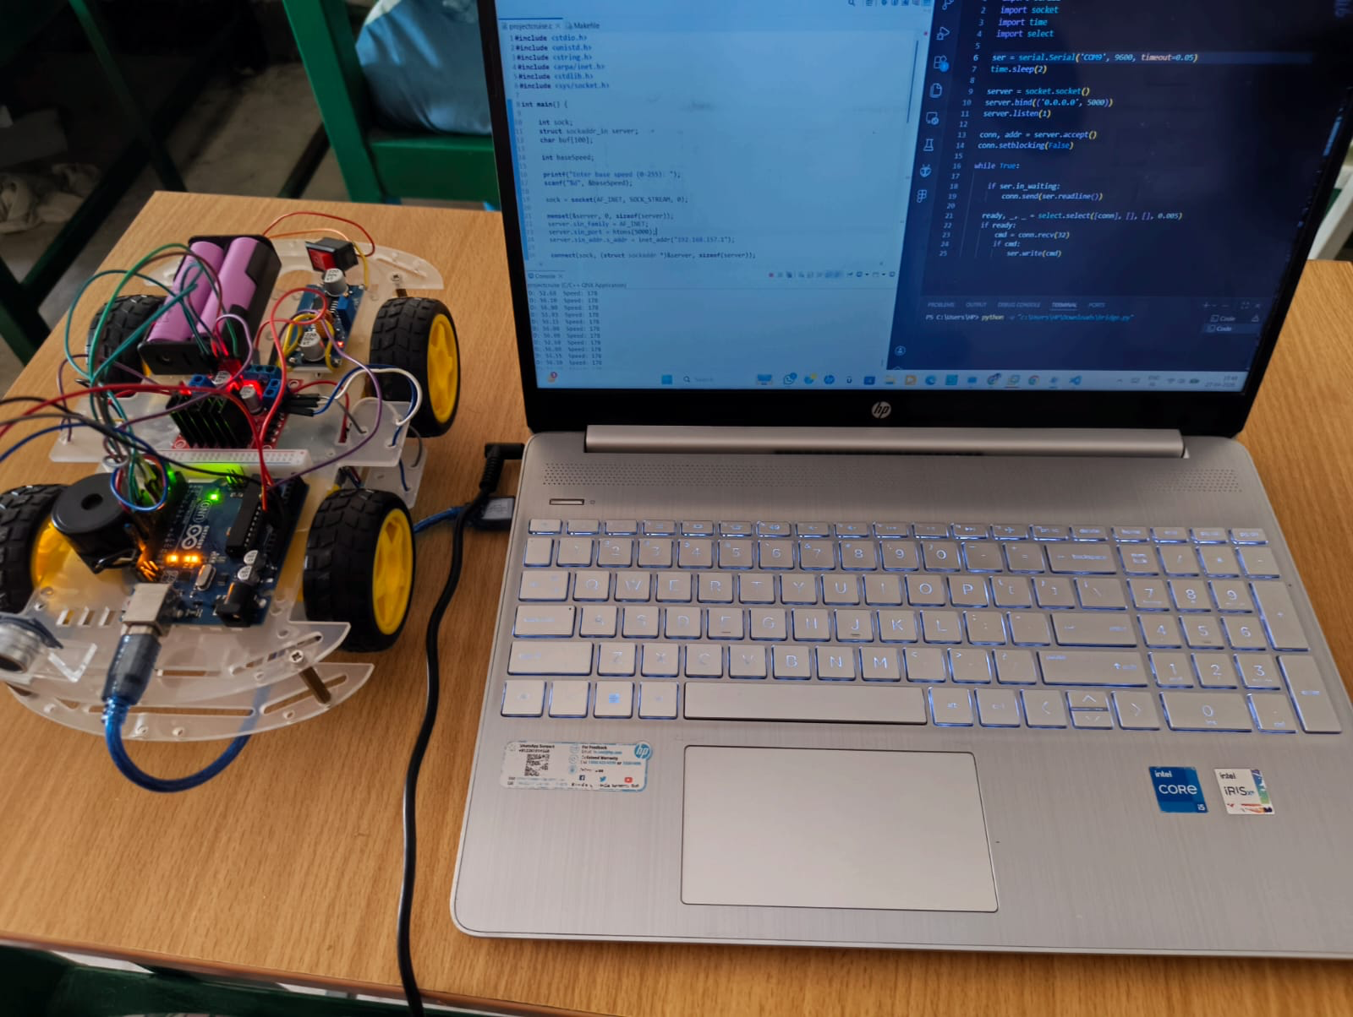
Hardware

Slide 9
Working Principle
Step 1 — Distance Measurement
The ultrasonic sensor continuously monitors the surrounding environment for nearby obstacles
Distance is calculated using the time-of-flight principle of ultrasonic wave propagation
Step 2 — Data Transmission
Measured distance values are transmitted from Arduino to QNX RTOS via the Python communication bridge
Ensures seamless, real-time data transfer for immediate processing
Step 3 — Data Processing
QNX RTOS receives and processes incoming sensor data in real time
Applies predefined control logic based on the measured distance value
Determines the appropriate speed regulation or braking action required
Step 4 — Command Generation
QNX RTOS generates precise control commands based on processed data
Commands are relayed back to Arduino through the Python communication layer
Step 5 — Motor Control & Safety Response
Arduino receives the commands and adjusts motor speed accordingly using PWM signals
If detected distance falls below 20 cm:
Vehicle comes to an immediate and complete stop
Buzzer is activated to issue a real-time safety alert

Slide 10
Software Component
Arduino IDE — Hardware Control Layer
Used to develop and upload firmware to the Arduino Uno microcontroller
Handles ultrasonic sensor data acquisition and real-time distance measurement
Manages PWM-based motor speed control and buzzer activation
Serves as the dedicated hardware execution and control layer
Python — Serial & Socket Communication Bridge
Acts as the central communication interface between Arduino and QNX RTOS
Utilizes serial communication for Arduino to Python data exchange
Utilizes socket communication for Python to QNX data exchange
Ensures real-time, continuous, and non-blocking bidirectional data transfer
QNX RTOS — Master Control & Decision Layer
Serves as the primary decision-making and processing unit of the system
Processes incoming sensor data in real time with high accuracy
Implements adaptive speed regulation and emergency braking logic
Provides deterministic task scheduling for time-critical operations
Delivers high reliability, fault tolerance, and fast, predictable system response

Slide 11
Control Logic
Distance > 60 cm
Vehicle runs at full speed
Distance 40–60 cm
Speed reduced moderately
Distance 20–40 cm
Speed reduced significantly
Distance < 20 cm
Vehicle stops immediately + buzzer alert

Slide 12
Role of QNX RTOS
QNX is critical for ensuring the Adaptive Cruise Control system's reliability and performance, especially in safety-critical automotive environments.
Real-Time Processing
Deterministic Response
Provides real-time processing capability, essential for instantaneous data analysis and command execution.
Ensures deterministic response, meaning actions are guaranteed to occur within strict, predictable timeframes.
Efficient Decision-Making
Safety-Critical Applications
Handles decision-making efficiently, allowing the system to react swiftly to changing road conditions and obstacles.
Suitable for automotive and safety-critical applications, meeting the rigorous demands of autonomous systems.

Slide 13
Communication Architecture
System Communication Flow
The system employs a hybrid communication model combining serial and network-based communication protocols, ensuring real-time, bidirectional data exchange across all integrated components.
Arduino to Python — Serial Communication
Communication is established via a USB serial interface
Arduino continuously transmits real-time distance data to Python
Python relays processed speed commands back to Arduino for execution
Python to QNX — Socket Communication
Communication is handled through TCP/IP socket protocol
Enables fast, stable, and reliable bidirectional data transfer
Supports real-time control decisions with minimal latency
End-to-End Data Flow
Arduino reads and captures sensor distance data in real time
Data is transmitted to Python via the serial communication interface
Python forwards the received data to QNX RTOS via socket communication
QNX processes the data and generates appropriate control commands
Commands are relayed back to Arduino through Python for immediate motor actuation

Slide 14
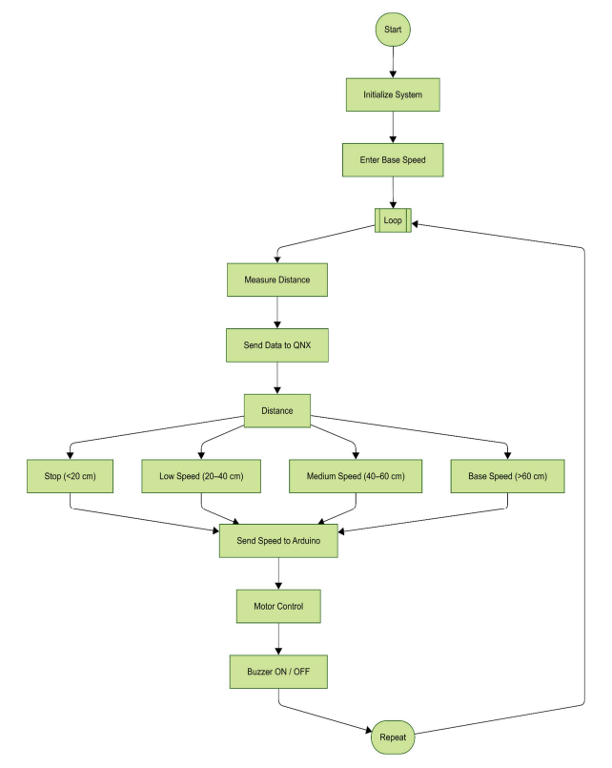
Algorithm Flow

Slide 15
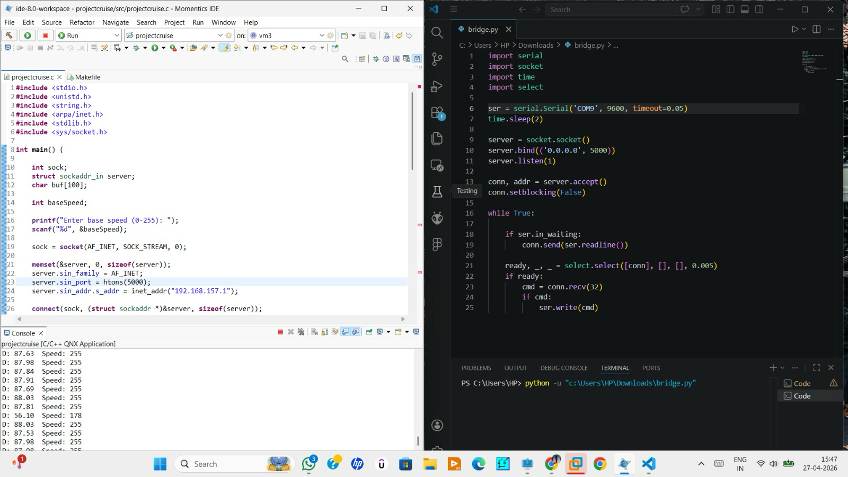
Results
The Adaptive Cruise Control system was developed using a multi-layered architecture comprising an Arduino-based embedded platform, a Python-driven serial-to-TCP communication bridge, and a QNX real-time control server. The system was rigorously evaluated under controlled experimental conditions, where physical obstacles were strategically positioned at predefined distances to assess responsiveness, accuracy, and real-time performance.
Key Results:
QNX RTOS delivered deterministic, low-latency control responses with no timing violations recorded
Vehicle speed was dynamically and smoothly adjusted in proportion to detected obstacle proximity
Automatic emergency braking activated accurately when distance fell below the 20 cm critical threshold
Seamless communication was maintained across Arduino, Python, and QNX with no data loss throughout testing

Slide 16
Challenges Faced
Inter-module communication latency, leading to delayed feedback and reduced real-time responsiveness across the Arduino–Python–QNX pipeline
Sensor noise and measurement uncertainty, causing fluctuations in ultrasonic readings and affecting control accuracy
Hardware-level reliability issues, particularly in motor driver circuitry, impacting consistent motor performance and system stability
System integration complexity, arising from a multi-layer hybrid architecture, making debugging and fault isolation more challenging

Slide 17
Solutions Implemented
Optimized ultrasonic sensing by reducing sensor timeout, resulting in faster distance acquisition and improved system responsiveness
Implemented non-blocking communication in Python, ensuring continuous data flow without delays or system stalling
Enhanced QNX control loop performance, enabling faster decision-making and improved real-time behavior
Refined serial data parsing mechanisms, ensuring accurate and reliable interpretation of incoming data

Slide 18

Applications
Autonomous vehicles
Collision avoidance systems
Smart robotics
Advanced Driver Assistance Systems (ADAS)

Slide 19
Conclusion
Successfully developed a smart cruise control system
Achieved real-time adaptive speed control
Demonstrated integration of embedded systems and RTOS

Slide 20
Thank You

