Slide 1
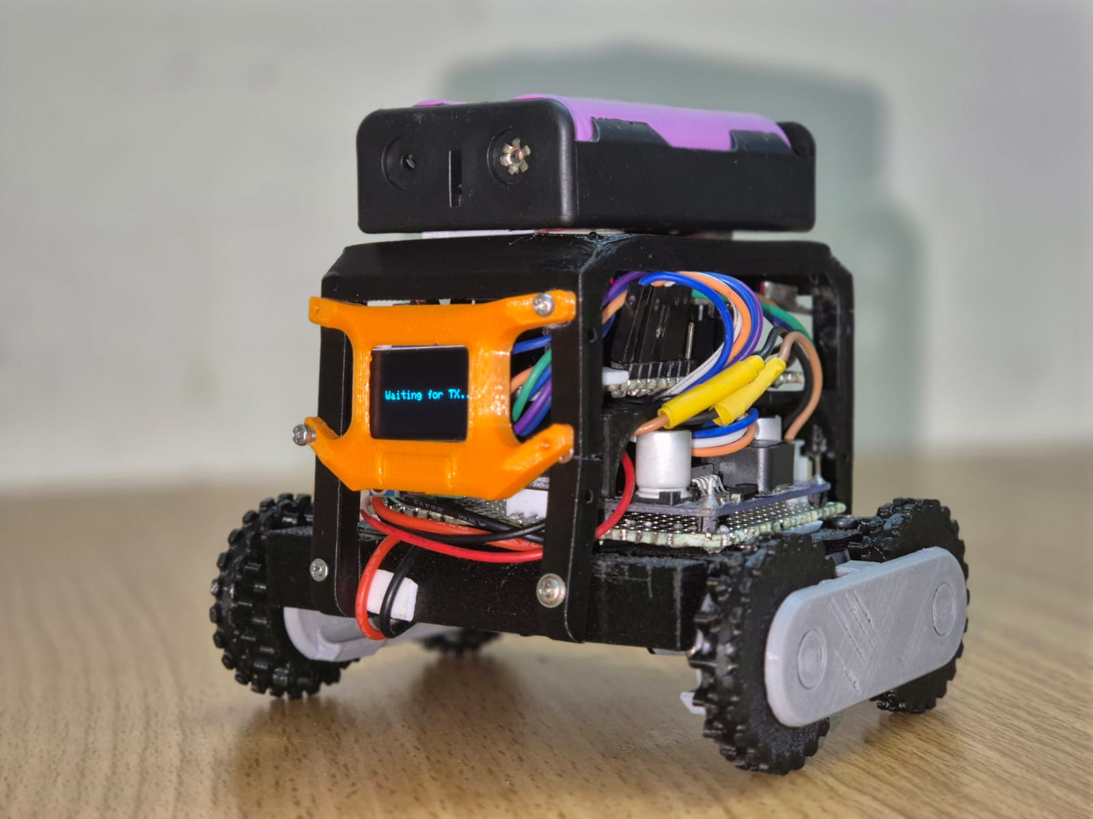
TinyML-Based Hand Gesture Control Robot
Abde Ali (RA2311005010054)
Ansh Srivastava (RA2311005010056)
Lathief Hussain (RA2311005010058)

Slide 2
Abstract :
This project presents a TinyML-based hand gesture-controlled robot that enables wireless control using natural hand movements. An MPU-6050 sensor and ESP32 capture and classify gestures (Forward, Backward, Left, Right, Still) using an on-device neural network trained on Edge Impulse. The recognized commands are sent via NRF24L01 to an Arduino Nano, which controls the robot’s motors. An OLED display provides visual feedback. The system achieves high accuracy (97.8%) and demonstrates an efficient, low-cost solution for real-time human-robot interaction.

Slide 3
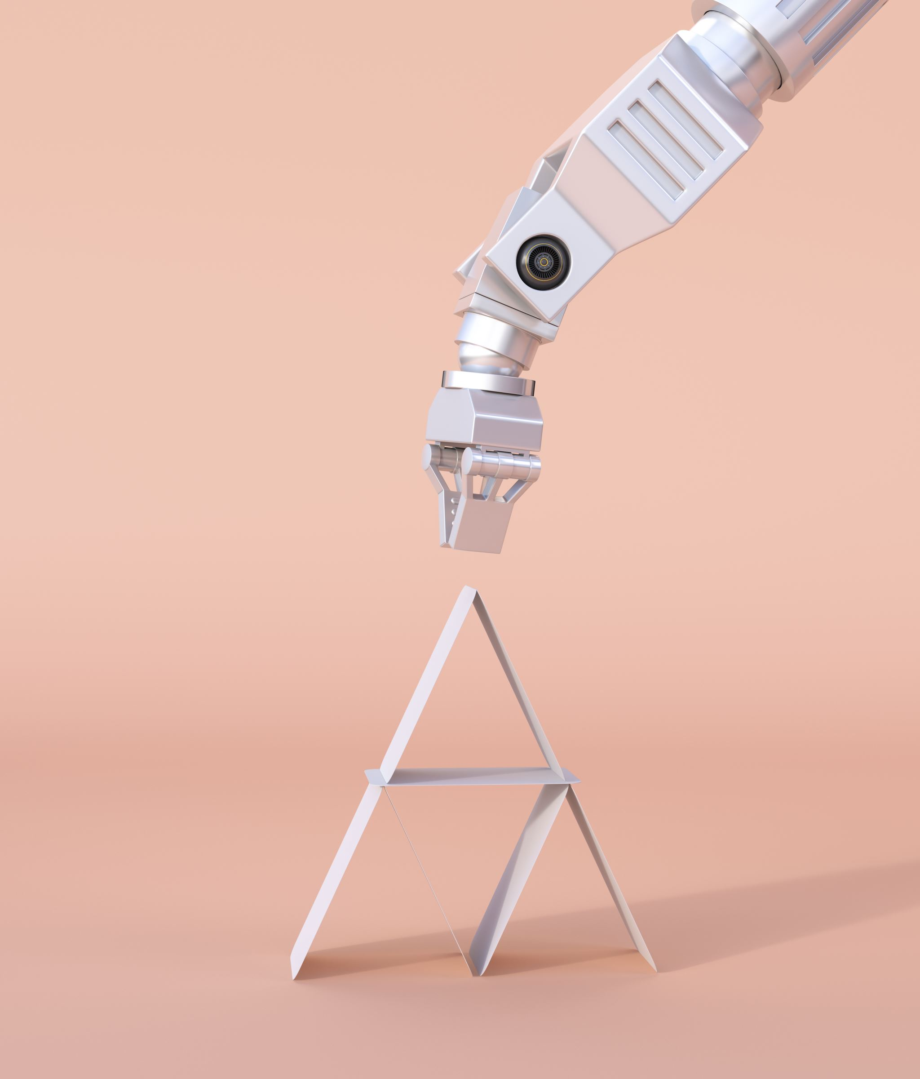
Motivation :
Traditional gesture systems using cameras are costly and power-consuming
IMU-based systems are compact, efficient, and reliable
TinyML enables machine learning on low-power microcontrollers
Gesture control provides natural and easy human-robot interaction
This project aims to create a low-cost, intelligent, and user-friendly robotic system

Slide 4
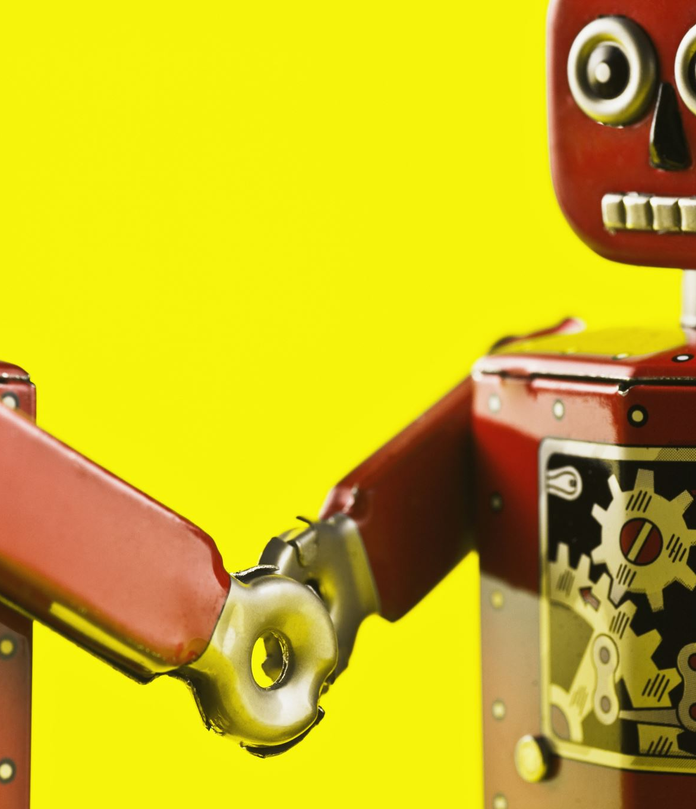
Problem Statement :
Traditional robot control methods such as joysticks and remote controllers are often difficult to use and limit natural interaction. These systems rely on physical interfaces, reducing ease of use and flexibility. As a result, there is a growing need for a more intuitive, contactless, and user-friendly method to control robotic systems, especially in areas like assistive technology and smart automation.

Slide 5
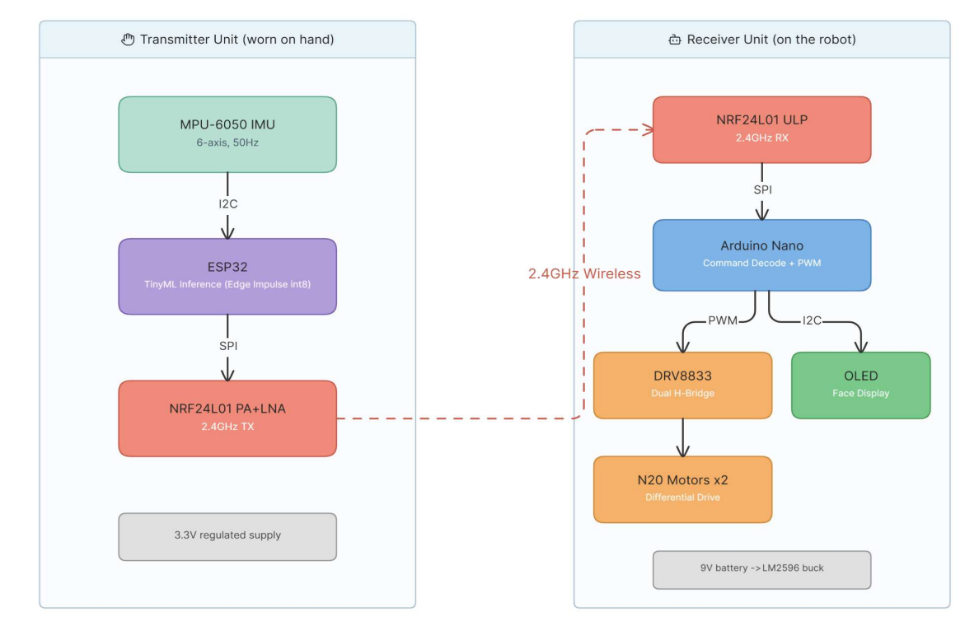
Block Diagram
The system has two parts: transmitter and receiver. The MPU-6050 sensor sends motion data to the ESP32, which uses a TinyML model to recognize hand gestures. The detected gesture is sent wirelessly using the NRF24L01 module. On the receiver side, an Arduino Nano receives the signal and controls the motors through a driver to move the robot. At the same time, an OLED display shows visual feedback.

Slide 6
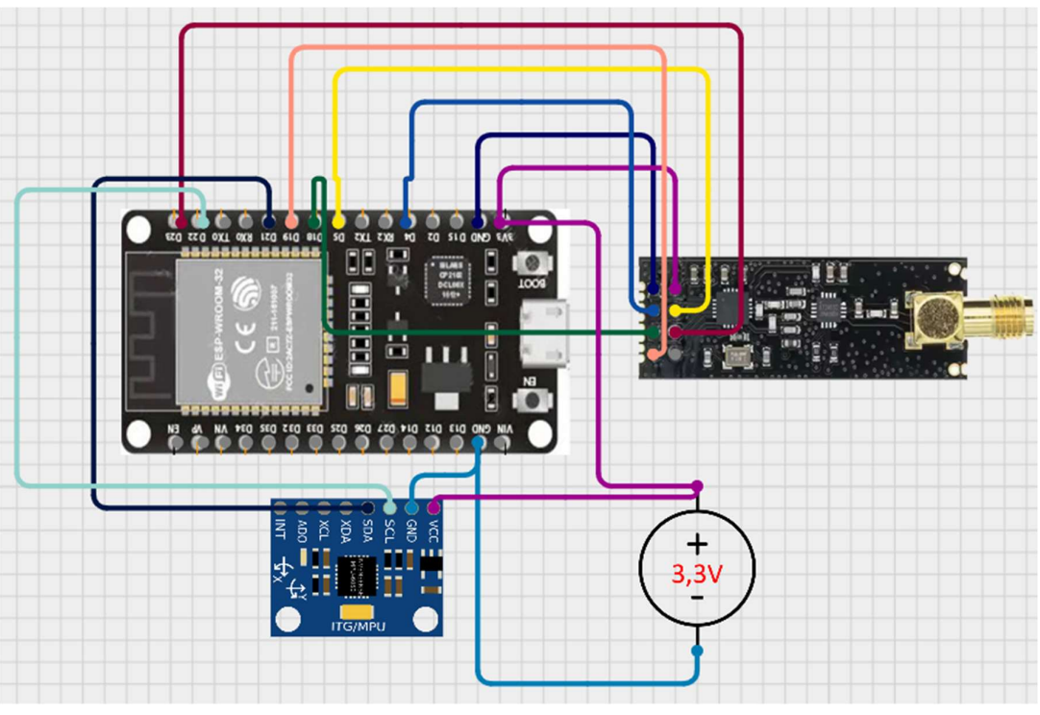
Circuit Diagram :
Transmitter circuit :
The transmitter uses an ESP32 connected to an MPU-6050 sensor via I2C to capture motion data. The ESP32 processes this data using a TinyML model to detect gestures. The detected gesture is sent wirelessly through the NRF24L01 module using SPI. The system runs on 3.3V and transmits the gesture as a simple signal to the receiver.

Slide 7
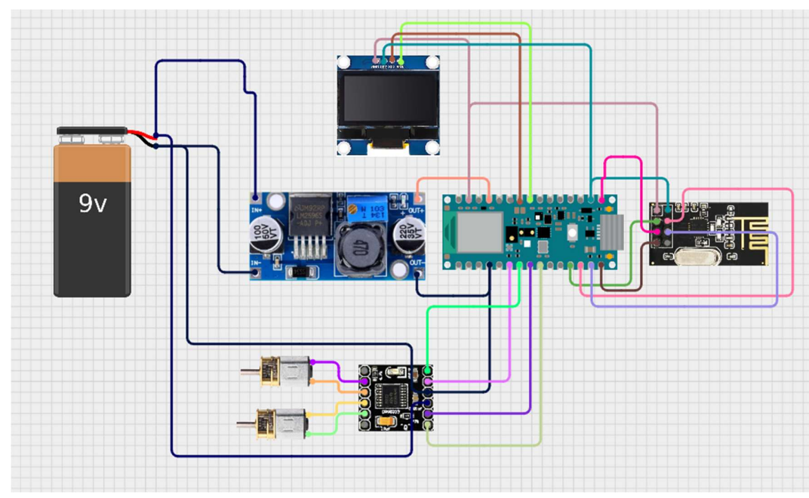
Reciever Circuit :
The receiver uses an Arduino Nano connected to an NRF24L01 module to receive gesture signals. Based on the received gesture, the Arduino controls the motors through the DRV8833 driver to move the robot. An OLED display shows visual feedback for each action. The system is powered by a 9V battery with a voltage regulator.

Slide 8
Hardware Components :
ESP32 (processing + ML)
MPU6050 (motion sensing)
NRF24L01 (wireless communication)
Arduino Nano (control unit)
DRV8833 (motor driver)
N20 Motors + OLED

Slide 9
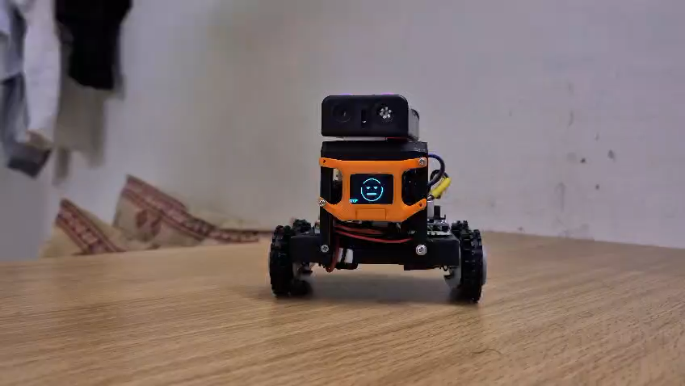
Hardware Image :

Slide 10
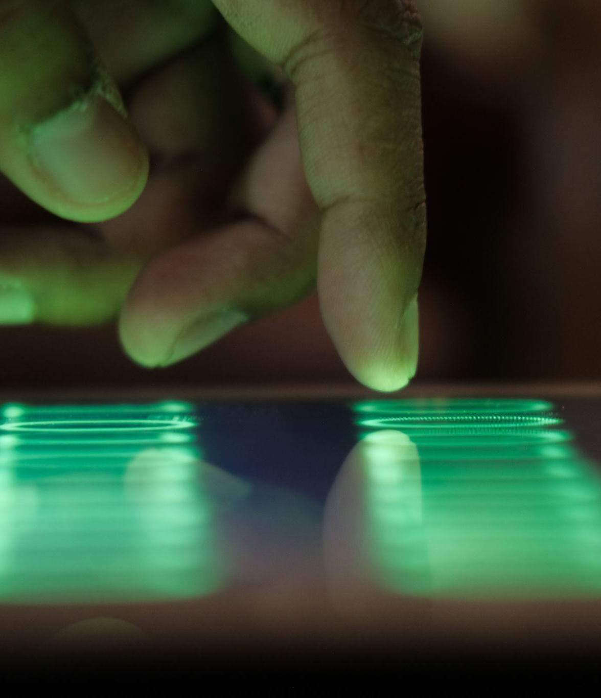
Data Collection :
Motion data was collected using the MPU-6050 IMU sensor for five different gestures: Forward, Backward, Left, Right, and Still. A total of 125 samples were recorded, with 25 samples for each gesture. The data was captured at a sampling rate of 50 Hz, with each sample lasting about 2 seconds. All the collected data was labeled and processed using the Edge Impulse platform for training the model.

Slide 11
Tiny Machine Learning Overview :
TinyML refers to the deployment of machine learning models on low-power microcontrollers, enabling real-time data processing without the need for cloud connectivity. It allows devices to perform intelligent tasks locally with minimal power consumption and fast response time. In this project, TinyML is used to recognize hand gestures on the ESP32 using a quantized model, making the system efficient, low-cost, and suitable for embedded applications.

Slide 12
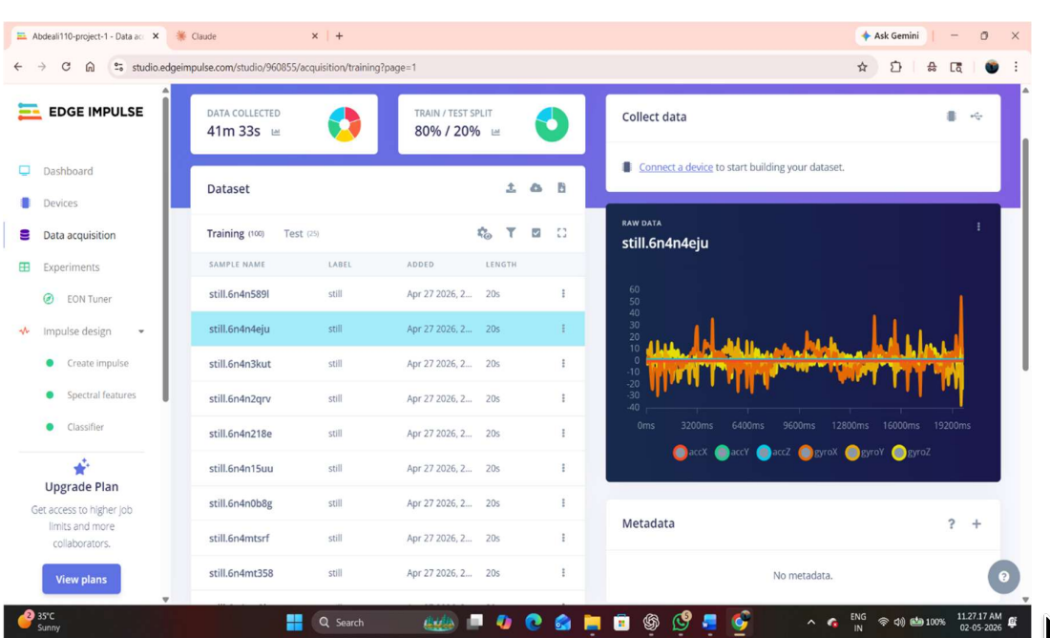
Model Training:
The model was trained using the Edge Impulse platform with the collected gesture data. First, spectral features were extracted from the raw IMU data using FFT to improve classification accuracy. A neural network classifier was then trained on these features to recognize five gesture classes. The model was optimized using quantization (int8) for deployment on the ESP32 and achieved a high accuracy of 97.8% with reliable real-time performance.

Slide 13
Result :
The trained TinyML model achieved a high accuracy of 97.8% in classifying five hand gestures with low loss and strong reliability. The system successfully performs real-time gesture recognition on the ESP32 without any cloud support. The robot responds quickly and accurately to user gestures, demonstrating smooth movement and effective wireless communication between transmitter and receiver.

Slide 14
Conclusion :
This project successfully demonstrates a TinyML-based hand gesture-controlled robot capable of real-time, controller-free operation using on-device machine learning. The system achieves high accuracy, low latency, and efficient wireless communication, making it a practical and low-cost solution for intuitive human-robot interaction. In the future, the system can be enhanced by adding more gesture commands, improving model accuracy with larger datasets, using long-range communication technologies like LoRa, optimizing power consumption, and integrating advanced displays or sensors for better functionality and user experience.

Slide 15
Thank you

