Slide 1
Palindromic String Analyzer
By - Ansh Tiwari
ERP - RU-25-10235
Branch - BTECH CSE AI/ML (IBM)
Guided By – Miss Naina Devi

Slide 2
Agenda
Introduction
Project Overview
Objective
Tools & Technology
Working Of the Project
Sample Output
Advantages
GITHUB Repository

Slide 3
Introduction :
The Palindromic String Analyzer is a mini project developed using the C programming language , focusing on string manipulation. The project accepts a string from the user, checks whether it is a palindrome, and reverses the string using logical operations. It uses core C concepts such as loops, functions, and string handling techniques to display both the original and reversed strings together
This mini project helps to improve logic building and problem-solving skills due to its simplicity and practical approach.

Slide 4
Tools & Technology
Programming Language: C
IDE: VS Code
Concepts Used: Strings, Functions, Loops

Slide 5
Project Overview
This project works on string manipulation
Checks whether a string is a palindrome
Reverses the given string
Displays clear results

Slide 6
Objectives
Accept string input from user
Reverse the string logically
Check palindrome condition
Display original and reversed strings

Slide 7
Working
#include <stdio.h>
#include <string.h>
void reverseString(char str[],char rev[]){
int length = strlen(str);
int i ;
for (i=0; i<length; i++){
rev[i] = str[length – i – 1] ;
}
rev[length]=‘\0’;
}
Int checkPalindrome(char str[],char rev[]){
If (strcmp(str,rev)==0)
return 1;
else
return 0;
}

Slide 8
int main () {
char str [100],rev[100];
printf("----- Palindromic String Analyzer -----\n\n");
printf("Enter a string: ");
fgets(str, sizeof(str),stdin);
str[strcspn(str, "\n")] = '\0’;
reverseString(str, rev);
printf("\nOriginal String : %s", str);
printf("\nReversed String : %s\n", rev);
if (checkPalindrome(str, rev))
printf("\nResult: The given string is a PALINDROME.\n");
else
printf("\nResult: The given string is NOT a palindrome.\n");
printf("\n--------------------------------------\n");
printf("Mini Project by Ansh Tiwari (IBM)\n");
return 0;
}

Slide 9
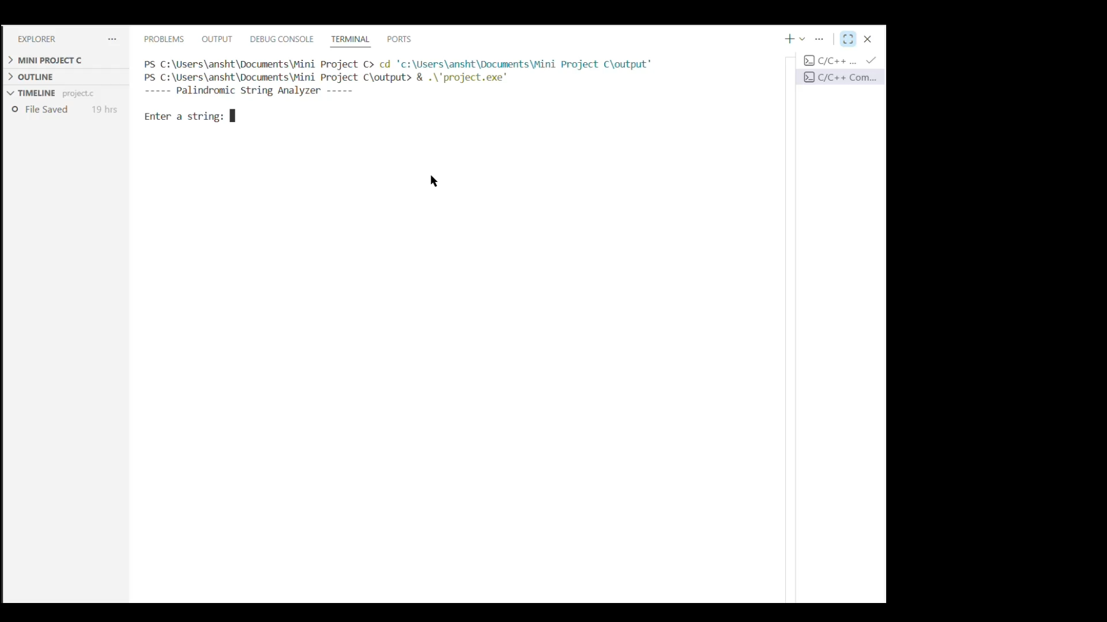
Sample Output

Slide 10
Applications of the Project
String validation programs
Text processing applications
Learning base for advanced string programs
Educational use for beginners

Slide 11
Advantages
Simple and Easy to Understand
Improves string handling and logical thinking
Demonstrates effective string manipulation
Helps in understanding use of functions and loops
Easy to modify and extend with additional features

Slide 12
Thank You
I hope this presentation clearly explained the concept, working, and implementation of the project.
🔗 GitHub Repository:
https://github.com/anshtiwari-jpg/C-MINI-PROJECT

