Slide 1
Used Car Sales Dashboard
By Ansh Kumar Tomar
Roll no. : 2367035004
Date : 10 June 2025

Slide 2
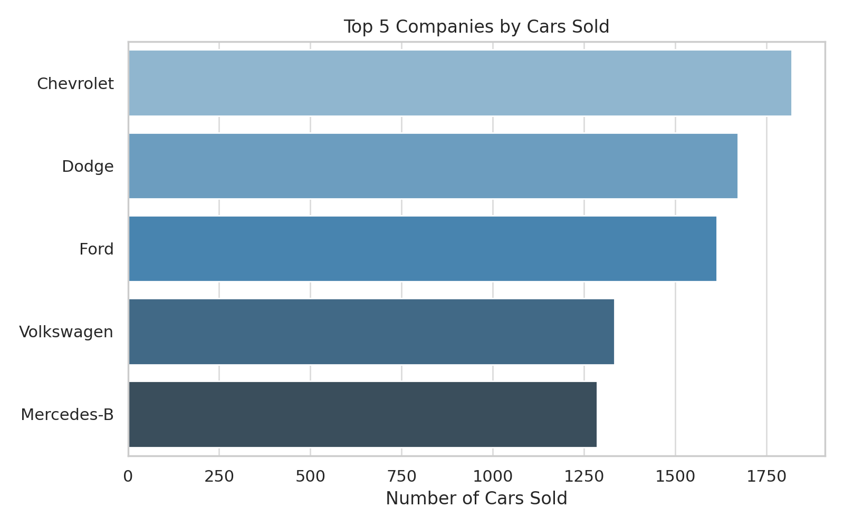
Top Companies

Slide 3
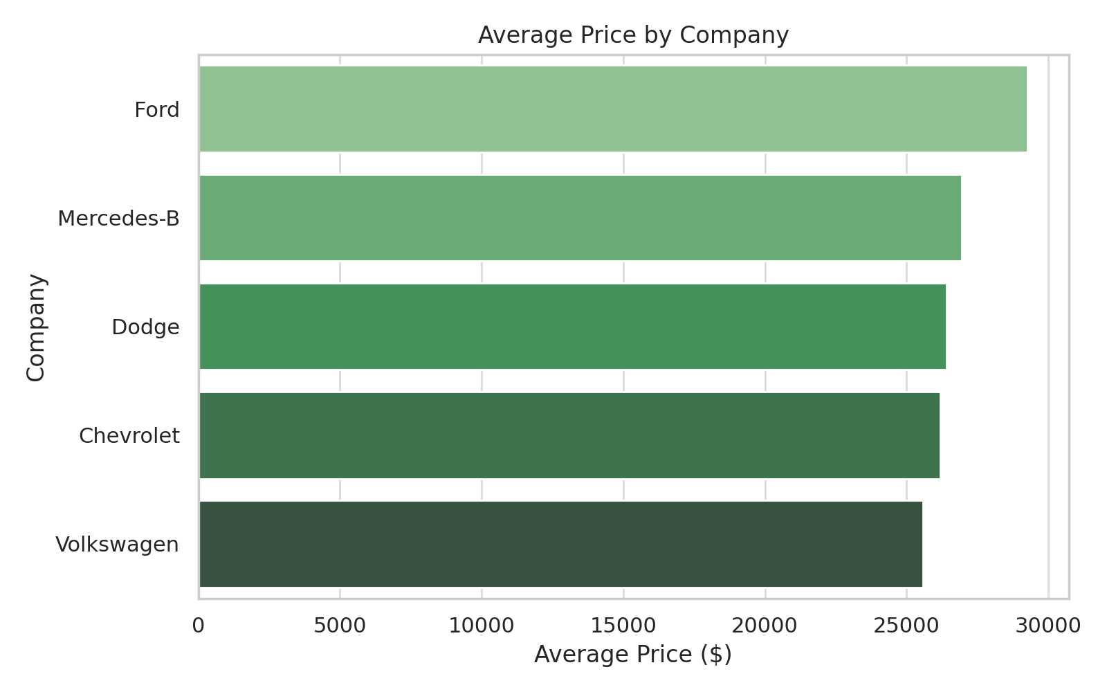
Average Price by Company

Slide 4
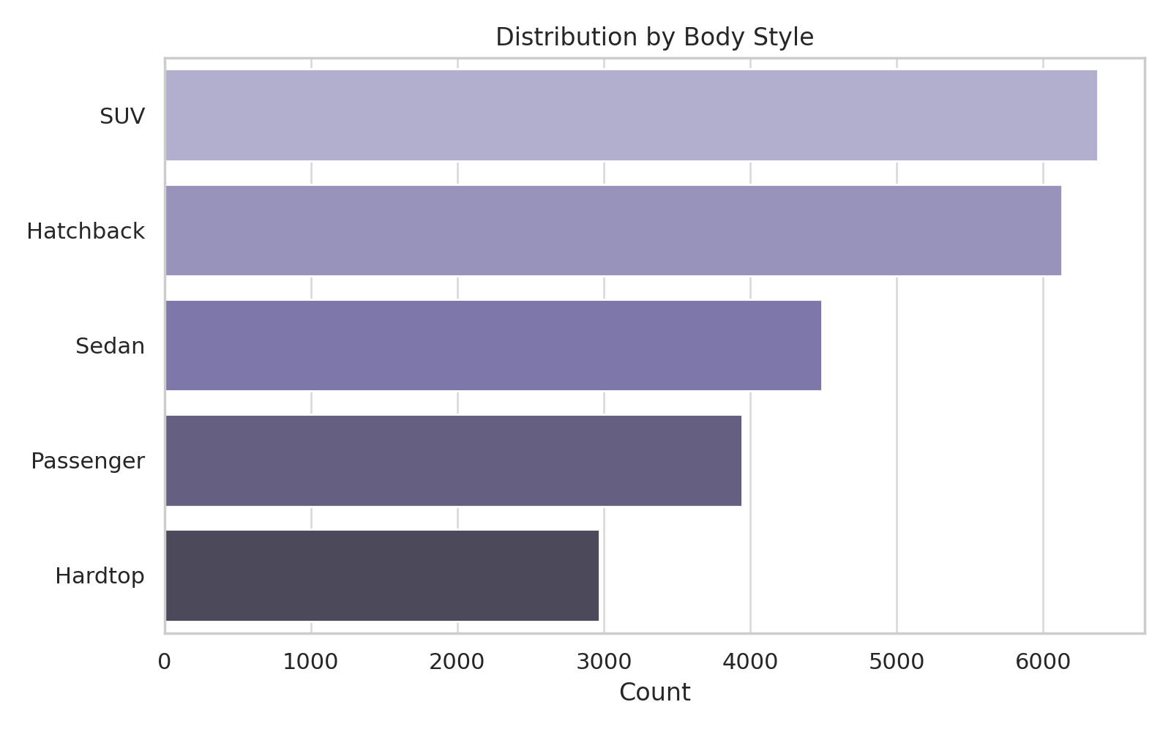
Body Style Distribution

Slide 5
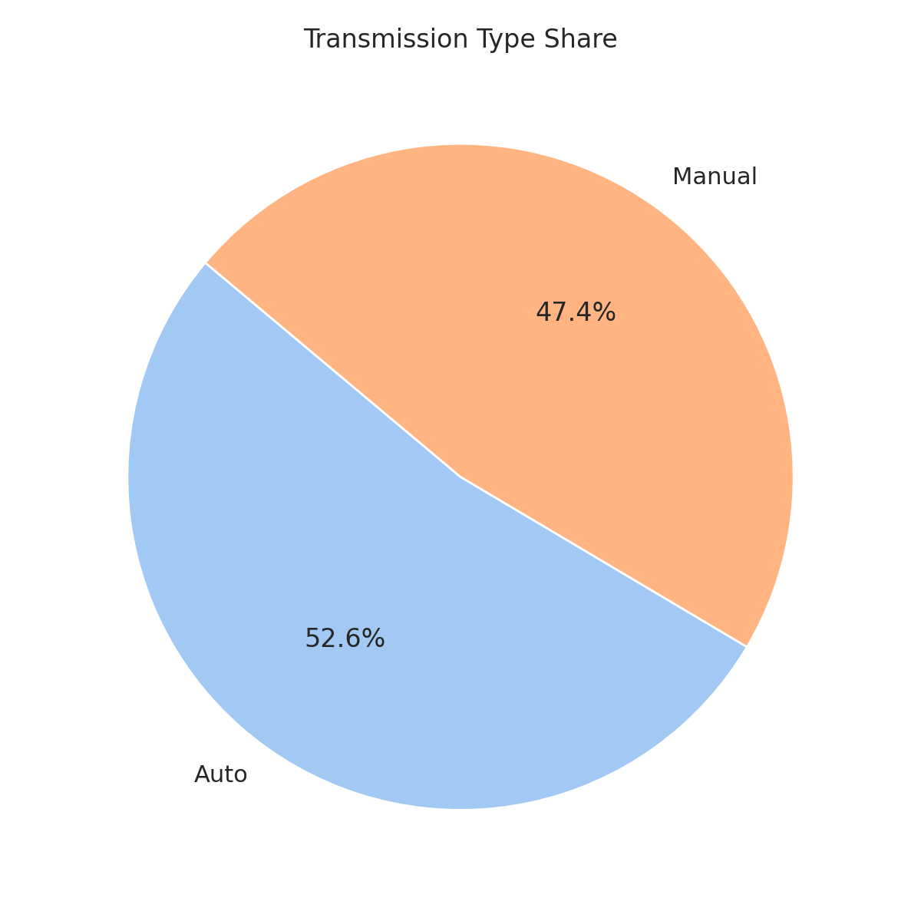
Transmission Share

Slide 6
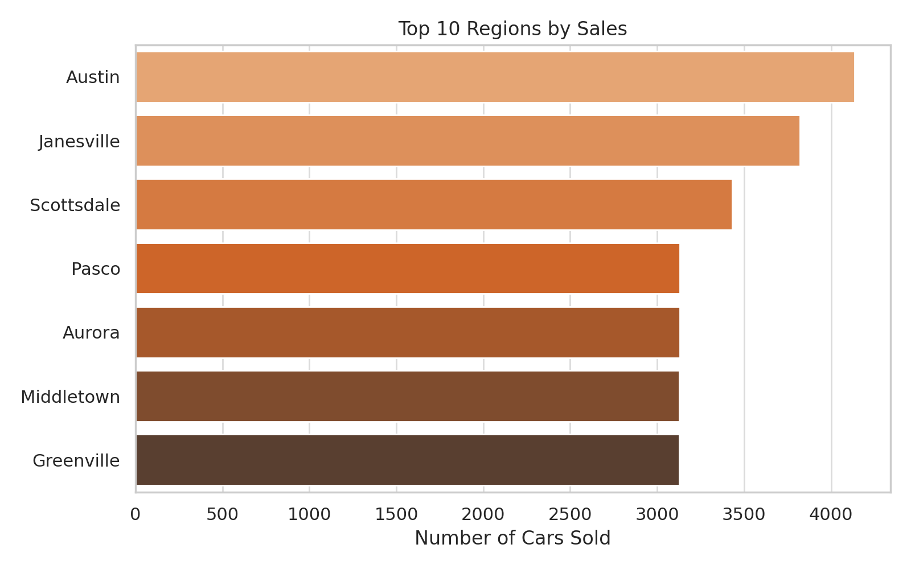
Region Sales

Slide 7
Summary & Recommendations
• Ford and Toyota are leading in used car sales volume.
• Average car prices are higher for premium brands like Cadillac.
• SUV remains the most popular body style.
• Automatic transmission cars dominate the market.
• Focused marketing in top-performing regions like Middletown and Aurora is recommended.

