Slide 1


Image Resolution Enhancer Software Group Project-II-AIML305
Guided By : Dr. Spoorthy. V,
Assistant Professor,
Department of AI/ML.
Team Members : Malak Soni(22AIML053)
Ansh Trivedi(22AIML056)

Slide 2
Content of the Presentation
Introduction( Outline of your Project)
Research Problem and Objectives
Literature Overview and Background
Methodology
Results and Analysis
Discussion
Limitations and Future Work
Conclusion
Department of Computer Science & Engineering ,CSPIT

Slide 3
Introduction
In today's digital age, images are an integral part of our daily lives, used across various industries such as media, healthcare, e-commerce, and more.
Not all the time we receive a high-resolution image(Camera quality/compressed image/etc).
SRCNN is a first deep learning model to produce high resolution images(not accurate in details).
To address this SRGAN (Super-Resolution Generative Adversarial Network) was introduced in 2017 by Christian Ledig.
SRGAN is a model composed of two elements (generator, discriminator).
DIV2K is the dataset on which the SRGAN can be train.

Slide 4
Research Problem and Objectives
Problem: Low-resolution images often fail to meet the standards of modern applications in industries like healthcare, e-commerce, and entertainment. Traditional methods for enhancing image resolution lack accuracy in restoring fine details.
Scope and Objectives:
Develop a solution to enhance low-resolution images using deep learning techniques.
Improve the quality and details of low-resolution images to match the standards of high-resolution images.
Demonstrate the capability of SRGAN in generating realistic high-resolution images for various real-world applications.

Slide 5
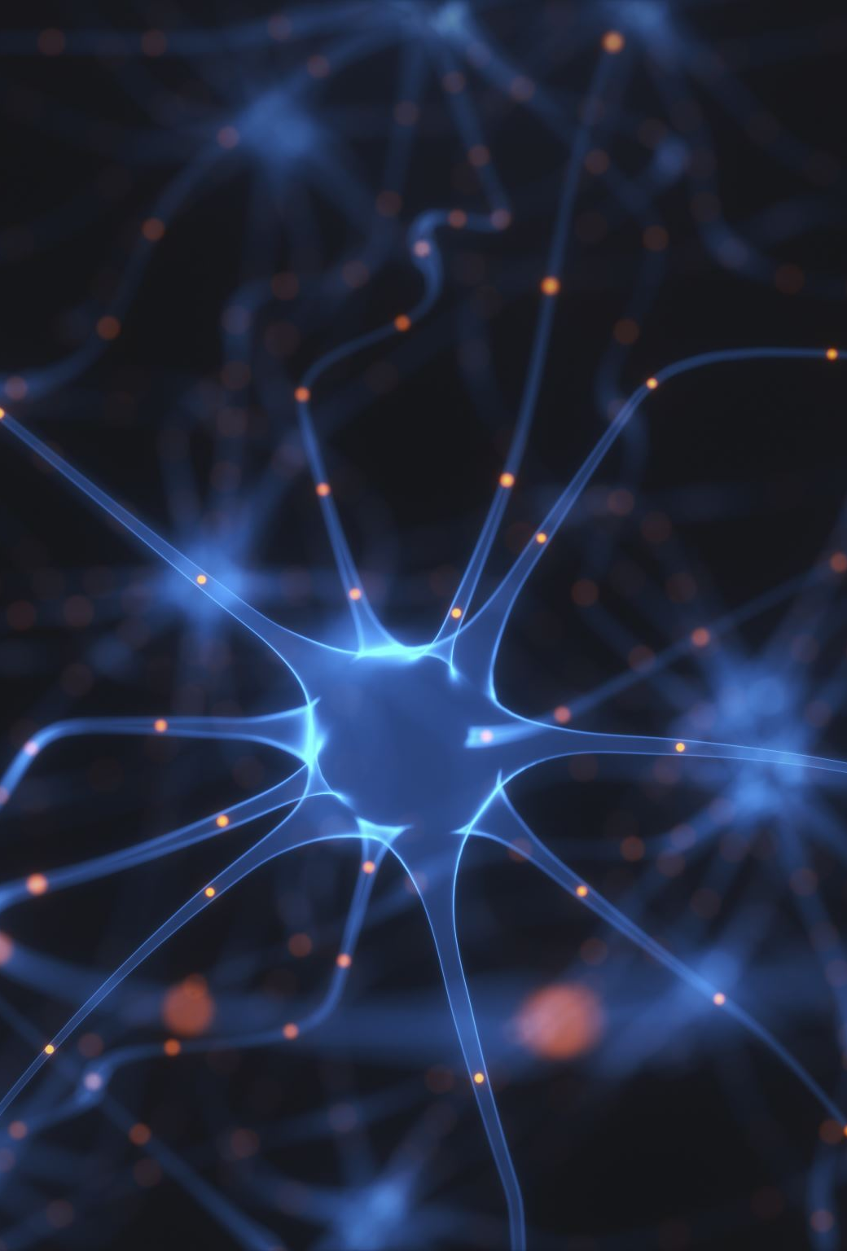
Literature Review / Background
Overview of Related Work:
SRCNN (Super-Resolution Convolutional Neural Network): One of the first deep learning-based methods for image super-resolution , but lacks detail restoration.
SRGAN (Super-Resolution GAN): Introduced in 2017 by Christian Ledig, SRGAN uses a GAN-based architecture (generator and discriminator) to produce realistic high-res images.
Positioning Your Work: This project builds on the foundations of SRGAN and explores its implementation and impact in real-world applications.
Novelty: The innovative aspect lies in leveraging the discriminator feedback in SRGAN to refine image outputs, leading to sharper edges and more realistic textures compared to traditional methods.

Slide 6
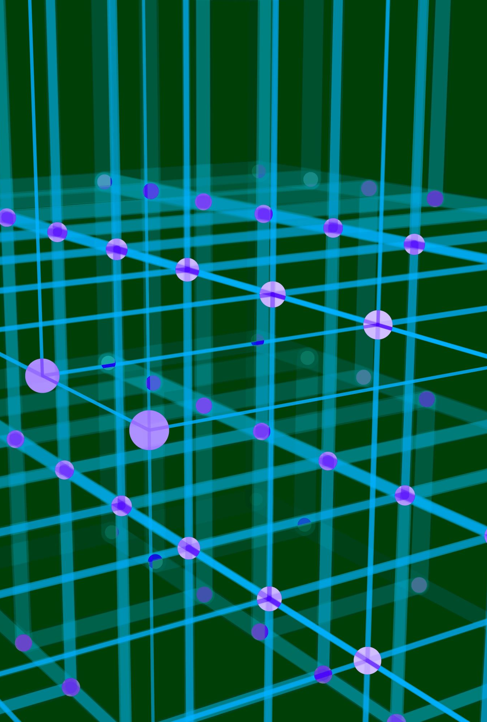
Methodology

Slide 7
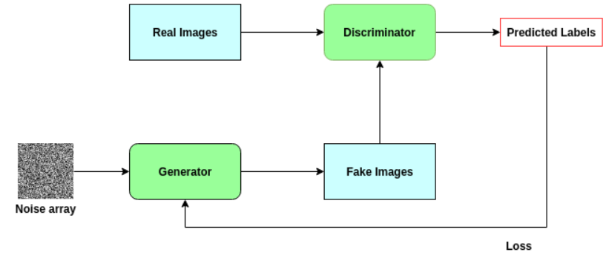
Approach
Generator (SRGAN): The generator in SRGAN takes low-resolution images as input and generates corresponding high-resolution images. It uses a deep convolutional neural network to learn features and upsample the image. The goal is to produce images that are visually close to the real high-resolution ones.
Discriminator (SRGAN):
The discriminator evaluates the generated high-resolution images and differentiates them from real high-resolution images. It uses a binary classification approach to determine whether the input is real or fake. The discriminator's feedback helps the generator improve the quality of its output, leading to more realistic images.

Slide 8
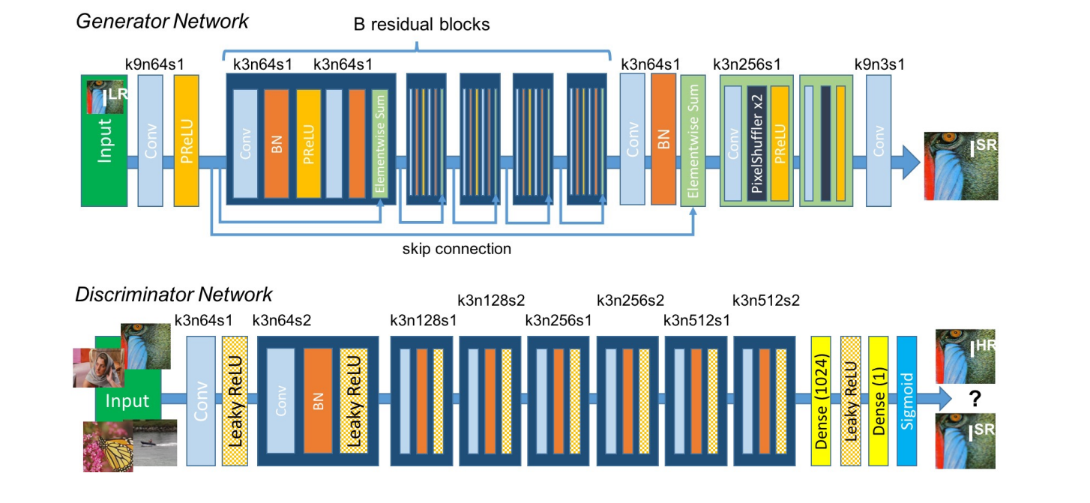
Flow Diagram/ Flow Chart of System

Slide 9
Steps or Phases:
Train the ESRGAN model using the DIV2K dataset.
Evaluate the quality of the generated high-resolution images against the real ones.
Fine-tune the generator using feedback from the discriminator.
Tools and Data:
Tools: Python, PyTorch, OpenCV.
Dataset: DIV2K (contains high-resolution and corresponding low-resolution image pairs).
Data Collection and Analysis:
Low-resolution images are upsampled using ESRGAN.
The output quality is analyzed using metrics such as PSNR (Peak Signal-to-Noise Ratio) and SSIM (Structural Similarity Index).

Slide 10

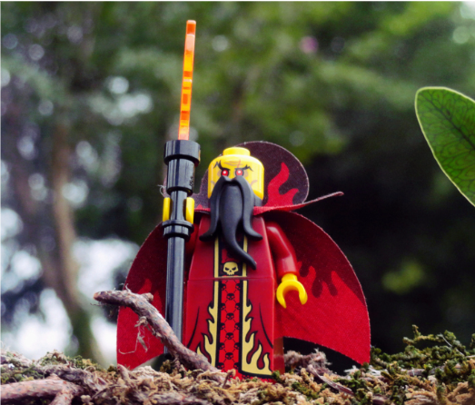
Functions it can perform
Improve size of image & add crisp edges

Slide 11


Results and Analysis

Slide 12
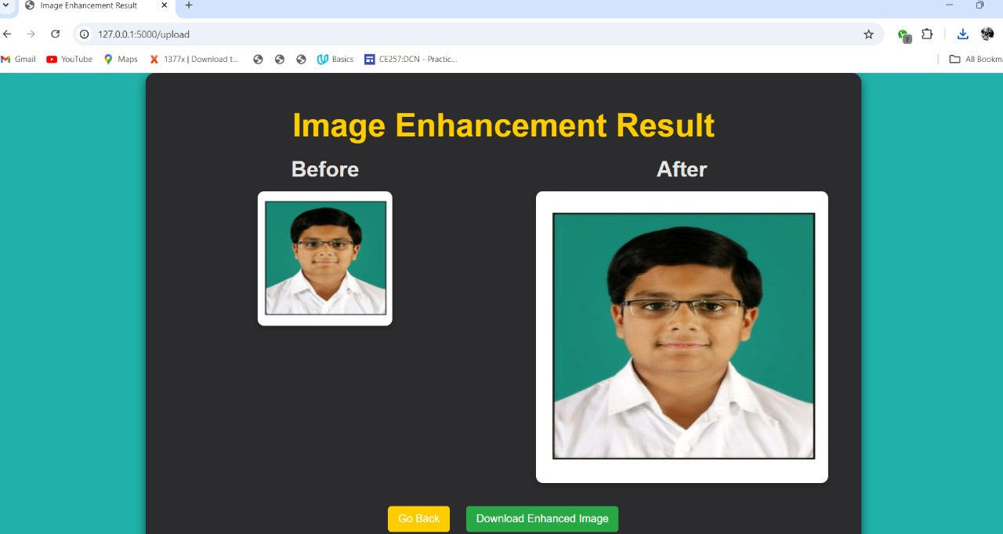

Slide 13

Discussion
Interpret Results: The improved image resolution aligns with the project’s objectives of restoring fine details and achieving realistic visuals.
Insights:
The adversarial training approach (using a generator and discriminator) plays a vital role in improving image quality.
The use of perceptual loss ensures better visual fidelity.
Applications:
Media and entertainment: Enhancing old photos or video quality.
Healthcare: Improving the resolution of medical scans for accurate diagnosis.
E-commerce: Optimizing product images for better customer experience.

Slide 14
Limitations and Future Work
Limitations:
Requires high computational power for training.
May struggle with extremely low-resolution inputs or noisy images.
Future Research:
Optimize ESRGAN for faster and more efficient training on large datasets.

Slide 15
Conclusion
Summary: ESRGAN effectively bridges the gap between low-resolution and high-resolution images, demonstrating its ability to generate realistic results.
Significance: The model can revolutionize industries reliant on high-quality imagery, enabling new applications in healthcare, media, and more.
Closing Statement: This project exemplifies the power of GANs in solving real-world problems and highlights future possibilities in image enhancement.

Slide 16

THANK YOU !!

