Slide 1
Singh Anshuman's Portfolio
Web developer passionate about creating beautiful, aesthetic websites.

Slide 2

About Me
1
Web Developer
Specializes in creating beautiful and aesthetic websites.
2
Passionate
Dedicated to crafting visually appealing online experiences.
3
Skilled
Proficient in various web development technologies.

Slide 3
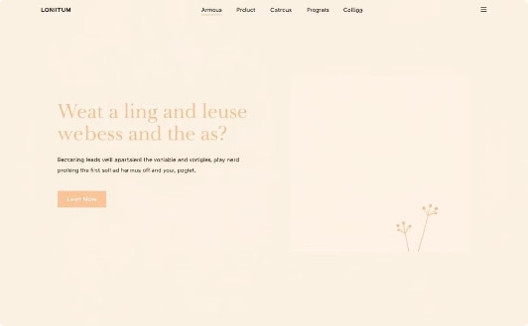
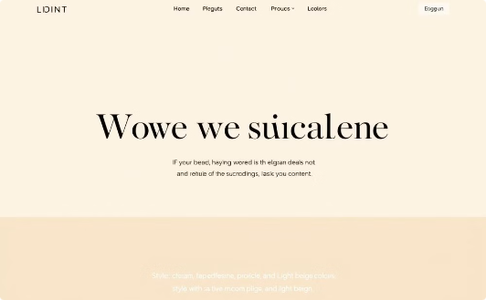
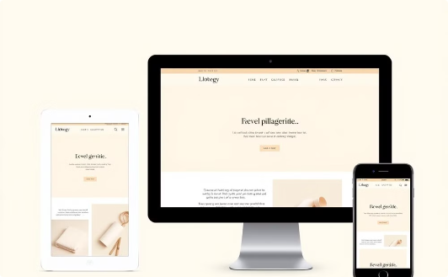
Website Design
Minimalist
Vibrant
Responsive
Clean layouts with focus on essential elements.
Eye-catching designs with bold colors and typography.
Seamless experience across all devices and screen sizes.

Slide 4
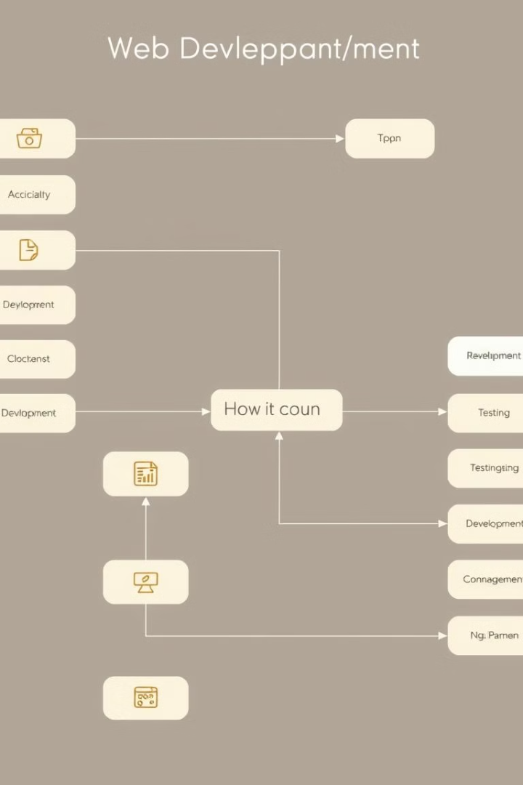
Development Process
1
Planning
Outline project requirements and create wireframes.
2
Design
Develop visual elements and user interface.
3
Development
Code the website using appropriate technologies.
4
Testing
Ensure functionality and compatibility across platforms.

Slide 5





Technical Skills
HTML5
CSS3
Structuring web content effectively.
Styling and layout of web pages.
JavaScript
React
Creating interactive and dynamic web experiences.
Building efficient user interfaces.

Slide 6
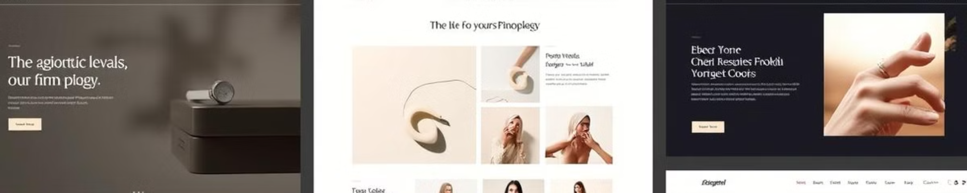
Portfolio Highlights
E-commerce Platform
Blog Template
Responsive design with seamless checkout process.
Minimalist layout focusing on content readability.
Corporate Website
Personal Portfolio
Professional design with intuitive navigation.
Showcase of skills with interactive elements.

Slide 7
Client Testimonials
Sarah K.
Michael R.
Emily T.
"Singh delivered an exceptional website that exceeded expectations."
"Impressive attention to detail and timely delivery."
"Our e-commerce sales increased after the redesign."

Slide 8




Connect With Me
Twitter
Follow for web development tips and insights.
GitHub
Explore my open-source projects and contributions.
LinkedIn
Connect professionally and view my work history.

