Slide 1
Self-Recovering Network Infrastructure using Automated Router Diagnosis
Members:
Anushka Pote (05)
Aditya Suryawanshi (12)
Advait Jog (13)
Anshu Jamare (17)
Guide: Dr. P.R. Selokar
Department of Electronics and Communication Engineering

Slide 2
Introduction
  Network downtime causes productivity loss in offices, IoT setups, and remote monitoring systems.
  Manual intervention for router restart increases recovery time.
  Our system detects connectivity failures and automatically restarts the router using a microcontroller-controlled relay.
  Uses Raspberry Pi Pico (control) + ESP32 (monitoring) for reliability and low cost.

Slide 3
Literature Survey
Sr. No. | Paper/Article referred | Source | Remarks
1 | Development of Programmable Relay Switch Using Microcontroller | 2018, P. Zabala, American Journal of Remote Sensing | Demonstrates microcontroller-based relay control, applicable for automated router restart.
2 | Automatic Router and Server Reset Using ESP8266 | 2017, Gkal, Instructables | IoT-based remote router restart concept - validates ESP-series feasibility.
3 | Reset your router the modern way | 2019, Jenny List, Hackaday | Pings an online service every few seconds, and turns the router off and on again via a power relay in the event that the ping attempt is repeatedly unsuccessful.

Slide 4
Literature Survey
Sr. No. | Paper/Article referred | Source | Remarks
4 | ESP-32 Wi-Fi Network Smart Monitoring System | 2023, Aysar Thamer Naser Tuaimah, SRJECS journal | Validates ESP-32 based failure detection
5 | A Generic IoT Quantum Safe - Watchdog Timer Protocol | 2023, ACM Digital Library | Provides restart logic for IoT based devices, backs self-recovery

Slide 5
Impact of project on Societal issues
  Reduced Downtime: Ensures uninterrupted internet connectivity for work-from-home employees, offices, and remote learning setups.
  Increased Productivity: Minimizes time wasted in manually troubleshooting routers.
  Better Accessibility: Useful for people in rural/remote areas where technician access is limited.
  Emergency Applications: Keeps surveillance, healthcare IoT, and disaster management systems online without human intervention.

Slide 6
Impact of project on Environmental issues
  Energy Efficiency: Automatic restart avoids unnecessary router run-time during failure conditions, reducing wasted power consumption.
  Device Longevity: Controlled restart sequence reduces stress on router hardware, extending life and preventing e-waste.
  Low-Power Hardware: Raspberry Pi Pico and ESP32 are low-power microcontrollers, contributing to reduced overall energy footprint.
  Scalable Design: Encourages repair/upgrade over replacement, indirectly reducing electronic waste generation.

Slide 7
Financial aspects of the project
  Low-Cost Build: Approx. ₹1,500 for Prototype.
  Saves Money: Reduces downtime losses and technician visits.
  Fast ROI: Pays for itself in a few months for high-dependency networks.
  Commercial Potential: Can be sold as a “Network Uptime Kit”.

Slide 8
Components Used
  ESP32: Monitors internet connectivity (ping/DNS check).
  Raspberry Pi Pico: Receives failure alerts via UART and controls relay.
  Relay Module (5V Optocoupler): Power cycles the router.
  LM2596 Buck: Converts High Adapter voltage into 5V for the microcontrollers.
  LEDs: Used to show status of relay (ON/OFF/FAULTY)

Slide 9
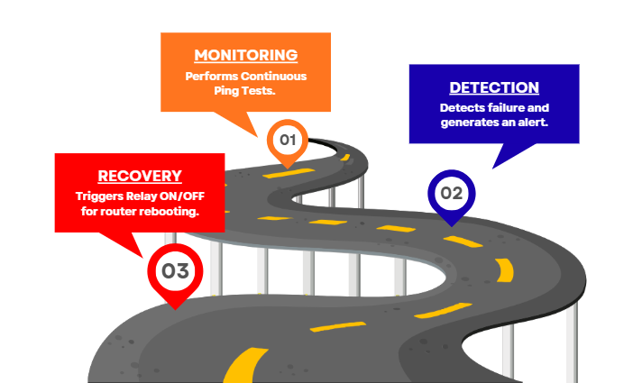
Workflow of the Project

Slide 10
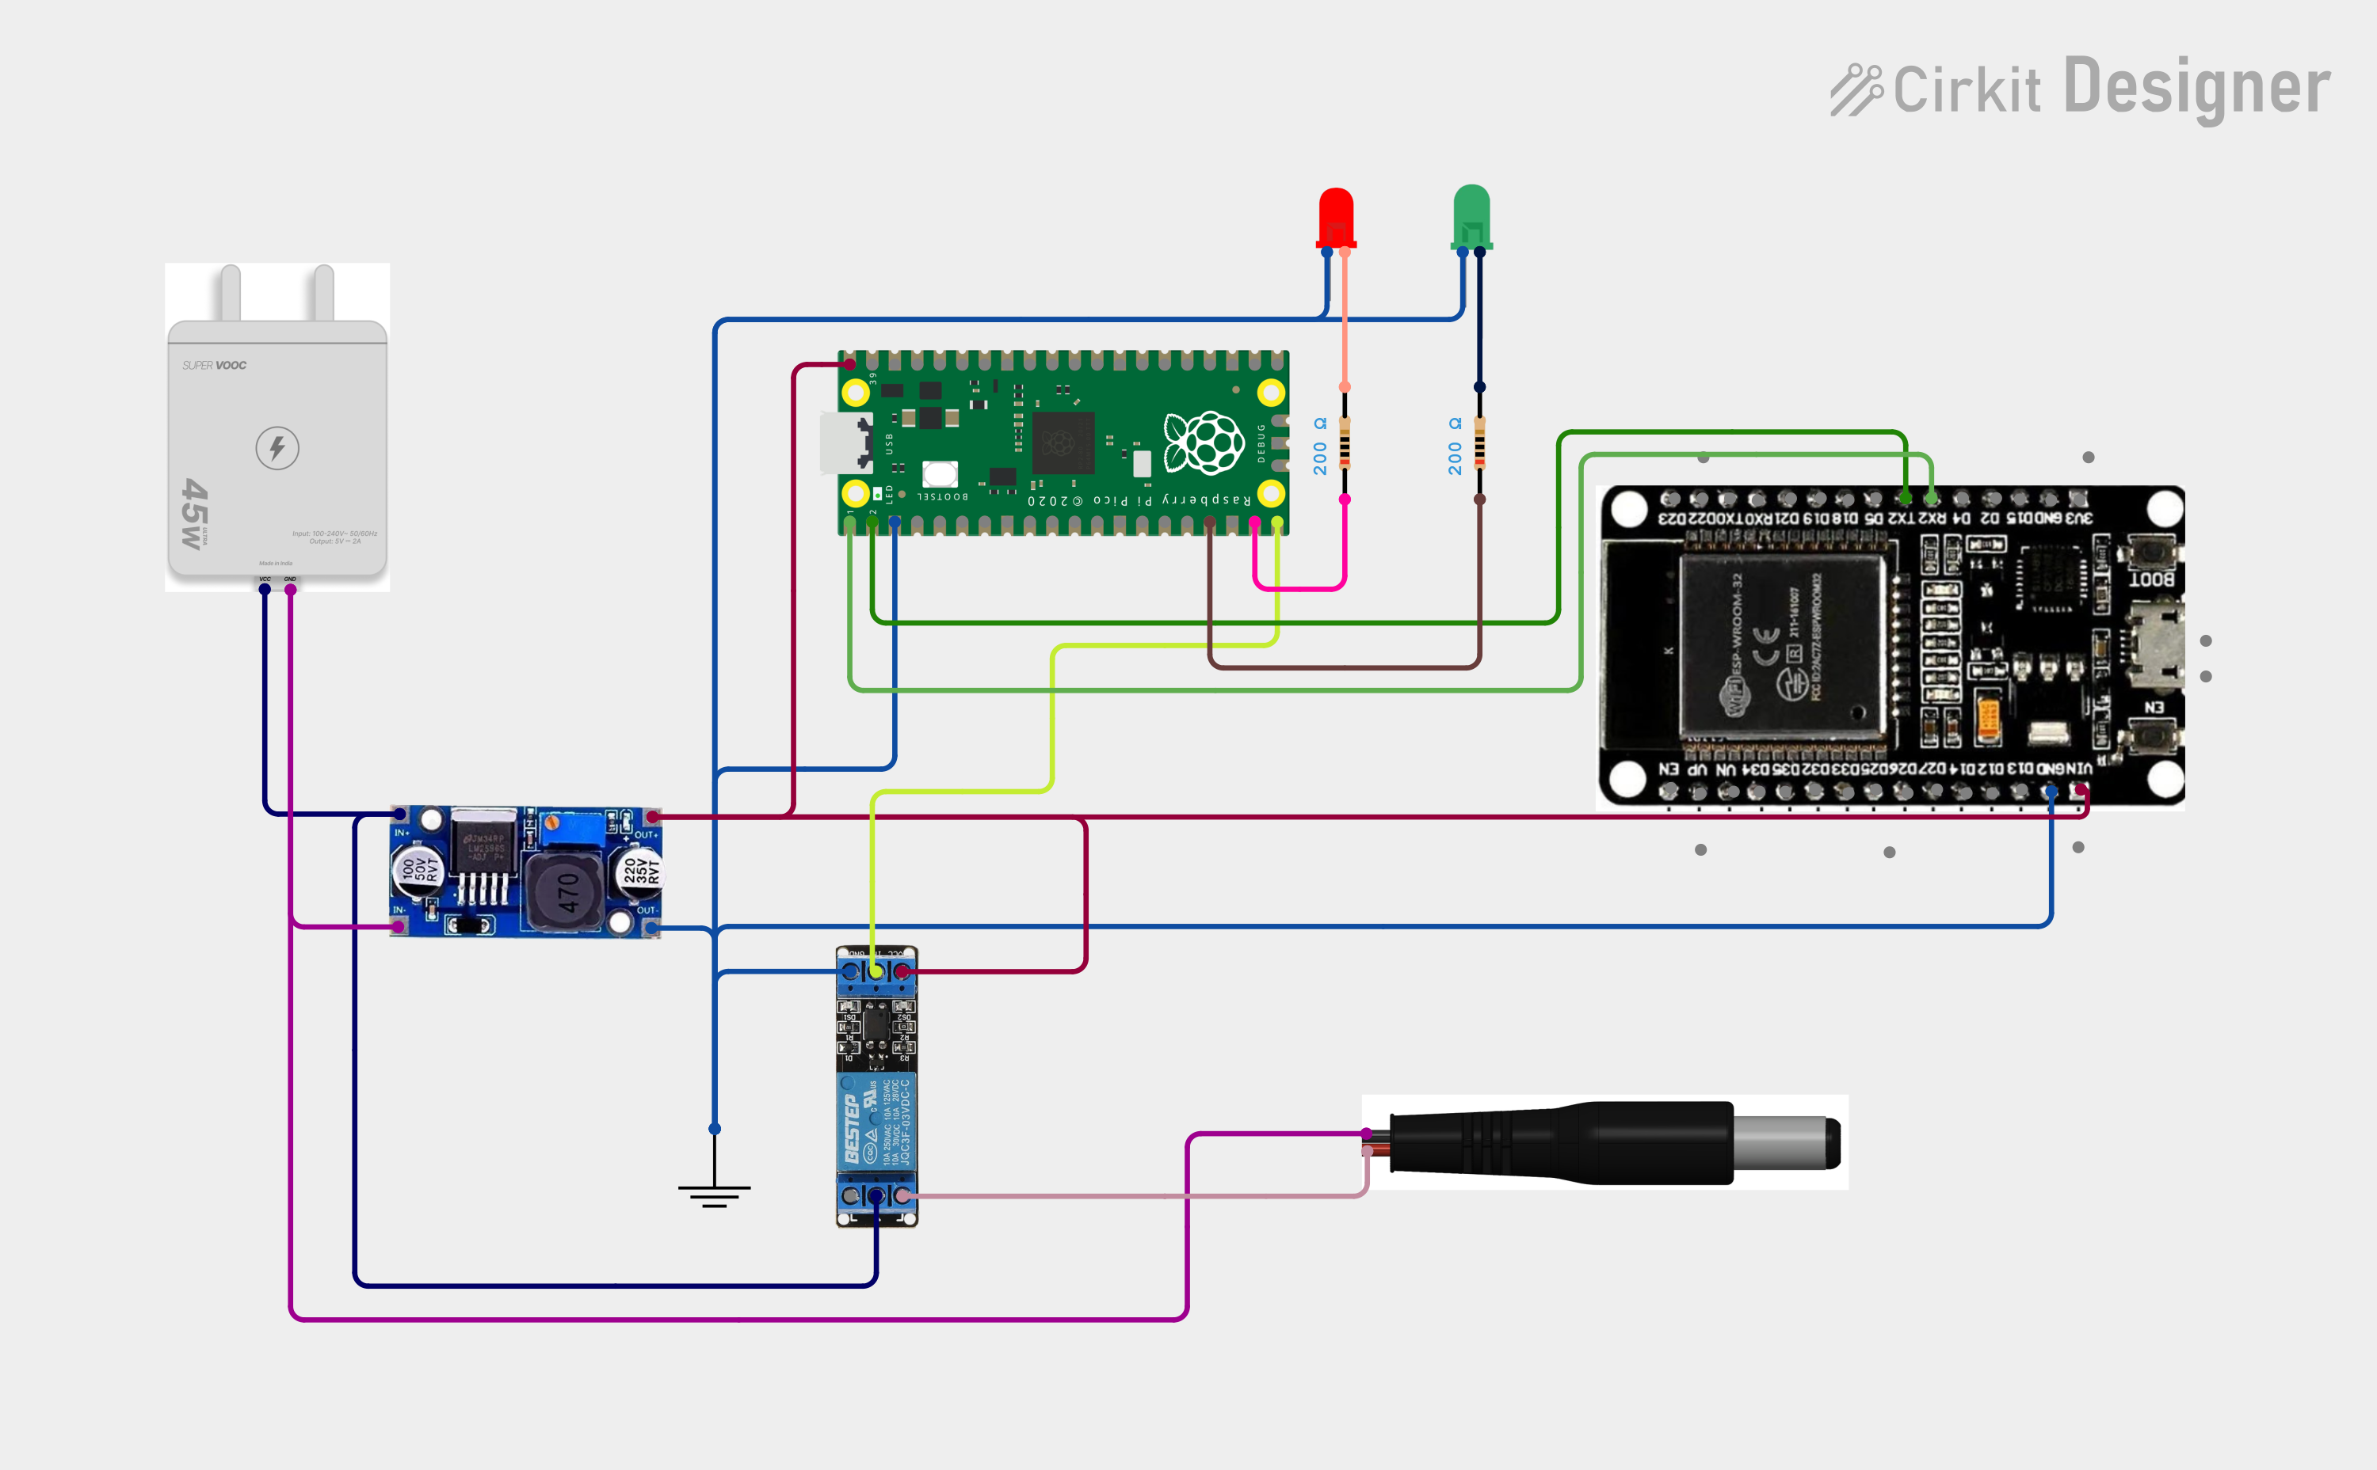
Circuit Diagram

Slide 11
Performance Analysis
Please refer to the video.

Slide 12
Conclusion
1. Conclusion:
  The proposed system is a reliable, low-cost solution for autonomous network
  recovery. It leverages Rpi Pico and ESP32 for efficient fault detection and recovery,
  reducing downtime without human intervention.
2. Future Scope:
    Multi-router support.
    Web-based monitoring dashboard.
    Surge protection.
    Fault logging and analysis.
    SMS/Email alerts.

Slide 13
References
1) P. Zabala et al., “Development of Programmable Relay Switch Using Microcontroller,” Asian Journal of Research in Science, 2018.
2) “Automatic Router and Server Reset Using ESP8266,” Instructables, 2017.
3) “Reset your router the modern way” Jenny List, Hackaday, 2019.
4) “ESP-32 Wi-Fi Network Smart Monitoring System” Aysar Thamer Naser Tuaimah, SRJECS journal, 2023
5) “A Generic IoT Quantum Safe - Watchdog Timer Protocol” ACM Digital Library, 2023

