Slide 1
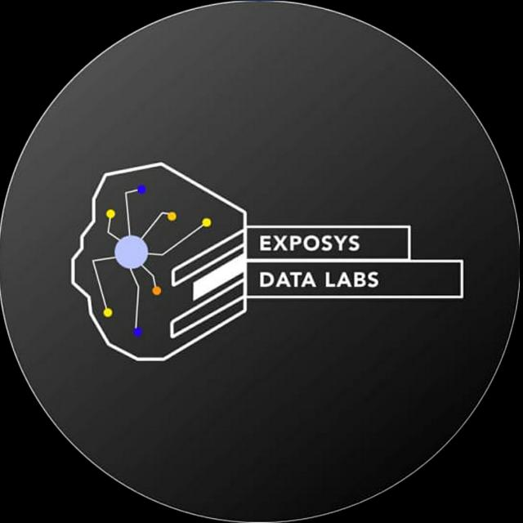
Implementing Customer Segmentation
using K-means clustering Algorithm
Internship Project
Presented
By
Anshu Kumari

Slide 2
Overview
Introduction
Customer Segmentation
Benefits of Customer Segmentation
Dataset for clustering
Data Information
Existing Methods
K-Means Algorithm
Optimal Number of Clusters
Technical Dependency
Clustering Results
Analysis
Conclusion

Slide 3
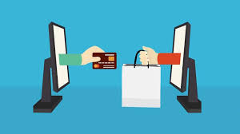
Introduction
Why do we need Clustering?
Ecommerce transactions are no longer a new thing. Many people shop with ecommerce and many companies use ecommerce to promote and to sell their products. Because of that, overloading information appears on the customers’ side. Overloading information occurs when customers get too much information about a product then feel confused. Personalization will become a solution to overloading problem.
After identification of targeted customers and their associative buying pattern, the business managers take the strategic profitable decisions accordingly.

Slide 4
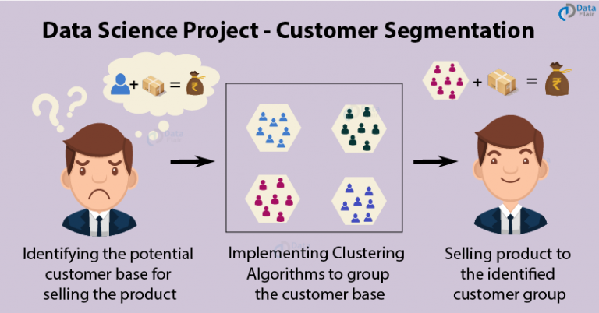
Customer Segmentation
Customer Segmentation is an important aspect in marketing campaigns, in identifying potentially profitable customers, and in developing customer loyalty.
It is the subdivision of a market into discrete customer group that share similar characteristics.
It can be a powerful means to identify unsatisfied customer needs.

Slide 5
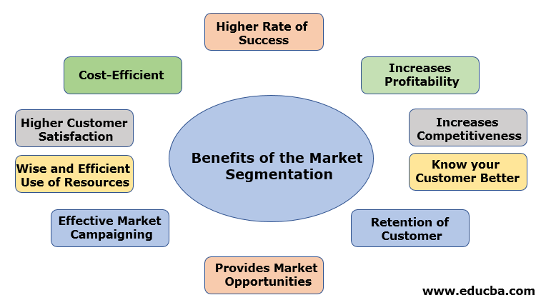
Benefits of Customer Segmentation
Marketing efficiency
Determine new market opportunities
Better brand strategy
Improve distribution strategies
Customer retention
Understand Customer’s digital behaviours
Benefits of Customer Segmentation

Slide 6
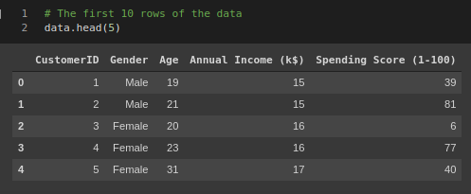
Dataset for clustering
I have given a dataset from a supermarket mall and through membership cards, we have some basic data about our customers like Customer ID, age, gender, annual income and spending score, which is something we assign to the customer based on our defined parameters like customer behavior and purchasing data.
The main aim of this problem is learning the purpose of the customer segmentation concepts, also known as market basket analysis, trying to understand customers and separate them in different groups according to their preferences, and once the division is done, this information can be given to marketing team so they can plan the strategy accordingly.

Slide 7
Data Information
This dataset is composed by the following five features:
CustomerID: Unique ID assigned to the customer
Gender: Gender of the customer
Age: Age of the customer
Annual Income (k$): Annual Income of the customer
Spending Score (1-100): Score assigned by the mall based on customer behavior and spending nature.
In this particular dataset we have 200 samples to study.

Slide 8
Existing Methods
K-Means Algorithm
MiniBatch K-means
Hierarchical Clustering
DBSCAN
GMM Algorithm
MeanShift

Slide 9
K-Means Algorithm
K-Means is a very common and popular clustering algorithm used by many developers all over the world. Apply K-Means Algorithm on a Dataset by using following steps:
Step 1: Specify number of clusters K.
Step 2: Initialize centroids by first shuffling the dataset and then randomly selecting K data points for the centroids without replacement.
Step 3: Keep iterating until there is no change to the centroids. i.e assignment of data points to clusters isn’t changing.

Slide 10

Optimal Number of Clusters
In K-Means algorithm, we need to always specify the number of clusters that we need the data set clustered into. Here, we use Elbow method to do so. In this method we use a term called WCSS. It measures sum of distances of observations from their cluster centroids which is given by the below formula.
where Yi is centroid for observation Xi. The main goal is to maximize number of clusters and in limiting case each data point becomes its own cluster centroid.

Slide 11
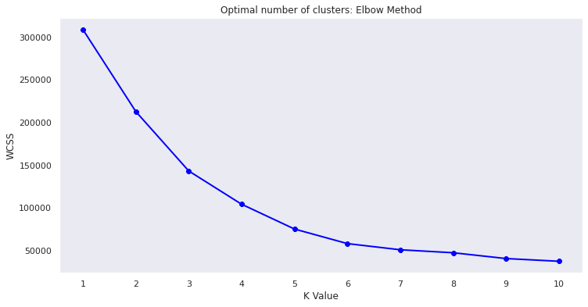
Optimal Number of Clusters

Slide 12
Technical Dependency
1. scikit-learn - 0.23.2
2. seaborn - 0.11
3. Numpy -1.19
4. Pandas-1.1.2
5. Matplotlib-3.3.2

Slide 13
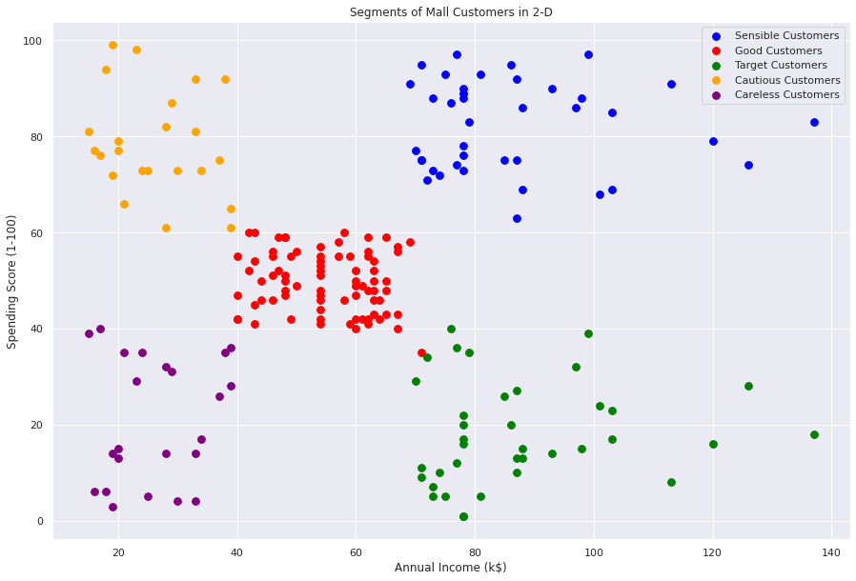
Clustering Results

Slide 14
Analysis
Sensible customers: The blue cluster groups young people with moderate to low annual income who actually spend a lot.
Good customers: The red cluster groups reasonably young people with pretty decent salaries who spend a lot.
Target customers: The green cluster basically groups people of all ages whose salary isn't pretty high and their spending score is moderate.
Cautious customers: The orange cluster groups people who actually have pretty good salaries and barely spend money, their age usually lays between thirty and sixty years.
Careless customers: The purple cluster groups whose salary is pretty low and don't spend much money in stores, they are people of all ages.

Slide 15
Conclusion
After developing a solution for this problem, we have come to the following conclusions:
K-Means Clustering is a powerful technique in order to achieve a decent customer segmentation.
Customer segmentation is a good way to understand the behaviour of different customers and plan a good marketing strategy accordingly.
There isn't much difference between the spending score of women and men, which leads us to think that our behaviour when it comes to shopping is pretty similar.
Observing the clustering graphic, it can be clearly observed that the ones who spend more money in malls are young people. That is to say they are the main target when it comes to marketing, so doing deeper studies about what they are interested in may lead to higher profits.
Although younglings seem to be the ones spending the most, we can't forget there are more people we have to consider, like people who belong to the pink cluster, they are what we would commonly name after "middle class" and it seems to be the biggest cluster.
Promoting discounts on some shops can be something of interest to those who don't actually spend a lot and they may end up spending more.

Slide 16


