Slide 1
Basics of Cascading Style Sheet -3

Slide 2
Contents
CSS Rule
Types of Selector
Nesting of selectors
What’s new in CSS 3
  border-radius
  box-shadow
  -webkit-animation
  -webkit-keyframes
  -webkit-transform
  DEMO

Slide 3
1. CSS Rule
Selector
Declaration Block
div {
font-family: Tahoma;
color: white;
background: green;
margin: 8px;
text-align: center;
}
Attribute Name
Value

Slide 4
2. Types of Selector
There are 3 types of selector :
  By html tag name directly.(Eg, div,h1,p)
  By Id of the html tag. (Eg, #demo1,#test)
  By Class of the html tag. (Eg, .demo2,.test)
Demo
Html tag
Id of the tag (#)
Class of the tag(.)
div {
font-family: Arial;
color: white;
background: red;
margin: 8px;
text-align: center;
}
#demo1 {
font-family: Arial;
color: white;
background: red;
margin: 8px;
text-align: center;
}
.demo2 {
font-family: Arial;
color: white;
background: red;
margin: 8px;
text-align: center;
}

Slide 5
CSS:
HTML:
div {
font-family: Tahoma;
color: white;
background: green;
margin: 8px;
text-align: center;
}
#demo1 {
font-family: Arial;
color: white;
background: red;
margin: 8px;
text-align: center;
}
.demo2 {
font-family: sans-serif;
color: white;
background: blue;
margin: 8px;
text-align: center;
}
<!DOCTYPE HTML>
<html>
<head>
<title>Sample 1</title>
<link rel="stylesheet" href="sample1.css" />
</head>
<body>
<div>This is the sample code which shows Tag as a selector.</div>
<div id="demo1" >This is the sample code which shows ID as a selector.</div>
<div class="demo2" >This is the sample code which shows Class as a selector.</div>
</body>
</html>

Slide 6
3. Nesting of selectors
Css provide facility to nest the selectors also.
There are so many ways through which we can nest selectors. Some of the common used are:
  , CSV (Comma separated value): When we use CSV then the properties will be applicable for all of the selectors.
  (Space): When we use Space then the browser will start from first selector, search for second selector completely inside the first selector (In this case it will search for the children of its own child also) and so on.
  > (Greater than): When we use greater sign then the browser will start from first selector, search for second selector inside the first selector( In this case it will search for its immediate children only) and so on.
  We can nest any number of selectors and we can also use combination of these all to give style to any element
Demo

Slide 7
4. What’s new in CSS 3
Border radius:
    It is one of the important property in Css-3.
    If we want to give some random shape then it is very helpful.
    The order is :
      Top-left
      Top-right
      Bottom-right
      Bottom-left
    With these property we can make circle with a simple one line.
Example :border-radius: 25px 10px 10px 25px;
    #Example_F {
        height: 70px;
        width: 70px;
        background:brown;
        border-radius: 35px;
    }
Demo

Slide 8
4. What’s new in CSS 3
Box shadow:
    - It will be very useful to give look and feel to the box.
    If we want to give some shadow then it is very helpful
    The order is :
      H-shadow
      V-shadow
      blur
      Spread
      Color
      inset
    With these property we can make box look very attractive
Demo
    #Example_D {
        border:5px solid blue;
        background-color:orange;
        width: 144px;
        height: 144px;
        border-radius: 20px;
        box-shadow:10px 10px 0 10px /* spread */ rgba(0,0,0,0.4) inset
    }

Slide 9
4. What’s new in CSS 3
Webkit-animation:
    - It will be very useful to give animation and make your webpage very attractive.
    If we want to give some animation (like rabbit running, jumping ball) then it is very helpful
    The order is :
      Animation-name
      Animation-duration
      Animation-timing function
      Animation iteration count
      Animation direction
    .ball {
    width: 50px;
    height: 50px;
    background: #00c6ff;
    border-radius: 50px;
    position:relative;
    -webkit-animation:mymove 3s linear 2 alternate;
    }

Slide 10
4. What’s new in CSS 3
Webkit-keyframes:
    It is used with webkit animation to apply some property to the selector.
    It more or less similar like calling a function
    Webkit animation will call webkit keyframes to apply some property to the elements.
    .ball {
    width: 50px;
    height: 50px;
    background: #00c6ff;
    border-radius: 50px;
    position:relative;
    -webkit-animation:mymove 3s linear 2 alternate;
    }
    @-webkit-keyframes mymove {
    0% {top:0px; background:red; width:100px;}
    100% {top:200px; background:yellow; width:300px;}
    }

Slide 11
4. What’s new in CSS 3
Webkit-transform:
    It is used with webkit keyframes to apply some property to the selector.
    It can be used individually also if needed.
    @-webkit-keyframes mymove /* Safari & Chrome */
    {
    0% {-webkit-transform:translate(0px,0px);}
    10% {-webkit-transform:translate(150px,250px);}
    20% {-webkit-transform:translate(450px,0px);}
    30% {-webkit-transform:translate(700px,250px);}
    40% {-webkit-transform:translate(910px,75px);}
    50% {-webkit-transform:translate(800px,0px);}
    60% {-webkit-transform:translate(500px,250px);}
    70% {-webkit-transform:translate(400px,0px);}
    80% {-webkit-transform:translate(300px,250px);}
    90% {-webkit-transform:translate(150px,0px);}
    95% {-webkit-transform:translate(100px,250px);}
    100% {-webkit-transform:translate(0px,0px);}
    }
Demo

Slide 12

Demo's

Slide 13
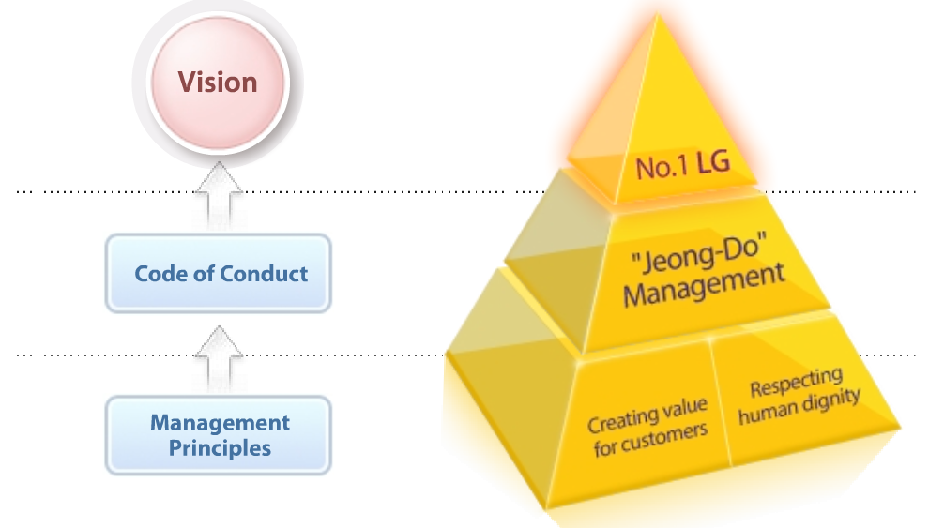

Thank You

