Slide 1
Famo.us
By:
Anshu Agrawal

Slide 2
Contents
What is Famo.us?
Main features.
Some Imp Facts (Minimum Frame rate).
Famo.us architecture.
Famo.us API.
Surfaces and renderables.
Comparison with 3D rendering libraries.
Working Demo

Slide 3
What is Famo.us
At its core, Famo.us is a cross-browser, high-performance UI layout, and optimization library with its own animation and physics engine — written in JavaScript.
Famo.us is optimized to perform its work within the shortest possible time per frame. (A recent Famo.us benchmark shows that Famo.us can take as little as 1 to 2 ms per 16.7 ms frame while it handles typical animation and has no performance overhead otherwise.)
The target UI can then be rendered at the best possible frame rate — typically a minimum of 60 fps. The Famo.us project is committed to maintaining or improving this fps performance in all subsequent releases.

Slide 4
Main features
Open-source and free
Usable with AngularJS
iOS and Android support (including buggy desktop support)
3D layout engine
3D physics based animation library
Minimum 60 fps animations
Can be rendered to DOM (Canvas, or WebGL are in a roadmap)
Supports Cordova, PhoneGap, Trigger.io or Crosswalk plus its own native wrapper

Slide 5
Some Imp Facts (Minimum Frame rate)
Animation is created by the rapid display of successive pages (frames) with changed elements.
Frame rate is the number of frames that are displayed per second.
A high frame rate creates the optical illusion of motion because of the latency in human vision (the same principle behind motion pictures).
To create animation on web pages, elements' style attributes — position, color, and opacity — are modified every frame.
How quickly these attributes can be updated ultimately determines the maximum frame rate of a UI.
For interaction with web applications, 60 frames per second (fps) is deemed the optimal rate for a smooth, native-application-like UX.
When 60 fps can't be achieved consistently, undesirable UX effects such as jerkiness and dropouts (known collectively as Jank) occur.

Slide 6
Famo.us Architecture
Operationally, Famo.us replaces typical DOM-centric layout operations and 2D or 3D animations with its own high-performance alternative.
Figure 1 illustrates the inner workings of Famo.us.
The Famo.us engine (a singleton object) is called for every frame by the browser's requestAnimationFrame() (rAF) callback function. Sixty times per second corresponds to 60 fps or 1/60s (16.7 ms) per frame.
Each callback is known as an engine tick in Famo.us.

Slide 7
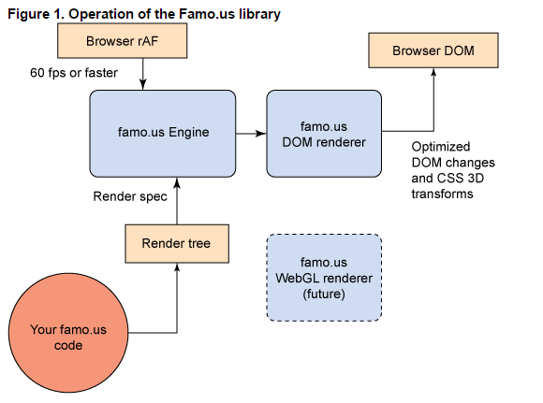

Slide 8
The Famo.us API
The Famo.us API presents its own set of high-level composable objects — such as surfaces, views, and widgets— to the developer. Your Famo.us code creates the scene graph to be rendered (currently called a render tree in Famo.us), wires up event handling, and directs or schedules animations.
Each node in the Famo.us scene graph is a render node. The scene graph is processed into render spec and build spec intermediary representations that the Famo.us rendering component uses internally to make updating of the target more efficient.
The rendering component evaluates the scene graph at the supported frame rate (currently 60 fps) and outputs the required updates to the browser's DOM, a Canvas element, or WebGL. (The beta implementation of Famo.us targets the browser's DOM only.) Famo.us is designed to output to any of its supported targets — even simultaneously (supporting multimode operations) — on the same screen.

Slide 9
Surfaces and renderables
In Famo.us, you compose and animate renderables. The lowest-level common renderable that you work with is a Surface.
A Surface displayed in the browser's DOM is a <div> element. (If you inspect a Famo.us Surface, you can see the <div>.) Other specialized types of surfaces in Famo.us are represented by other HTML5 elements:
Surface is a <div>.
VideoSurface is a <video>.
ImageSurface is a <img>.
InputSurface is a <input>.
CanvasSurface is a <canvas>.
The Surface class has a content field. This field is where you add the HTML to be rendered on the Surface (within the underlying <div>).

Slide 10
Comparison with 3D rendering libraries
This architecture of Famo.us is similar to WebGL 3D-rendering JavaScript libraries, including Three.js and SceneJS.
Frame rendering is triggered by browser rAF in all architectures.
3D libraries often include a physics engine to make animation more realistic. Famo.us includes a full physics engine to make animations more intuitive to the user.
HTML has no role in a 3D library other than the Canvas element being the element that the 3D viewport is rendered on. In Famo.us, HTML is what you render on a surface, but HTML no longer defines the structure of the UI page; the structure is specified in JavaScript code. You no longer need to manage a raft of< <div> or <table> tags to control layout; and CSS is used only to affect element style, not layout. (HTML is still important because — when the DOM is targeted — all visual elements are HTML elements.)

Slide 11
WORKING DEMO

Slide 12
THANKS

