Slide 1
JavaScript Test Framework
By:
Anshu Agrawal

Slide 2
Contents
Mocha.
Chai.
Difference between Mocha and Chai.
Sample Example.
Sinon.
Where it is used in Enyo.
Working Demo

Slide 3
MOCHA
Mocha is a feature-rich JavaScript test framework running on node.js and the browser, making asynchronous testing simple and fun.
Mocha tests run serially, allowing for flexible and accurate reporting, while mapping uncaught exceptions to the correct test cases.
npm install -g mocha

Slide 4
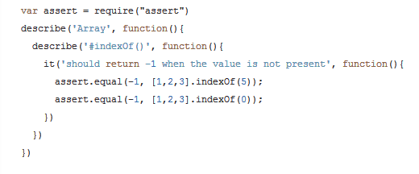
Sample of Mocha Test Framework

Slide 5
Assertions
Mocha allows you to use any assertion library you want, if it throws an error, it will work!
This means you can utilize libraries such as should.js, node's regular assert module, or others.
The following is a list of known assertion libraries for node and/or the browser:
should.js BDD style
expect.js expect() style assertions
chai expect(), assert() and should style assertions
better-assert c-style self-documenting assert()

Slide 6
CHAI
Chai is a BDD / TDD assertion library for node and the browser that can be delightfully paired with any javascript testing framework.
npm install chai

Slide 7
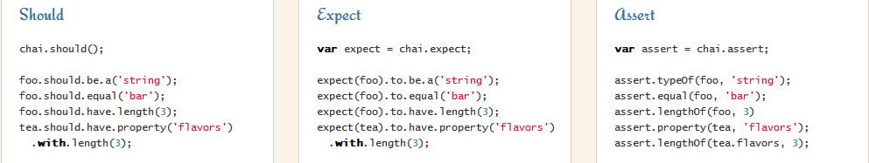
Chai Interfaces
Chai has several interfaces that allow the developer to choose the most comfortable. The chain-capable BDD styles provide an expressive language & readable style, while the TDD assert style provides a more classical feel.

Slide 8
The mocha testing framework and the chai expectation library
Mocha is a test framework while Chai is an expectation one.
Let’s say Mocha sets up and describes test suites and Chai provides convenient helpers to perform all kinds of assertions against your JavaScript code.
Both Mocha and Chai can be used in a Node environment as well as within the browser

Slide 9
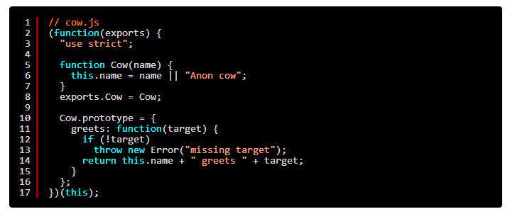
Example: We have a Cow object we want to unit test

Slide 10
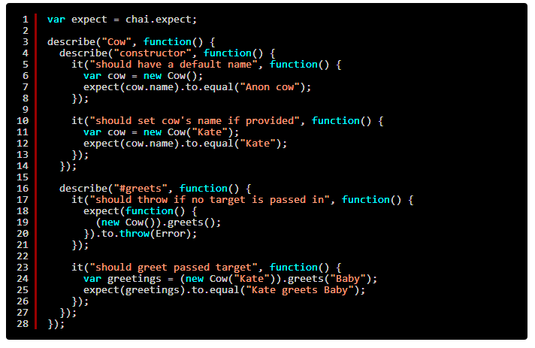
A simple test suite for our Cow object

Slide 11
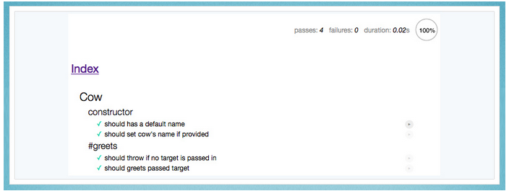
Result: If you open the HTML document in your browser, you should get something like:

Slide 12
SINON
When you do unit testing, you don’t want to depend on stuff external to the unit of code under test. And while avoiding your functions to have side effects is usually a good practice, in Web development it’s not always easy task (think DOM, Ajax, native browser APIs, etc.)
Sinon is a great JavaScript library for stubbing and mocking such external dependencies and to keep control on side effects against them.
Standalone test spies, stubs and mocks for JavaScript.
No dependencies, works with any unit testing framework.
npm install sinon

Slide 13
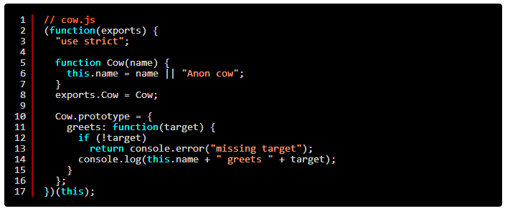
Sinon Example
Let’s imagine that our Cow#greets method wouldn’t return a string but rather directly log them onto the browser console:

Slide 14
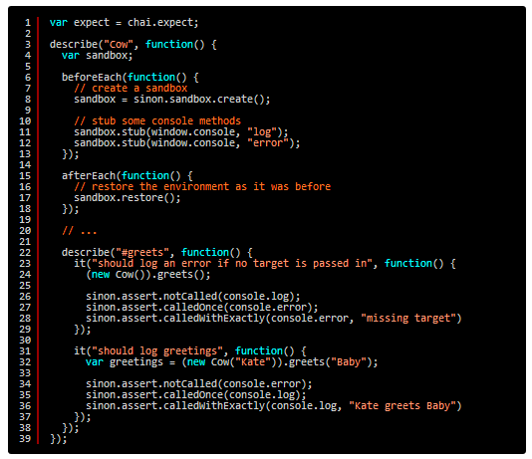
We’ll stub the console object’s log and error methods so we can check they’re called and what’s passed to them:

Slide 15
Where it is used in Enyo.
Binding.js
BindingSupport.js
Collection.js
DataGridList.js
DataRepeater.js
Model.js
RelationalModel.js
….
…..

Slide 16
WORKING DEMO

Slide 17
Reference points/links:
Mocha - http://visionmedia.github.io/mocha/
Chai – http://chaijs.com/
3) Sinon – http://sinonjs.org/
4) Samples –
http://blog.codeship.io/2014/01/22/testing-frontend-javascript-code-using-mocha-chai-and-sinon.html

Slide 18
THANKS

