Slide 1
Introduction to Web Components
By:
Anshu Agrawal

Slide 2
Introduction
Web Components are a collection of standards which are working their way through the W3C and landing in browsers as we speak.
In a nutshell, they allow us to bundle markup and styles into custom HTML elements.
What's truly amazing about these new elements is that they fully encapsulate all of their HTML and CSS.
That means the styles that you write always render as you intended, and your HTML is safe from the prying eyes of external JavaScript.
Web Components are a collection of building blocks, not a single thing.

Slide 3
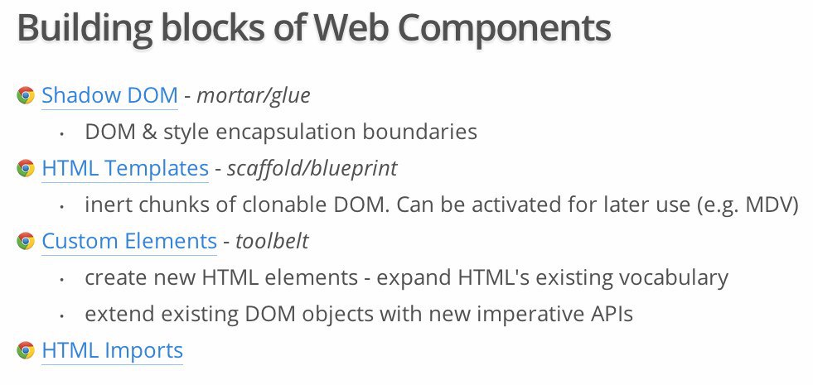

Slide 4
Explanation of Building Blocks
Shadow DOM allows us to encapsulate DOM and CSS.
HTML Templates are a way of having a clonable DOM that can be reused on the page.
Custom elements can either create new or extend existing elements. That means that a developer can, for example, extend the input element to support only credit card number format or they can create a new element which will contain all the fields required for credit card payment.
HTML Imports are a way of including web components into the page without having them inline in the code.

Slide 5
HTML Templates
Every good construction project has to start with a blueprint, and with Web Components that blueprint comes from the new <template> tag.
The template tag allows you to store some markup on the page which you can later clone and reuse.
Templates allow you to declare fragments of markup which are parsed as HTML, go unused at page load, but can be instantiated later on at runtime.
Everything inside a template is considered inert by the browser.
This means tags with external sources—<img>, <audio>, <video>, etc.—do not make http requests and<script> tags do not execute. It also means that nothing from within the template is rendered on the page until we activate it using JavaScript.

Slide 6
Shadow DOM & its terminologies
To create shadow DOM, select an element and call its createShadowRoot method.
This will return a document fragment which you can then fill with content.
Shadow Host
In shadow DOM parlance, the element that you call createShadowRoot on is known as the Shadow Host.
It's the only piece visible to the user, and it's where you would ask the user to supply your element with content.
If you think about our <video> tag from before, the <video> element itself is the shadow host, and the contents are the tags you nest inside of it.
Shadow Root
The document fragment returned by createShadowRoot is known as the Shadow Root.
The shadow root, and its descendants, are hidden from the user, but they're what the browser will actually render when it sees our tag.
In the <video> example, the play button, scrubber, timecode, etc. are all descendants of the shadow root. They show up on the screen but their markup is not visible to the user.

Slide 7
Shadow Boundary
Any HTML and CSS inside of the shadow root is protected from the parent document by an invisible barrier called the Shadow Boundary.
The shadow boundary prevents CSS in the parent document from bleeding into the shadow DOM, and it also prevents external JavaScript from traversing into the shadow root.
Example: Let's say you have a style tag in the shadow DOM that specifies all h3's should have a color of red. Meanwhile, in the parent document, you have a style that specifies h3's should have a color of blue. In this instance, h3's appearing within the shadow DOM will be red, and h3's outside of the shadow DOM will be blue. The two styles will happily ignore each other thanks to our friend, the shadow boundary.
And if, at some point, the parent document goes looking for h3's with $('h3'), the shadow boundary will prevent any exploration into the shadow root and the selection will only return h3's that are external to the shadow DOM.

Slide 8
Insertion Points
At this point our img-slider is inside the shadow DOM but the image paths are hard coded. Just like the <source> tags nested inside of <video>, we'd like the images to come from the user, so we'll have to invite them over from the shadow host.
To pull items into the shadow DOM we use the new <content> tag. The <content>tag uses CSS selectors to cherry-pick elements from the shadow host and project them into the shadow DOM. These projections are known as insertion points.
We'll make it easy on ourselves and assume that the slider only contains images, that way we can create an insertion point using the img selector.

Slide 9
Custom Element
Creating your own HTML element might sound intimidating but it's actually quite easy.
In Web Components speak, this new element is a Custom Element, and the only two requirements are that its name must contain a dash, and its prototype must extend HTMLElement.

Slide 10
HTML Imports
HTML Imports, part of the Web Components cast, is a way to include HTML documents in other HTML documents.
You're not limited to markup either. An import can also include CSS, JavaScript, or anything else an .html file can contain.
In other words, this makes imports a fantastic tool for loading related HTML/CSS/JS.
<link rel="import" href="/path/to/imports/stuff.html">

Slide 11
Thank You!!!

