Slide 1
CSS3 Matrix transformation
-Vikas Bangade

Slide 2
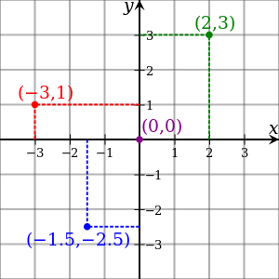
Cartesian coordinate system

Slide 3
How is our screen coordinate system ?
The top-left point in the viewport is the origin, with (0,0) coordinates. Values increase to the right along the X-axis, and down along the Y-axis.
(0,0)
+ve x
5px
5px
(5,5)
(50,5)
+ve y
(5,50)
(50,50)

Slide 4
local coordinate system of div?
When a transform is applied to an object, it creates a local coordinate system. By default, the origin — the (0,0) point — of the local coordinate system lies at the object’s center or 50% 50% .
(0,0)
+ve x
y
x
(0,0)
+ve y

Slide 5
Can we change local coordinate system of div?
We can change the origin of the local coordinate system by adjusting the transform-origin property .
Using transform-origin: 30px 30px
y
x
(30,30)

Slide 6

What is matrix ?
Matrix is a fancy math word for a rectangular array of numbers, symbols, or expressions.
In the computer graphics they’re used for things like linear transformations and projecting 3D images onto a 2D screen.
That’s precisely what the matrix functions do
matrix() allows us to create linear transformations.
while matrix3d() lets us create the illusion of three dimensions in two dimensions using CSS.

Slide 7

2d Transform
3×3 matrix used to calculate two dimensional transforms.
We can also write this as transform: matrix(a,b,c,d,e,f), where a - f are numbers.
When we apply a 2D transform, the browser multiplies the matrix by a vector: [x, y, 1].
The values of x and y are the coordinates of a particular point within the local coordinate space.

Slide 8
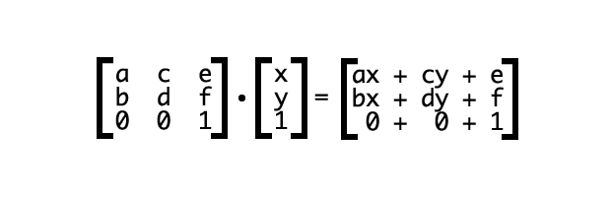
Transform coordinate
Any observations ?

Slide 9

Lets breakdown things….
translation transformation.
The values tx and ty are the values by which the origin should be translated

Slide 10
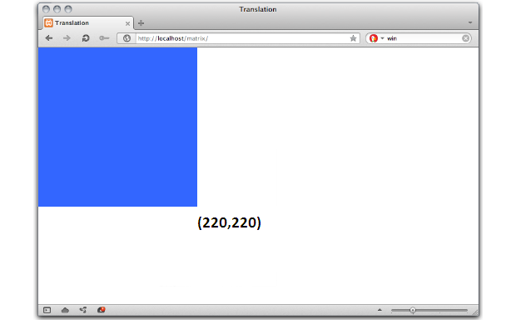
Examples….
#mydiv{
//transform: matrix(1, 0, 0, 1, tx, ty);
transform: matrix(1, 0, 0, 1, 0, 0);
}

Slide 11
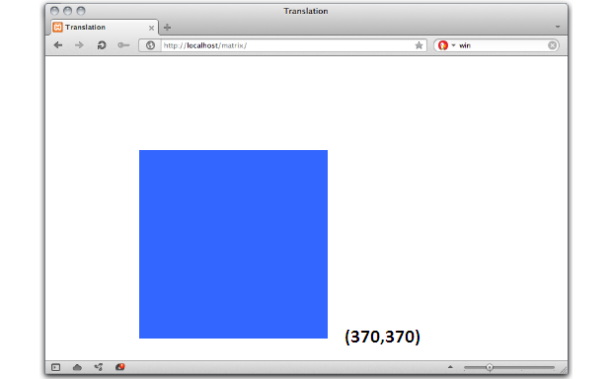
We’ll translate this object by 150 pixels along the X and Y axes…..
#mydiv{
transform: matrix(1, 0, 0, 1, 150, 150);
}
What is happening internally……………….?

Slide 12
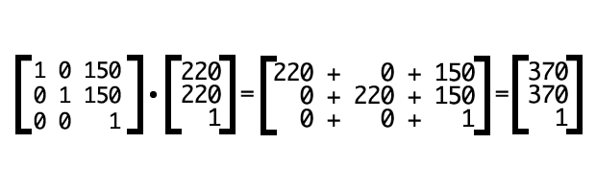

Slide 13
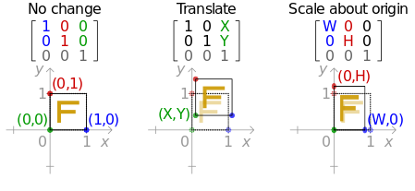
Lets Summarize……

Slide 14
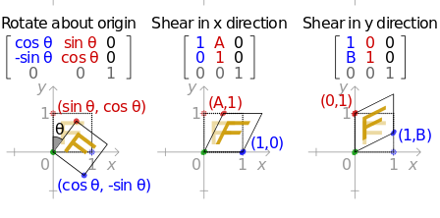
More……

Slide 15
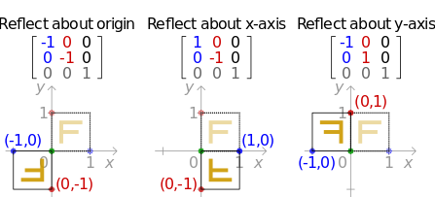
Even More……

Slide 16

3D transformation Matrix
matrix3d()
The matrix3d() CSS function describes a 3D transform as a 4x4 homogeneous matrix.
The 16 parameters are described in the column-major order.
matrix3d(a1, b1, c1, d1, a2, b2, c2, d2, a3, b3, c3, d3, a4, b4, c4, d4)
Matrix form

Slide 17

Lets see matrix of other 3D functions….
perspective()
The perspective() CSS function defines the distance between the z=0 plane and the user in order to give to the 3D-positioned element some perspective.
perspective(d)
Matrix form

Slide 18



Lets see matrix of other 3D functions….
Sr. No. | css | matrix
1 | rotateX()
2 | rotateY()
3 | rotateZ()

Slide 19
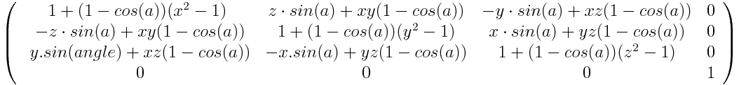
Lets see matrix of other 3D functions….
rotate3d()
The rotate3d()CSS function defines a transformation that moves the element around a fixed axis without deforming it. The amount of movement is defined by the specified angle; if positive, the movement will be clockwise, if negative, it will be counter-clockwise.
rotate3d(x, y, z, a)
X - Is a number describing the x-coordinate of the vector denoting the axis of rotation.
Y -Is a number describing the y-coordinate of the vector denoting the axis of rotation.
Z -Is a number describing the z-coordinate of the vector denoting the axis of rotation.
A- Is an angle representing the angle of the rotation. A positive angle denotes a clockwise rotation, a negative angle a counter-clockwise one.
Matrix :

Slide 20



Lets see matrix of other 3D functions….
Sr. No. | css | matrix
1 | scale3d(sx, sy, sz)
2 | translate3d(tx, ty, tz)
3 | skew(ax, ay)

Slide 21
Sequence for affine transformation
Final matrix = translate_matrix * rotate_matrix * skew_matrix *Scale_matrix
Sample link:
http://codepen.io/artsystems/pen/fydKH

Slide 22
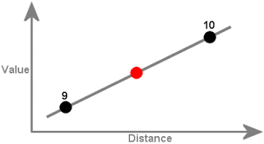
Interpolation
The basic idea is to break down transformation matrices into meaningful components like stretch, rotation, and translation, and then to interpolate those.
More details:
http://www.w3.org/TR/css3-transforms/#interpolation-of-3d-matrices

Slide 23
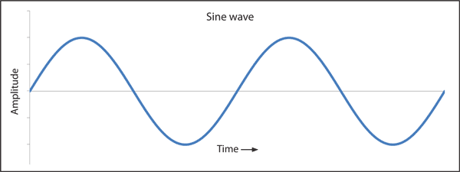
Exercise
Make the text letter animate in sinusoidal wave

