Slide 1
Famo.us Architecture
By:
Anshu Agrawal

Slide 2
Contents
Famo.us architecture.
Render Tree.
Famo.us Engine.
Why Browser DOM is slow?
Famo.us DOM renderer.

Slide 3
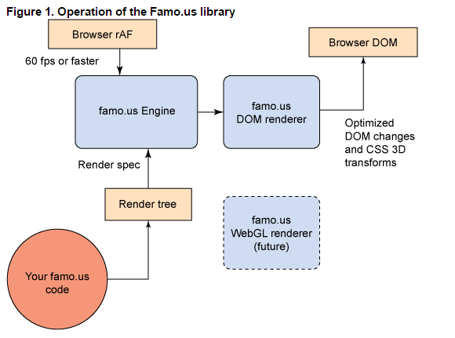

Slide 4
Render Tree
One of the first things to notice about Famo.us is how little we expose HTML and the DOM to the developer.
Interacting with the DOM is riddled with performance issues.
Famo.us abstracts away DOM management by maintaining a representation of it in JavaScript called the Render Tree.
If you inspect a website running Famo.us, you'll notice the DOM is very flat: most elements are siblings of one another. Inspect any other website, and you'll see the DOM is highly nested.
Famo.us takes a radically different approach to HTML from a conventional website.
We keep the structure of HTML in JavaScript, and to us, HTML is more like a list of things to draw to the screen than the source of truth of a website.

Slide 5
Render Tree
Developers are used to nesting HTML elements because that's the way to get relative positioning, event bubbling, and semantic structure. However, there is a cost to each of these: relative positioning causes slow page reflows on animating content; event bubbling is expensive when event propagation is not carefully managed; and semantic structure is not well separated from visual rendering in HTML.
Famo.us promises a rich 60 FPS experience, and to do so, we needed to circumvent these inefficiencies. When we decided to abstract away the DOM, we needed a way to maintain the expectations every web developer has of the DOM, but in a way that doesn't compromise on performance.
The Render Tree is our solution to relative positioning and semantic structure.

Slide 6
Famo.us Engine
Famo.us is an open source JavaScript framework for building high-performance mobile Web and hybrid mobile apps. The framework gets its speed and sizzle by replacing the browser's slow, DOM-based rendering mechanism with its own rendering engine and by tapping the GPU acceleration provided by CSS3's 3D transformation functions -- no plug-ins or native code required.

Slide 7
Why Browser DOM is slow?
Famo.us uses matrix3d WebKit transforms on <div> elements with absolute positions rather than using a conventional nested DOM tree in which child elements are positioned relative to their parent elements.
Famo.us keeps the structure of HTML in the JavaScript Render Tree and renders to absolutely positioned <div> elements, creating a flat HTML DOM that doesn't require any flow calculations for a redraw.
Combining border-radius and box-shadow is notoriously slow for browsers to render. Try to avoid this technique as it will lead to performance problems especially during animations.

Slide 8
Famo.us DOM renderer
Famo.us is very different from many Javascript frameworks, since it endorses zero touches to the DOM. Querying the DOM can lead to both performance issues as well as unexpected behavior.
In terms of performance, performing large queries against the DOM is fairly expensive (in measurement of CPU cycles). Also, seemingly simple requests, such as asking for the width of a DOM element, will sometimes cause the entire page to reflow in order to calculate the correct value for the element's width. These reflows are made more apparent in a highly animated environment.
There is also unexpected behavior because of how Famo.us uses DOM elements. Some Famo.us components, such as Scrollview, can cause the DOM element associated with a Surface to be deallocated. This resource pooling optimization allows Famo.us to minimize the amount of DOM element creations which is an expensive operation. However, this leads to issues when trying to access DOM elements that no longer are present in the DOM.

Slide 9
THANKS

