Slide 1

IE 612 - INTRODUCTION TO FINANCIAL ENGINEERING PROJECT PRESENTATION
Machine-Learning-Based Statistical Arbitrage with Markowitz Portfolio Optimization
23B3002 - Aviraj Khare
24B3031 - Mayank Devanand Kalambe
26M1527 - Anshuman Adarsh Phadke

Slide 2



INTRODUCTION
Project Overview
Problem
Solution
Why It Matters
Portfolio optimization depends on estimates of future returns, but these are usually taken from historical averages. Past returns are noisy and often fail to predict the future, leading to unstable portfolios and poor investment decisions.
We use machine learning to forecast stock returns from market data and trading signals. These forecasts help select the most promising stocks and serve as inputs to Markowitz optimization to decide how much to invest in each.
Better return forecasts lead to better portfolios. By combining data-driven predictions with proven portfolio theory, investors can build more robust strategies that balance risk and return more effectively than traditional methods.

Slide 3
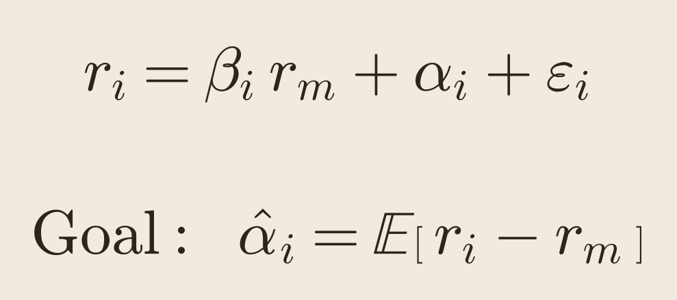
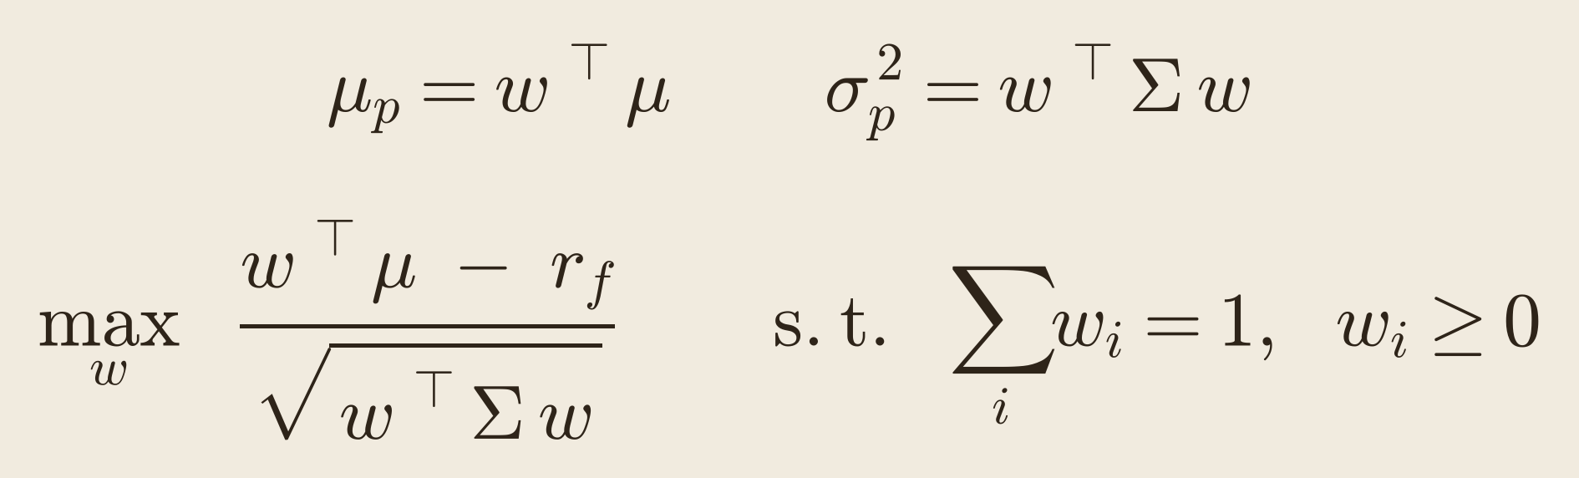
INTRODUCTION
Key Concepts
Statistical Arbitrage
Markowitz Optimization
Statistical Arbitrage is a quantitative trading strategy that exploits temporary deviations from expected relative pricing relationships among financial assets by constructing systematic, typically market-neutral portfolios based on statistically estimated return signals. It aims to generate positive risk-adjusted returns through repeated exploitation of small predictive edges across a diversified universe of securities, while controlling for market exposure, transaction costs, and other sources of risk.
Mean–Variance Optimization (Markowitz, 1952) is a portfolio optimization framework that determines the optimal allocation of capital across risky assets by maximizing expected portfolio return for a given level of risk, or equivalently, minimizing portfolio variance subject to a target expected return. It explicitly incorporates the covariance structure of asset returns to quantify diversification benefits and construct an efficient frontier of portfolios offering the highest expected return for each level of risk.
rᵢ stock · rₘ market · βᵢ market sensitivity · αᵢ excess return · εᵢ noise
w weights · μ expected returns · Σ covariance matrix · rf risk-free rate
Statistical arbitrage decides which stocks to buy; Markowitz optimization decides how much of each to buy.

Slide 4
LITERATURE
Literature Review
Portfolio Optimization and Risk Management:
[1] N. Chakrabarty and S. Biswas, “Strategic Markowitz portfolio optimization (SMPO): A portfolio return booster,” in Proc. IEEE Int. Conf., 2019, pp. 196–200.
[2] S. Bajpai, A. Deo, A. Sharma, and M. Baniya, “Portfolio optimization for Indian mutual funds: A comparative study,” in Proc. Int. Conf. Decision Aid Sciences and Applications (DASA), 2023, pp. 247–251, doi: 10.1109/DASA59624.2023.10286645.
[3] L. Ming and G. Chen, “Portfolio optimization and risk assessment based on random weighting, Markowitz mean-variance model and genetic algorithm,” in Proc. 13th Int. Conf. Intelligent Control and Information Processing (ICICIP), Muscat, Oman, 2025, doi: 10.1109/ICICIP64458.2025.10898105.
B. ML-Based Statistical Arbitrage:
[4] M. Zhang, X. Tang, S. Zhao, W. Wang, and Y. Zhao, “Statistical arbitrage with momentum using machine learning,” Procedia Comput. Sci., vol. 202, pp. 194–202, 2022, doi: 10.1016/j.procs.2022.04.027.
[5] S. Carta, S. Consoli, A. S. Podda, D. Reforgiato Recupero, and M. M. Stanciu, “Statistical arbitrage powered by explainable artificial intelligence,” Expert Syst. Appl., vol. 206, Art. no. 117763, 2022.
[6] N. Huck, “Large data sets and machine learning: Applications to statistical arbitrage,” Eur. J. Oper. Res., vol. 278, pp. 330–342, 2019.

Slide 5
OBJECTIVE
Our Solution
We built a machine-learning pipeline that replaces historical average returns with data-driven return forecasts as the input to Markowitz portfolio optimization. Using daily data for 238 Indian stocks (2018–2026), we engineered 56 features covering momentum, volatility, liquidity, trend and market conditions.
Seven models were trained to predict each stock’s return relative to the market over the next 20 trading days: Ridge, ElasticNet, Random Forest, XGBoost, RNN, LSTM and ARIMA. To avoid look-ahead bias, models were trained on 2019–2022, validated/tuned on 2023–mid 2024 and tested on mid 2024–2026, with quarterly walk-forward retraining on an expanding window.
Every 20 trading days, the models rank all stocks. We select the top 5 for a long-only portfolio, or additionally short the bottom 5 in a long–short version. As a proxy for the expected returns 20 day moving average of the returns is fed into Markowitz mean–variance optimization with Ledoit–Wolf covariance to determine portfolio weights.
Across all models, portfolio variants and rebalance dates, ML-based inputs consistently outperformed historical returns, raising the Sharpe ratio from 0.16 to well over 1.0.

Slide 6
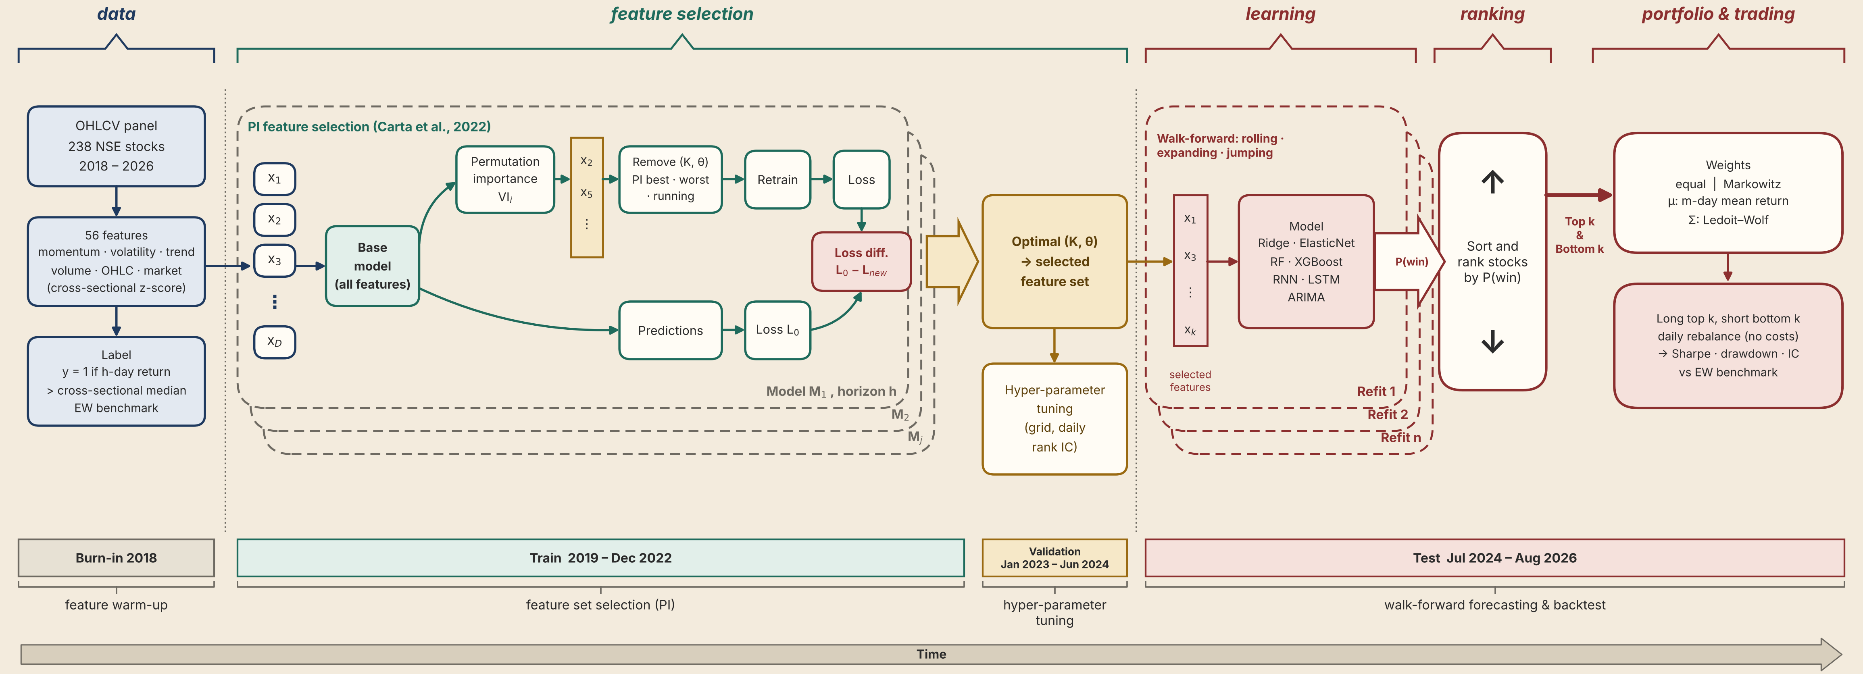
METHODOLOGY
Flowchart
** Data is taken from Bloomberg Terminal, 238 stocks from NSE100 LargeCap, MidCap and SmallCap Index

Slide 7
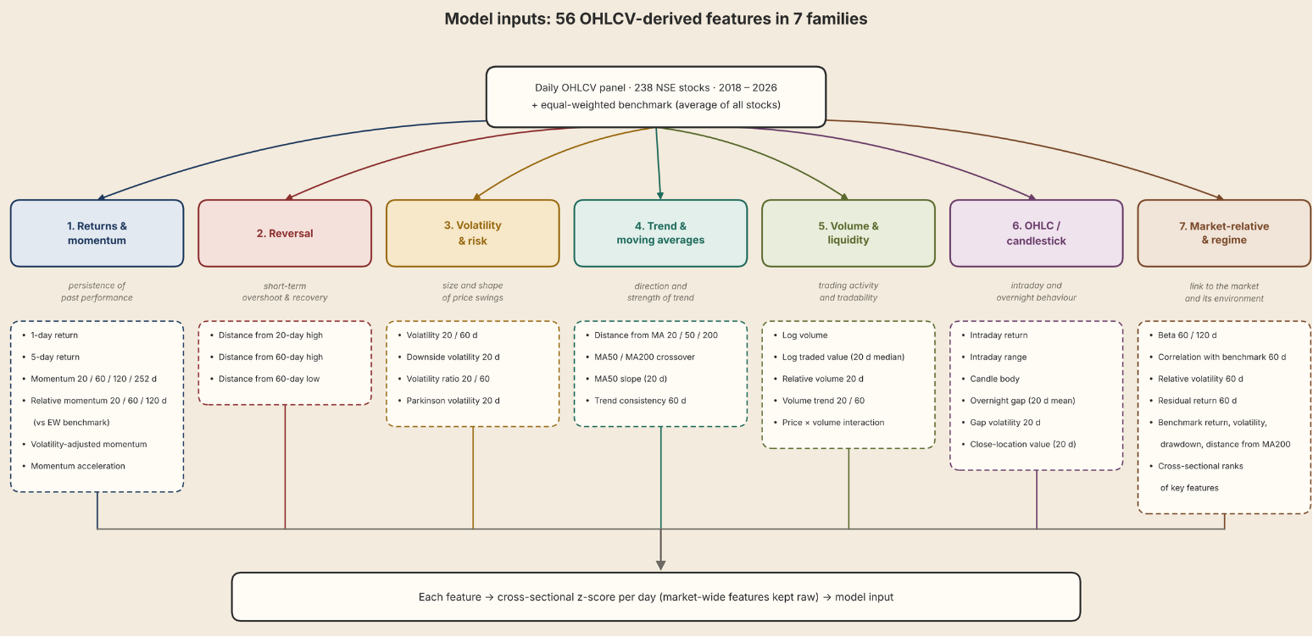
METHODOLOGY
Model Development: Features & Parameters

Slide 8
METHODOLOGY
Models Used
LINEAR
Ridge
min ‖y − Xβ‖² + λ‖β‖²
A linear regression that predicts each stock's 20-day excess return as a weighted sum of its features. An L2 penalty shrinks every coefficient towards zero, which keeps the model stable when features are correlated, as momentum and trend signals often are.
LINEAR
ElasticNet
min ‖y − Xβ‖² + λ₁‖β‖₁ + λ₂‖β‖²
Extends Ridge by combining L1 (lasso) and L2 penalties. The L1 part sets weak coefficients exactly to zero, so the model selects features by itself; the L2 part keeps groups of correlated features together instead of picking one at random.
TREE ENSEMBLE
Random Forest
ŷ(x) = (1/B) Σb Tb(x)
An ensemble of 500 decision trees. Each tree is grown on a bootstrap sample of the data and considers a random subset of features at every split, grouping stocks with similar future returns. The forest averages the trees' predictions.
TREE ENSEMBLE
XGBoost
ŷ = Σ_{k} f_{k}(x), min Σ l + Σ Ω(f_{k})
Gradient-boosted trees: trees are added one at a time, each one fitted to the errors left by the trees before it. Penalties on tree size and leaf weights, plus early stopping, control overfitting. Missing values are handled natively.
NEURAL NETWORK
RNN
h_{t} = tanh(W_{x} x_{t} + W_{h} h_{t−1} + b)
A neural network that reads each stock's last 20 days of features in order. At every step it updates a hidden state that summarises the history so far; the final state is mapped to the 20-day return forecast.
NEURAL NETWORK
LSTM
c_{t} = f_{t} ⊙ c_{t−1} + it ⊙ c̃_{t}
An RNN with gated memory cells. At each step the forget, input and output gates decide what to keep, what to add and what to expose, so the network can carry information across long sequences, here 60-day windows.
TIME SERIES
ARIMA
y_{t} = c + Σ φ_{i} y_{t−i} + Σ θ_{j} ε_{t−j} + ε_{t}
A classical time-series model fitted separately to each stock's own daily excess returns. It forecasts from past values (AR terms) and past shocks (MA terms); the orders p and q are chosen by BIC on a rolling 250-day window.
COMMON PARAMETERS
The target is whether a stock’s 20-day forward return beats an equal-weighted portfolio of all stocks.
Retrained on an expanding window 63 trading days. The portfolio goes long the top 5 and short the bottom 5. Markowitz optimisation with 20-day mean return as expected return and a 60-day Ledoit–Wolf covariance. The book is rebalanced at the close, with no transaction costs.

Slide 9
FEATURE SELECTION PROCESS 1)
Model Performance Comparison
Step 1: Build the candidate pool: 58 features
  40 stock features from Bloomberg Terminal: momentum, volatility, trend, volume, beta
  10 engineered/calculated features: Amihud illiquidity, Yang–Zhang volatility, RSI, ADX, MFI, CMF and others
  8 market-regime features: index momentum, volatility, drawdown
Step 2: Rank every feature by its Information Coefficient
  Daily rank correlation between each feature and the next 20-day excess return
  Computed on training data only (2019–2022), so there’s no look-ahead
  Kept features that are significant (Newey–West t-stat) and stable (same sign in most years)
Step 3: Model-specific selection
  Linear models: remove correlated duplicates (correlation > 0.8) and multicollinearity (VIF < 5)
  Tree models: keep features that beat random “shadow” copies (Boruta), or that rank high in SHAP importance
  Sequence models: the strongest IC features plus fast-changing daily signals

Slide 10
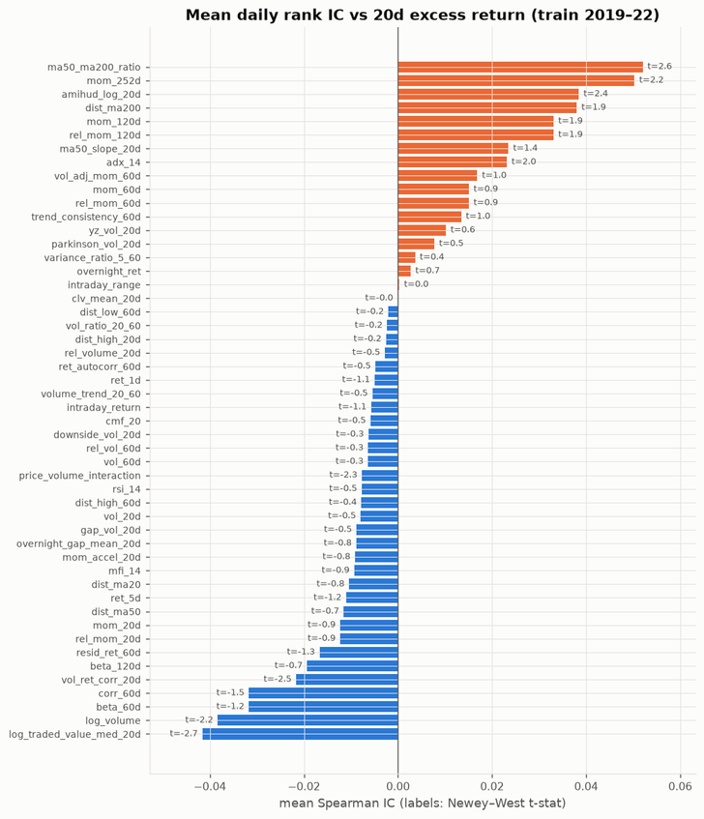
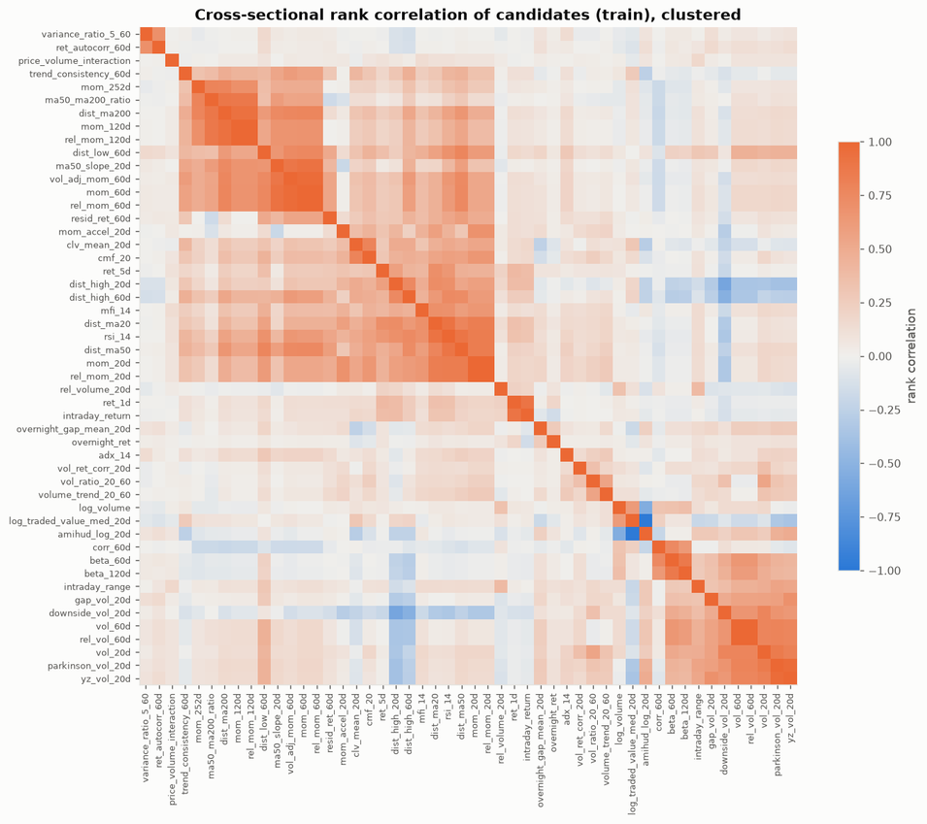
FEATURE SELECTION PROCESS 1)
Model Performance Comparison

Slide 11
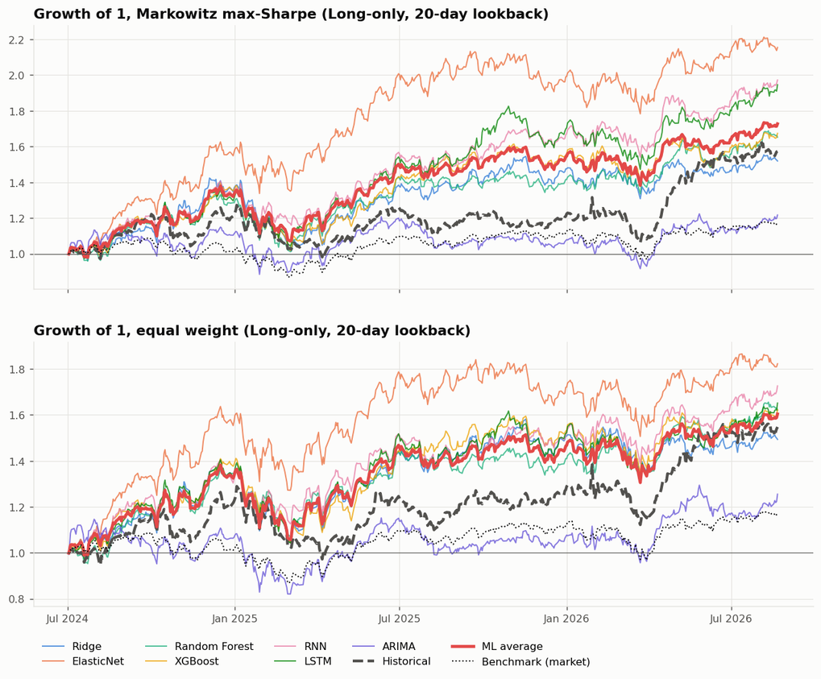
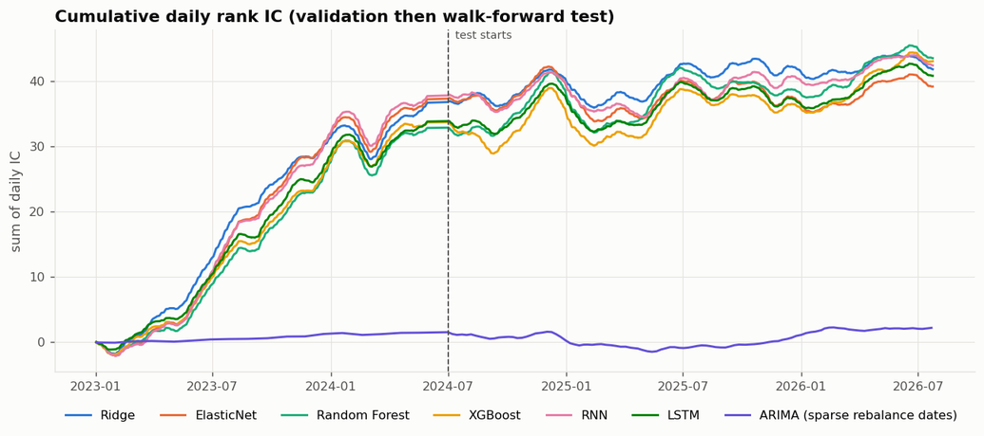
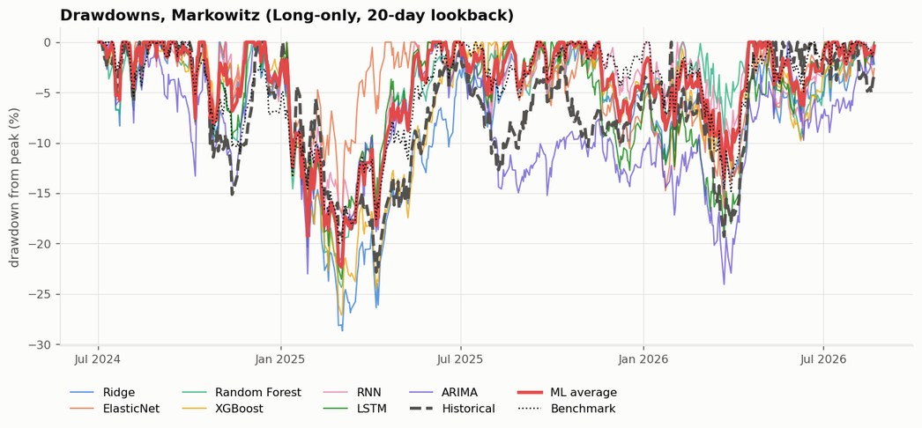
RESULTS 1)
Model Performance Comparison

Slide 12
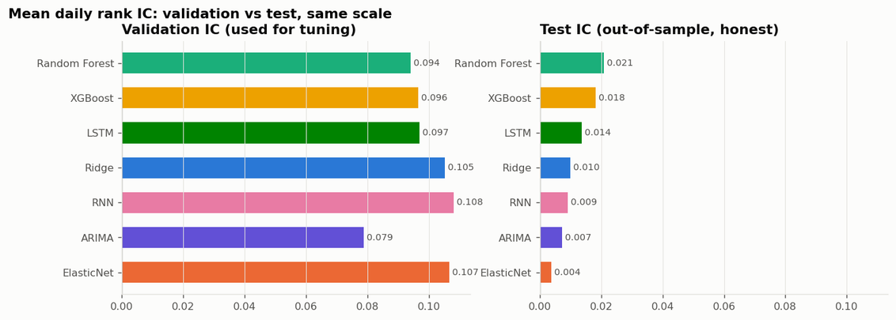
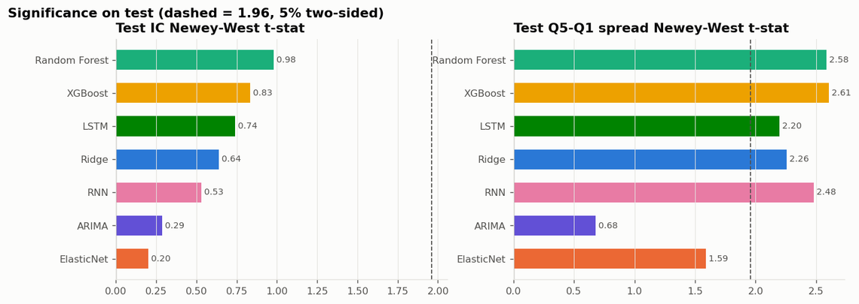
RESULTS 1)
Model Performance Comparison

Slide 13
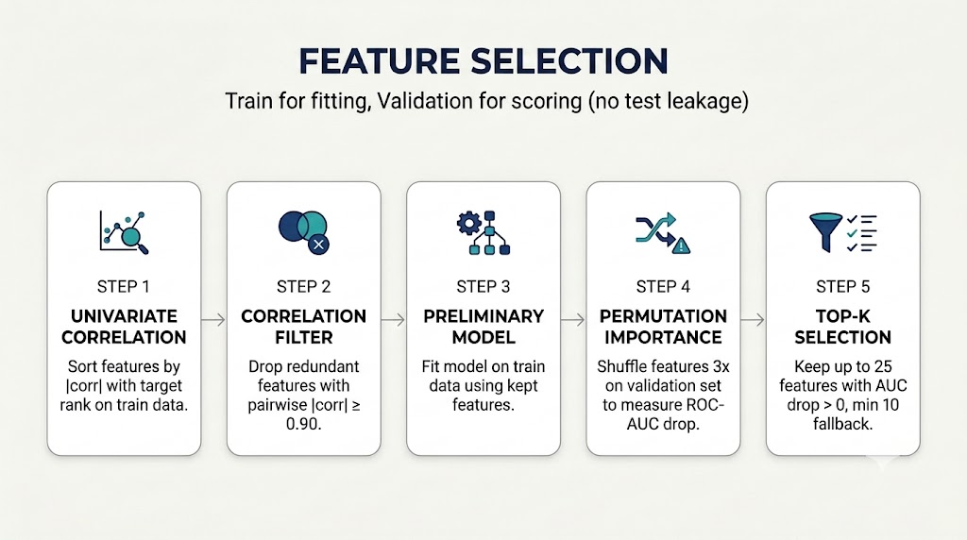
FEATURE SELECTION PROCESS 2)

Slide 14
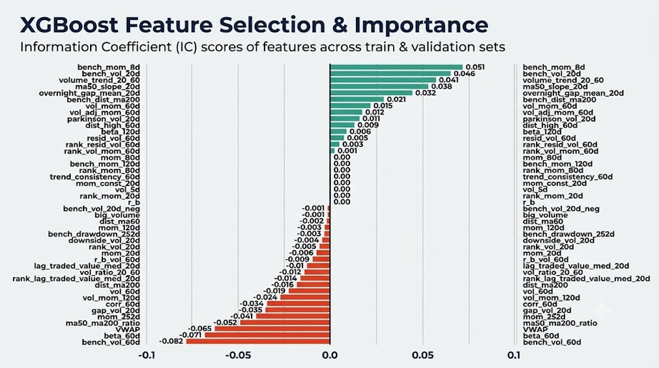
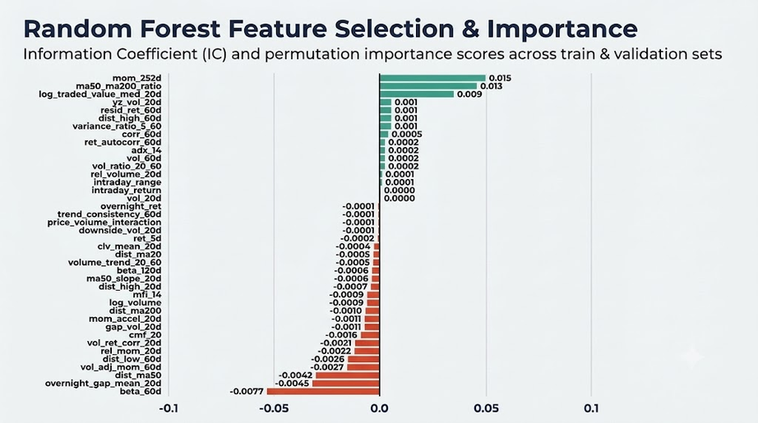
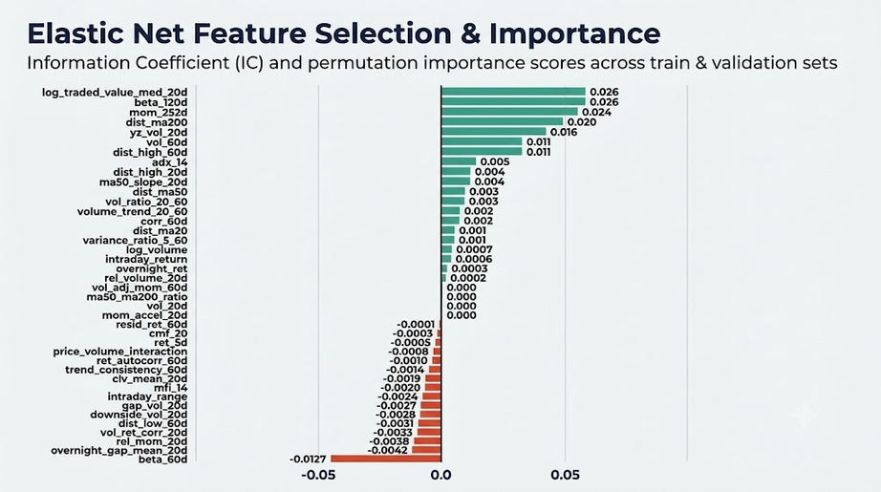
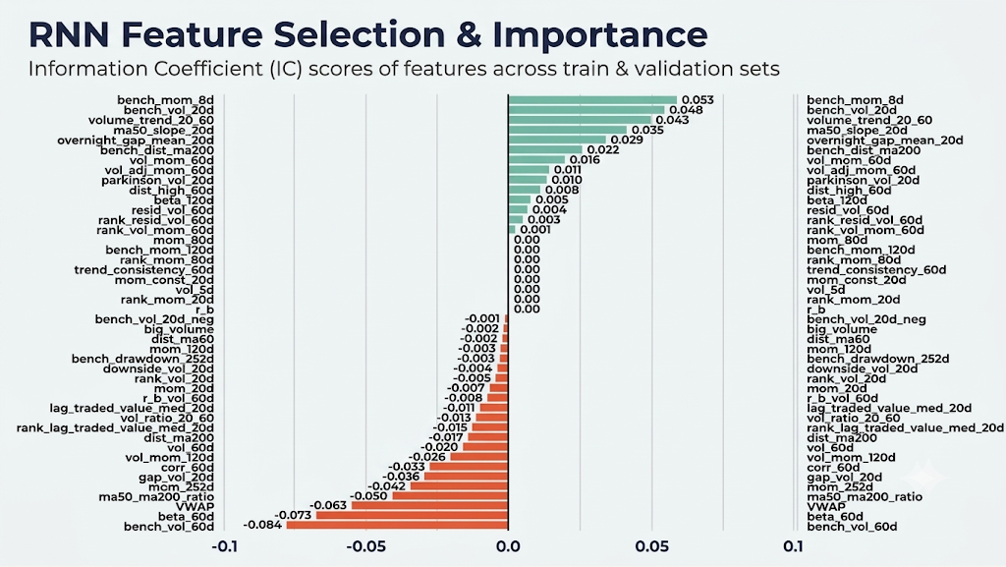
FEATURE SELECTION PROCESS 2)

Slide 15
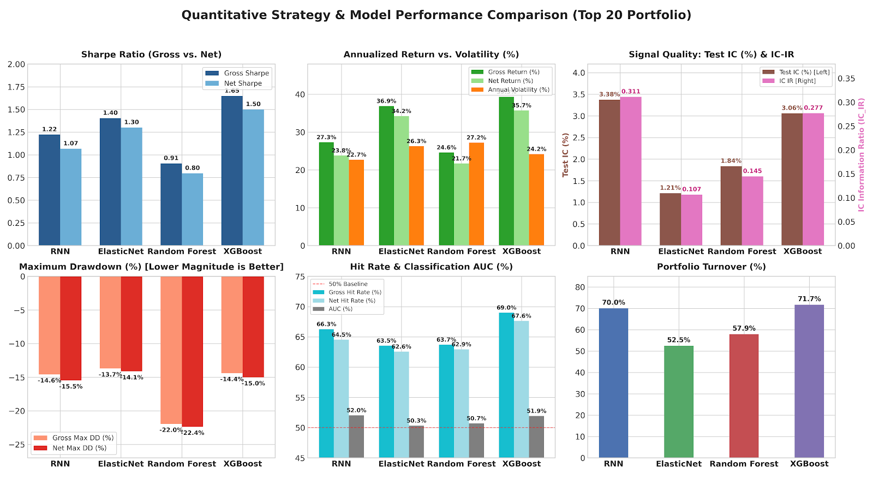
RESULTS 2)

Slide 16
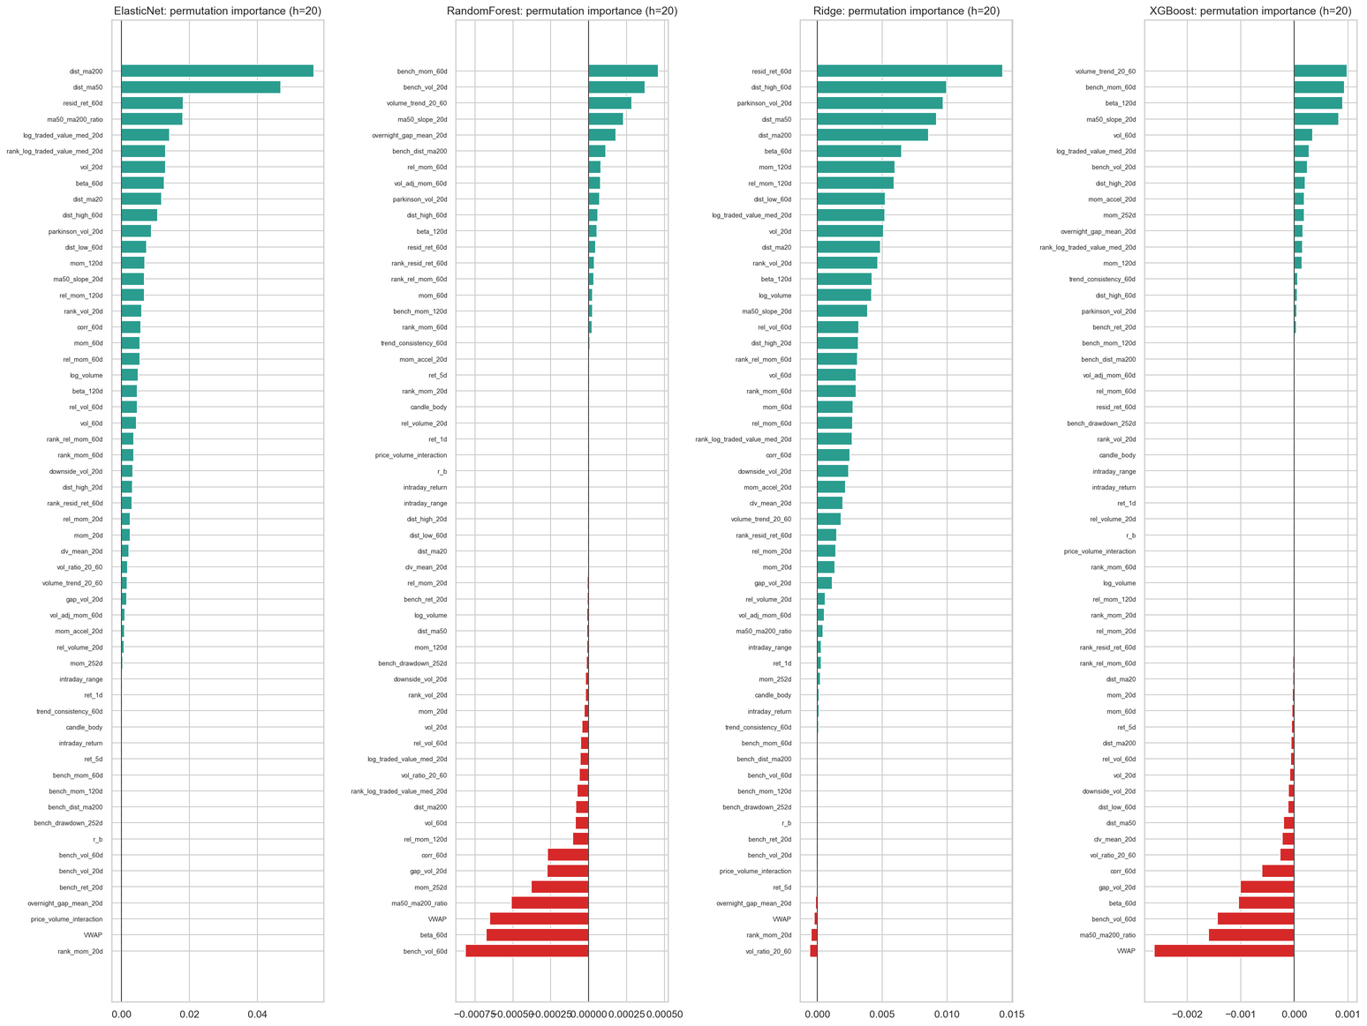
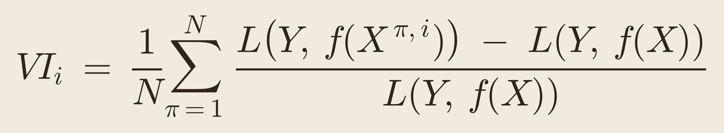
FEATURE SELECTION PROCESS 3)
Permutation Importance (Carla et al., 2022)
Each feature is scored by how much the model’s validation loss changes when that feature’s values are randomly shuffled, which breaks its link to the target (Breiman, 2001; Carta et al., 2022):
  f is the base model trained on all features.
  X^{{π,i}} is the validation data with feature i shuffled.
  L is the log-loss.
  N is the number of shuffles.
  VI > 0: the loss rises without the feature, so it carries signal.
  VI ≈ 0: the model does not use it.
  VI < 0: predictions improve when it is replaced with noise, so it is a candidate for removal.
  PI best: among features with VI < 0, take the K with the highest importance (the least harmful) and remove those below threshold θ. This is the most cautious.
  PI worst: among features with VI < 0, take the K with the lowest importance (the most harmful) and remove those below θ. It targets the noisiest features first.
  PI running: take the features already below θ and remove the K with the highest importance. It always removes features when any fall below θ.

Slide 17
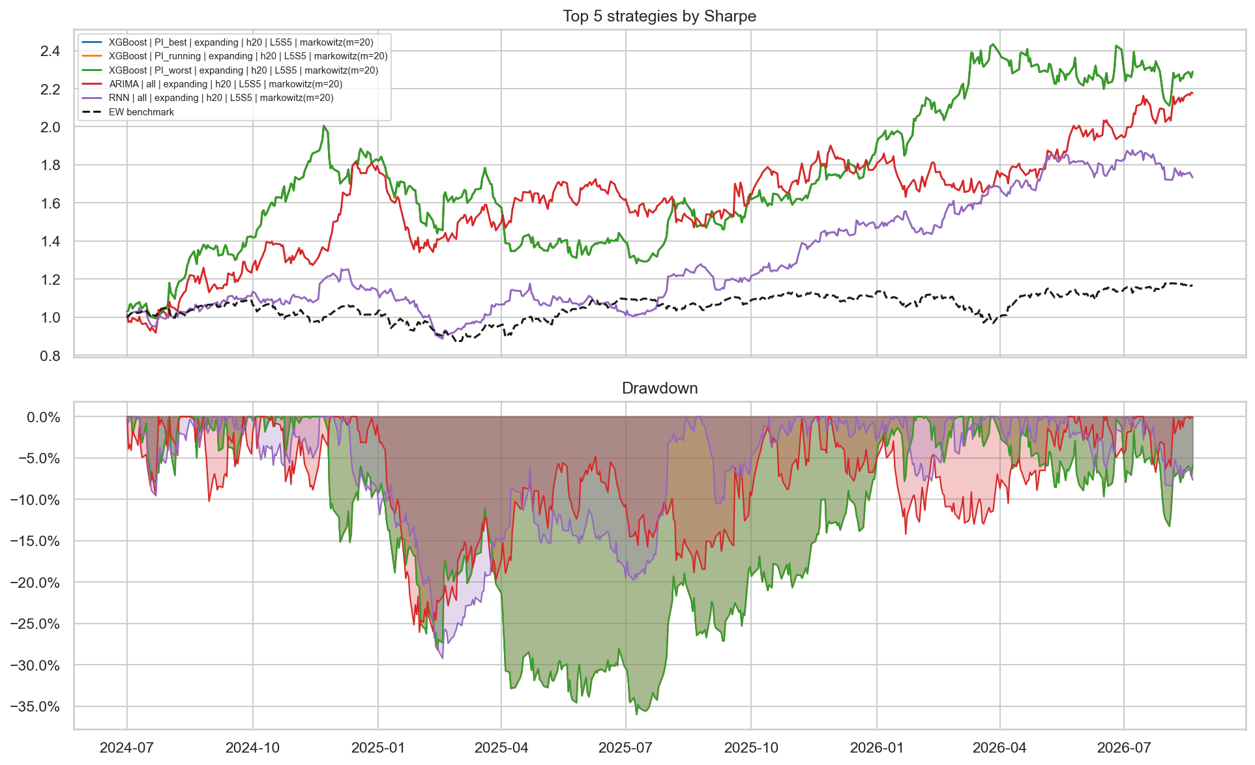
RESULTS 3) PERMUTATION IMPORTANCE Carta et al. (2022)
Model Performance Comparison
KEY RESULTS
XGBOOST LEADS
Sharpe 1.36 · ×2.27 vs ×1.17 EW
XGBoost with PI feature selection grows 1 to about 2.3 over the test period, against 1.17 for the equal-weighted benchmark. PI best, PI worst and PI running select the same features for XGBoost, so their three curves overlap as one. ARIMA (×2.2) and RNN (×1.75) follow.
RISK AND DRAWDOWN
Higher returns come with deep drawdowns. XGBoost falls about 35% between Apr and Jul 2025 before recovering to new highs in 2026. ARIMA and RNN drop 25–30% in early 2025. All strategies are 100% long / 100% short with no costs, so drawdowns are large relative to the unlevered benchmark. Returns are uneven, concentrated in late 2024 and early 2026.

Slide 18
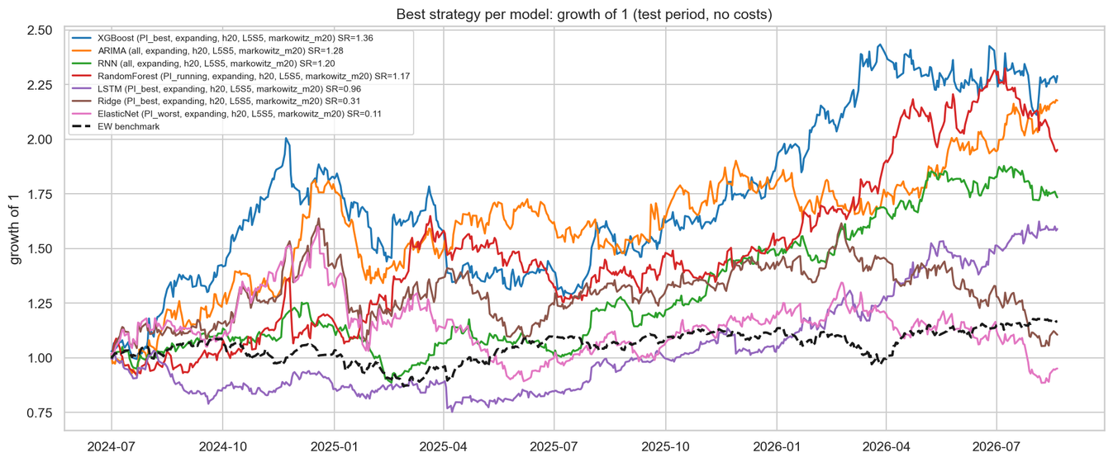
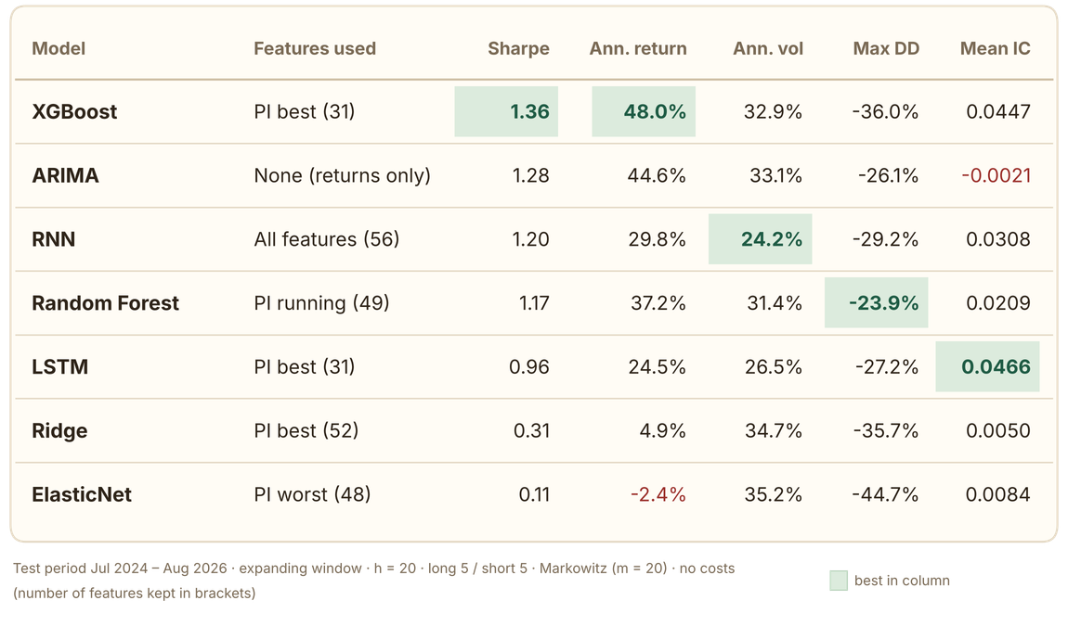
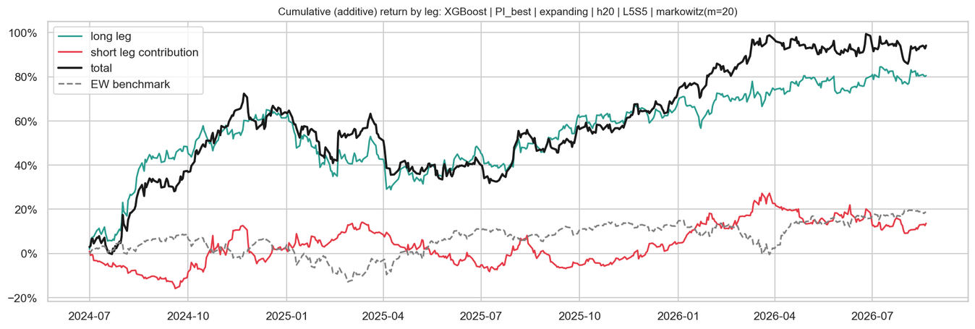
RESULTS 3) PERMUTATION IMPORTANCE Carta et al. (2022)
Model Performance Comparison

Slide 19
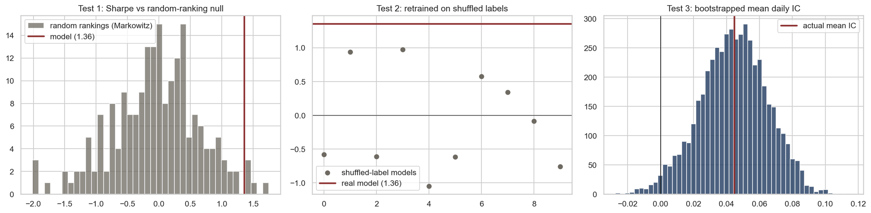
RESULTS – STRESS TESTING
Model Performance Significance Testing
The ranking signal is real. Three of four stress tests reject noise:
  Random-ranking null: the model’s Sharpe (1.36, equal-weighted) beats 97.5% of 1,000 random portfolios of the same size (null 95th percentile: 1.04, p = 0.025).
  Shuffled-label retraining: models retrained on shuffled labels reach at most a Sharpe of 0.97 across 10 runs, against 1.36 for the real model.
  IC bootstrap: mean daily rank IC is 0.0447, with a 90% interval of [0.0093, 0.0772] that excludes zero (P(IC > 0) = 98.2%).
The size of the edge is less certain. After correcting for the 25 configurations tested, the deflated Sharpe ratio is 0.715, below the 0.95 bar. So the model has genuine predictive skill, but this specific Sharpe level could partly reflect selection luck.
Equal weighting earns a Sharpe of 1.93, against 1.36 with Markowitz sizing. Markowitz with a 20-day return proxy dilutes the ranking signal.

Slide 20
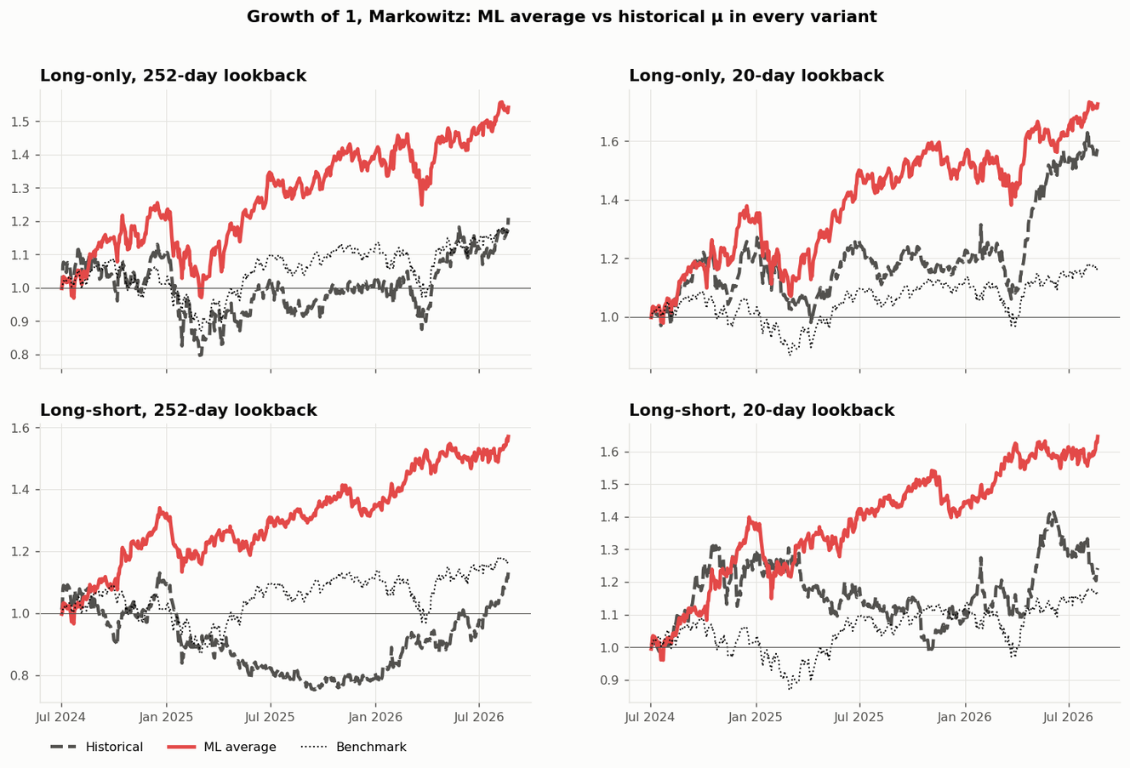
RESULTS
ML Forecasts vs Historical Averages
  ML beats historical returns in all 4 portfolio set-ups.
  Sharpe up to 1.47 with ML, vs 0.37–1.01 with historical.
  Smaller drawdowns: −16% vs −33% (long–short).
  Steadier growth. ML portfolios rise more consistently and have smaller drawdowns: −23% vs −30% long-only and −16% vs −33% long–short (252-day).
  Historical averages are noisy and overconfident; ML gives realistic expected returns.
Takeaway: Replacing historical averages with ML forecasts as the Markowitz input roughly doubles the Sharpe ratio, and the result holds in every variant.

Slide 21
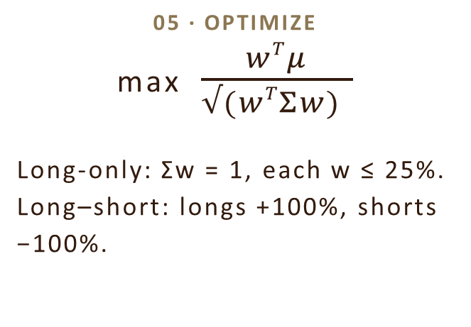
RESULTS
Markowitz Optimization
01 · ML FORECAST
Model scores
Random Forest predicts each stock's 20-day excess return; ranked into a score z.
02 · EXPECTED RETURN
E[μ] = 20 day Moving Average
Score scaled by volatility σ and model accuracy IC. Replaces the historical mean.
03 · SELECTION
Top/Bottom 5 stocks
Buy the 5 highest scores. Long–short also shorts the 5 lowest stocks.
04 · RISK MODEL
Covariance Σ
Ledoit–Wolf shrinkage on the last 60 daily returns, scaled to 20 days.
08 · EVALUATE
ML vs historical μ
Sharpe 1.07 vs 0.46; max drawdown −23% vs −30% (long-only, 252-day).
07 · HOLD & REBALANCE
Every 20 trading days
Hold then repeat from step 01 with new data every 20 days.
06 · ALLOCATE
Weights → shares
e.g. ₹10 lakh split by weight, in whole shares at the latest price.
05 · OPTIMIZE
max $\frac{wTμ}{√(wTΣw) }$
Long-only: Σw = 1, each w ≤ 25%.
Long–short: longs +100%, shorts −100%.

Slide 22
  Capital: ₹10,00,000 per side.
  Long: target ₹10,00,000, bought ₹9,96,904, so ₹3,096 is left over.
  Short: target ₹10,00,000, shorted ₹9,97,008, a ₹2,992 shortfall.
  Gross exposure: ₹19,93,913 (long + short).
  Net exposure: −₹104, so the portfolio is effectively market-neutral (dollar-neutral).
RESULTS
Markowitz Optimization

Slide 23
CONCLUSION
Thank you
As Harry Markowitz said,
“A good portfolio is more than a long list of good stocks and bonds. It is a balanced whole, providing the investor with protections and opportunities with respect to a wide range of contingencies.”

