Slide 1
Introduction to software engineering

Slide 2
Objectives
Software Engineering
To introduce software process
Software Engineering
SDLC Cycle
SDLC models

Slide 3
Software Engineering
Ability to solve complex programming problems:
How to break large projects into smaller and manageable parts?
Handling complexity in a software development problem is the main theme of software engineering discipline.
2 techniques: abstraction and decomposition
Learn techniques of: specification, design, interface development, testing, project management, etc.

Slide 4
Evolution of Design Techniques
Object-Oriented
Data flow-based(vlsi)
Data structure-based(IC)
Control flow-based/Structured
Explanatory

Slide 5
Evolution of Other Software Engineering Techniques
life cycle models,
specification techniques,
project management techniques,
testing techniques,
debugging techniques,
quality assurance techniques,
software measurement techniques,
CASE tools, etc.

Slide 6
Differences Between the Exploratory Style and Modern Software Development Practices
Emphasis has shifted
from error correction to error prevention.
Modern practices emphasize
detection of errors as close to their point of introduction as possible.

Slide 7
Differences Between the Exploratory Style and Modern Software Development Practices (CONT.)
In exploratory style,
errors are detected only during testing,
Now,
focus is on detecting as many errors as possible in each phase of development.
A lot of effort and attention is now being paid to:
requirements specification.
Also, now there is a distinct design phase:
standard design techniques are being used.

Slide 8
Software Product
is a product designated for delivery to the user
source codes
documents
reports
manuals
object codes
plans
data
test results
test suites
prototypes

Slide 9
Programs versus Software Products
Usually small in size
Author himself is sole user
Single developer
Lacks proper user interface
Lacks proper documentation
Ad hoc development.
Large
Large number of users
Team of developers
Well-designed interface
Well documented & user-manual prepared
Systematic development

Slide 10
The software process
A structured set of activities required to develop a software system
Specification;
Design;
Validation;
Evolution.
A software process model is an abstract representation of a process. It presents a description of a process from some particular perspective.

Slide 11
Software Life Cycle
Software life cycle (or software process):
series of identifiable stages that a software product undergoes during its life time:
Feasibility study
requirements analysis and specification,
design,
coding,
testing
maintenance.
Each of these stages is called ‘life cycle phase’.

Slide 12
Life Cycle Model
A software life cycle model (or process model):
a descriptive and diagrammatic model of software life cycle:
identifies all the activities required for product development,
establishes a precedence ordering among the different activities,
Divides life cycle into phases.

Slide 13
Life Cycle Model (CONT.)
Several different activities may be carried out in each life cycle phase.
For example, the design stage might consist of:
structured analysis activity followed by
structured design activity.

Slide 14
Why Model Life Cycle ?
A written description:
forms a common understanding of activities among the software developers.
helps in identifying inconsistencies, redundancies, and omissions in the development process.
Helps in tailoring a process model for specific projects.

Slide 15
Why Model Life Cycle ?
Processes are tailored for special projects.
A documented process model
helps to identify where the tailoring is to occur.
life cycle model:
defines entry and exit criteria for every phase.
A phase is considered to be complete:
only when all its exit criteria are satisfied.

Slide 16
Generic software process models
The waterfall model
Separate and distinct phases of specification and development.
Evolutionary development
Specification, development and validation are interleaved.
Component-based software engineering
The system is assembled from existing components.
RAD
Agile developments.

Slide 17
Various stages in software process

Slide 18
Feasibility Study
Main aim of feasibility study: determine whether developing the product
financially worthwhile
technically feasible.
First roughly understand what the customer wants:
different data which would be input to the system,
processing needed on these data,
output data to be produced by the system,
various constraints on the behavior of the system.

Slide 19
Activities during Feasibility Study
Work out an overall understanding of the problem.
Formulate different solution strategies.
Examine alternate solution strategies in terms of:
resources required,
cost of development, and
development time.

Slide 20
Activities during Feasibility Study
Perform a cost/benefit analysis:
to determine which solution is the best.
you may determine that none of the solutions is feasible due to:
high cost,
resource constraints,
technical reasons.

Slide 21
Requirements Analysis and Specification
Aim of this phase:
understand the exact requirements of the customer,
document them properly.
Consists of two distinct activities:
requirements gathering and analysis
requirements specification.

Slide 22
Goals of Requirements Analysis
Collect all related data from the customer:
analyze the collected data to clearly understand what the customer wants,
find out any inconsistencies and incompleteness in the requirements,
resolve all inconsistencies and incompleteness.

Slide 23
Requirements Gathering
Gathering relevant data:
usually collected from the end-users through interviews and discussions.
For example, for a business accounting software:
interview all the accountants of the organization to find out their requirements.

Slide 24
Requirements Analysis (CONT.)
The data you initially collect from the users:
would usually contain several contradictions and ambiguities:
each user typically has only a partial and incomplete view of the system.

Slide 25
Requirements Analysis (CONT.)
Ambiguities and contradictions:
must be identified
resolved by discussions with the customers.
Next, requirements are organized:
into a Software Requirements Specification (SRS) document.
Engineers doing requirements analysis and specification:
are designated as analysts.

Slide 26
Design
Design phase transforms requirements specification:
into a form suitable for implementation in some programming language.
In technical terms:
during design phase, software architecture is derived from the SRS document.
Two design approaches:
traditional approach,
object oriented approach.

Slide 27
Traditional Design Approach
Consists of two activities:
Structured analysis
Structured design

Slide 28
Structured Analysis Activity
Identify all the functions to be performed.
Identify data flow among the functions.
Decompose each function recursively into sub-functions.
Identify data flow among the subfunctions as well.

Slide 29
Structured Analysis (CONT.)
Carried out using Data flow diagrams (DFDs).
After structured analysis, carry out structured design:
architectural design (or high-level design)
detailed design (or low-level design).

Slide 30
Structured Design
High-level design:
decompose the system into modules,
represent invocation relationships among the modules.
Detailed design:
different modules designed in greater detail:
data structures and algorithms for each module are designed.

Slide 31
Object Oriented Design
First identify various objects (real world entities) occurring in the problem:
identify the relationships among the objects.
For example, the objects in a pay-roll software may be:
employees,
managers,
pay-roll register,
Departments, etc.

Slide 32
Object Oriented Design (CONT.)
Object structure
further refined to obtain the detailed design.
OOD has several advantages:
lower development effort,
lower development time,
better maintainability.

Slide 33
Implementation
Purpose of implementation phase (aka coding and unit testing phase):
translate software design into source code.
During the implementation phase:
each module of the design is coded,
each module is unit tested
tested independently as a stand alone unit, and debugged,
each module is documented.

Slide 34
Implementation (CONT.)
The purpose of unit testing:
test if individual modules work correctly.
The end product of implementation phase:
a set of program modules that have been tested individually.

Slide 35
Integration and System Testing
Different modules are integrated in a planned manner:
modules are almost never integrated in one shot.
Normally integration is carried out through a number of steps.
During each integration step,
the partially integrated system is tested.

Slide 36
Integration and System Testing
M1
M2
M3
M4

Slide 37
System Testing
After all the modules have been successfully integrated and tested:
system testing is carried out.
Goal of system testing:
ensure that the developed system functions according to its requirements as specified in the SRS document.

Slide 38
Maintenance
Maintenance of any software product:
requires much more effort than the effort to develop the product itself.
development effort to maintenance effort is typically 40:60.

Slide 39
Maintenance (CONT.)
Corrective maintenance:
Correct errors which were not discovered during the product development phases.
Perfective maintenance:
Improve implementation of the system
enhance functionalities of the system.
Adaptive maintenance:
Port software to a new environment,
e.g. to a new computer or to a new operating system.

Slide 40
Build & Fix Model
Product is constructed without specifications or any attempt at design
Build Code
Adhoc approach and not well defined
Fix
Simple two phase model

Slide 41
Build & Fix Model
Suitable for small programming exercises of 100 or 200 lines
Unsatisfactory for software for any reasonable size
Code soon becomes unfixable & unenhanceable
No room for structured design
Maintenance is practically not possible

Slide 42
Classical Waterfall Model
Feasibility Study
Req. Analysis
Design
Coding
Testing
Maintenance

Slide 43
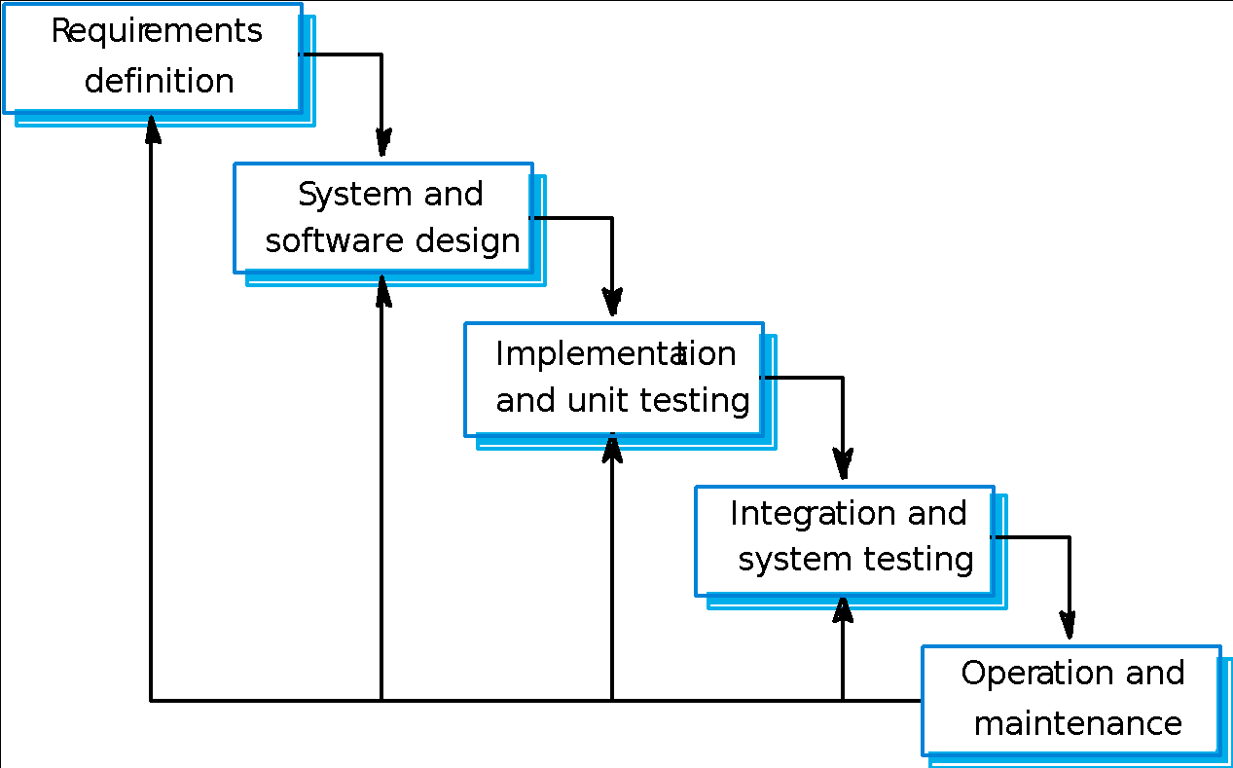
Waterfall model

Slide 44
Waterfall Strengths
Easy to understand, easy to use
Provides structure to inexperienced staff
Milestones are well understood
Sets requirements stability
Good for management control (plan, staff, track)
Works well when quality is more important than cost or schedule

Slide 45
Waterfall Deficiencies
All requirements must be known upfront
Deliverables created for each phase are considered frozen – inhibits flexibility
Can give a false impression of progress
Does not reflect problem-solving nature of software development – iterations of phases
Integration is one big bang at the end
Little opportunity for customer to preview the system (until it may be too late)

Slide 46
When to use the Waterfall Model
Requirements are very well known
Product definition is stable
Technology is understood
New version of an existing product
Porting an existing product to a new platform.
High risk for new systems because of specification and design problems.
Low risk for well-understood developments using familiar technology.

Slide 47
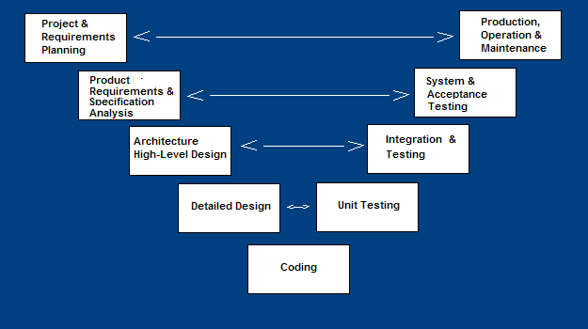
V-Shaped SDLC Model
A variant of the Waterfall that emphasizes the verification and validation of the product.
Testing of the product is planned in parallel with a corresponding phase of development

Slide 48
V-Shaped Strengths
Emphasize planning for verification and validation of the product in early stages of product development
Each deliverable must be testable
Project management can track progress by milestones
Easy to use

Slide 49
V-Shaped Weaknesses
Does not easily handle concurrent events
Does not handle iterations or phases
Does not easily handle dynamic changes in requirements
Does not contain risk analysis activities

Slide 50
Prototyping Model
Start with approximate requirements.
Carry out a quick design.
Prototype model is built using several short-cuts:
Short-cuts might involve using inefficient, inaccurate, or dummy functions.
A function may use a table look-up rather than performing the actual computations.

Slide 51
Prototyping Model (CONT.)
The developed prototype is submitted to the customer for his evaluation:
Based on the user feedback, requirements are refined.
This cycle continues until the user approves the prototype.
The actual system is developed using the classical waterfall approach.

Slide 52
Prototyping Model (CONT.)
Build Prototype
Requirements
Gathering
Customer Evaluation of Prototype
Customer satisfied
Quick Design
Design
Refine Requirements
Implement
Test
Maintain

Slide 53
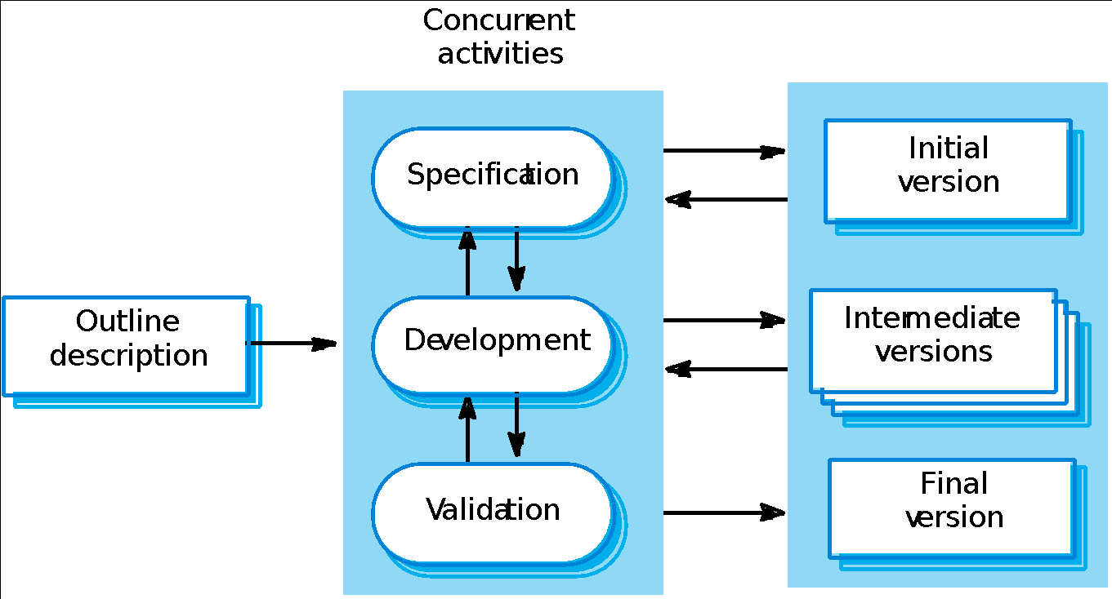
Evolutionary development

Slide 54
Evolutionary development
Exploratory development
Objective is to work with customers and to evolve a final system from an initial outline specification. Should start with well-understood requirements and add new features as proposed by the customer.
Throw-away prototyping
Objective is to understand the system requirements. Should start with poorly understood requirements to clarify what is really needed.

Slide 55
Characteristics of Evolutionary Development
Modern development processes take evolution as fundamental, and try to provide ways of managing, rather than ignoring, the risk.
System requirements always evolve in the course of a project.
Specification is evolved in conjunction with the software – No complete specification in the system development contract. Difficult for large customers.
Two (related) process models:
Incremental development
Spiral development

Slide 56
Evolutionary development
Problems
Lack of process visibility;
Systems are often poorly structured;
Special skills (e.g. in languages for rapid prototyping) may be required.
Applicability
For small or medium-size interactive systems;
For parts of large systems (e.g. the user interface);
For short-lifetime systems.

Slide 57
Incremental Development
Rather than deliver the system as a single delivery, the development and delivery is broken down into increments with each increment delivering part of the required functionality.
User requirements are prioritised and the highest priority requirements are included in early increments.
Once the development of an increment is started, the requirements are frozen though requirements for later increments can continue to evolve.

Slide 58
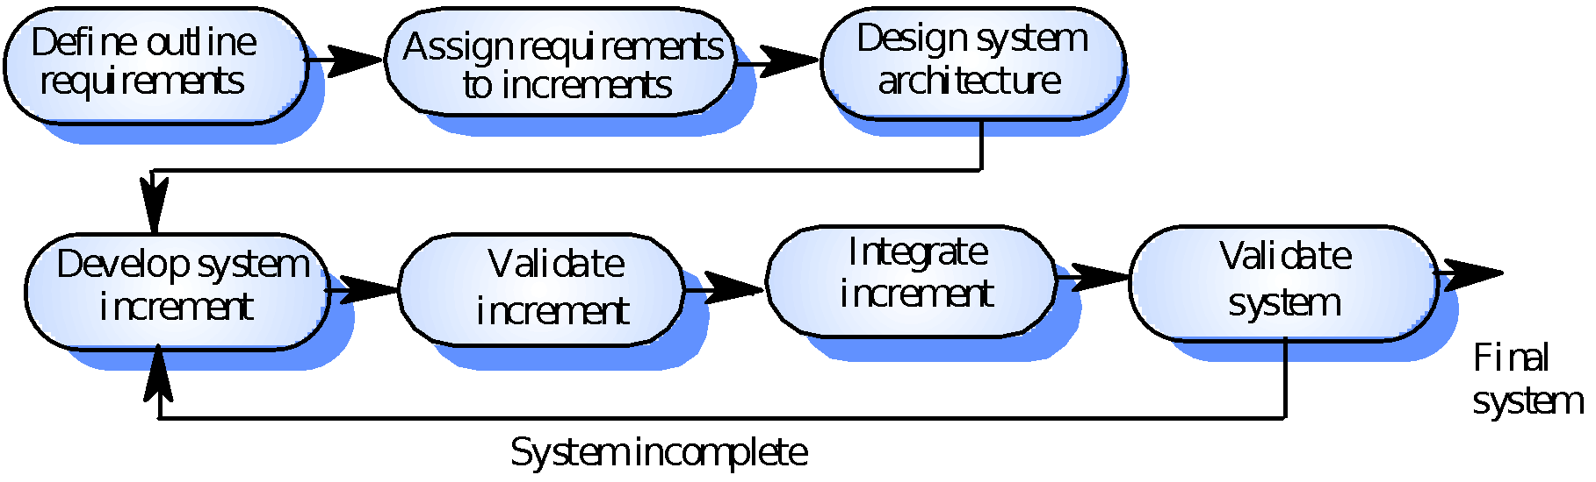
Incremental Development – Version I

Slide 59
Incremental Development –Advantages
Customer value can be delivered with each increment so system functionality is available earlier.
Early increments act as a prototype to help elicit requirements for later increments.
Lower risk of overall project failure.
The highest priority system services
tend to receive the most testing.

Slide 60
Incremental Development – Problems
Lack of process visibility.
Systems are often poorly structured.
Applicability claims in the literature:
For small or medium-size interactive systems.
For parts of large systems (e.g. the user interface).
For short-lifetime systems.

Slide 61
Incremental means adding, iterative means reworking
Increment | Iterate
fundamentally means “add onto”. | fundamentally means “change”.
repeating the process on a new section of work. | repeating the process on the same section of work
repeat the process (, design, implement, evaluate), | repeat the process (, design, implement, evaluate),

Slide 62
Incremental & iterative - summary
Iterative model - This model iterates requirements, design, build and test phases again and again for each requirement and builds up a system iteratively till the system is completely build.
Incremental model - It is non integrated development model. This model divides work in chunks and one team can work on many chunks. It is more flexible.
Spiral model - This model uses series of prototypes in stages, the development ends when the prototypes are developed into functional system. It is flexible model and used for large and complicated projects.
Evolutionary model - It is more customer focused model. In this model the software is divided in small units which is delivered earlier to the customers.
V-Model - It is more focused on testing. For every phase some testing activity are done.

Slide 63

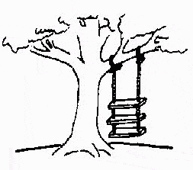
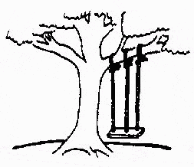

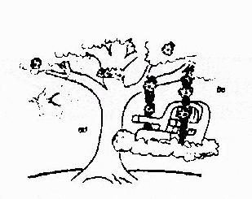
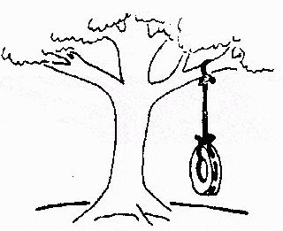
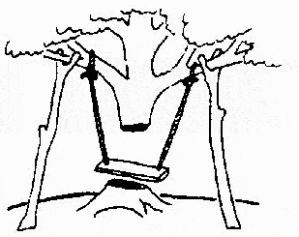
The Rapid Application Development (RAD) Model
Developed by IBM in 1980
User participation is essential
This is how the problem is solved now
The requirements specification was defined like this
The developers understood it in that way
This is how the problem was solved before.
This is how the program is described by marketing
This, in fact, is what the customer wanted …
That is the program after
department
12

Slide 64
The Rapid Application Development (RAD) Model
Build a rapid prototype
Give it to user for evaluation & obtain feedback
Prototype is refined
With active participation of users
Requirements
Planning
User
Description
Construction
Cut over

Slide 65
The Rapid Application Development (RAD) Model
Not an appropriate participation.
model
in the absence
of user
Reusable components are required to reduce development time.
Highly specialized & skilled developers are required and such developers are not easily available.

Slide 66
Spiral development
Process is represented as a spiral rather than as a sequence of activities with backtracking.
Each loop in the spiral represents a phase in the process.
No fixed phases such as specification or design - loops in the spiral are chosen depending on what is required.
Risks are explicitly assessed and resolved throughout the process.

Slide 67
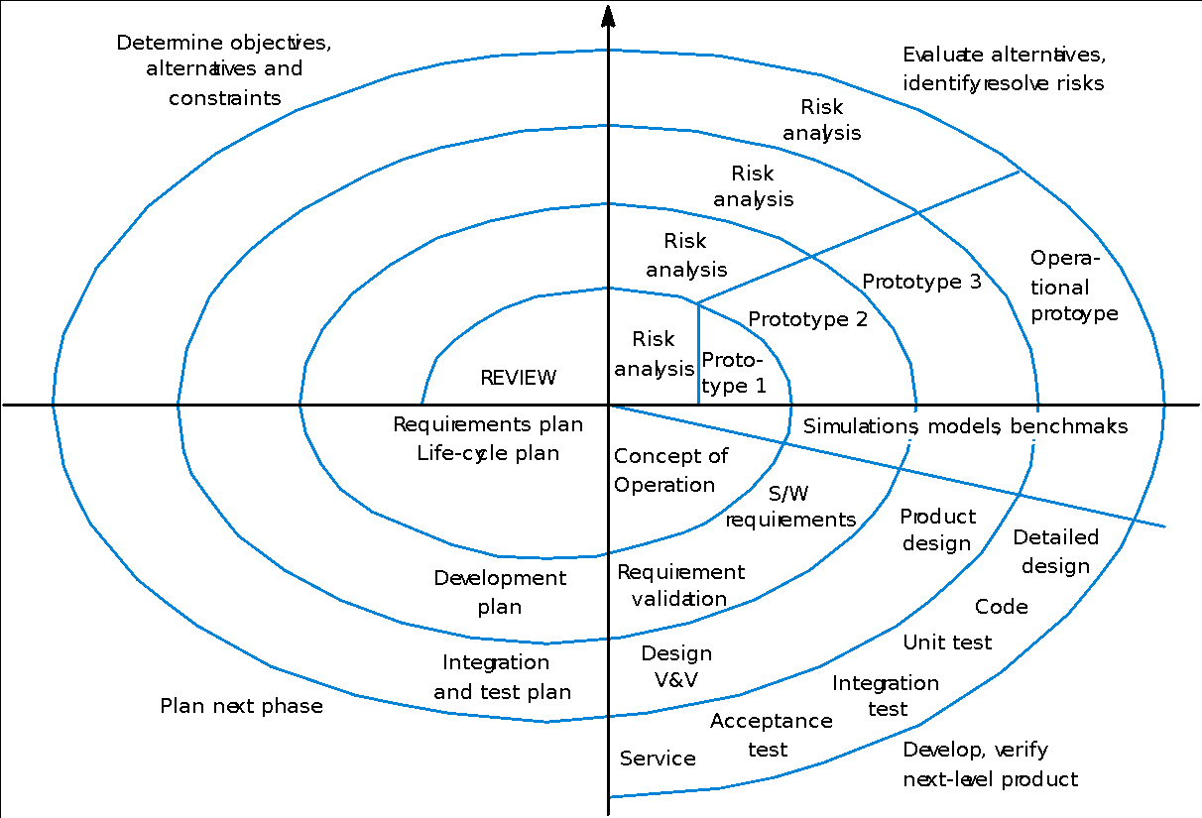
Spiral model of the software process

Slide 68
Spiral Model Strengths
Provides early indication of insurmountable risks, without much cost
Users see the system early because of rapid prototyping tools
Critical high-risk functions are developed first
The design does not have to be perfect
Users can be closely tied to all lifecycle steps
Early and frequent feedback from users
Cumulative costs assessed frequently

Slide 69
Spiral Model Weaknesses
Time spent for evaluating risks too large for small or low-risk projects
Time spent planning, resetting objectives, doing risk analysis and prototyping may be excessive
The model is complex
Risk assessment expertise is required
Spiral may continue indefinitely
Developers must be reassigned during non-development phase activities
May be hard to define objective, verifiable milestones that indicate readiness to proceed through the next iteration

Slide 70
When to use Spiral Model
When creation of a prototype is appropriate
When costs and risk evaluation is important
For medium to high-risk projects
Long-term project commitment unwise because of potential changes to economic priorities
Users are unsure of their needs
Requirements are complex
New product line
Significant changes are expected (research and exploration)

Slide 71
Agile Methods
Result from dissatisfaction with the overheads involved in design methods.
Software Development History:
During the 1970s, it was discovered that most large software development projects failed.
During the 1980s, many of the reasons for those failures began to be recognized.
In the 1990s, experiments and measurements were used to validate individual methods to prevent failure.
The current decade is characterized by complete processes to improve success.

Slide 72
Project Failure – the trigger for Agility
One of the primary causes of project failure was the extended period of time it took to develop a system.
Costs escalated and requirements changed.
Agile methods intend to develop systems more quickly with limited time spent on analysis and design.

Slide 73
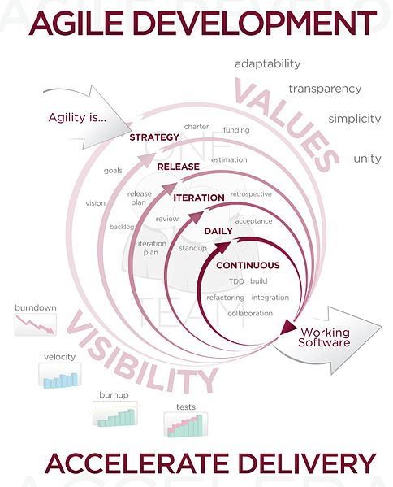
Agile Development

Slide 74
What is an Agile method? (1)
Focus on the code rather than the design.
Based on an iterative approach to software development.
Intended to deliver working software quickly.
Evolve quickly to meet changing requirements.
There are claims that agile methods are probably best suited to small/medium-sized business systems or PC products.

Slide 75
What is an agile method? (2)
Agile proponents believe:
Current software development processes are too heavyweight or cumbersome
Too many things are done that are not directly related to software product being produced
Current software development is too rigid
Difficulty with incomplete or changing requirements
Short development cycles (Internet applications)
More active customer involvement needed

Slide 76
What is an agile method? (3)
Agile methods are considered
Lightweight
People-based rather than Plan-based
Several agile methods
No single agile method
Extreme Programming (XP) most popular
No single definition
Agile Manifesto closest to a definition
Set of principles
Developed by Agile Alliance

Slide 77
Customer involvement | The customer should be closely involved throughout the development process. Their role is provide and prioritise new system requirements and to evaluate the iterations of the system.
Incremental delivery | The software is developed in increments with the customer specifying the requirements to be included in each increment.
People not process | The skills of the development team should be recognised and exploited. The team should be left to develop their own ways of working without prescriptive processes.
Embrace change | Expect the system requirements to change and design the system so that it can accommodate these changes.
Maintain simplicity | Focus on simplicity in both the software being developed and in the development process used. Wherever possible, actively work to eliminate complexity from the system.

Slide 78
What are the Agile Methodologies?
EXtreme Programming has received the most attention,
but here is a list:
XP
SCRUM
DSDM
The Crystal Family
ASD
FDD
dX (agile RUP)
Open Source
Agile Modeling
Pragmatic Programming

Slide 79
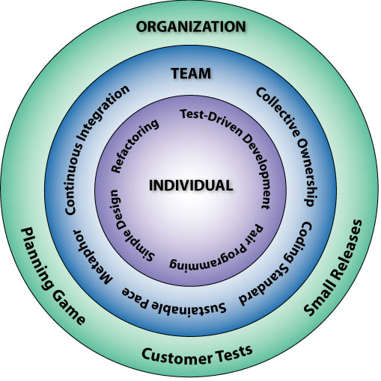
XP Practices
The Planning Game
Small Releases
Metaphor
Simple Design
Test-Driven Development
Refactoring
Pair Programming
Collective Ownership
Continuous Integration
40-Hour Workweek
On-site Customer
Coding Standards

Slide 80
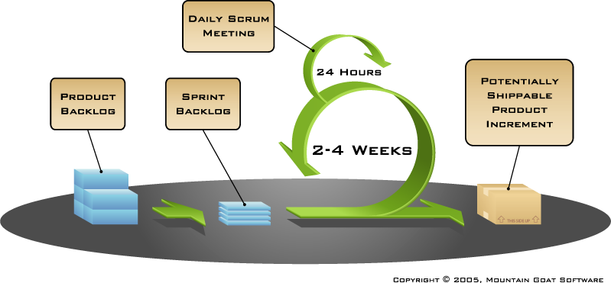
How Scrum Works?

Slide 81
Comparison of Different Life Cycle Models
Iterative waterfall model
most widely used model.
But, suitable only for well-understood problems.
Prototype model is suitable for projects not well understood:
user requirements
technical aspects

Slide 82
Comparison of Different Life Cycle Models (CONT.)
Evolutionary model is suitable for large problems:
can be decomposed into a set of modules that can be incrementally implemented,
incremental delivery of the system is acceptable to the customer.
The spiral model:
suitable for development of technically challenging software products that are subject to several kinds of risks.

Slide 83
Selection of a Life Cycle Model
Selection of a model is based on:
Requirements
Development team
Users
Project type and associated risk

Slide 84
Based On Characteristics Of Requirements
Requirements | Waterfall | Prototype | Iterative enhancement | Evolutionary development | Spiral | RAD
Are requirements easily understandable and defined? | Yes | No | No | No | No | Yes
Do we change requirements quite often? | No | Yes | No | No | Yes | No
Can we define requirements early in the cycle? | Yes | No | Yes | Yes | No | Yes
Requirements are indicating a complex system to be built | No | Yes | Yes | Yes | Yes | No

Slide 85
Based On Status Of Development Team
Development team | Waterfall | Prototype | Iterative enhancement | Evolutionary development | Spiral | RAD
Less experience on similar projects? | No | Yes | No | No | Yes | No
Less domain knowledge (new to the technology) | Yes | No | Yes | Yes | Yes | No
Less experience on tools to be used | Yes | No | No | No | Yes | No
Availability of training if required | No | No | Yes | Yes | No | Yes

Slide 86
Based On User’s Participation
Involvement of Users | Waterfall | Prototype | Iterative enhancement | Evolutionary development | Spiral | RAD
User involvement in all phases | No | Yes | No | No | No | Yes
Limited user participation | Yes | No | Yes | Yes | Yes | No
User have no previous experience of participation in similar projects | No | Yes | Yes | Yes | Yes | No
Users are experts of problem domain | No | Yes | Yes | Yes | No | Yes

Slide 87
Based On Type Of project With Associated Risk
Project type and risk | Waterfall | Prototype | Iterative enhancement | Evolutionary development | Spiral | RAD
Project is the enhancement of the existing system | yes | No | Yes | Yes | No | Yes
Funding is stable for the project | Yes | Yes | No | No | No | Yes
High reliability requirements | No | No | Yes | Yes | Yes | No
Tight project schedule | No | Yes | Yes | Yes | Yes | Yes
Use of reusable components | No | Yes | No | No | Yes | Yes
Are resources (time, money, people etc.) scare? | No | Yes | No | No | Yes | No

Slide 88
Multiple Choice Questions
Note: Select most appropriate answer of the following questions:
 | Spiral Model was developed by
 | (a) Bev Littlewood (c) Roger Pressman | (b) Berry Boehm (d) Victor Basili
Which model is most popular for student’s small projects?
 | (a) Waterfall model | (b) Spiral model
 | (c) Quick and fix model Which is not a software life cycle model? | (d) Prototyping model
 | (a) Waterfall model | (b) Spiral model
 | (c) Prototyping model Project risk factor is considered in | (d) Capability maturity model
 | (a) Waterfall model (c) Spiral model | (b) Prototyping model (d) Iterative enhancement model
 | SDLC stands for
 | (a) Software design life cycle | (b) Software development life cycle
 | (c) System development life cycle | (d) System design life cycle

Slide 89
Multiple Choice Questions
Note: Select most appropriate answer of the following questions:
 | Build and fix model has
 | (a) 3 phases (c) 2 phases | (b) 1 phase (d) 4 phases
 | SRS stands for (a) Software requirements specification | (b) Software requirements solution
 | (c) System requirements specification Waterfall model is not suitable for | (d) none of the above
 | (a) small projects | (b) accommodating change
 | (c) complex projects RAD stands for | (d) none of the above
 | (a) Rapid application development | (b) Relative application development
 | (c) Ready application development | (d) Repeated application development
RAD model was proposed by
Lucent Technologies
(c) IBM
(b) Motorola
(d) Microsoft

Slide 90
Multiple Choice Questions
Note: Select most appropriate answer of the following questions:
If requirements are easily understandable and defined,which model is best suited?
(a) Waterfall model
(c) Spiral model
(b) Prototyping model
(d) None of the above
If requirements are frequently changing, which model is to be selected?
(a) Waterfall model
(c) RAD model
(b) Prototyping model
(d) Iterative enhancement model
If user participation is available, which model is to be chosen?
(a) Waterfall model
(c) Spiral model
(b) Iterative enhancement model
(d) RAD model
If limited user participation is available, which model is to be selected?
(a) Waterfall model
(c) Iterative enhancement model
(b) Spiral model
(d) any of the above
If project is the enhancement of existing system, which model is best suited?
(a) Waterfall model
(c) Iterative enhancement model
(b) Prototyping model
(d) Spiral model

Slide 91
Multiple Choice Questions
Note: Select most appropriate answer of the following questions:
Which one is the most important feature of spiral model?
(a) Quality management
(c) Performance management
(b) Risk management
(d) Efficiency management
Most suitable model for new technology that is not well understood is:
(a) Waterfall model
(c) Iterative enhancement model
(b) RAD model
(d) Evolutionary development model
Statistically, the maximum percentage of errors belong to the following phase of SDLC
(a) Coding
(c) Specifications
(b) Design
(d) Installation and maintenance
Which phase is not available in software life cycle?
(a) Coding
(c) Maintenance
(b) Testing
(d) Abstraction
The development is supposed to proceed linearly through the phase in
(a) Spiral model
(c) Prototyping model
(b) Waterfall model
(d) None of the above

