Slide 1

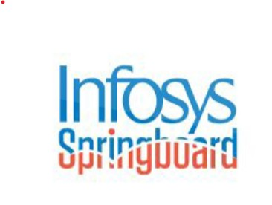
Infosys Springboard
Objective
AI-Driven
Supply Chain Disruption Predictor and Inventory Optimization
System

Slide 2
Project Overview In the pharmaceutical industry, managing product inventory, optimizing supply chains, and predicting potential disruptions are critical for ensuring smooth operations and meeting demand. Traditional methods of supply chain management often lack the ability to predict disruptions in real time or handle vast amounts of unstructured data, such as news articles related to supply chain issues.

Slide 3
Objective:
To develop an AI-driven Pharmaceutical Product Management and Supply Chain Prediction System that leverages machine learning (ML) to:
Optimize inventory management.
Predict supply chain disruptions in real-time.
Provide actionable insights for decision-makers in the pharmaceutical industry.

Slide 4
Why I Selected the Topic
Increasing global challenges in pharmaceutical supply chain management.
Need for better risk prediction and inventory optimization in the sector.
Opportunity to apply AI and machine learning techniques to solve real-world problems.
Relevance to industry needs, improving efficiency and reducing risks in pharmaceutical distribution.
Personal interest in combining AI, data science, and real-world applications for impact.

Slide 5
Approach to the Solution
Understanding the Problem & Data Collection.
Data Processing & Preprocessing
Model Development for Risk Prediction & Sentiment Analysis.
Web Application Development & Integration.
Data Visualization for Decision-Making.

Slide 6
Key Features of the System
Product Management (CRUD operations)
Risk Prediction Model
News Article Sentiment Analysis
Supply Chain Visualizations

Slide 7
System Architecture
Overview: The system integrates a Flask web application, machine learning models, and a SQLite database for pharmaceutical product management, supply chain prediction, and visualization.
Key Components:
Frontend:
HTML templates (index.html, products.html, etc.) for user interface.
Styled with CSS (style.css) for responsive design.
Backend:
Flask framework to handle user requests, routes, and data interactions.
SQLite for database management and querying product data.
Machine Learning:
Predicts supply chain risks, demand-supply gaps, and inventory levels.
Uses sentiment analysis on news articles to assess risk.
Database:
SQLite stores product details and prediction results.
Visualization:
Visualizes results using graphs (matplotlib) for easy interpretation.

Slide 8
Issues Encountered & Research
Data Integrity and Quality Issues.
Handling Real-Time Data Updates and Synchronization.
Scaling the Model for Large Datasets.
Visualization and User Interface Design.

Slide 9
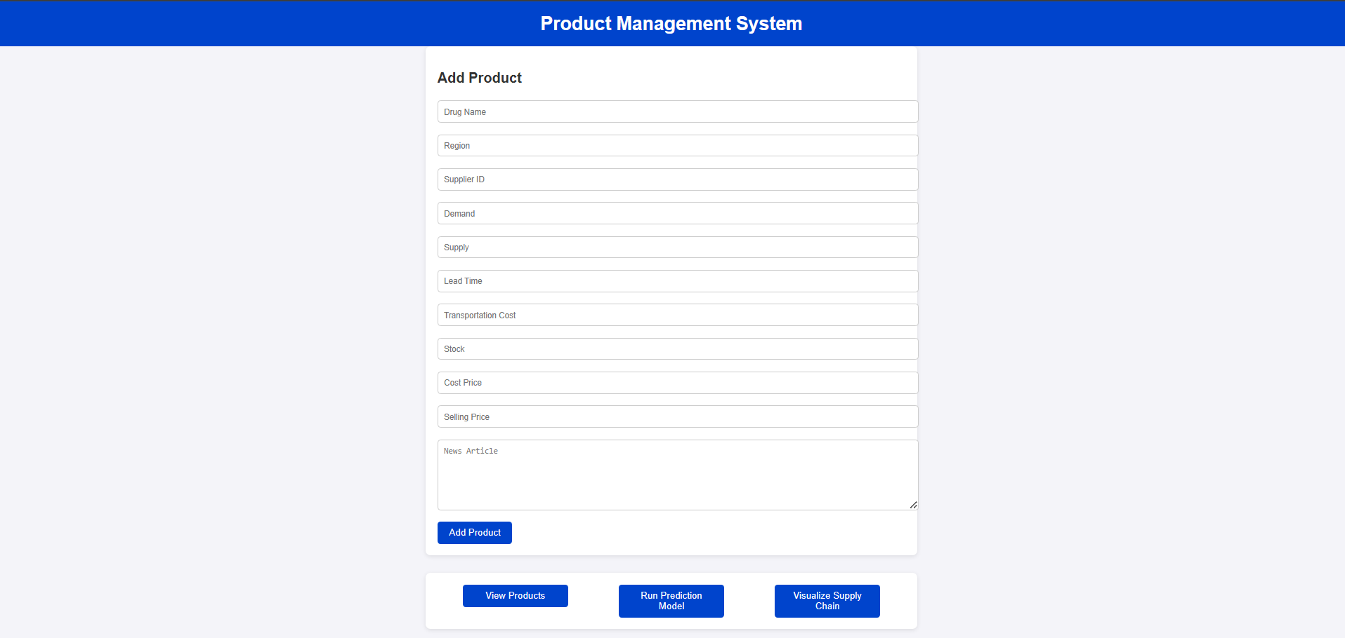
Sample Demo & Code Link

Slide 10
Sample Workflow:
User adds product information via a form.
Prediction models are executed for risk and inventory.
Visualization displays the risk level and inventory utilization.
Code Link : https://github.com/anshu421/Supply-Chain-Disruption-Predictor-and-Inventory-Optimization-System
Provides access to the source code, including Python scripts (predict_disruptions.py ,
app.py , upload.py , export_to_csv.py , database.py ) and HTML templates.

Slide 11
Future Enhancements
Predictive Analytics: Integrate more advanced AI models for better accuracy..
Scalability: Move to a more robust database like PostgreSQL for handling larger datasets.
Real-Time Data: Incorporate real-time supply chain data using APIs to update predictions continuously.
User Experience: Improve UI/UX with more interactive dashboards and mobile compatibility.

Slide 12
Thank you

