Slide 1
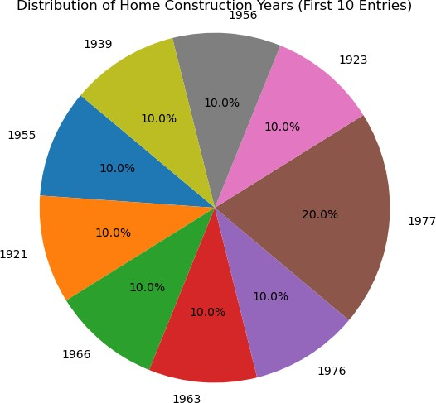
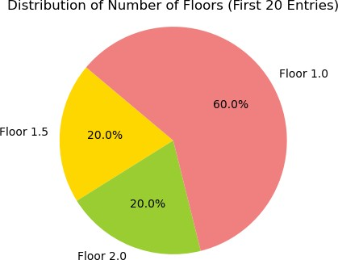
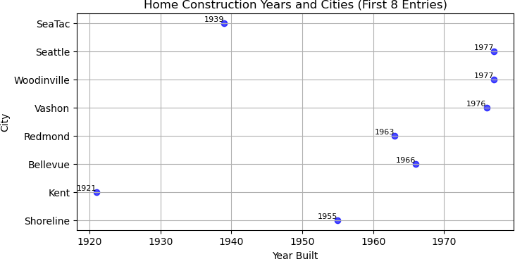
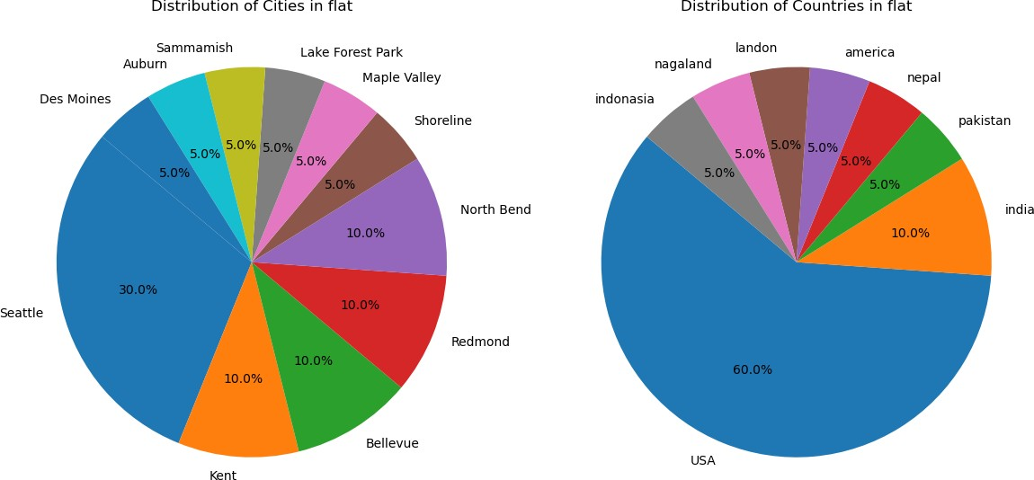
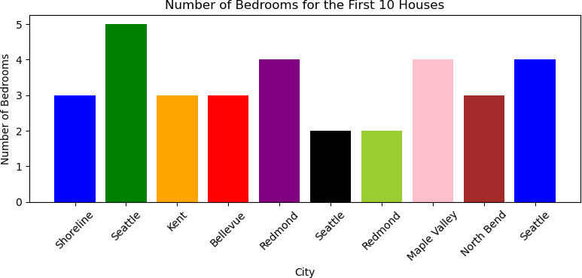
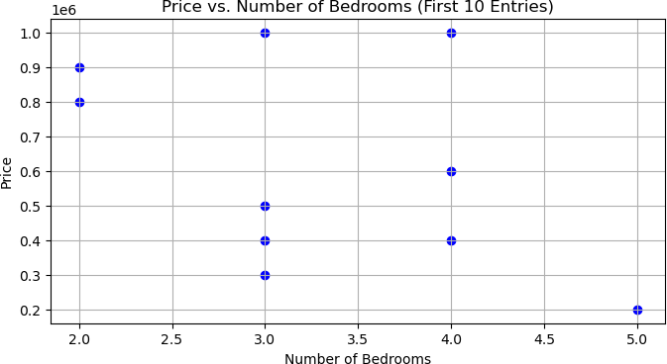
In [1]:
EDA ON HOUSEPRICE DATASET
Name - Anshu kumari
In [2]:
import numpy as np import pandas as pd import seaborn as sns
import matplotlib.pyplot as plt
In [3]:
house = pd.read_csv("Home.csv")
house
Out[3]: Price Bedrooms Bathrooms sqft_living floors sqft_above Home_built city country
0 3 lakh 3 1.50 1340 1.5 1340 1955 Shoreline USA
1 2 lakh 5 2.50 3650 2.0 3370 1921 Seattle USA
2 4 lakh 3 2.00 1930 1.0 1930 1966 Kent USA
3 5 lakh 3 2.25 2000 1.0 1000 1963 Bellevue india
4 6lakh 4 2.50 1940 1.0 1140 1976 Redmond USA
... ... ... ... ... ... ... ... ... ...
579 2.5 lakh 3 2.50 2010 2.0 2010 1977 Vashon USA
580 9 lakh 4 2.25 2710 2.0 2710 1977 Woodinville USA
581 9 lakh 4 2.50 5300 2.0 4570 1923 Seattle USA
582 6 lakh 3 1.50 1310 1.0 1090 1956 Seattle USA
583 3.6 lakh 4 1.50 1950 1.5 1950 1939 SeaTac USA
584 rows × 9 columns
In [4]:
house.index
_{Out[4]:} RangeIndex(start=0, stop=584, step=1)
In [5]:
house.min()
Out[5]: ^{Price}
1 lakh 1 1.0 700 1.0 650 1900
Algona USA
In [6]:
Bedrooms Bathrooms sqft_living floors sqft_above Home_built city country
dtype: object
house.max()
Out[6]: ^{Price}
988500
9
8.0
13540
3.0
9410
2014
Yarrow Point pakistan
In [7]:
Bedrooms Bathrooms sqft_living floors sqft_above Home_built city country
dtype: object
house.head()
Out[7]: Price Bedrooms Bathrooms sqft_living floors sqft_above Home_built city country
0 3 lakh 3 1.50 1340 1.5 1340 1955 Shoreline USA
1 2 lakh 5 2.50 3650 2.0 3370 1921 Seattle USA
2 4 lakh 3 2.00 1930 1.0 1930 1966 Kent USA
3 5 lakh 3 2.25 2000 1.0 1000 1963 Bellevue india
4 6lakh 4 2.50 1940 1.0 1140 1976 Redmond USA
In [8]:
house.columns
_{Out[8]:} Index(['Price', 'Bedrooms', 'Bathrooms', 'sqft_living', 'floors', 'sqft_above', 'Home_built', 'city', 'country'],
dtype='object')
In [9]:
house.shape
_{Out[9]:} (584, 9)
In [10]:
house.count()
Out[10]: ^{Price}
584
Bedrooms 584
In [11]:
Bathrooms 584
sqft_living 584
floors 584
sqft_above 584
Home_built 584
city 584
country 584 dtype: int64
house.iloc[0]
Out[11]: ^{Price}
3 lakh 3 1.5 1340 1.5 1340 1955
Shoreline USA
Bedrooms Bathrooms sqft_living floors sqft_above Home_built city country
In [12]:
Name: 0, dtype: object
Out[12]:
house.describe()
Bedrooms Bathrooms sqft_living floors sqft_above Home_built
count 584.000000 584.000000 584.000000 584.000000 584.000000 584.000000
mean 3.433219 2.172517 2145.017123 1.502568 1809.871575 1970.650685
std 0.952919 0.795362 1026.326320 0.565968 887.027643 29.575056
min 1.000000 1.000000 700.000000 1.000000 650.000000 1900.000000
25% 3.000000 1.750000 1440.000000 1.000000 1190.000000 1951.000000
50% 3.000000 2.250000 1965.000000 1.500000 1560.000000 1975.000000
75% 4.000000 2.500000 2657.000000 2.000000 2205.000000 1996.250000
max 9.000000 8.000000 13540.000000 3.000000 9410.000000 2014.000000
In [13]:
house.info()
<class 'pandas.core.frame.DataFrame'> RangeIndex: 584 entries, 0 to 583 Data columns (total 9 columns):
# Column Non-Null Count Dtype
Price 584 non-null object
Bedrooms 584 non-null int64
Bathrooms 584 non-null float64
sqft_living 584 non-null int64
floors 584 non-null float64
sqft_above 584 non-null int64
Home_built 584 non-null int64
city 584 non-null object
country 584 non-null object dtypes: float64(2), int64(4), object(3) memory usage: 41.2+ KB
In [14]:
house.isnull()
Out[14]:
Price Bedrooms Bathrooms sqft_living floors sqft_above Home_built city country
False False False False False False False False False
False False False False False False False False False
False False False False False False False False False
False False False False False False False False False
False False False False False False False False False
... ... ... ... ... ... ... ... ... ...
False False False False False False False False False
False False False False False False False False False
False False False False False False False False False
False False False False False False False False False
False False False False False False False False False
rows × 9 columns
In [15]:
house.sum()
Out[15]: ^{Price}
3 lakh2 lakh4 lakh5 lakh6lakh8lakh9 lakh10 lak...
2005
1268.75
1252690
877.5
1056965
1150860
ShorelineSeattleKentBellevueRedmondSeattleRedm... USAUSAUSAindiaUSApakistanUSAnepalUSAUSAamerica...
In [16]:
Bedrooms Bathrooms sqft_living floors sqft_above Home_built city country
dtype: object
house.duplicated()
Out[16]: ⁰
False False False False False
...
1
2
3
4
In [17]:
False
False
False
False
False
Length: 584, dtype: bool
# Sample data for the first 10 entries
home_built_years = [1955, 1921, 1966, 1963, 1976, 1977, 1977, 1923, 1956, 1939]
# Count the frequency of each home construction year
home_built_counts = {}
for year in home_built_years:
if year in home_built_counts: home_built_counts[year] += 1
else:
home_built_counts[year] = 1
# Prepare data for the pie chart
labels = [str(year) for year in home_built_counts.keys()] sizes = list(home_built_counts.values())
# Create a pie chart
plt.figure(figsize=(6, 6))
plt.pie(sizes, labels=labels, autopct='%1.1f%%', startangle=140) plt.axis('equal') # Equal aspect ratio ensures that pie is drawn as a circle. plt.title('Distribution of Home Construction Years (First 10 Entries)')
plt.show()
In [18]:
# Sample data for the first 20 entries
floors = [1.5, 2.0, 1.0, 1.0, 1.0, 2.0, 2.0, 1.0, 1.5, 1.0, 1.5, 1.0, 1.5, 1.0, 1.0, 1.0, 2.0, 1.0, 1.0, 1.0]
# Count the frequency of each floor type
floor_counts = {}
for floor in floors:
if floor in floor_counts: floor_counts[floor] += 1
else:
floor_counts[floor] = 1
# Prepare data for the pie chart
labels = [f"Floor {floor}" for floor in floor_counts.keys()] sizes = list(floor_counts.values())
colors = ['gold', 'yellowgreen', 'lightcoral', 'lightskyblue']
# Create a pie chart
plt.figure(figsize=(4, 4))
plt.pie(sizes, labels=labels, colors=colors, autopct='%1.1f%%', startangle=140) plt.axis('equal') # Equal aspect ratio ensures that pie is drawn as a circle. plt.title('Distribution of Number of Floors (First 20 Entries)')
plt.show()
In [19]:
import matplotlib.pyplot as plt
# Sample data for the first 8 entries
home_built_years = [1955, 1921, 1966, 1963, 1976, 1977, 1977, 1939]
cities = ["Shoreline", "Kent", "Bellevue", "Redmond", "Vashon", "Woodinville", "Seattle", "SeaTac"]
# Create a scatter plot
plt.figure(figsize=(8, 4))
plt.scatter(home_built_years, cities, color='blue', alpha=0.7) plt.xlabel('Year Built')
plt.ylabel('City')
plt.title('Home Construction Years and Cities (First 8 Entries)') plt.grid(True)
# Add labels to the data points
for i in range(len(home_built_years)):
plt.text(home_built_years[i], cities[i], str(home_built_years[i]), ha='right', va='bottom', color='black', fontsize=8)
plt.show()
In [24]:
# Select the first 15 entries
subset = house.head(20)
# Calculate the distribution of cities
city_counts = subset['city'].value_counts()
# Calculate the distribution of countries
country_counts = subset['country'].value_counts()
# Create a figure with two subplots (one for city and one for country)
fig, axes = plt.subplots(1, 2, figsize=(12, 6))
# Create a pie chart for cities
axes[0].pie(city_counts, labels=city_counts.index, autopct='%1.1f%%', startangle=140) axes[0].set_title('Distribution of Cities in flat')
# Create a pie chart for countries
axes[1].pie(country_counts, labels=country_counts.index, autopct='%1.1f%%', startangle=140) axes[1].set_title('Distribution of Countries in flat')
# Adjust layout
plt.tight_layout()
# Display the pie charts
plt.show()
In [26]:
# Select the first 10 entries
subset = house.head(10)
# Create a bar graph
plt.figure(figsize=(8, 4))
plt.bar(subset.index, subset['Bedrooms'], color=['blue', 'green', 'orange', 'red','purple','black','yellowgreen','pink','brown'], label='Bedrooms') plt.xlabel('City')
plt.ylabel('Number of Bedrooms')
plt.title('Number of Bedrooms for the First 10 Houses') plt.xticks(subset.index, subset['city'], rotation=45)
#plt.legend()
plt.tight_layout()
# Display the graph
plt.show()
In [22]:
house.head(10)
Out[22]: Price Bedrooms Bathrooms sqft_living floors sqft_above Home_built city country
0 3 lakh 3 1.50 1340 1.5 1340 1955 Shoreline USA
1 2 lakh 5 2.50 3650 2.0 3370 1921 Seattle USA
2 4 lakh 3 2.00 1930 1.0 1930 1966 Kent USA
3 5 lakh 3 2.25 2000 1.0 1000 1963 Bellevue india
4 6lakh 4 2.50 1940 1.0 1140 1976 Redmond USA
5 8lakh 2 1.00 880 1.0 880 1938 Seattle pakistan
6 9 lakh 2 2.00 1350 1.0 1350 1976 Redmond USA
7 10 lakh 4 2.50 2710 2.0 2710 1989 Maple Valley nepal
8 10 lakh 3 2.50 2430 1.0 1570 1985 North Bend USA
9 4 lakh 4 2.00 1520 1.5 1520 1945 Seattle USA
In [27]:
import matplotlib.pyplot as plt
# Sample data for the first 10 entries
prices = [300000, 200000, 400000, 500000, 600000, 800000, 900000, 1000000, 1000000, 400000]
bedrooms = [3, 5, 3, 3, 4, 2, 2, 4, 3, 4]
# Create a scatter plot plt.figure(figsize=(8, 4)) plt.scatter(bedrooms, prices, color='blue') plt.xlabel('Number of Bedrooms') plt.ylabel('Price')
plt.title('Price vs. Number of Bedrooms (First 10 Entries)') plt.grid(True)
# Display the graph
plt.show()
Conclusion
In this lab project, I, Anshu Kumari, have explored a housing dataset using Python and various libraries such as Pandas, Matplotlib, Seaborn, and NumPy. The dataset contains information about different homes, including features like price, number of bedrooms, number of bathrooms, square footage, floors, city, and country.
Throughout the project, I performed the following tasks:
Data Loading and Initial Exploration: Loaded the dataset from a CSV file using Pandas. Checked the shape, columns, and initial records of the dataset. Utilized functions like head(), describe(), and info() to understand the dataset's structure and basic statistics.
Data Visualization:
Created visualizations to analyze various aspects of the dataset. Used Matplotlib and Seaborn to generate different types of graphs, such as pie charts, scatter plots, and bar graphs. Explored the distribution of floors, home construction years and cities, number of bedrooms, and comparisons between price and bedrooms.
Data Analysis:
Calculated the frequency of certain features, such as floors, bedrooms, and city occurrences. Analyzed the distribution of data using graphical representations.
Data Quality Check:
Checked for missing values using the isnull() function , Checked for duplicated records using the duplicated() function , Checked for using the sum() function , Checked for using the info() function , Checked for using the shape() function , Checked for using the count() function , Checked for using the colum() function , Checked for using the head() function , Checked for using the max() function , Checked for using the min() function
In conclusion, this lab project aimed to gain insights into the housing dataset using Python and data visualization techniques. The analysis provided a better understanding of the dataset's characteristics, including the distribution of various features and relationships between them. This project demonstrates the use of programming and data analysis tools to explore and visualize real-world datasets, which can be valuable in making informed decisions and deriving insights for further analysis.

