Slide 1
Team
Anshu Ahirwar (150050077)
Ashish Chandra (05D05016)
Deepesh Meena (150050041)

Slide 2
BankWALAH
Open-Source

Slide 3
ABSTRACT
BANKWALAH is a web application that can be used by banks to manage their daily activities like managing employees, creating new accounts, crediting and debiting money to user accounts, calculating interests and crediting them to user accounts, debiting user accounts for charges like ATM uses etc.

Slide 4
INTRODUCTION
We see that all of the banks worldwide use their specialized software and there is no common platform.
The main objective of BANKWALAH is to provide the banks an open-source software to manage their activities.
By using BANKWALAH, banks can save lots of money that they pay to develop a customized software.

Slide 5
PRIOR ARTWORK
Our research began with the analysis of some banking websites. We wanted to keep the structure simple. The majority of the concepts of the tabular structure of the database are our own.

Slide 6
PROBLEM STATEMENT
The software will work on 3 fronts with different levels of authority.
The first level called SHAKTIMAAN aka SUPERADMIN will have the maximum authority with the power to alter everything.
The second level called GEETA aka MANAGER will have the authority to alter everything including employees and customers related to his particular branch.
The third level called GANGADHAR aka CLERK will have authority to alter records of customers related to his particular branch.
The software will use a database called BANKWALAH_DB having four tables in it called EMPLOYEES, CUSTOMERS, BRANCHES and TRANSACTIONS having various fields in them.

Slide 7
PRELIMINARY WORK
CREATE DATABASE BANKWALAH_DB;
CREATE TABLE EMPLOYEES (
EmpID int NOT NULL,
EmpName varchar(255) NOT NULL,
EmpFName varchar(255) NOT NULL,
EmpMName varchar(255),
EmpDOB date() NOT NULL,
EmpSex varchar(20) NOT NULL,
EmpLAdd varchar(255) NOT NULL,
EmpPAdd varchar(255),
EmpPhone varchar(20),
EmpEmail varchar(255),
EmpPAN varchar(20),
EmpAadhaar varchar(20),
EmpBrID int NOT NULL,
EmpRole varchar(20) NOT NULL,
EmpLogin varchar(20) NOT NULL,
EmpPass varchar(20) NOT NULL,
UNIQUE (EmpID),
PRIMARY KEY (EmpID),
FOREIGN KEY (EmpBrID) REFERENCES BRANCHES(BrID)
);
CREATE TABLE CUSTOMERS (
CustID int NOT NULL,
CustName varchar(255) NOT NULL,
CustFName varchar(255) NOT NULL,
CustMName varchar(255),
CustDOB date(20) NOT NULL,
CustSex varchar(20) NOT NULL,
CustLAdd varchar(255) NOT NULL,
CustPAdd varchar(255),
CustPhone varchar(20),
CustEmail varchar(255),
CustPAN varchar(20),
CustAadhaar varchar(20),
CustBrID int NOT NULL,
CustACType varchar(20) NOT NULL,
CustCurrBal double(18,2) NOT NULL,
CustLog text,
UNIQUE (CustID),
PRIMARY KEY (CustID),
FOREIGN KEY (CustBrID) REFERENCES BRANCHES(BrID)
);

Slide 8
PRELIMINARY WORK
CREATE TABLE BRANCHES (
BrID int NOT NULL,
BrLoc varchar(255) NOT NULL,
BrIFSC varchar(20) NOT NULL,
BrOpenDate date(20),
BrPhone varchar(20),
BrEmail varchar(255),
BrManID int NOT NULL,
UNIQUE (BrID),
PRIMARY KEY (BrID),
FOREIGN KEY (BrManID) REFERENCES EMPLOYEES(EmpID)
);
CREATE TABLE TRANSACTIONS (
TrID int NOT NULL,
TrBr varchar(255) NOT NULL,
TrTime datetime() NOT NULL,
TrRemarks varchar(255),
TrCustID int NOT NULL,
TrEmpID int NOT NULL,
UNIQUE (TrID),
PRIMARY KEY (TrID),
FOREIGN KEY (TrCustID) REFERENCES COSTOMERS(CustID),
FOREIGN KEY (TrEmpID) REFERENCES EMPLOYEES(EmpID)
);

Slide 9
REQUIREMENTS
Languages
PHP
SQL
HTML, CSS, JavaScript
Packages : Bootstrap, JQuery
Software Requirements
Apache Web Server
MySQL
PHP7 Package

Slide 10
IMPLEMENTATION
There will be three dashboards called SHAKTIMAAN, GEETA and GANGADHAR. Data can be inserted into the database through any of the above dashboards by an employee with proper authority.

Slide 11
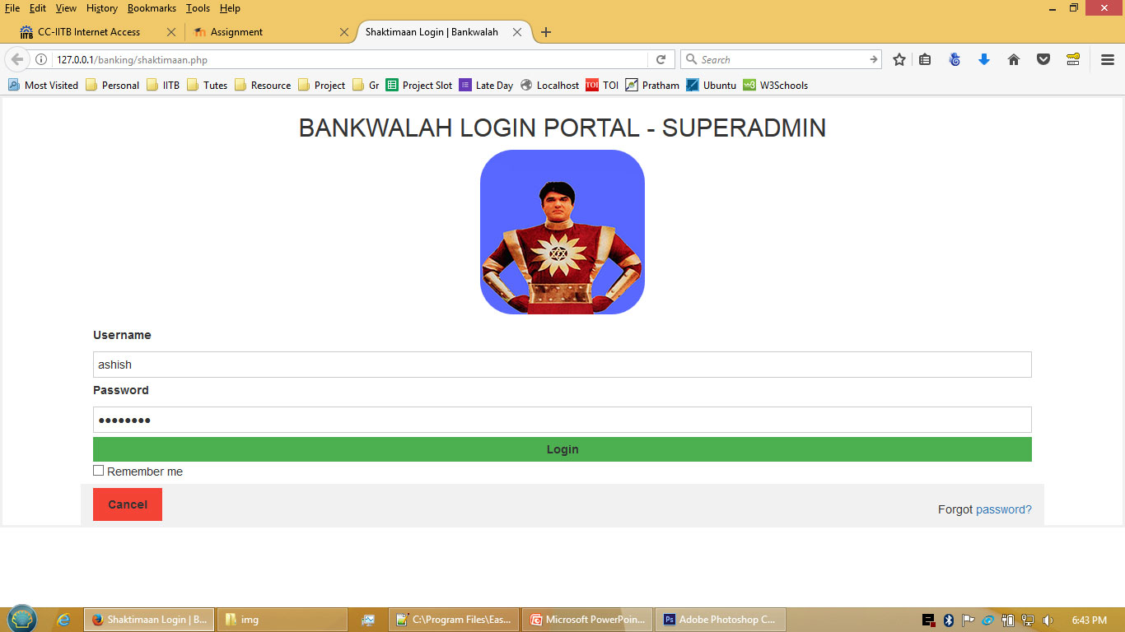
IMPLEMENTATION

Slide 12
FEASIBILITY
BANKWALAH is a student project which can be used by banks to further develop it as per their needs.
It uses basic login features. The security must be further improved before you can use it in a real life scenario.
We have left a number of modules like loans, drafts, cheques, special benefits to senior citizens, net banking etc which need to be developed further.

Slide 13
TESTING
BANKWALAH will be tested on localhost installed in our personal laptops.
We have Apache Web Server, MySQL and PHP7 installed in our laptops.
Open in Browser : http://localhost/bankwalah/shaktimaan.php

Slide 14
WORK ALLOCATION / TIMELINE
Database Queries and PHP – Ashish
Dashboard and Calculation Scripts – Deepesh
HTML and Layouts – Anshu
We will try to finish the project well before the deadline.

Slide 15
REFERENCES
PHP and MySQL Web Development, Luke Welling and Laura Thomson, Sams Publishing
SQL For Dummies, 8th Ed., Allen G. Taylor, Wiley Publishing
Database Development for Dummies, Allen G. Taylor, Wiley Publishing
http://www.w3schools.com
http://searchdatamanagement.techtarget.com/answer/Definition-of-primary-super-foreign-and-candidate-key-in-the-DBMS

Slide 16
☺ THANK YOU ☺

