Slide 1
Team
Anshu Ahirwar (150050077)
Ashish Chandra (05D05016)
Deepesh Meena (150050041)

Slide 2
BankWALAH
Open-Source

Slide 3
PROJECT REPORT
In the project proposal what we have promised to, we have certainly delivered it in the final demo and lot more as you can see once you go through the dashboard after login process.
Making a software of more than 100 PHP files and some JavaScript and CSS files was not an easy task.
Finally we are glad to see what we have done in a little time. We feel happy and content for what we have learnt in the process.
We thank you Prof. Kavi Arya and TAs specially Diptesh Kanojia which have been of great help.

Slide 4
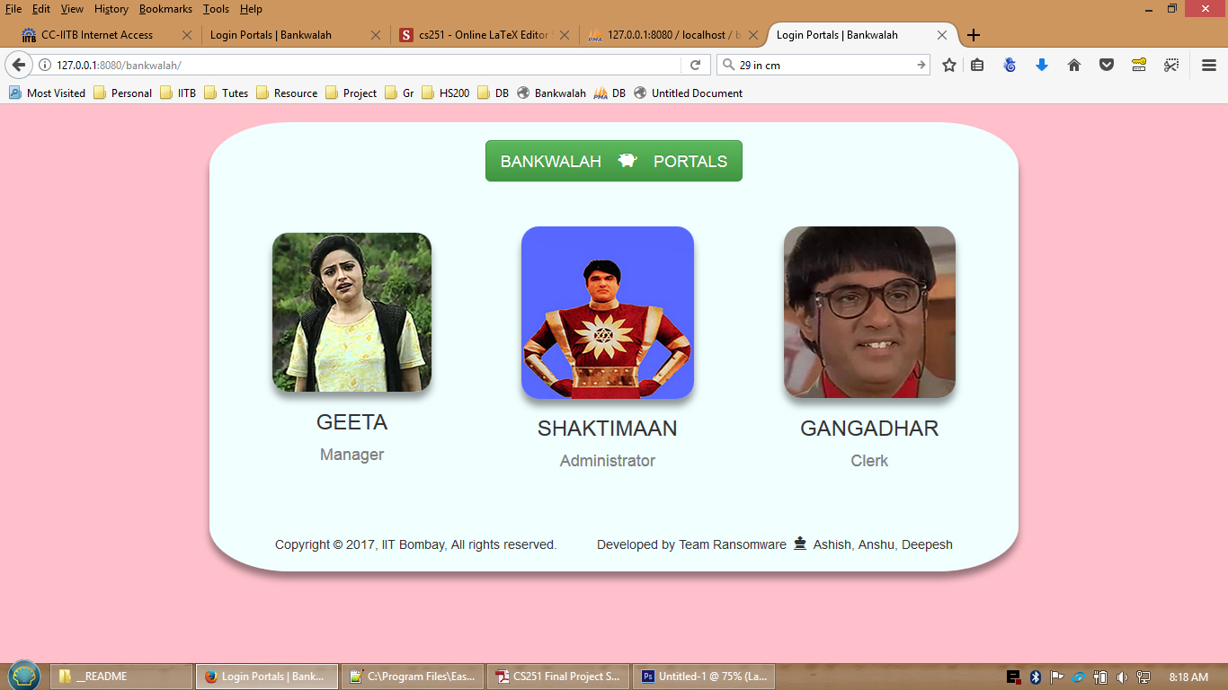
DASHBOARD SCREENSHOT

Slide 5
☺ THANK YOU ☺

