Slide 1
TBD

Slide 2
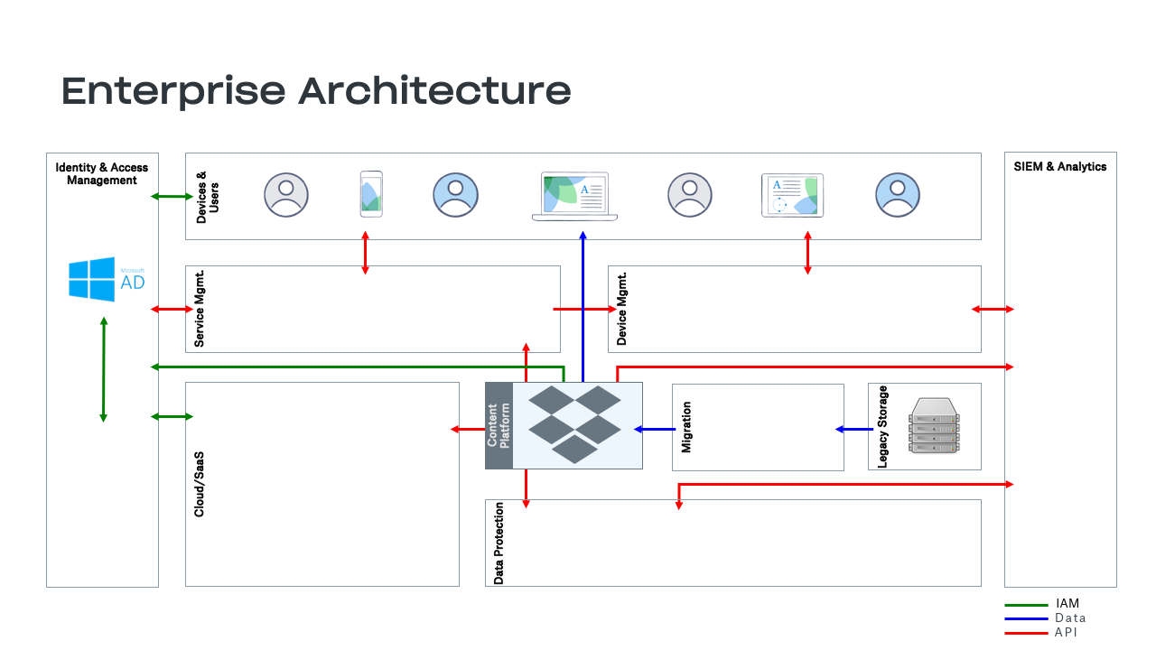

Slide 3

Line of Business Architecture
Business Units
Content Platform
Core Applications
Recruiting /
Human Resources
Email
Marketing
Chat
Finance
IT Services
Workflow Application
CRM
Helpdesk
Business
Intelligence
Backup

