Slide 1
TBD

Slide 2
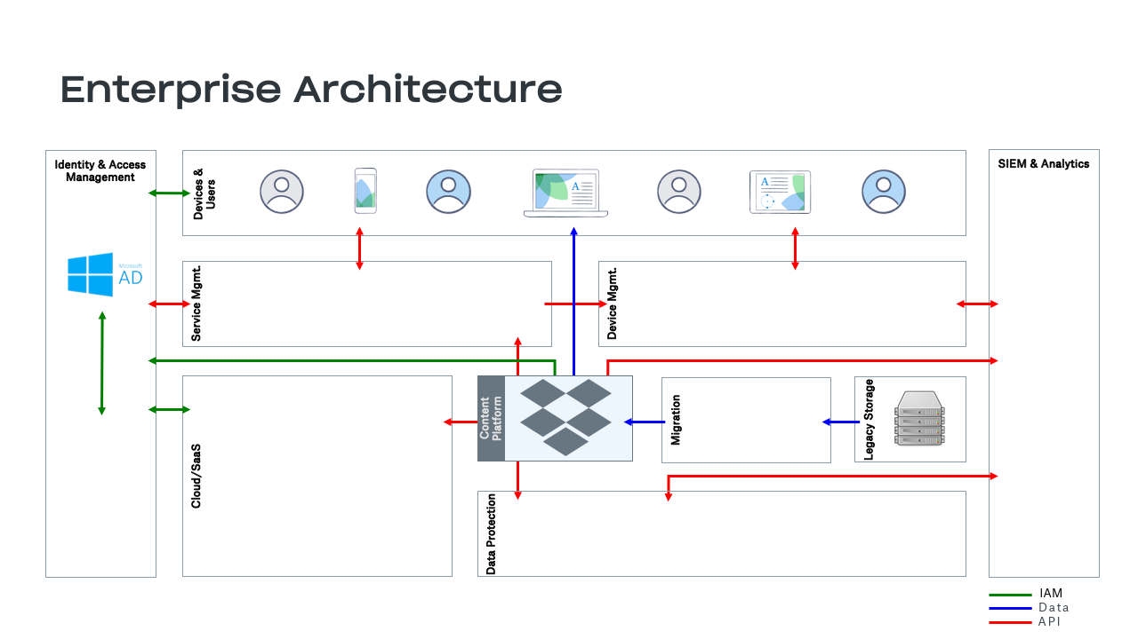

Slide 3

Line of Business Architecture
Business Units
End User and IT Applications
Recruiting /
Human Resources
Email
Content Platform
Marketing
Chat
Finance
Meetings
IT Services
CRM
Helpdesk
Business
Intelligence
Workflow

