Slide 1
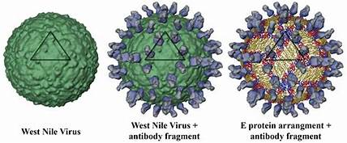
West Nile Virus Prediction (Anshu)

Slide 2
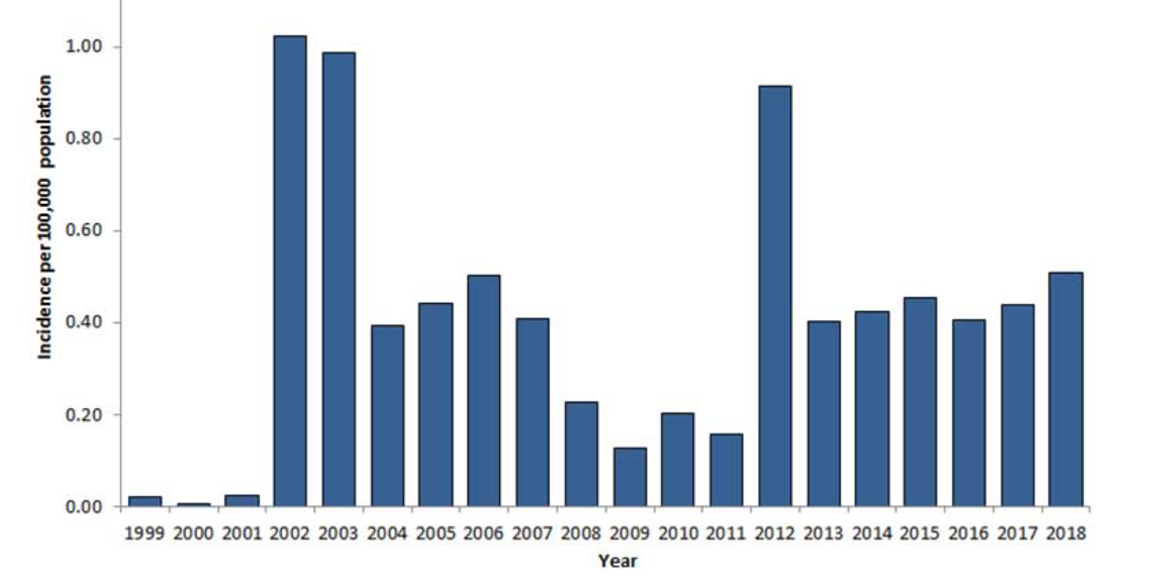
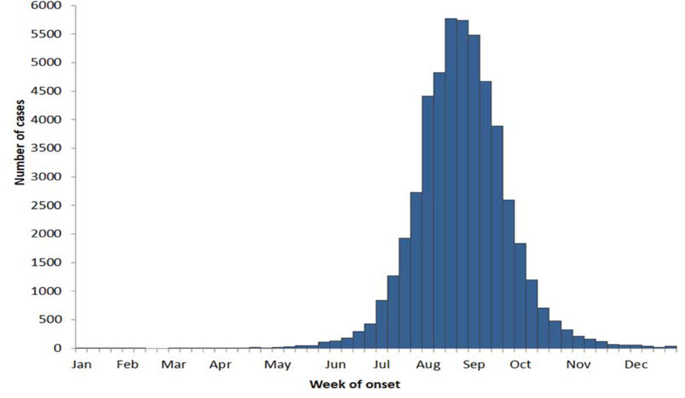
Presence of WNV Neuro-invasive disease
https://www.cdc.gov/westnile/statsmaps/cumMapsData.html

Slide 3
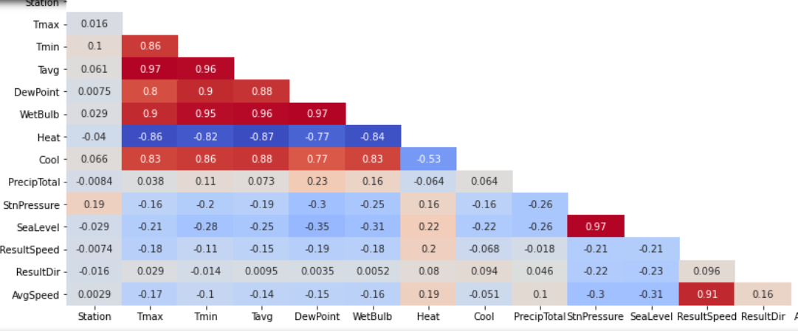
Analysis- Weather Data after cleaning
Strong Correlation Heat and Cold to the Temperature
Strong correlation
Between, Tmin, Tmax, Tavg, WetBulb, DewPoint – will keep WetBulb for modelling
Strong Correlation SeaLevel and StnPressure
Strong Correlation ResultSpreed
& AvgSpeed

Slide 4
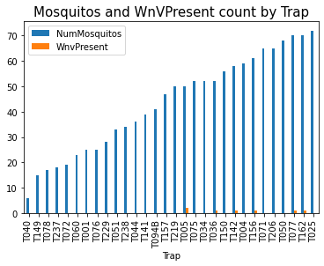
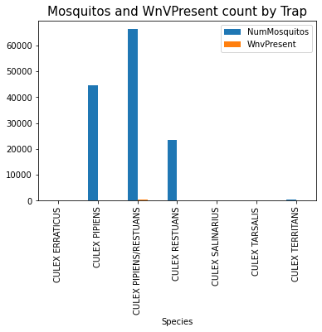
Traps and the presence of Virus and Species of Mosquitos

Slide 5
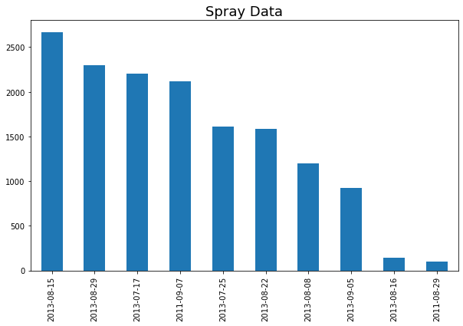
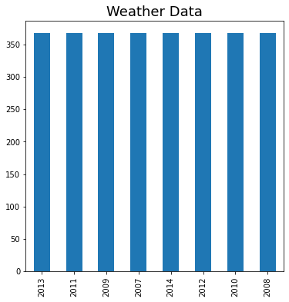
Data Available
Spray Data available for 10 days
Weather data is available from year 208-2013

Slide 6
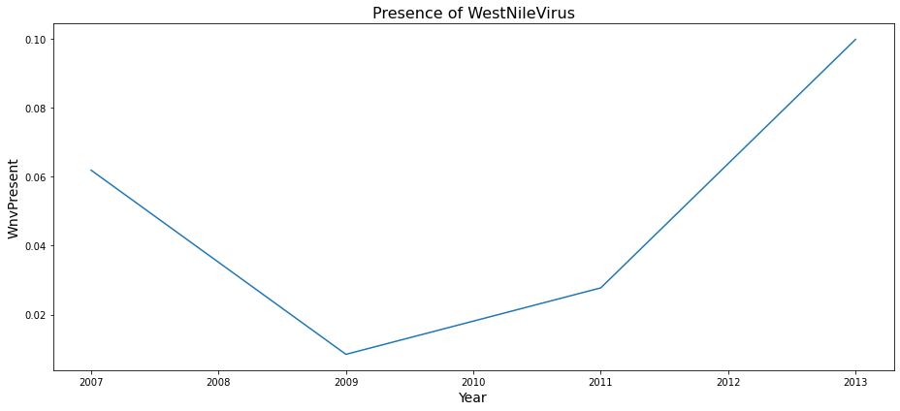
Virus presence by Year

Slide 7
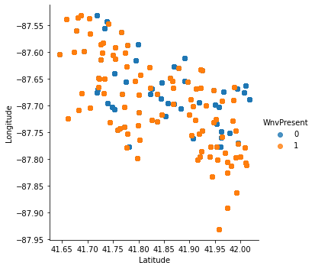
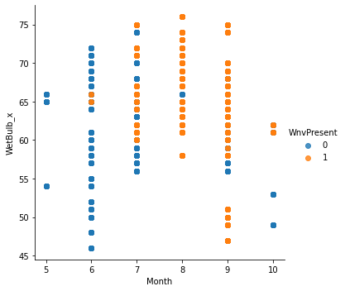
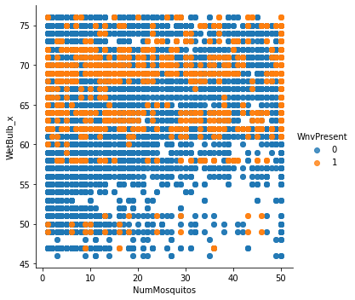
Feature visualization depicting the presence of Virus

Slide 8
MODEL SELECTION
Model | Train Accuracy | Test Accuracy | Recall | ROC_AUC
Logistic_Regression(balanced) | 0.69 | 0.687 | 0.7 | 0.693
Logistic regression w/Somte | 0.72 | 0.698 | 0.6 | 0.65
Random Forest Smote | 0.789 | 0.63 | 0.63 | 0.75
AdaBoost | 0.736 | 0.763 | 0.76 | 0.75
XGBoost +weights | 0.62 | 0.615 | 0.863(Kaggle-0.647) | 0.73
XGBoost +Smote | 0.66 | 0.6 | 0.72 | 0.60

Slide 9
Cost Benefit Analysis
Medical Costs = SUM [Cost of impatient and outpatient care, Lost of Productivity, Miscellaneous expenses (like travel)]*
Data sources: Inpatient cost from hospital data, outpatient cost from Consumer Price Index (CPI), diagnosis costs from 4 labs, phone surveys. Productivity lost data estimated based on cost for day of work missed for people <60 years.
Cost of Mosquito Vector Control: SYMVCD provided cost for emergency spray in 2005. Employee overtime cost estimated and incorporated.
Medical Costs for 46 cases that occurred in Sacramento Country (2005):
  Inpatient = $33,143 per inpatient
  Outpatient = $6,317 per outpatient
Productivity Costs:
  <60 years: $10,800
  >60 years: $7,500
Total costs:
  Medical costs = $2,140,409
  Medical plus productivity loss = $2,844,338.
Spray costs = $701,790, including overtime costs.
Cost Benefit Analysis (2005): In 2005, costs of treatment is ~ 3x of spray costs. Benefits of spray control outweigh the cost of spray control. Given there were 46 infections in total, spray control will only need to prevent 15 infections to break-even from a cost point of view.
Leveraging average inflation data between 2005 and 2020, $1 in 2005 is equivalent of $1.33 in 2020 **.
  Projected spray cost in 2020 = cost in 2005 * 1.33 = $933,380
  Projected total cost per patient = cost per patient in 2005 * 1.33 = 82,238
  Spray control would need to prevent 12 cases to exceed the costs of spray
  Total cases in 2019 reported as of April, 2020 = 226 ***
  Project cost of 226 cases = $18.6 million
  Return on Investment (ROI) of spray = 19x
*Zohrabian et al. (https://www.ncbi.nlm.nih.gov/pmc/articles/PMC3323281/)
** https://www.in2013dollars.com/us/inflation/2005
*** https://www.cdc.gov/westnile/statsmaps/preliminarymapsdata2019/disease-cases-state-2019.html

Slide 10
THANK YOU!!!!
Notes:
In Slide Show mode, select the arrows to visit links.

