Slide 1
Project 3
Web API and Classification
Project 3
Anshu Dhingra

Slide 2
Problem Statement
The recent system shutdown failure caused the Nvidia and Amd reddit’s posts to mixed up and lost their classification.
Data Science team at Nvidia has been tasked to classify the post based on the Natural Language processing (NLP)
This is critical for Nvidia to understand consumers interest.

Slide 3
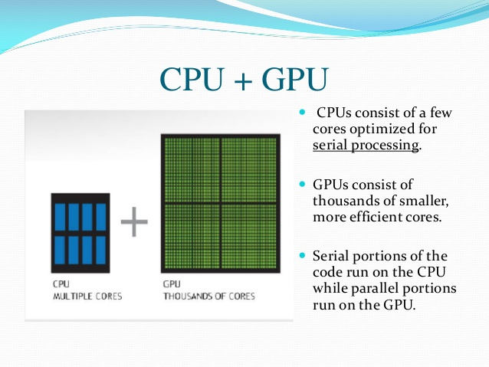

Slide 4
Workflow
DATA Collection & Data Cleaning
Pre-processing
EDA
Model Selection
Conclusion & Recommendation
Data Collection using request Library
Data Cleaning – Removing duplicates and empty post
Pre-processing – Removing HTML, non-letter and stemming the words
EDA – Most frequent words and length of meaningful words
Model Selection – ran 4 models
Conclusion and Recommendation – Based on accuracy and ROC AUC score

Slide 5
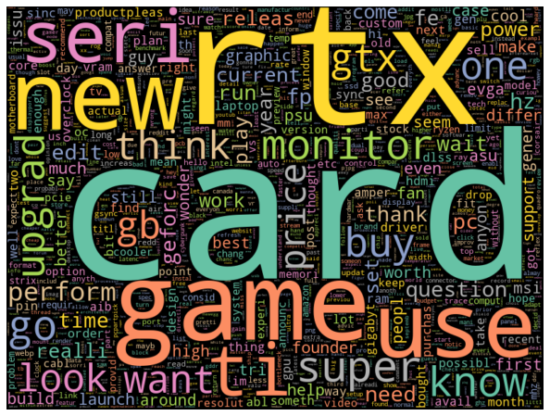
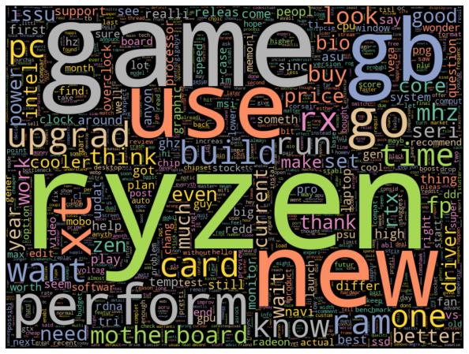
EDA - Word Cloud
Nvidia
Amd

Slide 6
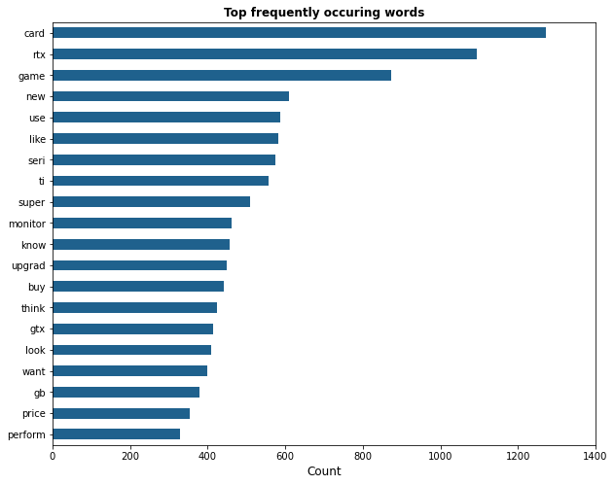
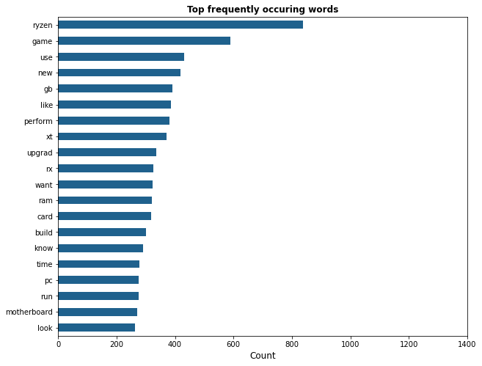

EDA – Most frequent words
Nvidia
AMD

Slide 7
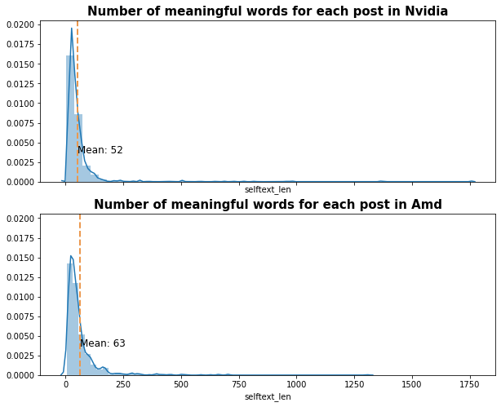
Length of words

Slide 8
Base Model Accuracy

Slide 9
Modelling
Count Vectorizer & Logistic Regression,
TF-IDF & Logistic Regression,
Count Vectorizer & Naive Bayes
TF-IDF & Naive Bayes

Slide 10
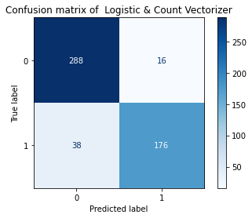
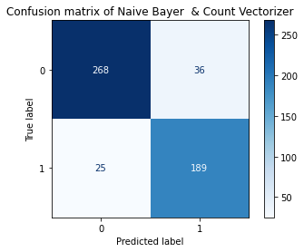
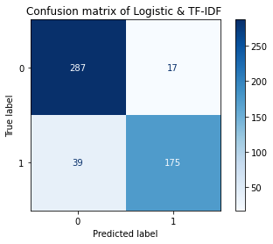

Confusion Matrix of Logistic Regression
Confusion Matrix of Naive Bayer

Slide 11
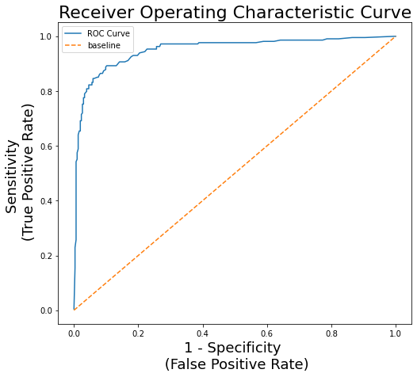
ROC AUC CURVE
Higher AUC is capable of distinguishing between the classed

Slide 12
Model Evaluation
Model | Train accuracy | Test accuracy | Precision | Recall | F1-Score | ROC AUC**
CountVectorizer & Logistic Regression | 0.92 | 0.895 | 0.9 | 0.88 | 0.89 | 0.884
TF-IDF & Logistic Regression | 0.91 | 0.891 | 0.9 | 0.88 | 0.88 | 0.88
CountVectorizer & Naive Bayes | 0.907 | 0.882 | 0.882 | 0.88 | 0.88 | 0.882
TF-IDF & Naive Bayes | 0.89 | 0.85 | 0.86 | 0.85 | 0.85 | 0.85

Slide 13
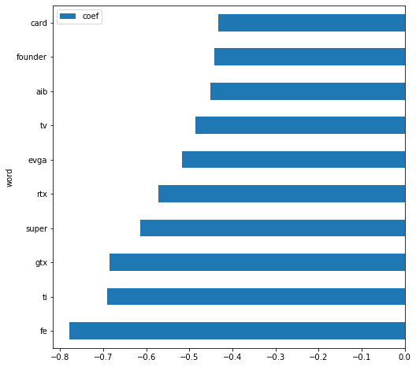
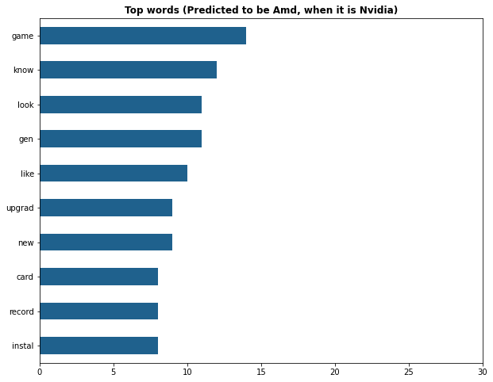
Top Most Predicted Words
Top Misclassified Words

Slide 14
Conclusion and Recommendations
Count Vectorizer & Logistic Regression classifier was selected on the basis of high accuracy and high ROC AUC scores.
The model achieved an accuracy of 0.89 on the test set, outperforming the baseline score of 0.587.
In order to reduce misclassification, we can collect more training data to make better train the model
Once more data is obtained, other classification models like SVM, KNN and Random Forests can be used.
We can try using other hyperparameters to improve the accuracy and AUC ROC score

