Slide 1

An Algebraic Formulation of the Graph Reconstruction Conjecture Revisited.
Under the guidance of Dr. Dinabandhu Pradhan
Assistant Professor
A Presentation By:-
Sudhanshu Rawat
Adm. No. 18MS0063

Slide 2
Table of contents
1. Introduction
2. Graph Reconstruction conjecture
3. The Rank of the Matrix
4. Existence of matrix with optimal rank
5. Conclusion And results.
6. References.

Slide 3
Introduction
For v ∈ V (G), the degree of v,( deg(v)), is the number of edges connected to v.
A graph is regular if all it’s vertices have the same degree.
$k_{n}$denotes the complete graph on n vertices (every possible edge).
A vertex deleted subgraph of G is an unlabelled graph formed by deleting v vertex and all edges attached to it.
The deck of G, D(G), is the collection of all induced subgraphs which are obtained by deleting 1 vertex and all the edges attached to it.

Slide 4
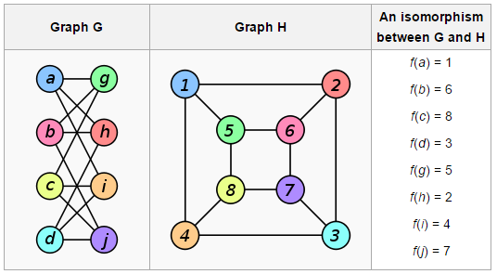
Introduction continued…
Graph isomorphism
Two graphs which contain the same number of graph vertices connected in the same way are said to be isomorphic.

Slide 5
Introduction continued…
Can we determine the graphs uniquely by their sub-graphs?

Slide 6
Graph Reconstruction
Graph H is reconstruction of Graph G (H~G) if there is one-one map f:V(G) V(H) such that for every v ε V(G) the graph G-v and H-f(v) are isomorphic .
( if H~G implies H is isomorphic to G)
A graph is reconstructible if, given it’s deck, we can uniquely determine what the original graph was.
Example

Slide 7
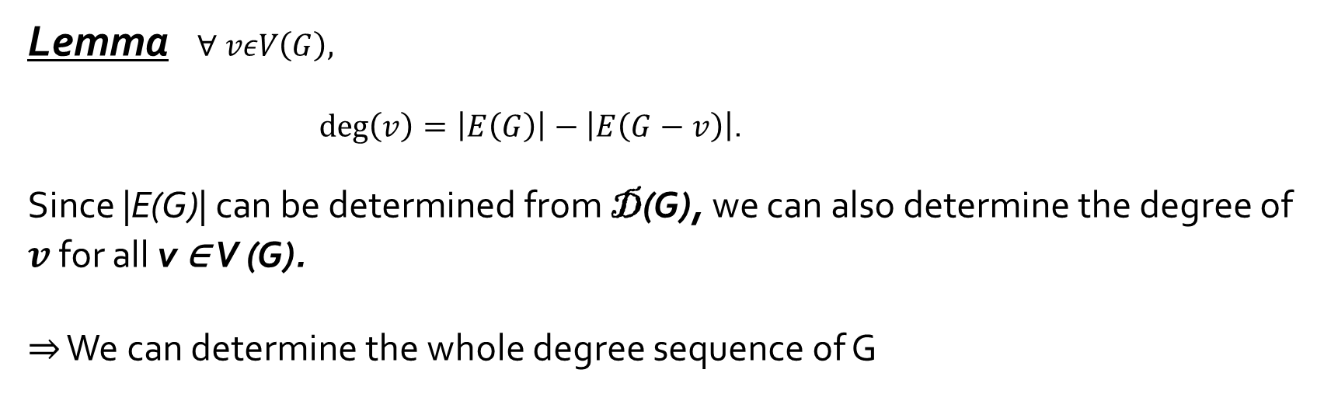
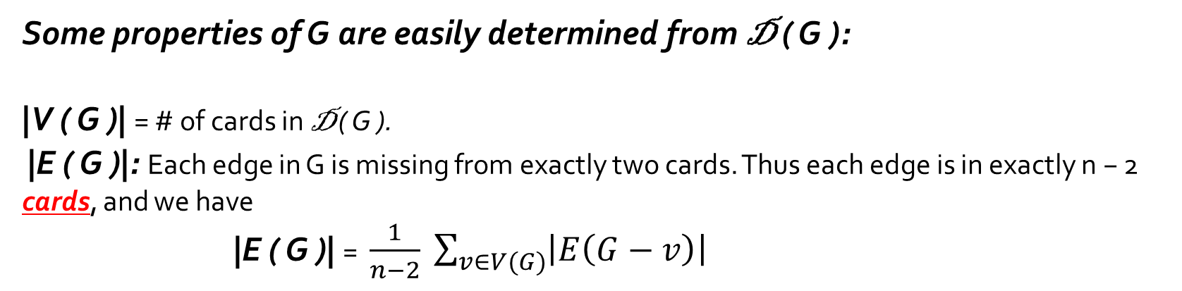
Some properties of G are easily determined from D ( G ):
|V ( G )| = # of cards in D ( G ).
|E ( G )|: Each edge in G is missing from exactly two cards. Thus each edge is in exactly n − 2 cards, and we have
|E ( G )| = $\frac{1}{n−2} \sum_{v∈V(G)}{\left|E\left(G−v\right)\right|}$
Lemma $∀ vεV\left(G\right),$
$\deg\left(v\right)=\left|E\left(G\right)\right|−\left|E\left(G−v\right)\right|$.
Since |E(G)| can be determined from D(G), we can also determine the degree of $v$ for all v ∈ V (G).
⇒ We can determine the whole degree sequence of G

Slide 8
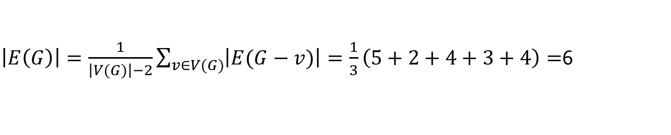

Graph Reconstruction conjecture
“Every Graph with at least Three vertices is re-constructible”
Example : We are given following Deck.
To check whether it is reconstructible or not.
$$\left|V(G)\right|=\# cards=5$$
$\left|E\left(G\right)\right|=\frac{1}{\left|V(G)\right|−2}\sum_{v∈V(G)}{\left|E(G−v)\right|}=\frac{1}{3}\left(5+2+4+3+4\right)=$6
Thus the degrees of the missing vertices in order by using lemma $\deg\left(v\right)=\left|E\left(G\right)\right|−\left|E\left(G−v\right)\right|$ are 1,4,2,3,2.
Note the degree of the vertex deleted in the second graph is 4.
Thus it must have been connected to every other vertex:

Slide 9
Graph Reconstruction conjecture
“Every Graph with at least Three vertices is re-constructible”
Example : We are given following Deck.
To check whether it is reconstructible or not.
$$\left|V(G)\right|=\# cards=5$$
$\left|E\left(G\right)\right|=\frac{1}{\left|V(G)\right|−2}\sum_{v∈V(G)}{\left|E(G−v)\right|}=\frac{1}{3}\left(5+2+4+3+4\right)=$6
Thus the degrees of the missing vertices in order by using lemma $\deg\left(v\right)=\left|E\left(G\right)\right|−\left|E\left(G−v\right)\right|$ are 1,4,2,3,2.
Note the degree of the vertex deleted in the second graph is 4.
Thus it must have been connected to every other vertex:

Slide 10
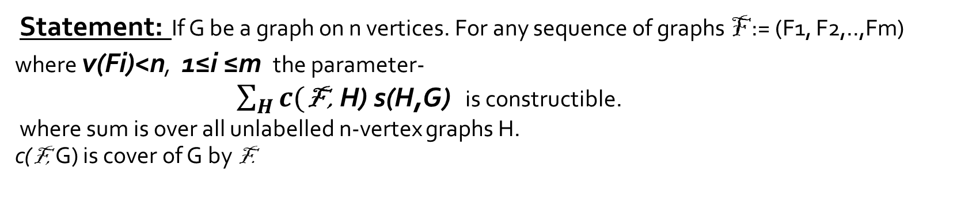
Subgraph Counting Lemmas
Kelly’s Lemma
Statement: If H~G and F is any graph such that V(F)<V(G) then s(F,G) = s(F,H) i.e. number of subgraph of G isomorphic to F = Number of subgraph of H isomorphic to F.
Kocay’s Lemma
Statement: If G be a graph on n vertices. For any sequence of graphs F := (F1, F2,..,Fm) where v(Fi)<n, 1≤i ≤m the parameter-
$\sum_{H}{c(\text{F}\text{ ,} \text{H}\text{) }\text{s}\text{(}\text{H}\text{,}\text{G}\text{)}}$ is constructible.
where sum is over all unlabelled n-vertex graphs H.
c(F, G) is cover of G by F.

Slide 11
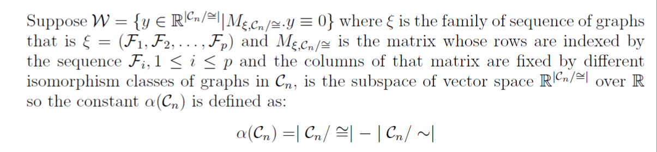
Rank of the matrix
If the matrix has large rank then it will have few non re-constructible classes.
Lemma

Slide 12
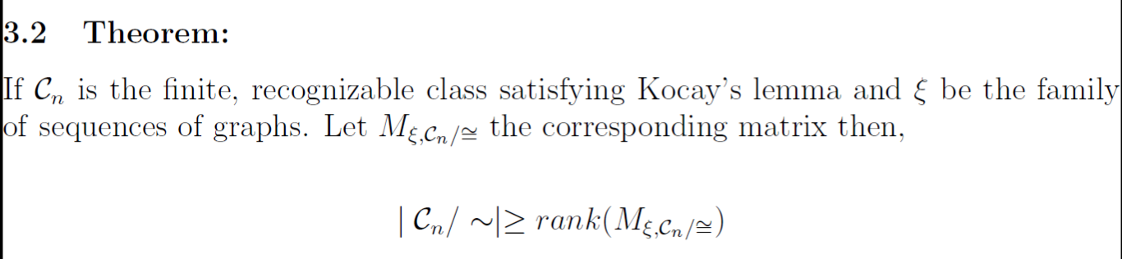
Rank of the matrix continued…
The proof of this theorem has been done using rank nullity theorem

Slide 13
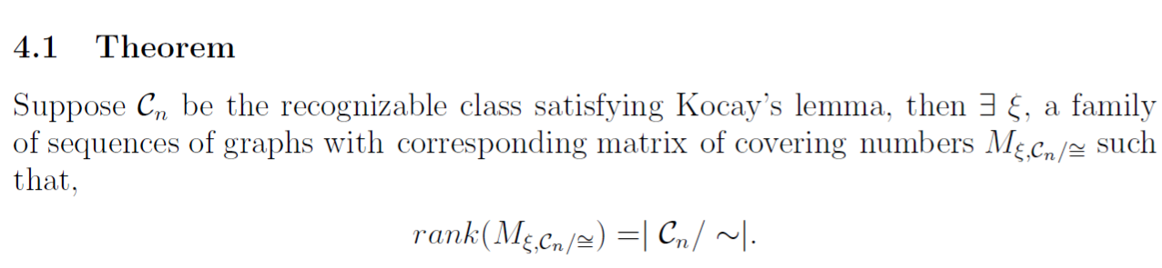
Existence of matrix with optimal rank

Slide 14
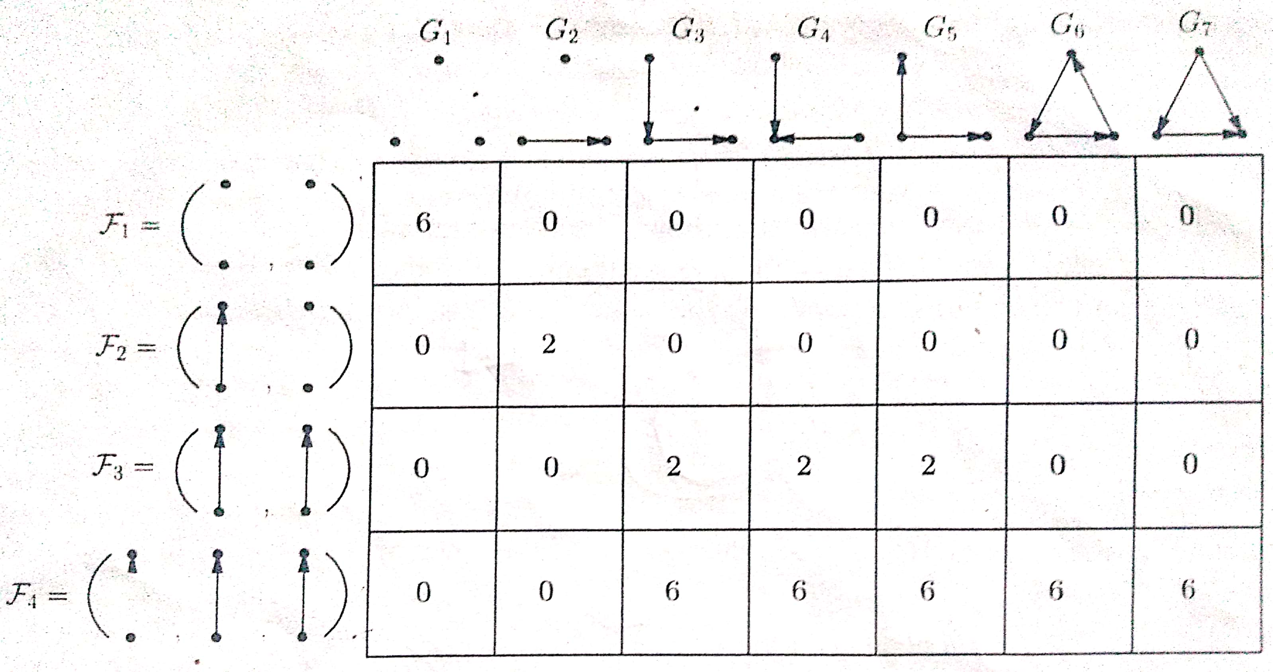
Result and conclusion
The rank of the matrix can not be improved by adding more sequence of graphs

Slide 15
Result and conclusion continued…
The equations which are obtained by applying Kocay's lemma provide not only
the information about reconstruction of G but also they provide total number of
graphs that are non re-constructible

Slide 16
References
1. Igor C. Oliveira and Bhalchandra D. Thatte, An Algebric Formulation of the Graph Reconstruction conjucture, Journal of Graph theory
2. B. Bollobas, Almost every graph has reconstruction number trhee. J. Graph Theory 14(1) (1990)
3. V. B. Mnukhin, The k-orbit reconstruction and the orbit algebra, Acta Applicandae Math. 29(1-2) (1992),
4. Introduction to graph theory by douglas b. west

Slide 17
Thank you

