Slide 1
Project Presentation of Co-Op Project at Industry (Module-1)
On
Automated Version Management Large-Scale Python Monorepos
Divyanshu Sharma
2210991538
Supervised By
Dr Preeti Saini
Department of computer science and engineering
Chitkara University of Institute of engineering and Technology , Chitkara University , Punjab ,India

Slide 2
Abstract
Centralized Version Orchestration for Python Monorepos
Challenges of Distributed Versioning
Distributed semantic versioning causes version drift, merge conflicts, and unstable CI/CD in large Python monorepos.
Centralized Version Orchestration
A single authoritative repository-level version is used, injecting correct release versions dynamically during build time.
Empirical Evaluation Results
Centralized orchestration reduced merge conflicts by 87%, improved build reproducibility to over 98%, and sped up pipelines.

Slide 3
Challenges of Distributed Versioning in Monorepos
Complex Version Management
Monorepos simplify code sharing but complicate versioning with independent semantic versioning per package.
Non-deterministic CI/CD Behavior
Independent package updates cause variable dependency resolution and inconsistent build outcomes in pipelines.
Manual Version Coordination Burden
Release engineers manually align dozens of package versions, causing time-consuming merge conflicts and errors.
Impact on Code Review and Development
Frequent version commits overwhelm reviews and divert developer focus from features and quality improvements.

Slide 4
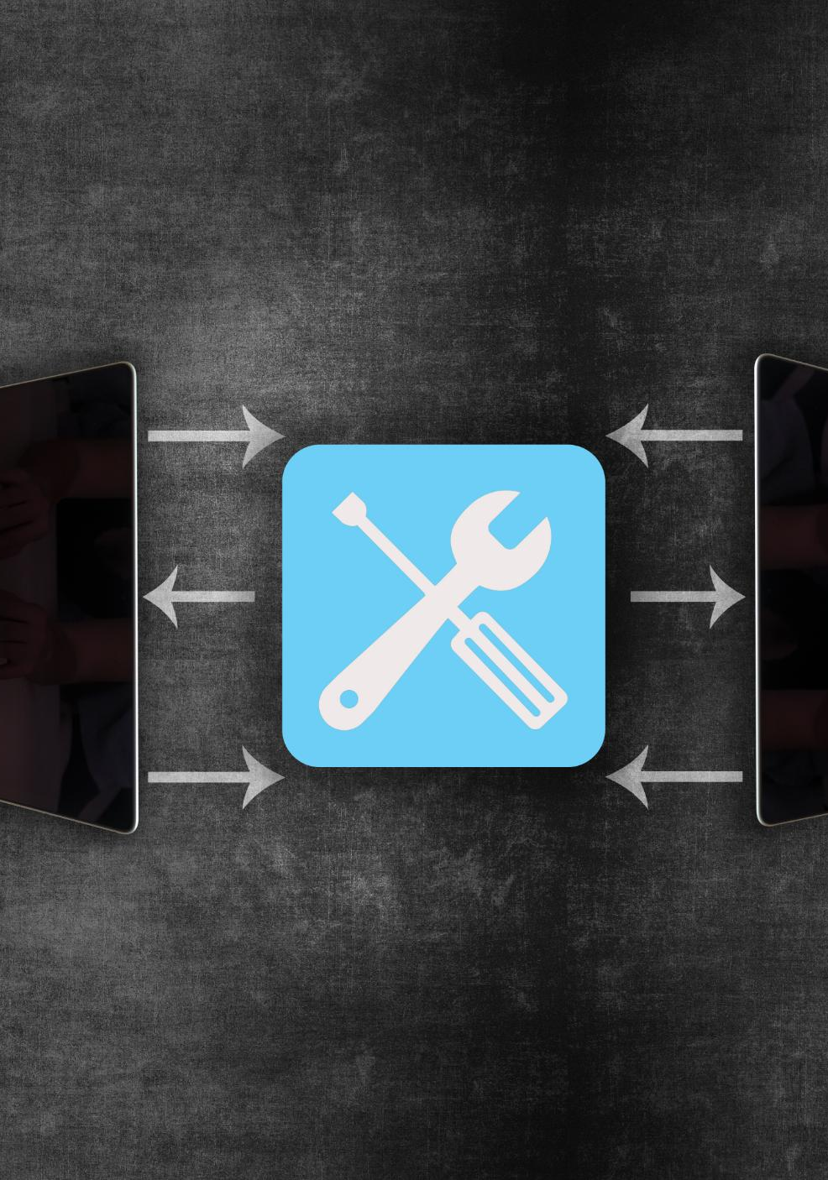
Monorepo Practices, Packaging, and CI/CD ResearchPython
Monorepo Large-scale Management
Large-scale monorepo management involves centralized build systems to handle interdependencies and reduce merge conflicts effectively.
Python Packaging Standards
Python packaging uses semantic versioning and build standards outlined in PEP 440, 517, and 518 to ensure consistent dependency resolution.
CI/CD Build Reproducibility
Reproducible CI/CD builds address non-deterministic dependency resolution and focus on version consistency to prevent build failures.

Slide 5
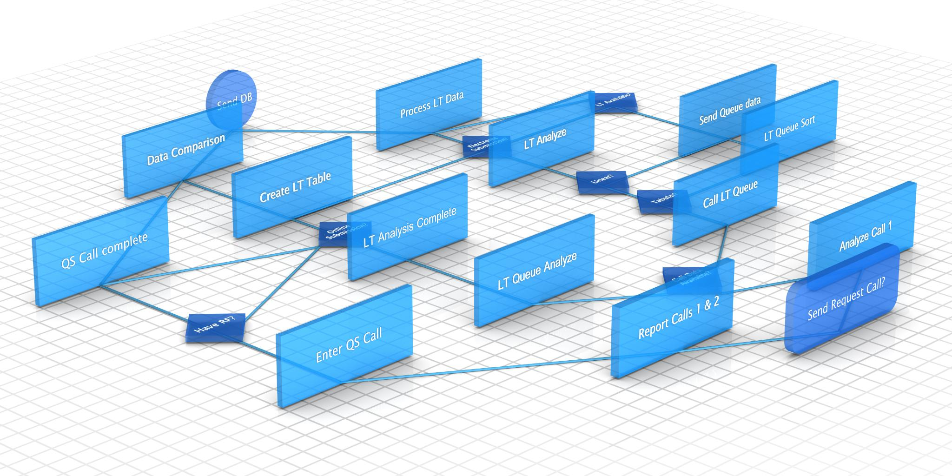
Architecture of the Centralized Version Orchestration Framework
Repository-Level Version Control
A single VERSION file acts as the authoritative source for package versions, protected by CODEOWNERS for controlled updates.
Sentinel Version Metadata
Packages use a sentinel version, like 0.0.0.dev0, to prevent accidental publishing of stale or inconsistent versions.
CI/CD Integration and Version Injection
The pipeline injects release versions into package metadata during builds without modifying source control, using a lightweight Python script.
Dependency Synchronization Engine
Dependency graph and cycle detection replace path dependencies with exact versions to ensure valid, deterministic builds.

Slide 6

Quantitative Impact on CI/CD Performance and Reliability
Reduction in Merge Conflicts
Version-related merge conflicts decreased from 14.7 to 3.4 per sprint, achieving an 87% improvement.
CI/CD Pipeline Performance
Pipeline duration decreased by up to 36.3%, with dependency resolution time reduced by over 85%.
Enhanced Build Reproducibility
Build reproducibility increased from 70.4% to over 98.4%, exceeding organizational goals.
Reliability and Scalability Gains
Dependency failures dropped by 89.5%, validating framework scalability across large monorepos.

Slide 7

Developer Productivity and Experience Improvements
Enhanced Developer Experience
Surveys show increased release confidence and reduced onboarding complexity after framework adoption.
Time and Effort Savings
Monthly savings of 22 to 26 developer hours arise from fewer merge conflicts and streamlined version control.
Faster Release Cycles
Release duration reduced by 46%, enabling more frequent and predictable feature delivery.

Slide 8
Summary of Contributions and Practical Implications
Centralized Version Orchestration
Centralized version orchestration improves management of large Python monorepos by decoupling version authority and enforcing CI/CD consistency.
Empirical Benefits
Real-world data shows an 87% reduction in merge conflicts and up to 36% faster CI/CD pipelines, enhancing build reproducibility and reliability.
Developer Productivity and Reliability
Developer surveys confirm increased productivity, release confidence, and velocity with minimal migration effort required for adoption.
Scalability and Practicality
The framework offers a scalable, reliable, and low-overhead alternative to distributed semantic versioning for large scale monorepos.

