Slide 1
Seminar III Semester Overview and Trends in Self Supervised Learning (SSL)
Anshu Garg
a_garg19@cs.uni-kl.de
Supervisor: Mahdi Chamseddine

Slide 2
Outline
Overview on SSL
Topic Introduction
Literature Review
Comparison
Conclusion

Slide 3
Overview on SSL
SSL – get supervision from data itself by generating pseudo task.
Pretext Tasks - to understand input data to perform Downstream Task.
Multiple rounds of SSL training is very helpful.
Idea: Humans learn by first learning simple concepts before solving complex tasks.
Goal: learn sematics of data

Slide 4
Topic Introduction
Focus Area: Use of SSL on Point Clouds (PC)
Application:
Utilisation of unlabelled 3D point cloud generated by scanning technologies.
Reduces the number of labelled input data required to perform downstream tasks.
Notes:
generated by scanning technologies like LiDAR scanners and stereo cameras for Un/Supervised Learning tasks like object classification, object segmentation etc, used by Robotics, self-driving cars etc.
Due to lack of user interfaces to handle huge 3D point cloud data (billions of points), data is not properly utilised.

Slide 5
Literature Review - Paper 1 Self-Supervised Deep Learning on Point Cloud by Reconstructing Space [4]
Idea – SSL method is point segmentation task - Train a Neural Network to reconstruct the point cloud whose parts have been randomly displaced in the space.
Method –
PC is first converted to unit cube, each axis is equally divided
Each point is assigned a voxel ID as the label.
All voxels are randomly swapped. Pretext task - predict the original voxel ID for each point.
Notes:
We phrase the self-supervised learning task as a point segmentation task, in which the label for each point is generated from the point cloud itself.
Small or no augmentation (random shift) is provided per point per voxel. It will be useful for generalisation of this task on other tasks.
Using the voxel ID as per-point label admits a unique solution even for almost all axis-symmetric point clouds, as long as the individual voxels are not all randomly rotated, i.e. as long as a general sense of the orientation of the input point cloud is maintained.
Method - 1. in k equal parts which forms (k*k*k) voxels.
2. (by using k cube voxel numbers).

Slide 6
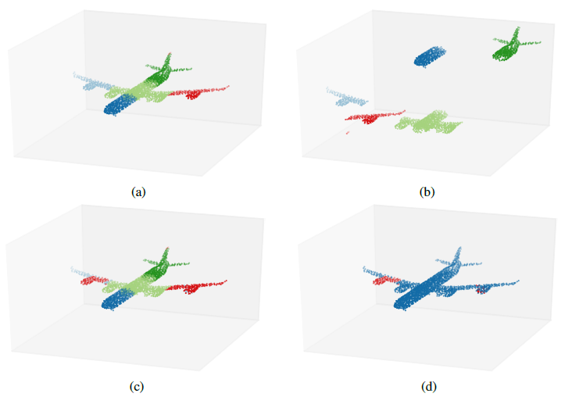
Literature Review - Paper 1 Self-Supervised Deep Learning on Point Cloud by Reconstructing Space [4]
Notes:
Small or no augmentation (random shift) is provided per point per voxel. It will be useful for generalisation of this task on other tasks.
Using the voxel ID as per-point label admits a unique solution even for almost all axis-symmetric point clouds, as long as the individual voxels are not all randomly rotated, i.e. as long as a general sense of the orientation of the input point cloud is maintained.

Slide 7
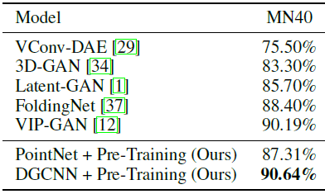

Literature Review - Paper 1 Self-Supervised Deep Learning on Point Cloud by Reconstructing Space [4]
Experiment and Dataset: (others refer from paper)
Object Classification – Test Set: ModelNet 40 (MN40) Training Set: ShapeNet. Metric: Accuracy percentage.
Notes:
Selection of k depends on amount of details present in PC (k= 3 in this paper).
2. Our approach is universally applicable to any point cloud data. Operating on raw point cloud enables flexibility with regards to the point cloud density. Thus, provised learning of per-point embeddings instead of per-voxel or per-pixel embeddings without explicit supervision.

Slide 8
Literature Review - Paper 1 Self-Supervised Deep Learning on Point Cloud by Reconstructing Space [4]
Results
This method is not specific to NN architecture (any NN for PC example: PointNet, PointNet++, PointCNN).
This method learns generalized features by capturing semantic properties of PC.
This method do not face problem of sampling of PC, which is basis of many Supervised and UnSupervised techniques.
Notes:
1. Can be flexibly used to pre-train any deep learning model operating on raw point clouds for other tasks.
1. Selection of k depends on amount of details present in PC (k= 3 in this paper).
2. Our approach is universally applicable to any point cloud data. Operating on raw point cloud enables flexibility with regards to the point cloud density. Thus, improvised learning of per-point embeddings instead of per-voxel or per-pixel embeddings without explicit supervision.
4. SOTA models performance improved with small number of labelled input data.
This method do not face problems like flawed similarity metric selection, sampling of unordered PC, which are basis of many Supervised and UnSupervised techniques.
The method is applicable on raw PC, thus allows to learn per-point embedings in PC.

Slide 9
Literature Review - Paper 2 Self-Supervised Few-Shot Learning on Point Cloud [2]
Idea:
2 SSL methods proposed by representing PC in hierarchical partitioning using cover tree. Different radius balls are used at different levels of cover tree.
A Self -Supervised network is suggested.
Pre-training with this SSL method improves the performance of Supervised and UnSupervised models in few-shot learning scenario.

Slide 10
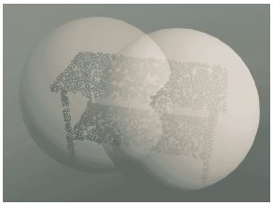
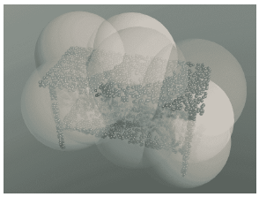
Literature Review - Paper 2 Self-Supervised Few-Shot Learning on Point Cloud [2]
Cover Tree (T) Data Structure: Every level of T contains balls of different radius (highest at the root).

Slide 11
Literature Review - Paper 2 Self-Supervised Few-Shot Learning on Point Cloud [2]
Methods: generate duplicate labels by
SSL 1: Regression Task (R) – distance (L2 Norm) between each pair of ball on each level in cover tree T (learn inter-ball relation).
SSL 2: Classification Task (C) – On the basis of parent ball‘s center, classify the quardrant in which each child ball‘s center exists (learn intra-ball relation).

Slide 12
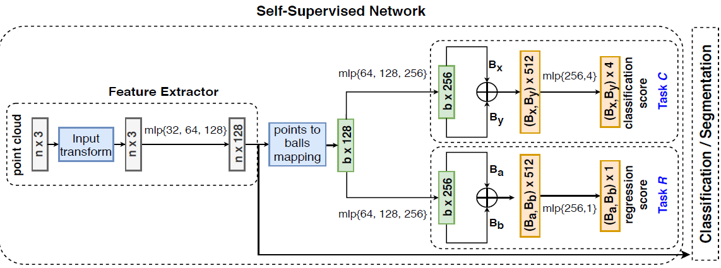
Literature Review - Paper 2 Self-Supervised Few-Shot Learning on Point Cloud [2]
m-shot, k-way learning - k is number of sampled classes, m is labelled PC for each k class.
A NN architecture provides feature extractor trained by combined loss from both the braches of learning tasks.
Notes:
y – integer class label – whose value can be from Y = {1,…K}
Sample k(dash) class from Y
m – labelled PC from each kdash class
Mk(dash) – total labelled PC - this forms Support set S (testing set)
5. Support Set (S) – having mk total labelled PC, used for training
6. Query Set (Q) – test set, contains samples from k classes.
7. Expansion constant (ec) – smallest value which covers all the balls in PC by using number of (ec) balls of radius epsilon (ep).
Any model capable of classification/segmentation downstrean task like DGCNN/PointNet can be used.
Model architecture explained:
Self-Supervised Network Our self-supervised network starts with a feature extractor that first normalizes the input point clouds in support set S, followed by passing them through three MLP layers with shared fully connected layers (32; 64; 128) to arrive at 128-dimensional point vectors. For each ball B in T (in input space), we construct a corresponding ball in feature space, by grouping in similar fashion, the point embeddings that represent the points in B. Then, a feature space ball is represented by a ball vector, which is the centroid of the point embeddings belonging to the ball. These ball vectors are then fed to two branches, one for each self-supervised task, i.e. C and R, where both branches transform the ball vectors via three separate MLP layers with shared fully connected layers (64; 128; 256). The ball pairs corresponding to each pretext task are represented by concatenating each ball’s vector to get a 256 + 256 = 512 dimensional vector. Finally, C trains to classify the quadrant class label, while the regression task R trains to predict the l2-norm distance between balls in the ball pair. Note that losses from both tasks C and R are back-propagated to the feature extractor during training.

Slide 13
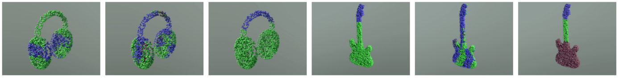
Literature Review - Paper 2 Self-Supervised Few-Shot Learning on Point Cloud [2]
Experiment and Dataset: (others refer from paper)
Part Segmentation – Dataset: ShapeNet, Metric: mIoU%, 10 shot 10 way learning, DGCNN (none, VoxelSSL, this SSL).
Notes:
Selection of k depends on amount of details present in PC (k= 3 in this paper).
2. Our approach is universally applicable to any point cloud data. Operating on raw point cloud enables flexibility with regards to the point cloud density. Thus, provised learning of per-point embeddings instead of per-voxel or per-pixel embeddings without explicit supervision.

Slide 14
Literature Review - Paper 2 Self-Supervised Few-Shot Learning on Point Cloud [2]
Results:
Cover Tree T captures multi-scale and non-parametric representation of PC. Different hierarchy in T stores different complexity levels of PC.
T is able to capture more sparse and highly variable point density PC.
With R and C task model learns inter-ball and intra-ball spatial relation.
Notes:
Selection of k depends on amount of details present in PC (k= 3 in this paper).
2. Our approach is universally applicable to any point cloud data. Operating on raw point cloud enables flexibility with regards to the point cloud density. Thus, provised learning of per-point embeddings instead of per-voxel or per-pixel embeddings without explicit supervision.

Slide 15
Literature Review - Paper 3 Self-Supervised Learning for Domain Adaptation on Point Cloud [3]
Idea:
New architecure - 2 heads with shared feature Encoder, Supervised head - trained on labelled data (Source) for classification/segmentation (supervised) task,
SSL head - trained on both Source and unlabelled data (Target) for SSL task.
SSL pretext : as classification task - Deformation Reconstruction (DefRec). Idea - deformations/occlusions in scanning of real 3D objects.
Training procedure - PCM (PC Mixup) on Source dataset.
Notes:
1. Since SSL operates on unlabeled data, it is natural to test its effectiveness for unsupervised domain adaptation (UDA).
2. In UDA, one aims to classify data from a Target distribution, but the only labeled samples available are from another, Source, distribution. This learning setup has numerous application, including “sim-toreal”, where a model is trained on simulated data in which labels are abundant and is tested on real-world data.
3. Our training scheme has two separate data flows trained in an alternating fashion and in an end-to-end manner. Supervised data flow and self-supervised data flow. Both data flows use the same feature
encoder which is modeled by a neural network for point clouds. After being processed by the shared feature encoder, labeled source samples are further processed by a fully connected sub-network (head) denoted by hsup and a supervised loss is applied to their result (either the regular cross-entropy loss or a mixup variant. Similarly, after the shared feature encoder, the unlabeled source/target samples are fed into a different head, denoted hSSL which is in charge of producing a reconstructed version of bx. A reconstruction loss is then applied to the result.

Slide 16
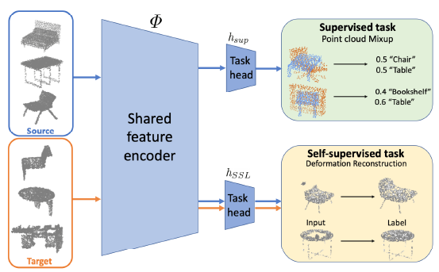
Literature Review - Paper 3 Self-Supervised Learning for Domain Adaptation on Point Cloud [3]
Application:
DA is important in scenarios such as simulated to real world.
Notes:
where we have lots of labelled data in one domain and very less in other for example,

Slide 17
Literature Review - Paper 3 Self-Supervised Learning for Domain Adaptation on Point Cloud [3]
Method:
DefRec – PC is deformed, model (SSL head) is trained to reconstruct it.
Different types of deformation techniques - Volume-based, Feature-based, Sampling-based.
PCM – mix two PC.
Network Architecture – DGCNN architecture for feature extractor and Supervised head. For SSL head Convolution layers of size (256,256,128,3) is used.
Notes:
Reconstruction Loss (Lssl)– Chamfer Distance between original PC (x) and reconstructed PC (x-cap). -- DefRec
PCM Loss (Lce)- Cross-entropy loss on output of Supervised head, with PCM as input.
Overall Loss – Lce + λ(Lssl), here λ controls SSL term.
1. Source distribution and unlabeled instances from a different, Target distribution. Both distributions of point clouds are based on objects labeled by the same set of classes.
2. Applying DefRec only to target samples yields better results.
3. The deformation is achieved by selecting a subset of points and deforming them by sampling new points from an isotropic Gaussian distribution with a small standard deviation.
PCM - for Source dataset, two PC x, x‘ with one-hot labels y,y‘ each PC having n points, sample Mixup Coefficient (ϒ) from Beta distribution and sample ϒ.n points from x and (1- ϒ).n points from x’. Label(ẏ) of new MixUp PC(ẋ) is convex combination ϒy+(1- ϒ)y’. If PCM is not to be used pass x instead of ẋ.
1. Source distribution and unlabeled instances from a different, Target distribution. Both distributions of point clouds are based on objects labeled by the same set of classes.
2. Applying DefRec only to target samples yields better results.
3. The deformation is achieved by selecting a subset of points and deforming them by sampling new points from an isotropic Gaussian distribution with a small standard deviation.
Dataset - PointDA-10 (subset of ShapeNet, ModelNet, ScanNet) and PointSegDA (subset of ADOBE, FAUST, MIT and SCAPE).

Slide 18
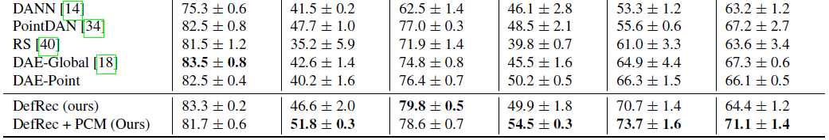
Literature Review - Paper 3 Self-Supervised Learning for Domain Adaptation on Point Cloud [3]
Experiment and Dataset: (others refer from paper)
Object Classification – Data Set: PointDA-10, Metric: Average Accuracy per class.
Notes:
Domain-Adversarial Training of Neural Networks (DANN)
Dataset - PointDA-10 (subset of ShapeNet, ModelNet, ScanNet) and PointSegDA (subset of ADOBE, FAUST, MIT and SCAPE).

Slide 19
Literature Review - Paper 3 Self-Supervised Learning for Domain Adaptation on Point Cloud [3]
Results:
DefRec learns statistical structure of different parts of objects in PC form, thus provides generalisation for different classes.
Model is robust by the different deformation.
PCM boosts the performance of many baseline models.
Notes:
4. deforming large regions degrades the performance, particularly with more than 300 points. Also, layer 4 is dominated by layer 3 by a small gap. Overall, the model is largely robust to the choice of layer and the number of points for small enough regions.
Slide –
4. DA is proved since the gap between Source and Target domain is bridged, thus representations learned during SSL training are generic.

Slide 20
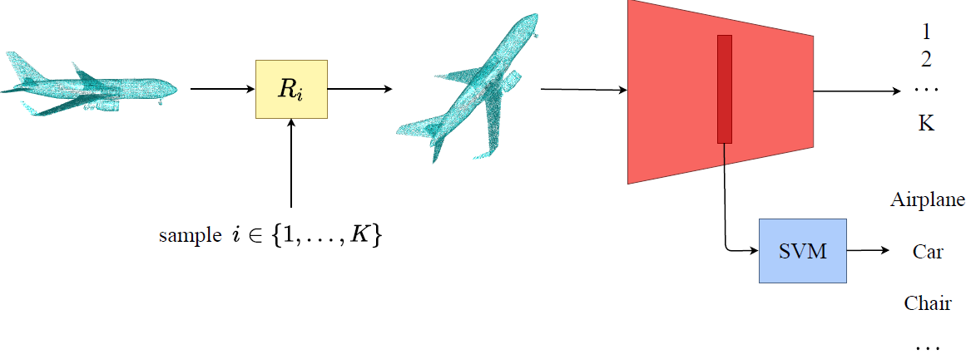
Literature Review - Paper 4 Self Supervised Learning of Point Cloud via Orientation Estimation[5]
Idea:
SSL tasks : Rotation angle Classification

Slide 21
Literature Review - Paper 4 Self Supervised Learning of Point Cloud via Orientation Estimation[5]
Method:
Model: PointNet & DGCNN final layer modified to classify or regress rotation angle on ShapeNet dataset.
Rotation Regression - predicts 4 values (3 rotation axis and 1 rotation angle).
Rotation Classification - predicts k probablity values for k angles. k is hyperparameter.
Notes:
Rotation: Input PC rotated by randonly selected rotation angle from k rotations (R1, R2,..., Rk) .
Classification – Cross entropy loss
Regression – L2 loss

Slide 22
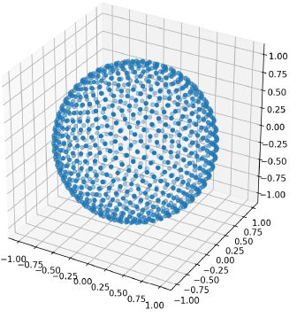
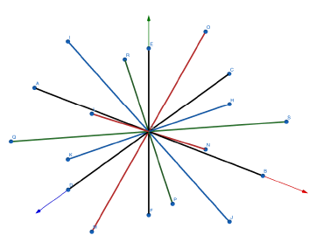
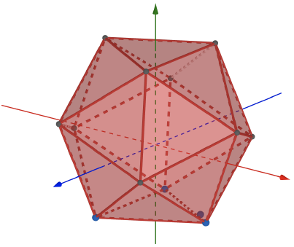
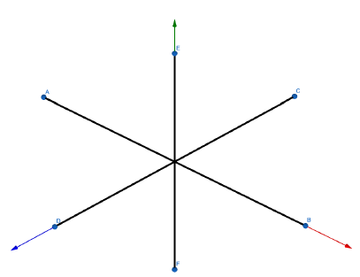
Literature Review - Paper 4 Self Supervised Learning of Point Cloud via Orientation Estimation[5]
Method:
4. Selection of k: is uniform acccording to Regular Polyhydron.
(k = 6, 18, 32, 54)
Notes:
This is done to avoid bias in learning
For six rotation angles, we choose the six directions of the x;y;z axes.
For K = 18, we take directions of the six axes and the twelve angle bisectors for each two consecutive axes.
For K = 32, a regular icosahedron is centered at the origin, and directions towards its 12 vertices and 20 face centers are chosen.
For K = 54; 100, we use the golden spiral sunflower distribution, where the golden ratio is

Slide 23
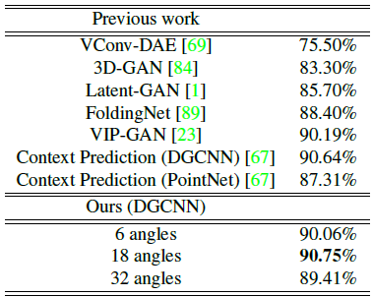
Literature Review - Paper 4 Self Supervised Learning of Point Cloud via Orientation Estimation[5]
Experiment and Dataset: (others refer from paper)
Object Classification – Test Set: ModelNet 40 (MN40) Training Set: ShapeNet. Metric: Accuracy percentage.
Notes:
Selection of k depends on amount of details present in PC (k= 3 in this paper).
2. Our approach is universally applicable to any point cloud data. Operating on raw point cloud enables flexibility with regards to the point cloud density. Thus, provised learning of per-point embeddings instead of per-voxel or per-pixel embeddings without explicit supervision.

Slide 24
Literature Review - Paper 4 Self Supervised Learning of Point Cloud via Orientation Estimation[5]
Results:
Too large and too low k values doesn‘t work well.
SOTA models performance improved with small number of labelled input data.
Semantic features like global orientation are learned by this method.
Notes:
This method learn different features than other SSL methods, enhance performance when multiple SSL methods are combined. (Context Prediction)

Slide 25
Comparison
Can‘t compare Paper 2 and Paper 3 results, have application dependent experiments.
Paper 4 and Paper 1 have almost same Accuracy percentage (90.75% and 90.64% respectively) for Object Classification experiment on ModelNet40 dataset with pre-training on ShapeNet with respective SSL technique for DGCNN model.
Notes:
Future Scope : SSL methods from which geometry and spectral information of PC can be captured.

Slide 26
Conclusion
Pre-training with SSL methods helps in learning semantic information on input data and can improve the performance of Supervised and UnSupervised SOTA Models.
Features extracted from SSL method can be used as Transfer Learning for other models in downstream tasks.
SSL helps models to work with less amount of labelled data.
Notes:
Future Scope : SSL methods from which geometry and spectral information of PC can be captured.

Slide 27
References
https://lilianweng.github.io/lil-log/2019/11/10/self-supervised-learning.html#why-self-supervised-learning
https://arxiv.org/abs/2009.14168
https://arxiv.org/abs/2003.12641
https://arxiv.org/abs/1901.08396
https://arxiv.org/abs/2008.00305
https://arxiv.org/abs/1505.07818
https://arxiv.org/abs/1911.02744
https://arxiv.org/abs/1910.08207
Notes:
Future Scope : SSL methods from which geometry and spectral information of PC can be captured.

Slide 28
Thank You

