Slide 1
EULER CIRCUITS AND THE KONIGSBERG BRIDGE PROBLEM
THEORY OF COMPUTATION
CSD - 225

Slide 2
TEAM
185032 - Anshudhar Kumar Singh
185035 - Anshu Singh
185041 - Anshika
PROBLEM STATEMENT - Understand the Euler Circuits and The Konigsberg Bridge Problem with the help of the paper titled “Euler Circuits and The Konigsberg Bridge Problem” and complete three tasks out of 12 tasks as mentioned in the paper. Prepare a presentation using LaTex that includes short summary of Euler Circuits and The Konigsberg Bridge Problem and the solution of the task performed by you. (Task 1,2,3)
Every member has contributed equally

Slide 3
Introduction
Modern graph theory has seen many developments throughout the centuries, yet the remarkable beginning of graph theory was a ‘feeble glance’ which Leonard Euler directed towards the geometry of position. Euler undertook the development of mathematical formulation of now-famous as The Konigsberg Bridge Problem in his paper Commentarii Academiae Scientiarum Im- perialis Petropolitanae in 1736.

Slide 4
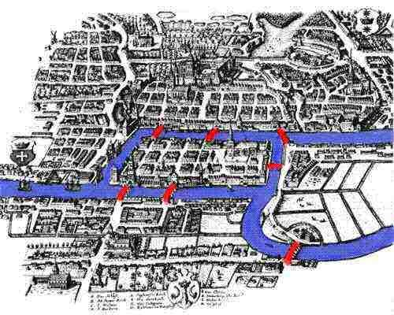
Fig 1. The city of Konigsberg

Slide 5
Euler’s Methodology
Euler states the problem as follows :
“ in Königsberg in Prussia, there is an island A, called the Kneiphof ; the river which surrounds it is divided into two branches, as can be seen in Fig. [1], and these branches are crossed by seven bridges, a,b,c,d,e,f and g. Concerning these bridges, it was asked whether anyone could arrange a route in such a way that he would cross each bridge once and only once.”

Slide 6
He first generalised the problem as :
“whatever be the arrangement and division of the river into branches, and however many bridges there be, can one find out whether or not it is possible to cross each bridge exactly once?”
He began his analysis by replacing the land with points and bridges with line segments. He started with first ruling out the choice of making exhaustive lists of all possible routes as 2 this task was too difficult as well as laborious. Hence, he first tries to find if there is such a path or not?

Slide 7
He then starts to name the land using capital letters and writes the route as follows:
“If a traveller goes from A to B over bridge a or b, I write this as AB — where the first letter refers to the area the traveller is leaving, and the second refers to the area he arrives at after crossing the bridge. Thus, if the traveller leaves B and crosses into D over bridge f, this crossing is represented by BD, and the two crossing AB and BD combined I shall denote by the three letters ABD, where the middle letter B refers to both the area which is entered in the first crossing and to the one which is left in the second crossing.”

Slide 8
And hence by this method it was observed that for representing n bridges we need (n+1) points. If we can do that it means such a route will be possible.
And hence the modern day definition of walk i.e. a sequence of alternating vertices and edges in which both the order of vertices and edges used are specified. And if no edge is repeated, it is said to be path and if the terminal and initial vertex are equal, the path is said to be circuit.
The problem was therefore reduced to finding a sequence of letters. But before this euler turned to a sub problem that is, if there is such a sequence even possible?

Slide 9

For this purpose he turned to a rule where he only considered two areas, and tried to find out occurrences of landmass for different numbers of bridges.
In the figure above, Letter A would occur one time if one bridge is considered, whether he starts from the A or not. If three bridges are considered, then A will occur twice in sequence and thrice if number of bridge is five and so on.
Fig 2.

Slide 10
Hence, if bridges are odd in number then, letter will occur (n+1)/2 times.
Similarly on observing the even cases, letter A will occur n/2 times if it started from other end and (n/2 + 1) times if start from A. (n refers to the number of bridges)
And hence, the table for konigsberg bridges will be as follows :
No of bridges = 7;
(n+1) = 8

Slide 11
Region | Bridges | No. of times Region must appear
A | 5 | 2
B | 3 | 2
C | 3 | 2
D | 3 | 2
However, 3+2+2+2 = 9, which is more than 8, so the journey is impossible

Slide 12
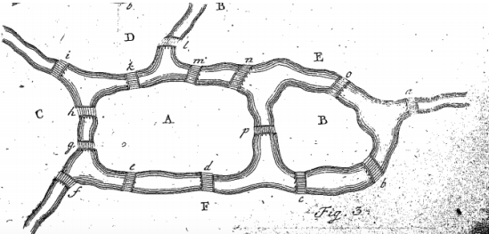
Now the same logic applied to a rather following figure, the table yield is as follows :
Fig 3

Slide 13
Region | No of Bridges | Times Region must appear
A* | 8 | 4
B* | 4 | 2
C* | 4 | 2
D | 3 | 2
E | 5 | 3
F* | 6 | 3

Slide 14
By addition, we get 16 which equals to the number of bridges plus one, which means journey is, in fact, possible.
Also, if the total number of appearances is equal to the number of bridges plus one, journey should start from region in which there are odd number of bridges which leads to it. And if the number is equal to the number of bridges than it must be started from the even region.

Slide 15
Euler’s Conclusions
In paragraph 16, euler points out that the total of the numbers listed directly to the right of the landmasses adds up to twice the total number of bridges. This fact later becomes known as the handshaking lemma.
In Paragraph 17, Euler goes on to state that the sum of all the bridges leading to each region is even, since half of this number is equal to the total number of bridges. However, this is impossible if there are an odd number of landmasses with an odd number of bridges. Therefore, Euler proves that if there are some odd numbers attached to land masses, there must be an even number of these landmasses.

Slide 16
Euler then explains that it is obvious that if there are two landmasses with an odd number of bridges then the journey will always be possible if the journey starts in one of the regions with an odd number of bridges. This is because if the even numbers are halved, and each of the odd ones are increased by one and halved, the sum of these halves will equal one more then the total number of bridges. However, if there are four or more land masses with an odd number of bridges, then it is impossible for there to be a path. This is because the sum of the halves of the odd numbers plus one along with the sum of all of the halves of the even numbers will make the sum of the third column greater than the total number of bridges plus one. Therefore, Euler just proved that there can be at most two landmasses with an odd number of bridges.

Slide 17
Euler gives the three guidelines that someone can use to figure out if a path exists using each bridge once and only once. First, he claimed if there are more than two landmasses with an odd number of bridges, then no such journey is possible. Second, if the number of bridges is odd for exactly two landmasses, then the journey is possible if it starts in one of the two odd numbered landmasses. Finally, Euler states that if there are no regions with an odd number of landmasses then the journey can be accomplished starting in any region. After stating these three facts, Euler concludes his proof with Paragraph 21, which simply states that after one figures out that a path exists, they still must go through the effort to write out a path that works. Euler believed the method to accomplish this was trivial, and he did not want to spend a great deal of time on it. However, Euler did suggest concentrating on how to get from one landmass to the other, instead of concentrating on the specific bridges at first.

Slide 18
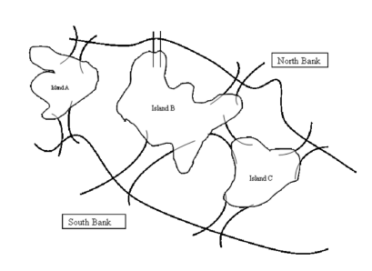
Task 1
Sketch the diagram of a graph with 5 vertices and 8 edges to represent the bridge crossing problem in the following figure.

Slide 19
For solving the problem we can assume the landmasses as the vertices and the bridges as the edges. Then we get the following graph :
N
A
B
C
S

Slide 20
Task 2
For the bridge problem shown in Project TASK 1 above, how many capital letters (representing graph vertices) will be needed to represent an Euler path?

Slide 21
From Euler’s paragraph 5, it says that we need number of bridges plus one letters for representing an Euler path.
Then according to that we should be needing (8+1) i.e. 9 letters to represent the path.
Also from next paragraphs we can say there would be,
1 times A,
2 times letter B, C, N, S.
Hence, in total 9 letters.

Slide 22
Task 3
In paragraph 8, Euler deduced a rule for determining how many times a vertex must appear in the representation of the route for a given bridge problem for the case where an odd number of bridges leads to the land mass represented by that vertex. Before reading further, use this rule to determine how many times each of the vertices A , B , C and D would appear in the representation of a route for the Königsberg Bridge Problem. Given Euler’s earlier conclusion (paragraph 5) that a solution to this problem requires a sequence of 8 vertices, is such a sequence possible? Explain.

Slide 23
According to the observation recorded till paragraph 8, Euler found the number of occurrences of a letter by considering only one landmass as A (the other side of the bridge will be considered as B).
According to that rule, if one crosses one bridge that letter will occur 1 time, if there are three bridges, then the traveller will have a journey like ABAB or BABA, i.e. two times. Similarly for five bridges, it should be ABABAB or BABABA. Hence the letter should appear (n+1)/2 times.

Slide 24
Hence, for Konigsberg problem, we will have, graph as :
A
A
A
A

Slide 25
Hence if we consider each vertices in the above graph, then vertex A have 5 brides, hence it should occur three times, and since each of the other vertices have three bridges attached they should occur two times each. Hence the total sequence should be of 3+2+2+2 = 9 digits. But the previous to this statement euler already proved that the sequence should be one more than the number of bridges i.e. 8. Hence, such a sequence is not possible. Hence no euler path is possible in the Konigsberg problem.

Slide 26
References
https://medium.com/basecs/k%C3%B6nigsberg-seven-small-bridges-one-giant-grap h-problem-2275d1670a12
https://www.maa.org/press/periodicals/convergence/leonard-eulers-solution-to-thekonigsberg-bridge-problem#:~:text=Euler%20states%20that%20if%20the,like%20the %20K%C3%B6nigsberg%20Bridge%20problem.
https://scilogs.spektrum.de/hlf/the-bridges-of-konigsberg

Slide 27
END

