Slide 1
Secure data hiding in images using steganography
CAPSTONE PROJECT
Presented By: Anshuka Vashishtha
Student Name : Anshuka Vashishtha
College Name & Department : The NorthCap University (B.Tech CSE)

Slide 2
OUTLINE
Problem Statement
Technology used
Wow factor
End users
Result
Conclusion
Git-hub Link
Future scope

Slide 3
Problem Statement
With the rise of digital communication, ensuring data security has become crucial. Traditional encryption methods are often susceptible to interception. This project implements steganography by embedding a secret message within an image at the pixel level. The encoded message can only be retrieved using a correct passcode, ensuring secure and covert data transmission.

Slide 4
Technology used
Libraries:
OpenCV (cv2): For image processing and pixel-level data embedding.
OS: To handle file operations like opening the encrypted image.
String : For handling character-based operations.
Platforms:
Python : Installed via Homebrew or Anaconda.
macOS Terminal: Used for running scripts and file operations.
Preview App: Default macOS tool for viewing encrypted images.
Image Formats: Supports JPEG, PNG, and other OpenCV-compatible formats.
Hardware:
MacBook: Required for running Python scripts and processing images.
SSD Storage: Used to save and retrieve encrypted images efficiently.

Slide 5
Wow factors
Pixel-Level Steganography – Hides messages in image pixels, making them undetectable.
Passcode-Protected Decryption – Ensures only authorized users can retrieve the message.
Mac-Optimized Execution – Seamlessly integrates with macOS tools like Preview and Terminal.
Simple Yet Powerful Algorithm – Easy to implement while maintaining high security.
No File Size Increase – Embedding in the blue channel keeps the image size almost unchanged.
Cross-Platform Compatibility – Works on macOS, Windows, and Linux.
Offline and Secure – No internet needed, reducing the risk of hacking.

Slide 6
End users
Journalists & Activists – To securely share sensitive information without detection.
Cybersecurity Enthusiasts – For learning and experimenting with steganography techniques.
Students & Researchers – To explore data security and cryptography concepts.
Government & Intelligence Agencies – For confidential data transmission.
Businesses & Corporations – To protect internal communications and trade secrets.
Individuals Concerned About Privacy – For secure personal messaging without third-party access.

Slide 7
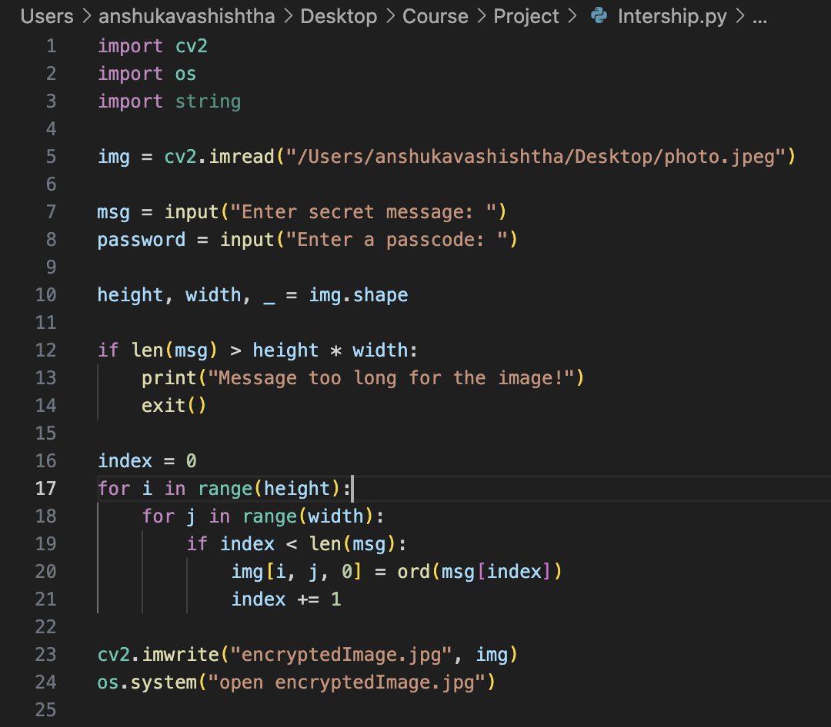
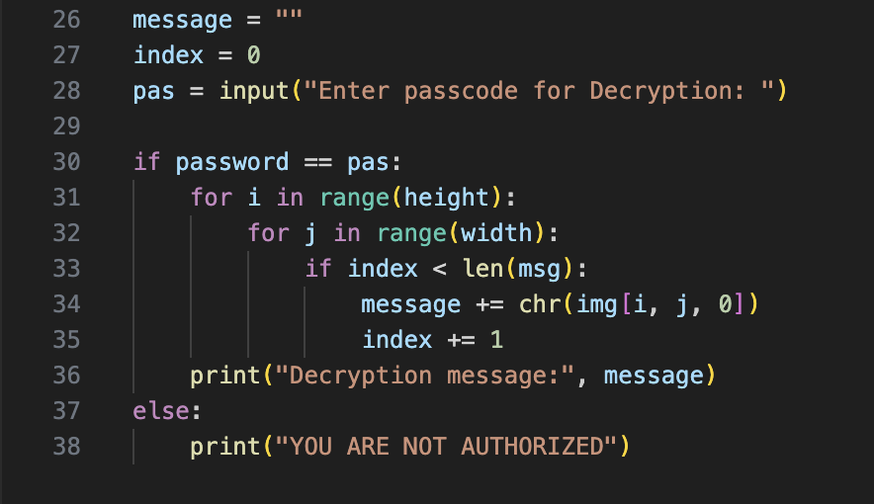
Results
Encryption Code
Decryption Code

Slide 8

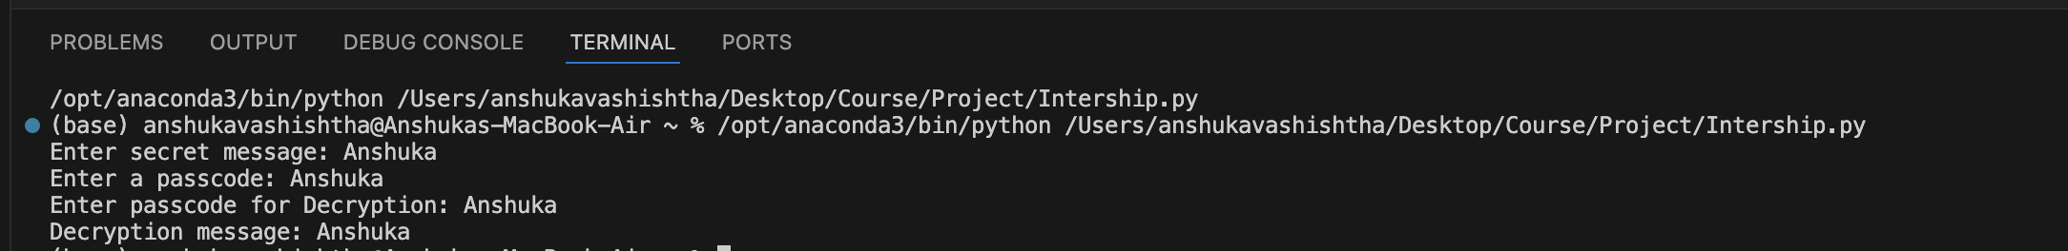
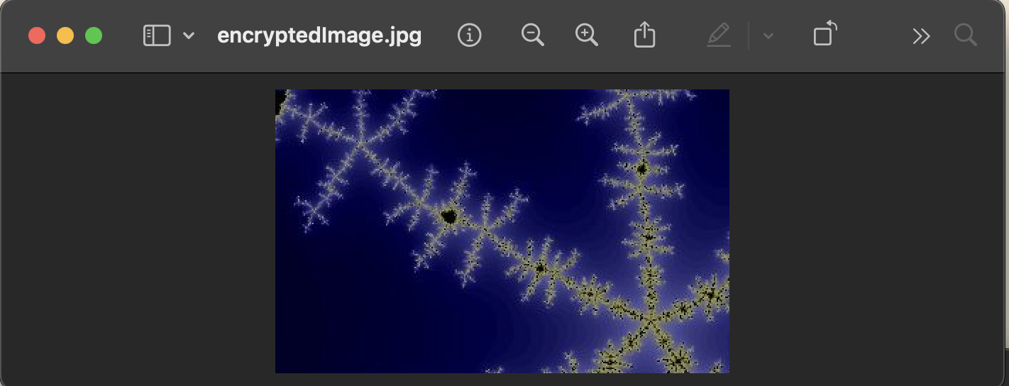
Results
Input Image
Output
Encrypted Image

Slide 9
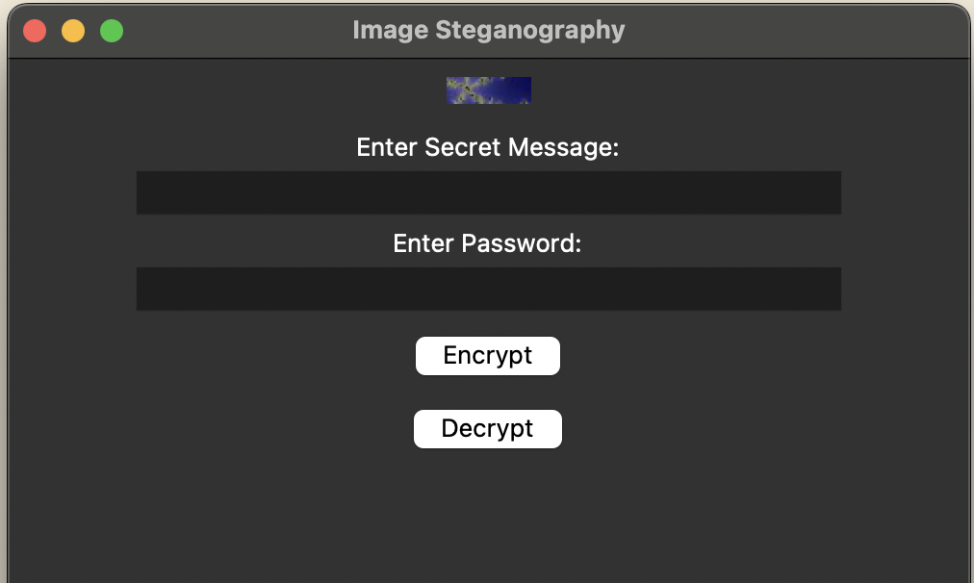
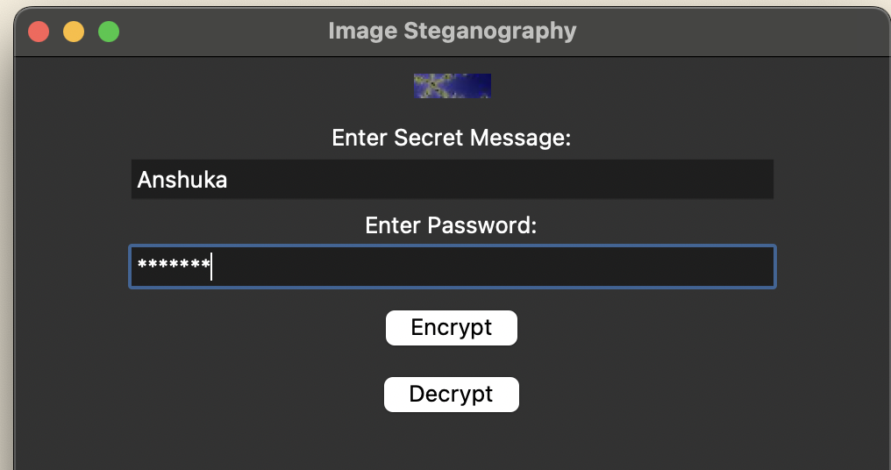
Results
GUI

Slide 10
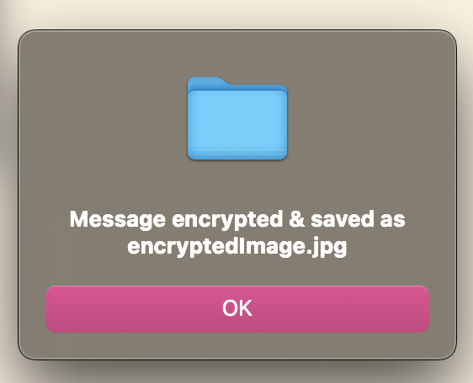
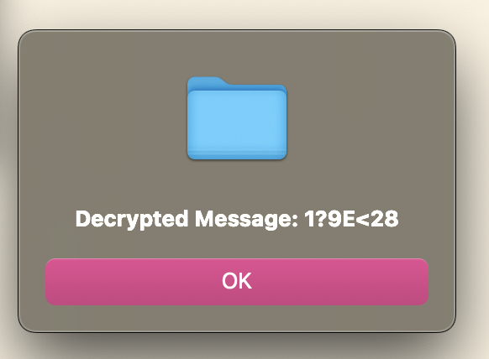
Results
GUI

Slide 11
Conclusion
This project successfully demonstrates secure data hiding using steganography, embedding secret messages within images at the pixel level. By implementing passcode-protected decryption, it ensures only authorized users can retrieve the hidden data. Unlike traditional encryption methods, this approach remains visually undetectable while maintaining the original file size. The project is Mac-optimized, offline, and secure, making it ideal for privacy-conscious users, journalists, researchers, and cybersecurity enthusiasts. Overall, it provides an efficient, simple, and effective solution for covert data transmission.

Slide 12
GitHub Link
Make sure that there should be readme file

Slide 13
Future scope(optional)
Multi-Layer Encryption – Combine steganography with encryption for added security.
Image-Based Key Authentication – Use an image instead of a passcode for decryption.
Support for More File Formats – Extend to videos, audio, and PDFs.
AI-Powered Steganalysis Prevention – Make detection even harder using AI techniques.
Mobile App Development – Create an app for easy use.
Cloud Integration – Securely store and retrieve encrypted images online.
Different Color Channel Encoding – Use multiple channels for improved flexibility.

Slide 14
THANK YOU

