Slide 1
AI agent

Slide 2
introduction
One of the most sought-after use cases of LLMs has been Document question and answering.
And after OpenAI made their ChatGPT endpoints public, it has become much easier to build an interactive conversational bot with any text data sources.
In this demo, we will build an LLM Q&A CLI app from scratch.
The answers would be posted on a slack channel

Slide 3
Workflow
Processing the provided PDF file to extract texts.
We also need to be careful about the context window of the LLM. So, we need to make chunks of those texts.
To query relevant chunks of text, we need to get embeddings of those text chunks. For this, we need an embedding model. For this code, we will use the Huggingface MiniLM-L6-V2 model, you can go with any model you wish such as OpenAI, Cohere, or Google Palm.
For storing and retrieving embeddings, we will use a Vector database such as Chroma. There are many different Vector Databases you can opt for such as Open Search, Qdrant, Weaviate, and many more.
When a user sends a query, it will get converted to embeddings by the same model, and the chunks with similar meaning to the query will be fetched.
The fetched chunks will be concatenated with the query at the end and will be fed to the LLM via an API.
The fetched answer from the model will be posted to a defined slack workspace channel using a slack app.

Slide 4
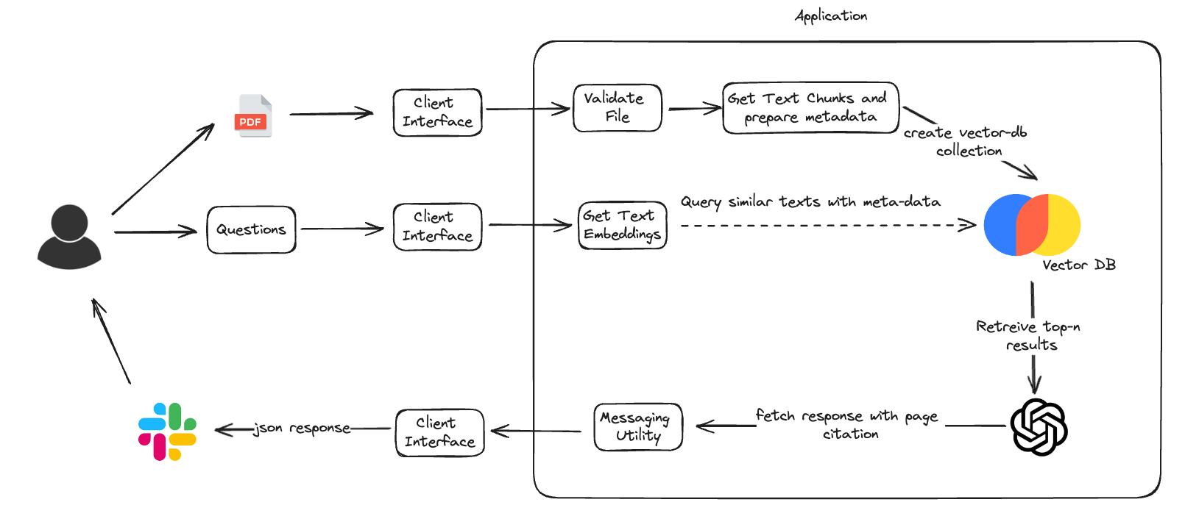
Flow diagram

Slide 5
Possible enhancements
Usage of streamlit UI to enhance CLI
Multiple pdfs as provision for better retrieval strategy
Usage of context (RAG?) in the prompt for better answers
Better Vector DB like Open Search?

Slide 6
conclusion
So, this was all about building a PDF Q&A chatbot with a Command Line Interface built without using frameworks such as the Langchain and Llama Index. Here is a quick summary of things we covered.
Langchain and other AI frameworks can be a great way to get started with AI development. However, it’s important to remember that they are not a silver bullet. They can make your code more complex and can cause bloat, so use them only when you need them.
The use of frameworks makes sense when the complexity of projects requires longer engineering hours if done from scratch.
A document Q&A workflow can be designed from scratch without a framework like Langchain from the first principle.

