Slide 1


DATA ANALYSIS

Slide 2


Today's agenda
Project recap
Problem
The Analytics team
Process
Insights
Summary

Slide 3

Social Buzz, a rapidly expanding technology unicorn, that
requires swift adaptation to its global expansion. Accenture
has initiated a 3-month POC with these objectives:
1. Auditing Social Buzz's big data practices.
2. Providing IPO success recommendations.
3. Conducting an analysis to identify Social Buzz's top 5 most popular content categories.
Project Recap

Slide 4

Problem
Over 100000 posts per day
36,500,000 pieces of content per year!
However, in the face of this abundance, how can we effectively leverage it?
This includes the analysis aimed at identifying the five most popular
content categories for Social Buzz.

Slide 5



ANDREW FLEMING
Chief Technology Architect
The Analytics team
MARCUS ROMPTON
Senior Principal
ANSHU KUMARI
Data Analyst
Notes:
Talking about experience, we have a large data analytics practice at Accenture but we had a team of 3 people primarily focusing on this task. Andrew Fleming is our Chief Technical Architect and his expertise really helped to guide the team to produce high quality analysis.
Marcus Rompton, a senior principal has worked with the worlds biggest clients on solving their data problems and was heavily involved in the data engineering side of this project.
And finally myself, [NAME], who was solely responsible for taking leadership guidance and delivering high quality insights from the raw datasets and turning these into business decisions.

Slide 6
Data Understanding
Data Cleaning
Data Mining
Data Analysis
Uncover Insights
Process
1
2
3
4
5

Slide 7

Insights
16 1897 JANUARY
Unique Categories REACTIONS TO "ANIMAL" POSTS Month with Most posts

Slide 8
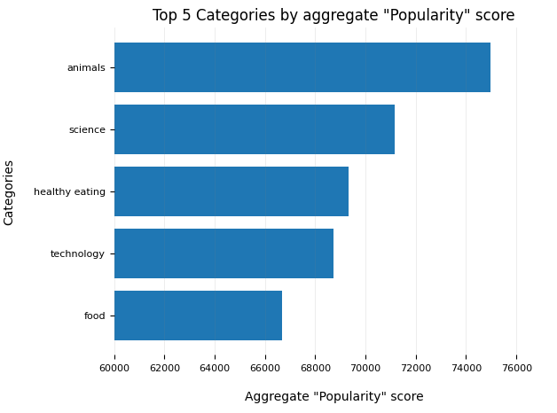
Notes:
From our analysis, you can see that the top 5 most popular categories of posts were animals, science, healthy eating, technology and food in descending order.
Animals had an aggregate popularity score of around 74965. It is very interesting to see both food and healthy eating within the top 5, it really shows that food is a highly engaging content category. Healthy eating ranks slightly higher than food, so perhaps your user base may be skewed towards healthy eaters and health-conscious people.
Finally, its also interesting to see science and technology too. This may suggest that people enjoy consuming factual content and snippets of content that they can learn something from.

Slide 9
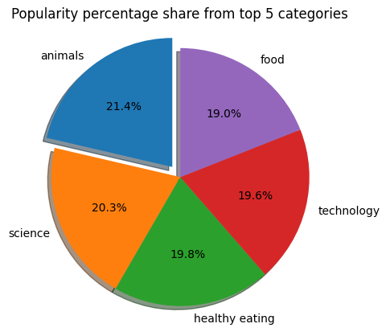
Notes:
Additionally, you can see from this chart the % split of popularity between the top 5 categories. There is not much difference between the share of each category, however, the difference between the 1st most popular, animals and the 2nd most popular, science, is the largest gap equal to 1.1%.
In business terms, this could suggest that the most popular category, animals, is tailing away from the rest of the categories and may continue to get more and more popular. To avoid an issue where 1 content category consumes the entire platform, it will be important for you to ensure that any algorithms used to govern the content on the platform gives a fair balance to the content categories.

Slide 10

ANALYSIS
Animals and science are the two most popular categories of content, showing that people enjoy "real-life" and "factual" content the most.
INSIGHT
Summary
Food is a common theme with the top 5 categories with "Healthy Eating" ranking the highest. This may give an indication to the audience within your user base. You could use this insight to create a campaign and work with healthy eating brands to boost user engagement.
NEXT STEPS
This ad-hoc analysis is insightful, but it's time to take this analysis into large scale production for real-time understanding of your business. We can show you how to do this.
Notes:
So to summarize:
We tackled this task and found the top 5 most popular categories as asked, but we also went one step further.
- We found that animals and science are the two most popular categories, suggesting that users like "real-life" and "factual" content
- We also found that food was a common theme amongst popular content and the most popular food category was healthy eating. This could be a signal to show the types of people that are using your platform, and you could use this insight to boost engagement even further. For example, you could run a campaign with content focused on this category or work with healthy eating brands to promote content.
- As much as this analysis was insightful, we are ready to take it to the next stage and we have the expertise within Accenture to help you realize these kinds of insights in production across your organization and in real-time. We would love to help you with this.

Slide 11
Thank you!
ANY QUESTIONS?

