Slide 1
Modeling the Neuron components BT6270 Introduction to Computational Neuroscience

Slide 2
Single Neuron Modeling
Biophysical Modeling
Dendritic Processing
Axonal Processing
Synaptic Transmission
More
Detailed
Action Potential
generation
Hodgkin-Huxley Model
Simplified Neuron Models
FitzHugh-Nagumo model
Morris-Lecar Model
Izhikevich Models
Integrate and fire neuron
McCulloch-Pitts neuron
Less
Detailed

Slide 3
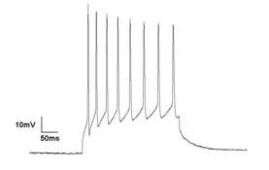
Point Neuron
(e.g. HH model)
V(t)
Signal Propagation -
Biophysical modeling
V(x, t)
Cytosol
V_{m}(t)mV
Vm

Slide 4
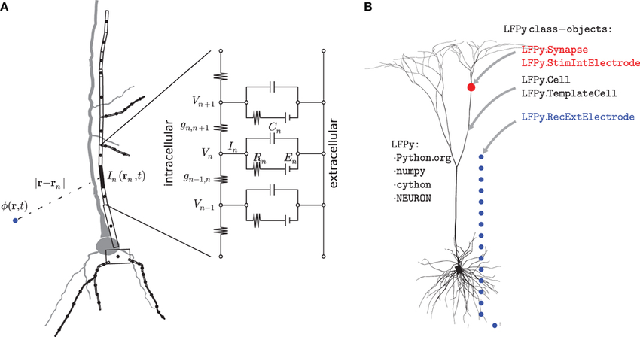
Biophysical modeling
https://www.researchgate.net/publication/259961755_LFPy_A_tool_for_biophysical_simulation_of_extracellular_potentials_generated_by_detailed_model_neurons/figures?lo=1

Slide 5
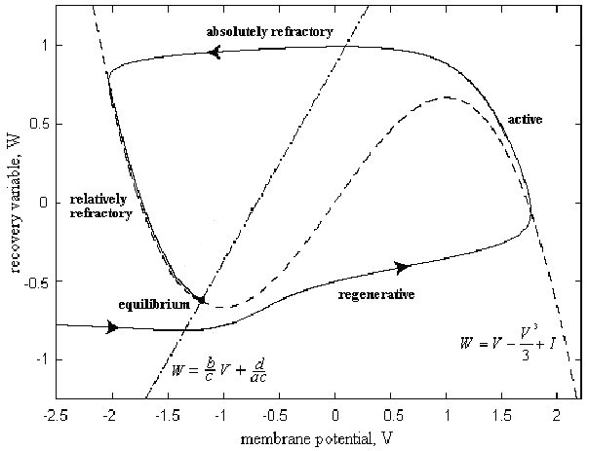
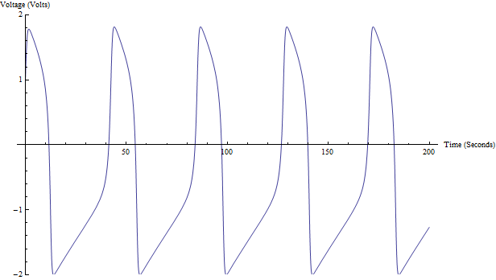
Simplified (2-variable) neuron models

Slide 6
Biophysical modeling: Neuron Signaling components
Axonal
Propagation
Axon collaterals
dendrites
Neuron
Outputs
Inputs

Slide 7
The 4 Neuron Signaling components
Dendritic Processing: Signal propagation along dendrites is mostly passive, as along an electrical cable;
Action Potential Generation: Summation occurs in the axon hillock; action potential is generated
Axonal Propagation: action potential propagates down the axon without losing amplitude because it is charged all along the way by voltage-sensitive channels;
Neurotransmission occurs across a synapse – as though there is a “hotline” from axon terminal A to apical dendrite B – via chemical means;
This whole sequence of events occurs in a neat unidirectional fashion from the apical dendrites to axon terminals.

Slide 8
Dendritic propagation

Slide 9
Wave propagation over a dendrite
Vm
As the wave propagates down the dendrite:
It loses amplitude
It spreads in time

Slide 10
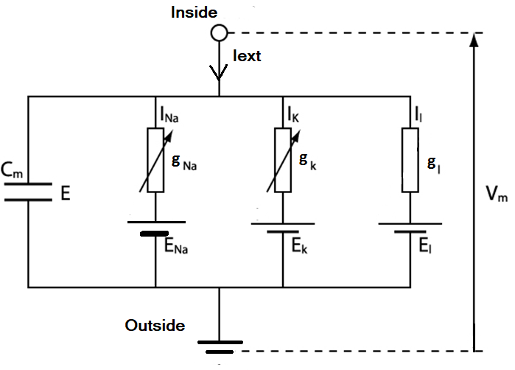
Membrane with voltage-sensitive channels

Slide 11
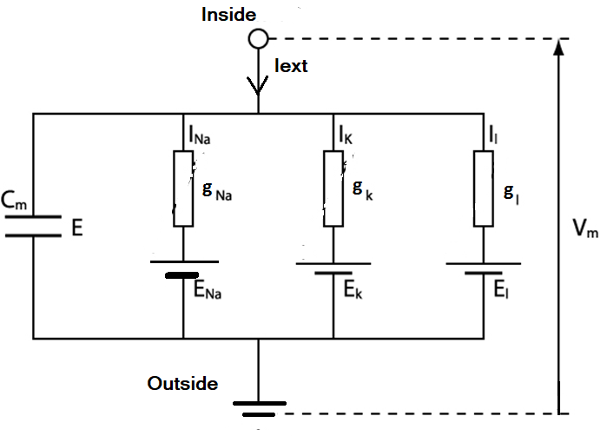
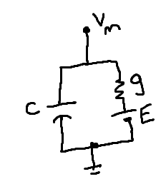
Membrane WITHOUT voltage-sensitive channels

Slide 12
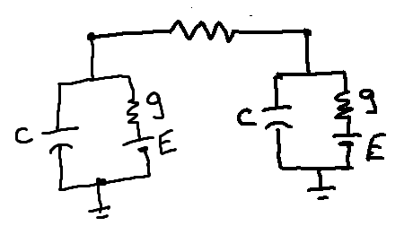
Dendritic processing: Passive cable
No active elements
No voltage-dependent ion channels
All the
conductance branches
merged to one
R
No “arrow” on g
At a single point on a membrane
Along the length of the membrane

Slide 13
Formulating the cable equation
Reference:
C. Koch, Biophysics of Computation.

Slide 14

Point Neuron
(e.g. HH model)
V(t)
Signal Propagation -
Biophysical modeling
V(x, t)
V_{m}(x,t)
V_{m}(t)
Cytosol
V_{m}(t)mV
Per unit
Area
Per unit
Length

Slide 15
Axial resistance
Resistance offered by the intracellular compartment per unit length of the cable of diameter, d.
The resistivity of the intracellular medium is R_{i}.
We now relate the resistivity, R_{i}, which is an intrinsic property of the intracellular medium, to axial resistance, r_{a}, which is resistance per unit length of the cable.

Slide 16
Axial resistance
In general the resistance, R, and resistivity, ρ, (here denoted by R_{i}) of a pipe of area of cross-section, A, and length, L, are related as:
R = ρ L/A, and
Resistance per unit length (L=1) of the pipe is:
R = ρ/A
A similar relation for our cable is:
r_{a}
(Ω/cm)

Slide 17
Membrane resistance
The membrane offers resistance for flow of current between the intracellular compartment and the extracellular space. This resistance is inversely proportional to the surface area of the membrane.
r_{m}

Slide 18
Membrane resistance
Therefore, if R_{m} is the resistance of a membrane patch of unit area, a quantity referred to as specific resistance, the total resistance offered by a cylinder of diameter, d, and unit length (L=1), is given as:
g_{m} = G_{m} A= G_{m} (π d L)
g_{m} = 1/ r_{m}; G_{m} = 1/R_{m}
r_{m}
(Ω cm)

Slide 19

Membrane capacitance
The plasma membrane has a specific capacitance, C_{m}, of about 10⁻⁶ F/cm².
Therefore, capacitance of the cable of unit length, c_{m}, is,
(F/cm)
c_{m}

Slide 20
The cable as an electric circuit
Using the electrical parameters defined above, we can now represent the cable as an electric circuit.
In this circuit, the continuous cable is represented as a series of discrete circuit elements, in which each element approximates a short length of the cable, say, of length, Δx.

Slide 21
Circuit equivalent for a dendrite
Δx
r_{a}
r_{a}
r_{a}
V(x)
V(x+Δx)
I_{i}(x-Δx)
I_{i}(x)
I_{i}(x+Δx)
I_{m}(x)
I_{m}(x+ Δx)
r_{m}
c_{m}
r_{m}
c_{m}

Slide 22


Analogy to the membrane current, I_{m}
NOT like this
MORE like this!

Slide 23
Ohm’s law for axial resistance
Applying Ohm’s law to one of the axial resistances, r_{a} Δx,
(1)

Slide 24
Kirchoff’s current law at the nodes
Applying the law of continuity of current at a given node in the circuit
Combining (1) and (2),
(2)
(3)

Slide 25
Now, the membrane current, I_{m}, can be resolved into three components:
1) current through membrane capacitance,
2) current through membrane resistance,
3) externally injected current, I_{ext}, if any.

Slide 26
Linear Cable Equation
Combining (3) and (4), we get equation 5, known as the Linear Cable Equation.
where
(4)
(5)
known as the time constant, of the cable.
known as the space constant, and,

Slide 27
Eqn. 5 can be further simplified if the membrane voltage, is defined with reference to the resting potential, V_{rest}.
Assuming that the resting potential is the same everywhere along the cable, it only offsets the membrane potential and does not affect the derivative terms in eqn. (5).

Slide 28
The Cable Equation
Thus, from now on, if we designate V_{m} to represent the deviation of membrane potential from the resting potential, V_{rest}, the (V_{m} - V_{rest}) term in eqn. (5) can be replaced by, V_{m}, and we have the following simpler form.
(6)

Slide 29

The cable equation ???!!!

