Slide 1
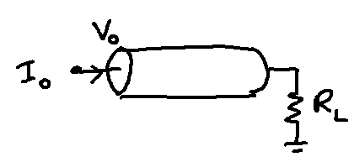
Arbitrary Boundary Condition
Let load resistance be = R_{L}.
Load voltage = V_{L}.
Boundary conditions:

Slide 2
Substituting in V(X)…
(15)

Slide 3
Axial current is,
Current flowing into the load is, I_{i}(X) at X = L, which is,
Since load current is also equal to, V_{L}/ R_{L}, we have

Slide 5
Substituting the above in eqn (15)
(16)

Slide 7
On further reduction we obtain,

Slide 8
Input resistance
Applying the formula for the input current, we can obtain the expression for R_{in} as,

Slide 10
Branched cables

Slide 11
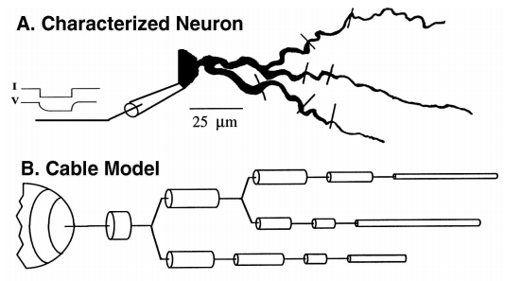
Dendritic tree

Slide 12
A simple dendritic tree: 1 main cable with 2 branches
R_{in1}
I₀
Sealed Ends
R_{in2}

Slide 13
Branched cables
Assume that the 2 rightmost branches terminate with sealed end (open) boundary conditions. Input resistance of the branches,
(16)
(17)

Slide 14
1 main cable with 2 branches
R_{in1}
I₀
R_{in2}

Slide 15
Terminal resistance of main cable, R_{L,0} is given as,
Given the terminal resistance, the input resistance is calculated as,
(18)
(19)

Slide 16
Moving from outermost dendritic tips, one moves towards the soma. Finally at X=0, in the parent cable,
Given V₀, voltage distribution along the main branch is,
(20)

Slide 17
1 main cable with 2 branches
L
I₀
R_{in}
R_{in}

Slide 18
1 main cable with 2 branches
R_{in1}
I1
I₀
I2
R_{in2}
I_{i}(X=L) of the main cable = total current into the two branches
Calculate I1 and I2 using current division rule for a set of parallel resistors.

Slide 19
A simple dendritic tree: 1 main cable with 2 branches
I1
R_{in1}
I₀
Sealed Ends
I2
R_{in2}

Slide 20
From the above, we can calculate V₁₂, the voltage at the bifurcation point as,
Voltage distribution along the two terminal branches is,

Slide 21
Summary
Upward pass (terminals to the root) – compute R_{in}’s
Compute R_{in,1} and R _{n,2} using eqns. (16,17). Using R_{in,1} and R _{n,2}compute R_{L,0} using,eqn. (18).
Using all the 3 results compute, R­_{in,0} using eqn. (19).
Downward pass (Root to terminals – compute V(x)):

Slide 22
Rall’s condition
When the diameters of the two terminal branches are related to the diameter of the main branch in a special way.
Lengths of the two terminal branches must be the same i.e., L₁ = L₂ = L (say).

Slide 23
Therefore
Note that, thanks to the way the diameters of the 3 cables are related, we have a special relation among them also,

Slide 24
Input resistance of the terminal branches are,
Thus, terminal resistance of the main cable is given as,

Slide 25
From, eqn. (20) we may write down the voltage distribution of the main cable as,

Slide 26
Inserting the expression for R_{L,0} from eq. (18)

Slide 27
Rall’s conditions:
R_{m}, R_{i} are the same in all branches
All terminals end in the same boundary condition
All terminal branches end at the same electrotonic distance from the origin of the main branch.

Slide 28
4. At every branch point, infinite input resistances must be matched, i.e.,
5. Where, d_{i} are the diameters of the branch cables and d₀ is the diameter of the root cable at the branch cable.
X = L₀ + X₁

