Slide 1
Infinite Cable - Steady State Analysis:
BT6270 Introduction to Computational Neuroscience

Slide 2
Consider Voltage distribution under steady state conditions
V(x,t) → V(x)

Slide 3
Infinite Cable - Steady State Analysis:
Though our ultimate objective is to be able to describe signal transmission along the cables with complex geometries, we begin with a simple situation.
We consider an infinite cable in which a constant current is injected at a point. The goal is to determine membrane voltage distribution under steady state conditions.
I_{ext} = constant

Slide 4
External Current:
Boundary conditions:
Initial condition:
I_{ext} = I₀ δ(x) u(t)
(7)
spatially it is a point source; and temporally it is a step function.
(8.a)
(8.b)

Slide 5
Under steady state conditions,
Therefore, eqn. (6) becomes,
Since (9) is a II order equation, consider a solution of the form:
Membrane voltage is represented as, V_{m}(x).
(9)
(10)

Slide 6
Now let us apply the boundary conditions eqn. (8), to the solution eqn. (10).
Since V_{m}(x) tends to 0 at +inf, A=0, and since V_{m}(x)=0 at –inf, B = 0.
This difficulty can be overcome if we let the form of the solution be,
(11)
where V₀ is the steady state voltage at x=0.

Slide 7
Let us try to verify that V_{m}(x) of eqn. (11) satisfies eqn. (9).
Use:
(sign(x))² = 1
d(sign(x))/dx = 2δ(x)
f(x)δ(x) = f(0) δ(x)

Slide 8
Comparing the last equation with eqn. (9), we have
Therefore, the final form of steady state membrane voltage of an infinite cylinder is,
(12)
(13)

Slide 9
Electrotonic Distance and Input Resistance
Any length, l, can be expressed as electrotonic distance, L, as,
Input resistance, R_{in}, is defined as the ratio of voltage at the point of current injection to the magnitude of current injected.

Slide 10
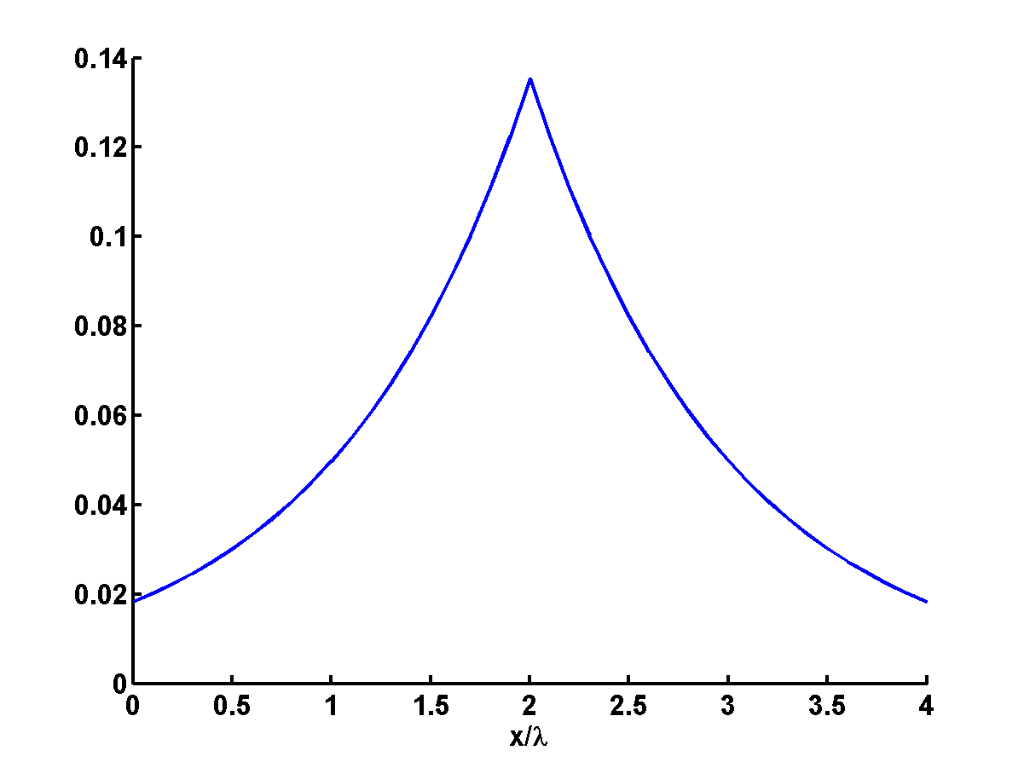
Example:
Consider a infinite cable with the static current I₀= 10 mA injected at point x=2. Plot the static solution for such a cable.
Solution:
The static solution for the infinite cable is given by: .
Since current I₀=10 mA is injected at x=2,
I_{ext} = I₀ δ(x);
The plot of V_{m}(x) vs x/λ would be:

Slide 11
Semi-infinite Cable:
Let us consider the case of a semi-infinite cable where current of magnitude, I₀, is injected into one end of the cylinder.
I_{ext} = constant
I₀/2
I₀/2
R_{si}
R_{si}

Slide 12
Since an infinite cable can be viewed as two semi-infinite cables in parallel, steady state membrane voltage of a semi-infinite cable is twice that of the infinite cable, and is given as,

Slide 13
Similarly, the input resistance, which is naturally twice that of an infinite cable, is,
is called the input resistance of a semi-infinite cable.

