Slide 1
Time-dependent solution
;
How to convert the equation to T and X?
(C. Koch, Biophysics of Computation, 2004)

Slide 2
Time-dependent solution (dimensionless form)
I_{inj} = Current density
;
Q(x,t) = charge passing
through [0,x) and [0,t)
(Tuckwell, Intro to Theoretical Neurobiology, 1988)

Slide 3
Time-dependent solution (dimensionless form)
;
Switch from
to
notation

Slide 4
Infinite cable
Boundary condition:
If (an infinitely brief pulse)
For long times, decay pattern is the same throughout the cable.
Also denoted as:
V_{δ}(X,T) = Voltage response to an Impulse current

Slide 5
Since the system is linear, response to arbitrary current injection is given as,

Slide 6
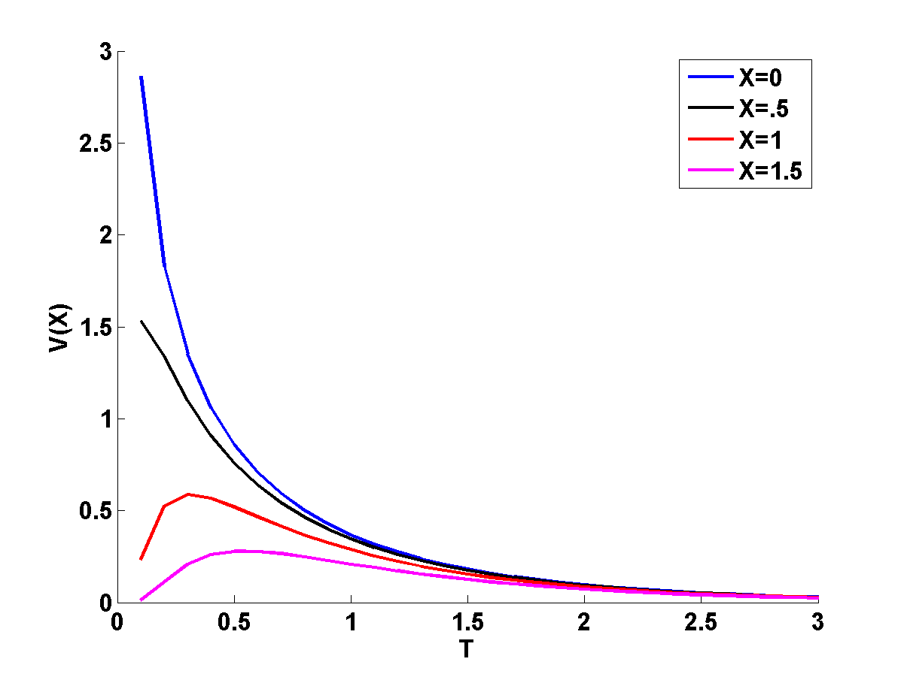
V(X,T) variation with time, T
The required plots can be generated using the formula:
We plot the X's(distance's) at intervals of 0.5.

Slide 7
-T is the most dominant term

Slide 8
V(X,T) vs T in log-log plot
(Koch 2004)

Slide 9
V(X,T) vs X (for a given T)
(Koch 2004)
Gaussian amplitude reduces
with increasing T

Slide 10
V(X,T) vs T (for a given X)
(Koch 2004)

Slide 11
Voltage response to current step:

Slide 12
Propagation Velocity:
Linear cable equation does not admit any wave equation, due to dissipation of energy through the passive membrane.
If voltage-sensitive, nonlinear elements are sensitive, then we can have traveling waves as it happens in the axons.

Slide 13
One way of defining velocity is by tracking motion of the peak.
But a centroid gives uniform propagation velocity.

Slide 14
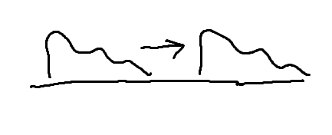
How to calculate propagation velocity?
The Cable equation does not allow traveling wave solution
To obtain a traveling wave solution, V(X,T) must be of the form: V(ωt – kX)

Slide 15
Approach #1:
Where is it at time t1? x1
Where is it at time t2? x2
Velocity = (x2 – x1)/(t2 – t1)

Slide 16
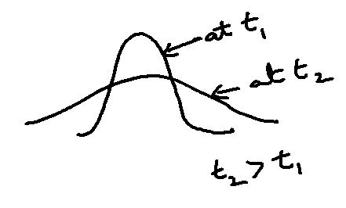
Approach #1:
Where is it at time t1? x1
Where is it at time t2? x2
Velocity = (x2 – x1)/(t2 – t1)
Both Peak and Center of Gravity do not move
Cannot define any “velocity”!!!

Slide 17
Approach #2:
When is it at x1? t1
When is it at x2? t2
Velocity = (x2 – x1)/(t2 – t1)

Slide 18
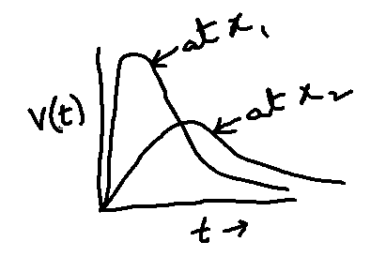
Approach #2:
When is it at x1? = t1
T_{peak} as a function of X is too complicated
Vel = (x1 – x2)/(T_{peak} (x1) – T_{peak}(x2))
When is it at x2? = t2
T_{peak} as a function of X is too complicated
Velocity will not be a constant
Velocity = (x2 – x1)/(t2 – t1)
Lets consider T_{centroid} as a function of X
Vel = (x1 – x2)/(T_{Centroid} (x1) – T_{Centroid}(x2))

Slide 19
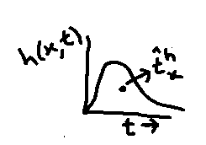
Time-coordinate of the Centroid

Slide 20
Transfer delay

Slide 21
Transfer delay
Transfer delay is the difference in centroid of induced voltage at y, and the centroid of injected current at ‘x’.
Input or local delay:

Slide 22
Symmetry relation
D_{xy} is always positive and is independent of the shape of the transient input current.
It is the property of the cable and not of the input waveform
No matter what the electrical structure of the cable, the transfer delay is symmetric.

Slide 23
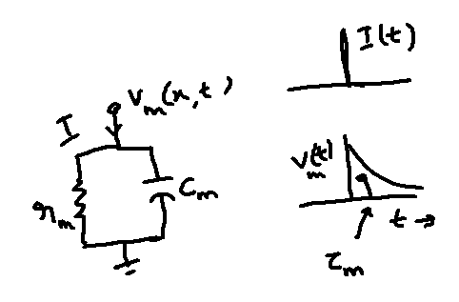
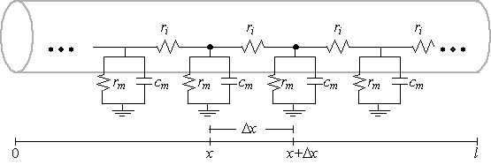
Isopotential neuron – membrane patch:
Iso-potential Condition ➔ axial resistance = 0

Slide 24
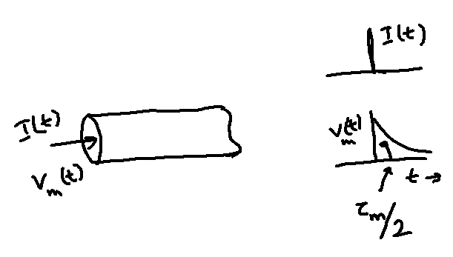
Infinite or semi-infinite cable:

Slide 25
If the current is injected at x and the voltage is recorded at y, the two centroids are displaced by,

Slide 26
Propagation velocity is proportional to sqrt(diameter)
Propagation delay in difference between
centroids of voltage at x and y:
For an infinite cable,

Slide 27
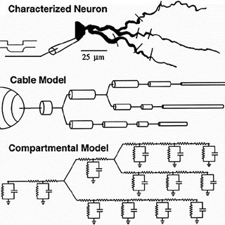
Compartmental Modeling

