Slide 1
CONVOLUTIONAL NEURAL NETWORK FOR IMAGE CLASSIFICATION USING TENSORFLOW
UCS742 Deep Learning

Slide 2

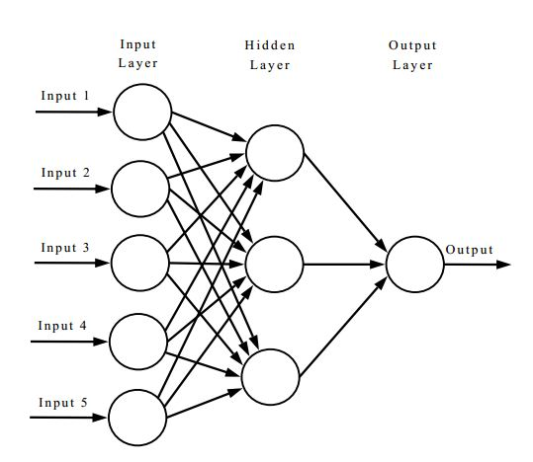
Artificial Neural Networks (ANN)
ANN is an information processing paradigm, to predict outcomes for certain input scenarios.
It is inspired by the way biological nervous systems, such as the brain, process information.
ANN is configured for a specific application, such as pattern recognition or data classification, through a learning process.
A fully-connected Artificial Neural Network, with 5 inputs, 1 output, and one hidden layer with 3 neurons.

Slide 3
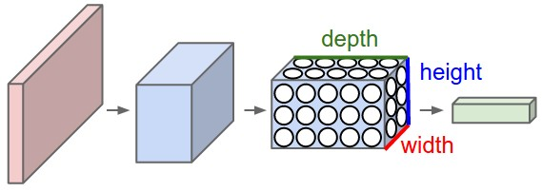
Convolutional Neural Networks (CNN)
CNNs take only images as input and they constrain the architecture in a more sensible way, to aid image processing.
The layers of a CNN have neurons arranged in 3 dimensions: width, height, depth.
Neurons in a layer are connected only to a small region of the layer before it, instead of all the neurons in a fully-connected manner.
The final output reduces the full image into a single vector of class scores, arranged along the depth dimension.

Slide 4
Characteristics
A CNN architecture is in the simplest case a list of Layers that transform the image volume into an output volume (e.g. holding the class scores)
There are a few distinct types of Layers (e.g. CONV/FC/ReLU/POOL are by far the most popular)
Each Layer accepts an input 3D volume and transforms it to an output 3D volume through a differentiable function
Each Layer may or may not have parameters (e.g. CONV/FC do, ReLU/POOL don’t)
Each Layer may or may not have additional hyperparameters (e.g. CONV/FC/POOL do, ReLU doesn’t)

Slide 5
Limitations of Neural Networks
Need a large dataset
Because of the large dataset, training time is usually significantly high
The scale of a network's weights (and of the weight updates) is very important for performance.
When the features are of the same type (pixels, word counts, etc), this is not a problem.
However, when the features are heterogeneous, weights and updates will all be on different scales.
Parameters are hard to interpret - although there is progress being made.
Hyper-parameter tuning is non-trivial

Slide 6
Dataset
MNIST Dataset of handwritten digits.
60,000 sample images, size 28 x 28.
50,000 images in Training Set
10,000 images in Test Set
Images pre-processed – normalized for size and centered.
10 categories, corresponding to 10 digits (0-9).
Dataset produced by 250 writers. No writers common in Training and Test Sets.

Slide 7
Architecture of Network implemented
2 Convolution layers, 2 fully connected layers.
Layer | Input | Output | Notes
Convolution Layer 1 | Image, 28 x 28 | 16 features, 14 x 14 | 16 Filters, 5 x 5
Convolution Layer 2 | Feature, 14 x 14 | 36 features, 7 x 7 | 36 Filters, 5 x 5
Flattening, 36 features of 7 x 7 dimension to one vector of size 1764
Fully Connected Layer 1 | Flattened vector, 1764 | Fully connected to last layer | 128 neurons
Fully Connected Layer 2 | Inputs from first FC layer | Confidence values for each of 10 categories | 10 neurons

Slide 8
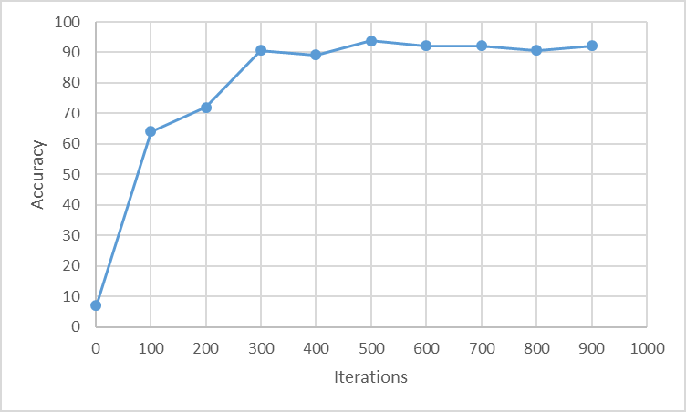
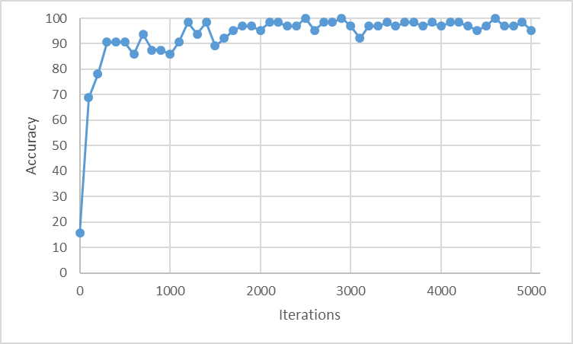
Accuracy With Optimization
The accuracy (both on training set and test set) increases significantly with increasing number of optimization iterations, up to a certain level. This can be seen with the accuracy change for 1,000 (top) and 5,000 (bottom) iterations.
The model is ideally run until the accuracy achieved doesn’t start dropping significantly (early stopping).

Slide 9
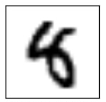
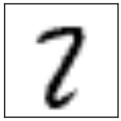
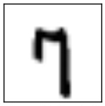
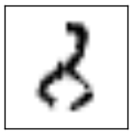
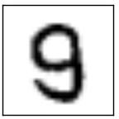
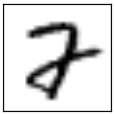
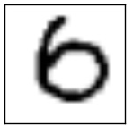
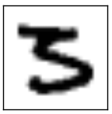
Erroneous Predictions

